Slide 1
A New Efficient Algorithm for Computing the Longest Common Subsequence
Costas S. Iliopoulos and M. Sohel Rahman Theory of Computing Systems, Volume 45, Issue 2, pp 355-371(2009)

Slide 2
Abstract
In this paper, we present a new and efficient algorithm for solving the LCS problem for two strings. Our algorithm runs in O(R log log n + n) time, where R is the total number of ordered pairs of positions at which the two strings match.

Slide 3
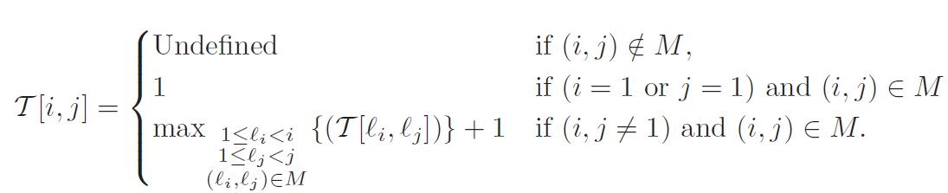

Introduce
X = c b b d a c
Y = a b c d d b a
Set M = {(i, j) | X[i] = Y[j], 1 $≤$ i, j $≤$ n}

Slide 4
Introduce
X = c b b d a c
Y = a b c d d b a
 | a | b | c | d | d | b | a
c | 0 | 0 | 1 | 0 | 0 | 0 | 0
b | 0 | 1 | 0 | 0 | 0 | 2 | 0
b | 0 | 1 | 0 | 0 | 0 | 2 | 0
d | 0 | 0 | 0 | 2 | 2 | 0 | 0
a | 1 | 0 | 0 | 0 | 0 | 0 | 3
c | 0 | 0 | 2 | 0 | 0 | 0 | 0

Slide 5
RMQ
Range Maxima Query
RMQ: 陣列A[1…n] 限定範圍 (i, j) 找出A 中位置介於 i 與 j 之 間最大(小)的元素。
O(n)完成預處理後， 可於O(1)完成query
e = (Value, j) E = { (1, 3), (1, 2), (2, 6), (2, 4), (2, 5) }
 | a | b | c | d | d | b | a
c | 0 | 0 | 1 | 0 | 0 | 0 | 0
b | 0 | 1 | 0 | 0 | 0 | 2 | 0
b | 0 | 1 | 0 | 0 | 0 | 2 | 0
d | 0 | 0 | 0 | 2 | 2 | 0 | 0
a | 1 | 0 | 0 | 0 | 0 | 0 | 3
c | 0 | 0 | 2 | 0 | 0 | 0 | 0

Slide 6
LCS-I
X = c b b d a c
Y = a b c d d b a
M = (1, 3), (2, 2), (2, 6) (3, 2), (3, 6), (4, 4), (4, 5), (5, 7), (6, 3)
當前LCS長度 = 0
找每一行最大的值，此值代表到這個元素為止的LCS長度，若此值大於當前LCS長度，則更新當前LCS長度。
 | a | b | c | d | d | b | a
c | 0 | 0 | * | 0 | 0 | 0 | 0
b | 0 | * | 0 | 0 | 0 | * | 0
b | 0 | * | 0 | 0 | 0 | * | 0
d | 0 | 0 | 0 | * | * | 0 | 0
a | * | 0 | 0 | 0 | 0 | 0 | *
c | 0 | 0 | * | 0 | 0 | 0 | 0

Slide 7
LCS-I
X = c b b d a c
Y = a b c d d b a
M = (1, 3), (2, 2), (2, 6) (3, 2), (3, 6), (4, 4), (4, 5), (5, 7), (6, 3)
當前LCS長度 = 0
i = 1，處理(1, 3)，此行最大的值為1 > 0，大於當前LCS長度，故更新之。
 | a | b | c | d | d | b | a
c | 0 | 0 | 1 | 0 | 0 | 0 | 0
b | 0 | * | 0 | 0 | 0 | * | 0
b | 0 | * | 0 | 0 | 0 | * | 0
d | 0 | 0 | 0 | * | * | 0 | 0
a | * | 0 | 0 | 0 | 0 | 0 | *
c | 0 | 0 | * | 0 | 0 | 0 | 0

Slide 8
LCS-I
X = c b b d a c
Y = a b c d d b a
M = (1, 3), (2, 2), (2, 6) (3, 2), (3, 6), (4, 4), (4, 5), (5, 7), (6, 3)
當前LCS長度 = 1
i = 2，處理(2, 2)與(2, 6)，此行最大 的值為2 > 1，大於當前LCS長度，故更新之。
 | a | b | c | d | d | b | a
c | 0 | 0 | 1 | 0 | 0 | 0 | 0
b | 0 | 1 | 0 | 0 | 0 | 2 | 0
b | 0 | * | 0 | 0 | 0 | * | 0
d | 0 | 0 | 0 | * | * | 0 | 0
a | * | 0 | 0 | 0 | 0 | 0 | *
c | 0 | 0 | * | 0 | 0 | 0 | 0

Slide 9
LCS-I
X = c b b d a c
Y = a b c d d b a
M = (1, 3), (2, 2), (2, 6) (3, 2), (3, 6), (4, 4), (4, 5), (5, 7), (6, 3)
當前LCS長度 = 2
i = 3，處理(3, 2)與(3, 6)，此行最大 的值為2 = 2，等於當前LCS長度，不更新。
 | a | b | c | d | d | b | a
c | 0 | 0 | 1 | 0 | 0 | 0 | 0
b | 0 | 1 | 0 | 0 | 0 | 2 | 0
b | 0 | 1 | 0 | 0 | 0 | 2 | 0
d | 0 | 0 | 0 | * | * | 0 | 0
a | * | 0 | 0 | 0 | 0 | 0 | *
c | 0 | 0 | * | 0 | 0 | 0 | 0

Slide 10
LCS-I
X = c b b d a c
Y = a b c d d b a
M = (1, 3), (2, 2), (2, 6) (3, 2), (3, 6), (4, 4), (4, 5), (5, 7), (6, 3)
當前LCS長度 = 2
i = 4，處理(4, 4)與(4, 5)，此行最大 的值為2 = 2，等於當前LCS長度，不更新。
 | a | b | c | d | d | b | a
c | 0 | 0 | 1 | 0 | 0 | 0 | 0
b | 0 | 1 | 0 | 0 | 0 | 2 | 0
b | 0 | 1 | 0 | 0 | 0 | 2 | 0
d | 0 | 0 | 0 | 2 | 2 | 0 | 0
a | * | 0 | 0 | 0 | 0 | 0 | *
c | 0 | 0 | * | 0 | 0 | 0 | 0

Slide 11
LCS-I
X = c b b d a c
Y = a b c d d b a
M = (1, 3), (2, 2), (2, 6) (3, 2), (3, 6), (4, 4), (4, 5), (5, 7), (6, 3)
當前LCS長度 = 2
i = 5，處理(5, 1)與(5, 7)，此行最大 的值為3 > 2，大於當前LCS長度，故更新之。
 | a | b | c | d | d | b | a
c | 0 | 0 | 1 | 0 | 0 | 0 | 0
b | 0 | 1 | 0 | 0 | 0 | 2 | 0
b | 0 | 1 | 0 | 0 | 0 | 2 | 0
d | 0 | 0 | 0 | 2 | 2 | 0 | 0
a | 1 | 0 | 0 | 0 | 0 | 0 | 3
c | 0 | 0 | * | 0 | 0 | 0 | 0

Slide 12
LCS-I
X = c b b d a c
Y = a b c d d b a
M = (1, 3), (2, 2), (2,6) (3, 2), (3, 6), (4, 4), (4, 5), (5, 7), (6, 3)
當前LCS長度 = 3
i = 6，處理(6, 3)，此行最大 的值為2 < 3，小於當前LCS長度，不更新。
完成，LCS長度為3
 | a | b | c | d | d | b | a
c | 0 | 0 | 1 | 0 | 0 | 0 | 0
b | 0 | 1 | 0 | 0 | 0 | 2 | 0
b | 0 | 1 | 0 | 0 | 0 | 2 | 0
d | 0 | 0 | 0 | 2 | 2 | 0 | 0
a | 1 | 0 | 0 | 0 | 0 | 0 | 3
c | 0 | 0 | 2 | 0 | 0 | 0 | 0

Slide 13

Time Complexity
找出Set M需花費$O(R\log{\log{n}})$
更新每次的RMQ前處理需要$O(n)$，做n次，故需要$O\left(n^{2}\right)$
LCS-1共需$O(R\log{\log{n}}+n^{2})$

Slide 14
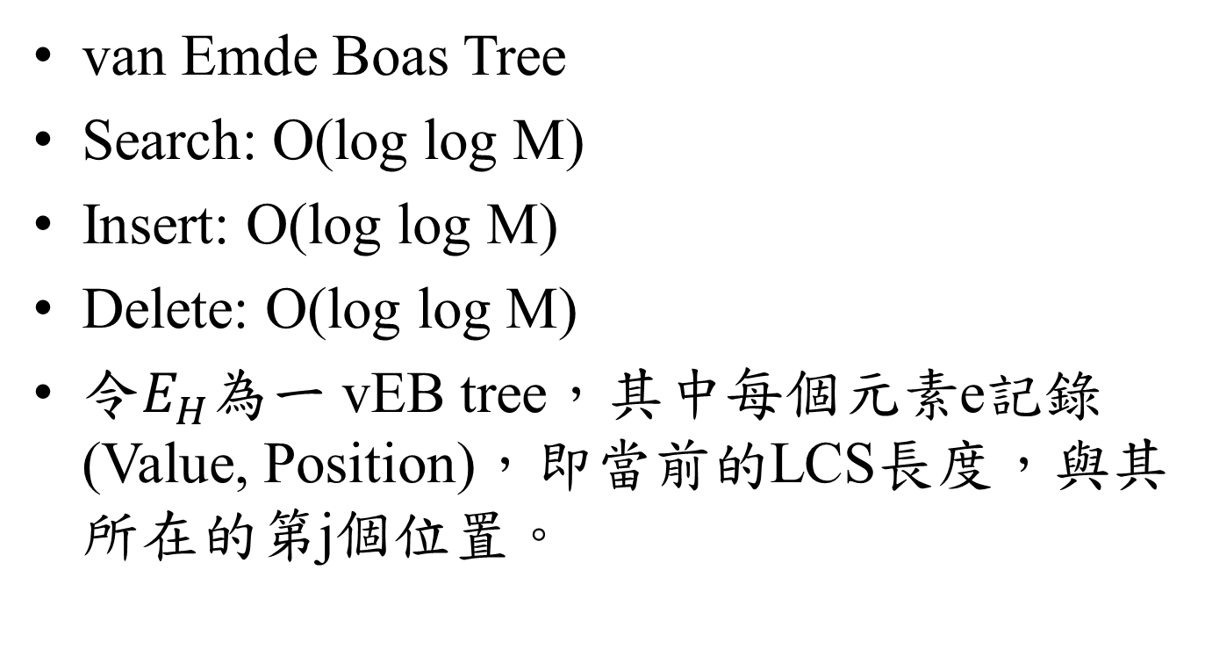
vEB tree
van Emde Boas Tree
Search: O(log log M)
Insert: O(log log M)
Delete: O(log log M)
令$E_{H}$為一 vEB tree，其中每個元素e記錄(Value, Position)，即當前的LCS長度，與其所在的第j個位置。

Slide 15
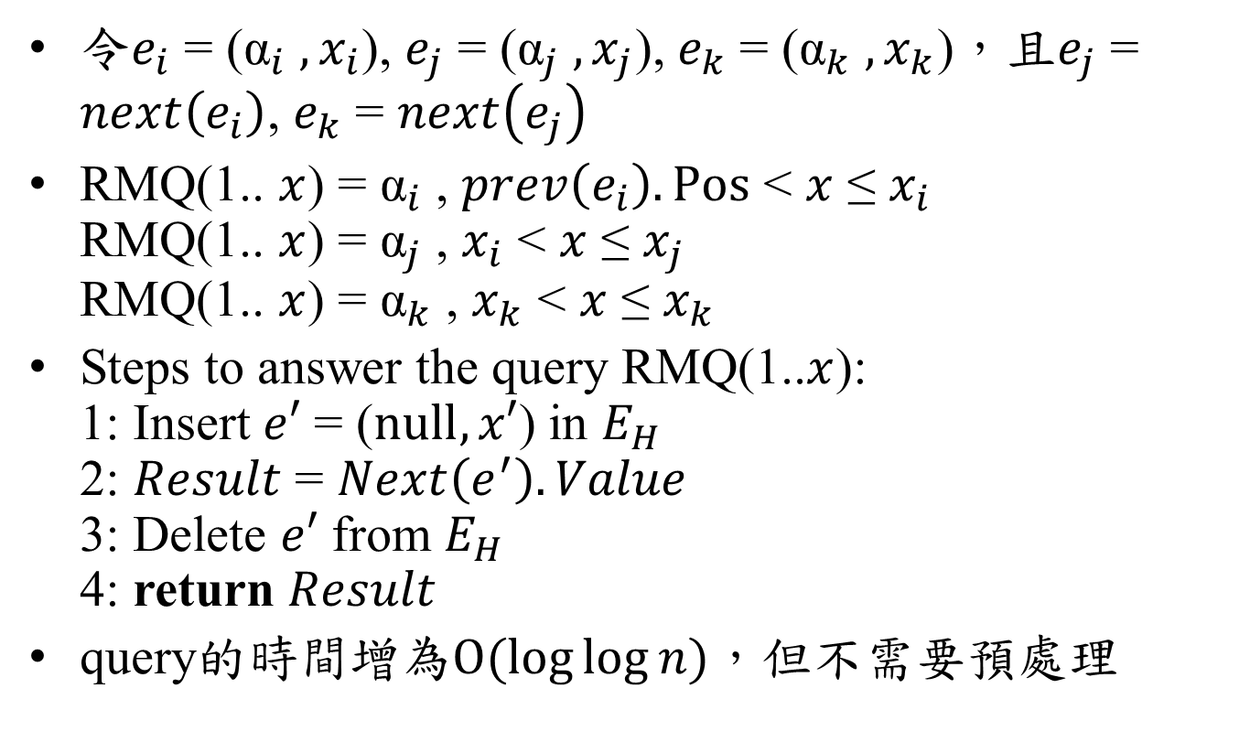
LCS-II
令$e_{i}$ = (${\text{α}}_{i}$ $,x_{i}$), $e_{j}$ = (${\text{α}}_{j}$ $,x_{j}$), $e_{k}$ = (${\text{α}}_{k}$ $,x_{k}$)，且$e_{j}$ = $next\left(e_{i}\right)$, $e_{k}$ = $next\left(e_{j}\right)$
RMQ(1.. $x$) = ${\text{α}}_{i}$ , $prev\left(e_{i}\right).Pos$ < $x$ ≤ $x_{i}$ RMQ(1.. $x$) = ${\text{α}}_{j}$ , $x_{i}$ < $x$ ≤ $x_{j}$ RMQ(1.. $x$) = ${\text{α}}_{k}$ , $x_{k}$ < $x$ ≤ $x_{k}$
Steps to answer the query RMQ(1..$x$): 1: Insert $e′$ = ($null, x′$) in $E_{H}$ 2: $Result$ = $Next\left(e^{′}\right).Value$ 3: Delete $e′$ from $E_{H}$ 4: return $Result$
query的時間增為$O(\log{\log{n}})$，但不需要預處理

Slide 16
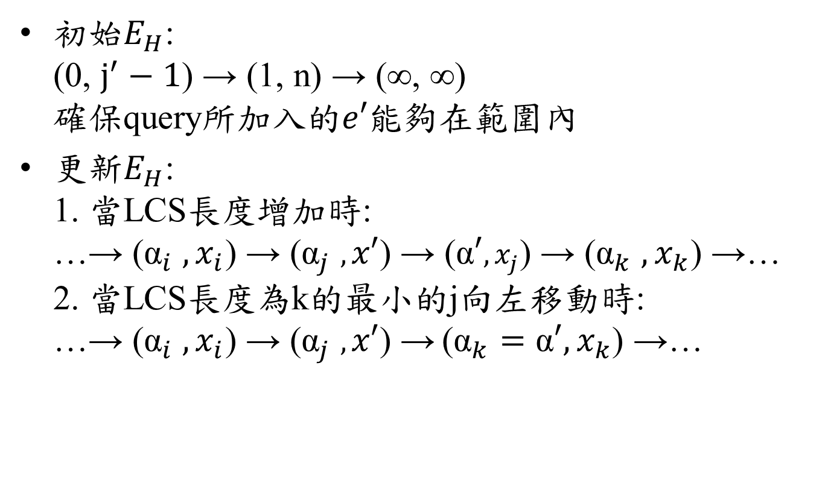
LCS-II
初始$E_{H}$: (0, $j^{′}−1$) → (1, n) → (∞, ∞) 確保query所加入的$e′$能夠在範圍內
更新$E_{H}$: 1. 當LCS長度增加時: …→ (${\text{α}}_{i}$ $,x_{i}$) → (${\text{α}}_{j}$ $,x′$) → ($\text{α}′,x_{j}$) → (${\text{α}}_{k}$ $,x_{k}$) →… 2. 當LCS長度為k的最小的j向左移動時: …→ (${\text{α}}_{i}$ $,x_{i}$) → (${\text{α}}_{j}$ $,x′$) → (${\text{α}}_{k}=\text{α}′,x_{k}$) →…

Slide 17

LCS-II
X = c b b d a c
Y = a b c d d b a
$E_{H}$: (0, 2) → (1, 7) → (∞, ∞)
處理(1, 3) RMQ(1..2) = 1 T[1, 3] = 1 令$\text{α}′$ = 1 RMQ(1..3) = 1 = $\text{α}′$，無需更新$E_{H}$
 | a | b | c | d | d | b | a
c | 0 | 0 | * | 0 | 0 | 0 | 0
b | 0 | * | 0 | 0 | 0 | * | 0
b | 0 | * | 0 | 0 | 0 | * | 0
d | 0 | 0 | 0 | * | * | 0 | 0
a | * | 0 | 0 | 0 | 0 | 0 | *
c | 0 | 0 | * | 0 | 0 | 0 | 0

Slide 18
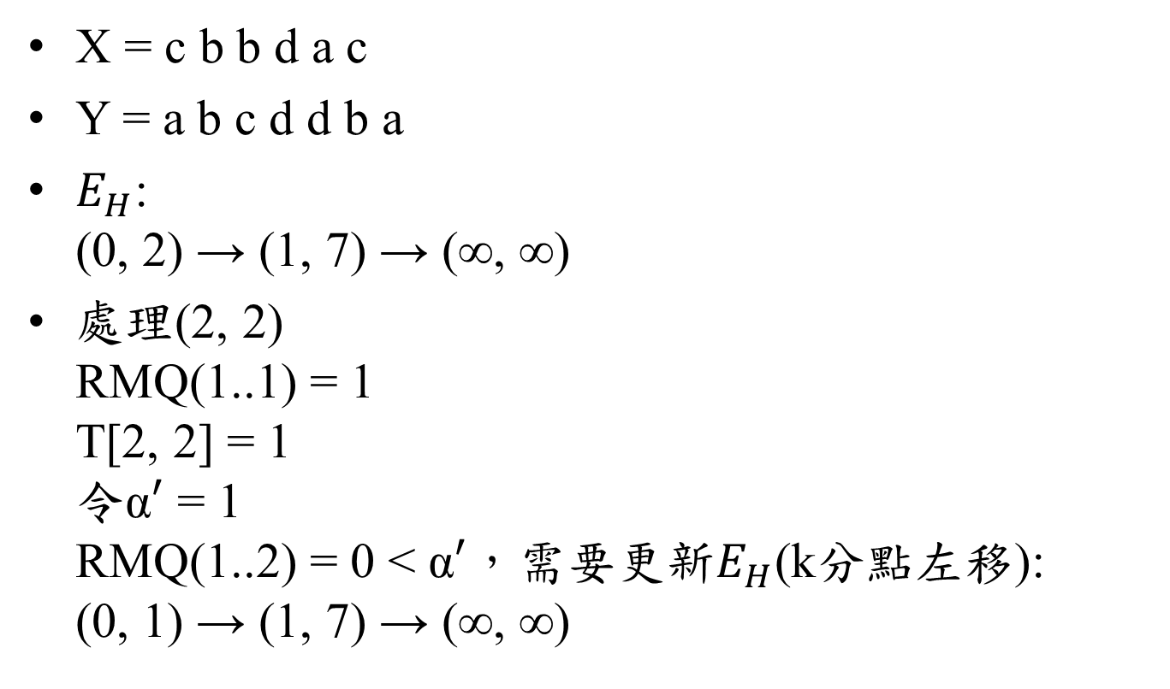
LCS-II
X = c b b d a c
Y = a b c d d b a
$E_{H}$: (0, 2) → (1, 7) → (∞, ∞)
處理(2, 2) RMQ(1..1) = 1 T[2, 2] = 1 令$\text{α}′$ = 1 RMQ(1..2) = 0 < $\text{α}′$，需要更新$E_{H}$(k分點左移): (0, 1) → (1, 7) → (∞, ∞)
 | a | b | c | d | d | b | a
c | 0 | 0 | 1 | 0 | 0 | 0 | 0
b | 0 | * | 0 | 0 | 0 | * | 0
b | 0 | * | 0 | 0 | 0 | * | 0
d | 0 | 0 | 0 | * | * | 0 | 0
a | * | 0 | 0 | 0 | 0 | 0 | *
c | 0 | 0 | * | 0 | 0 | 0 | 0

Slide 19
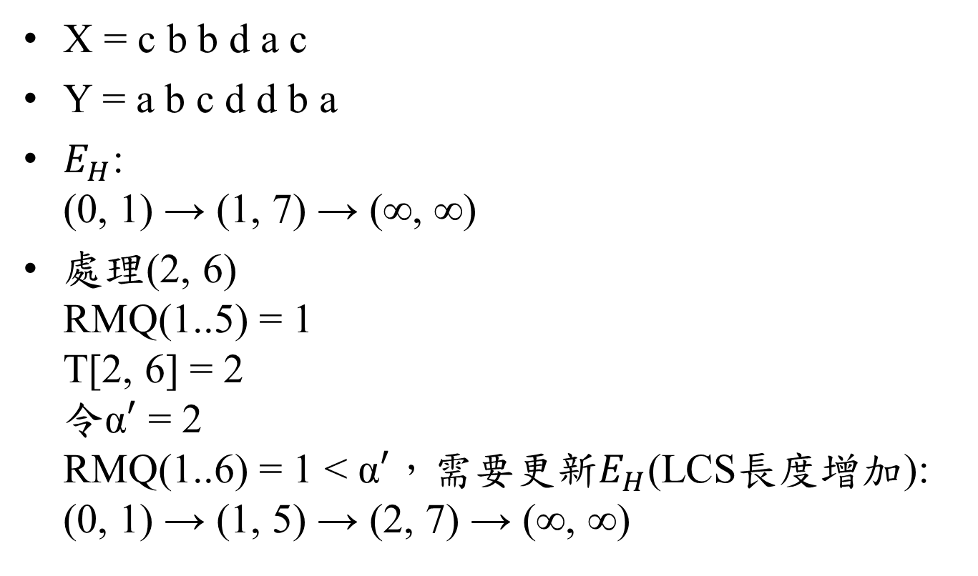
LCS-II
X = c b b d a c
Y = a b c d d b a
$E_{H}$: (0, 1) → (1, 7) → (∞, ∞)
處理(2, 6) RMQ(1..5) = 1 T[2, 6] = 2 令$\text{α}′$ = 2 RMQ(1..6) = 1 < $\text{α}′$，需要更新$E_{H}$(LCS長度增加): (0, 1) → (1, 5) → (2, 7) → (∞, ∞)
 | a | b | c | d | d | b | a
c | 0 | 0 | 1 | 0 | 0 | 0 | 0
b | 0 | 1 | 0 | 0 | 0 | * | 0
b | 0 | * | 0 | 0 | 0 | * | 0
d | 0 | 0 | 0 | * | * | 0 | 0
a | * | 0 | 0 | 0 | 0 | 0 | *
c | 0 | 0 | * | 0 | 0 | 0 | 0

Slide 20

LCS-II
X = c b b d a c
Y = a b c d d b a
$E_{H}$: (0, 1) → (1, 5) → (2, 7) → (∞, ∞) 處理(3, 2) RMQ(1..1) = 0 T[3, 2] = 1 令$\text{α}′$ = 1 RMQ(1..2) = 1 = $\text{α}′$，無需更新$E_{H}$
 | a | b | c | d | d | b | a
c | 0 | 0 | 1 | 0 | 0 | 0 | 0
b | 0 | 1 | 0 | 0 | 0 | 2 | 0
b | 0 | * | 0 | 0 | 0 | * | 0
d | 0 | 0 | 0 | * | * | 0 | 0
a | * | 0 | 0 | 0 | 0 | 0 | *
c | 0 | 0 | * | 0 | 0 | 0 | 0

Slide 21
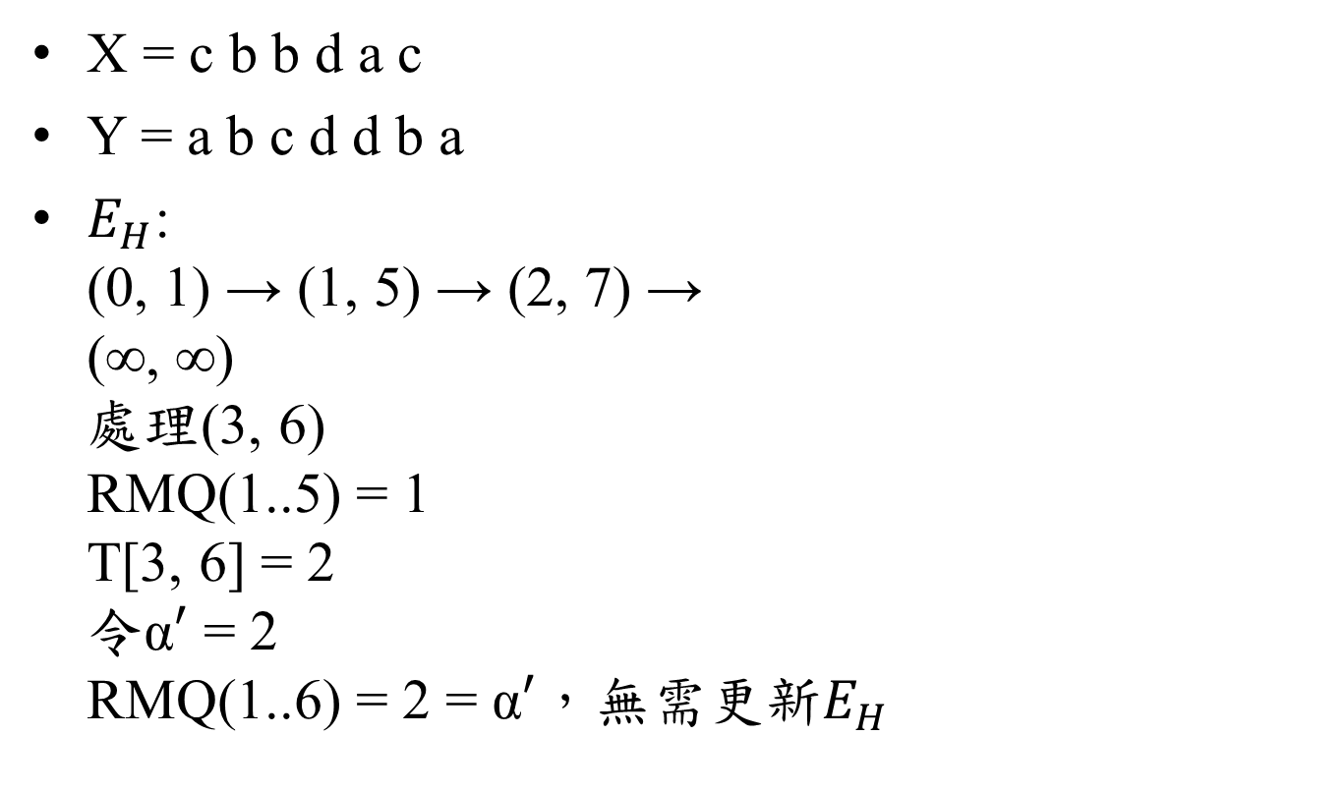
LCS-II
X = c b b d a c
Y = a b c d d b a
$E_{H}$: (0, 1) → (1, 5) → (2, 7) → (∞, ∞) 處理(3, 6) RMQ(1..5) = 1 T[3, 6] = 2 令$\text{α}′$ = 2 RMQ(1..6) = 2 = $\text{α}′$，無需更新$E_{H}$
 | a | b | c | d | d | b | a
c | 0 | 0 | 1 | 0 | 0 | 0 | 0
b | 0 | 1 | 0 | 0 | 0 | 2 | 0
b | 0 | 1 | 0 | 0 | 0 | * | 0
d | 0 | 0 | 0 | * | * | 0 | 0
a | * | 0 | 0 | 0 | 0 | 0 | *
c | 0 | 0 | * | 0 | 0 | 0 | 0

Slide 22
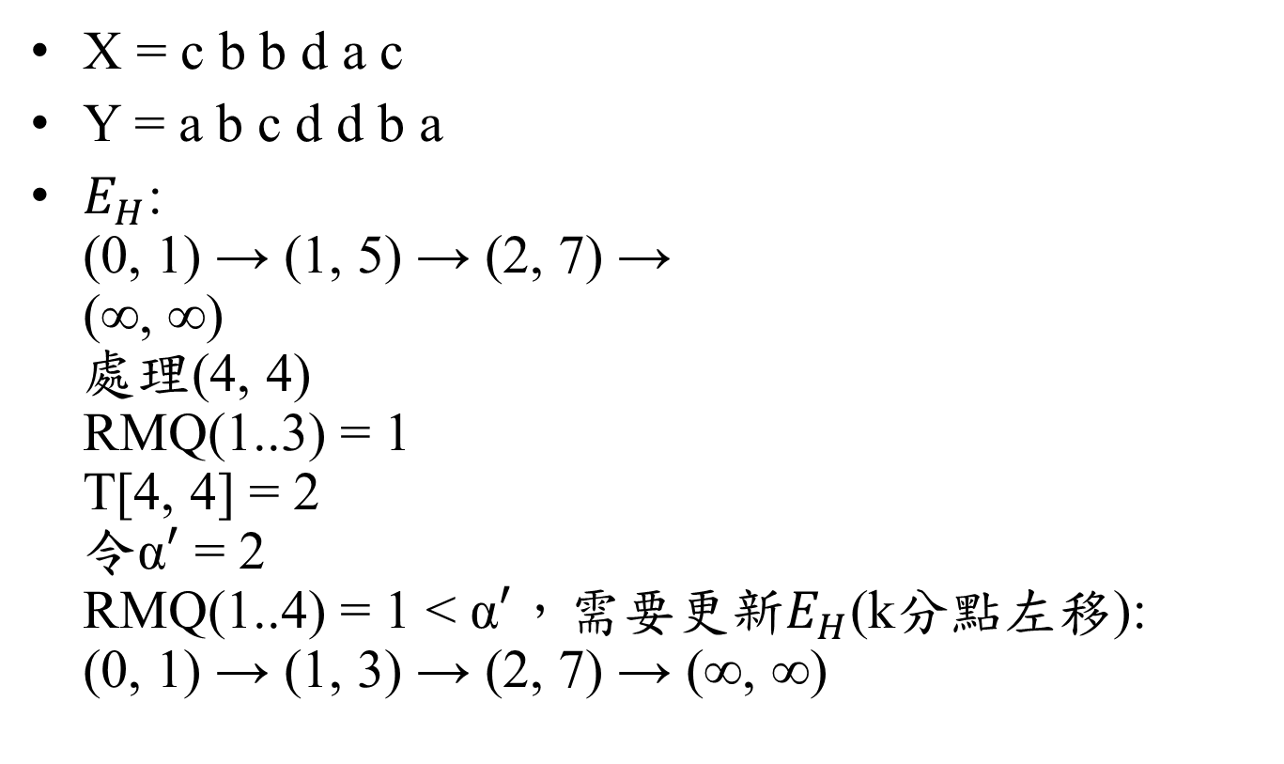
LCS-II
X = c b b d a c
Y = a b c d d b a
$E_{H}$: (0, 1) → (1, 5) → (2, 7) → (∞, ∞) 處理(4, 4) RMQ(1..3) = 1 T[4, 4] = 2 令$\text{α}′$ = 2 RMQ(1..4) = 1 < $\text{α}′$，需要更新$E_{H}$(k分點左移): (0, 1) → (1, 3) → (2, 7) → (∞, ∞)
 | a | b | c | d | d | b | a
c | 0 | 0 | 1 | 0 | 0 | 0 | 0
b | 0 | 1 | 0 | 0 | 0 | 2 | 0
b | 0 | 1 | 0 | 0 | 0 | 2 | 0
d | 0 | 0 | 0 | * | * | 0 | 0
a | * | 0 | 0 | 0 | 0 | 0 | *
c | 0 | 0 | * | 0 | 0 | 0 | 0

Slide 23
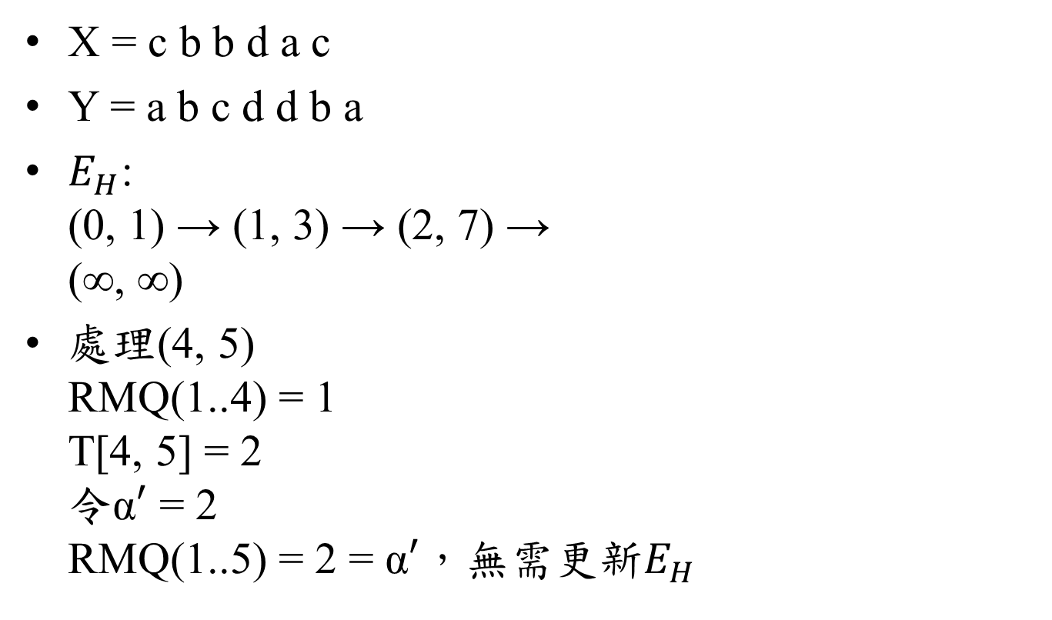
LCS-II
X = c b b d a c
Y = a b c d d b a
$E_{H}$: (0, 1) → (1, 3) → (2, 7) → (∞, ∞)
處理(4, 5) RMQ(1..4) = 1 T[4, 5] = 2 令$\text{α}′$ = 2 RMQ(1..5) = 2 = $\text{α}′$，無需更新$E_{H}$
 | a | b | c | d | d | b | a
c | 0 | 0 | 1 | 0 | 0 | 0 | 0
b | 0 | 1 | 0 | 0 | 0 | 2 | 0
b | 0 | 1 | 0 | 0 | 0 | 2 | 0
d | 0 | 0 | 0 | 2 | * | 0 | 0
a | * | 0 | 0 | 0 | 0 | 0 | *
c | 0 | 0 | * | 0 | 0 | 0 | 0

Slide 24
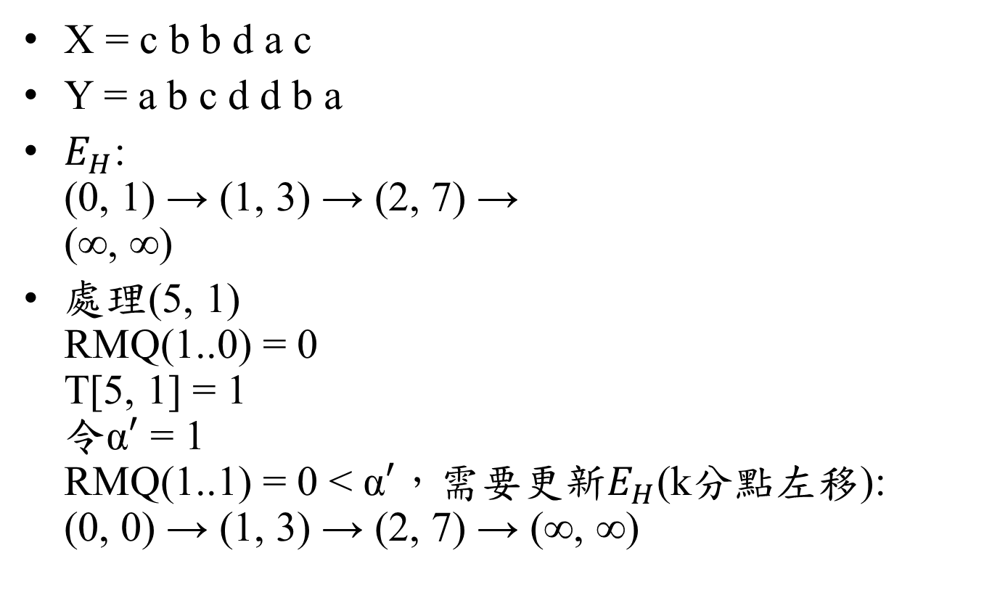
LCS-II
X = c b b d a c
Y = a b c d d b a
$E_{H}$: (0, 1) → (1, 3) → (2, 7) → (∞, ∞)
處理(5, 1) RMQ(1..0) = 0 T[5, 1] = 1 令$\text{α}′$ = 1 RMQ(1..1) = 0 < $\text{α}′$，需要更新$E_{H}$(k分點左移): (0, 0) → (1, 3) → (2, 7) → (∞, ∞)
 | a | b | c | d | d | b | a
c | 0 | 0 | 1 | 0 | 0 | 0 | 0
b | 0 | 1 | 0 | 0 | 0 | 2 | 0
b | 0 | 1 | 0 | 0 | 0 | 2 | 0
d | 0 | 0 | 0 | 2 | 2 | 0 | 0
a | * | 0 | 0 | 0 | 0 | 0 | *
c | 0 | 0 | * | 0 | 0 | 0 | 0

Slide 25
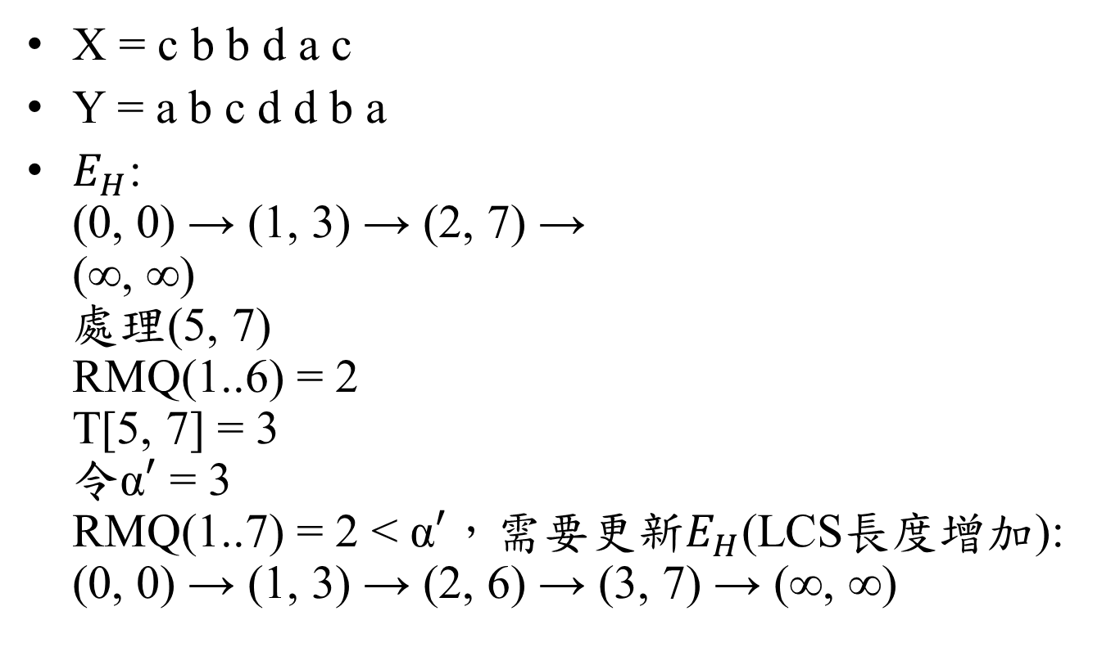
LCS-II
X = c b b d a c
Y = a b c d d b a
$E_{H}$: (0, 0) → (1, 3) → (2, 7) → (∞, ∞) 處理(5, 7) RMQ(1..6) = 2 T[5, 7] = 3 令$\text{α}′$ = 3 RMQ(1..7) = 2 < $\text{α}′$，需要更新$E_{H}$(LCS長度增加): (0, 0) → (1, 3) → (2, 6) → (3, 7) → (∞, ∞)
 | a | b | c | d | d | b | a
c | 0 | 0 | 1 | 0 | 0 | 0 | 0
b | 0 | 1 | 0 | 0 | 0 | 2 | 0
b | 0 | 1 | 0 | 0 | 0 | 2 | 0
d | 0 | 0 | 0 | 2 | 2 | 0 | 0
a | 1 | 0 | 0 | 0 | 0 | 0 | *
c | 0 | 0 | * | 0 | 0 | 0 | 0

Slide 26
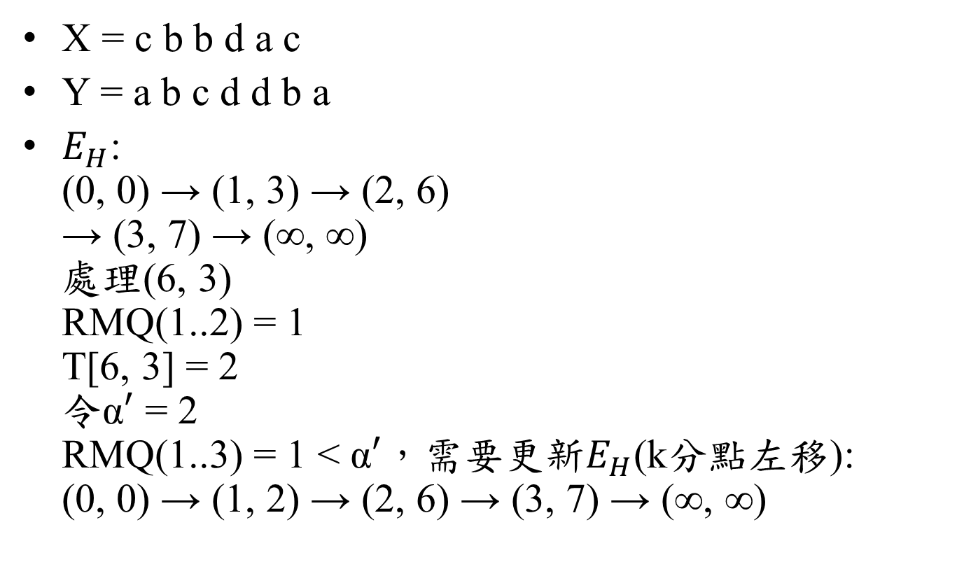
LCS-II
X = c b b d a c
Y = a b c d d b a
$E_{H}$: (0, 0) → (1, 3) → (2, 6) → (3, 7) → (∞, ∞) 處理(6, 3) RMQ(1..2) = 1 T[6, 3] = 2 令$\text{α}′$ = 2 RMQ(1..3) = 1 < $\text{α}′$，需要更新$E_{H}$(k分點左移): (0, 0) → (1, 2) → (2, 6) → (3, 7) → (∞, ∞)
 | a | b | c | d | d | b | a
c | 0 | 0 | 1 | 0 | 0 | 0 | 0
b | 0 | 1 | 0 | 0 | 0 | 2 | 0
b | 0 | 1 | 0 | 0 | 0 | 2 | 0
d | 0 | 0 | 0 | 2 | 2 | 0 | 0
a | 1 | 0 | 0 | 0 | 0 | 0 | 3
c | 0 | 0 | * | 0 | 0 | 0 | 0

Slide 27

LCS-II
X = c b b d a c
Y = a b c d d b a
$E_{H}$: (0, 0) → (1, 2) → (2, 6) → (3, 7) → (∞, ∞)
LCS長度 = RMQ(1..7) = 3
 | a | b | c | d | d | b | a
c | 0 | 0 | 1 | 0 | 0 | 0 | 0
b | 0 | 1 | 0 | 0 | 0 | 2 | 0
b | 0 | 1 | 0 | 0 | 0 | 2 | 0
d | 0 | 0 | 0 | 2 | 2 | 0 | 0
a | 1 | 0 | 0 | 0 | 0 | 0 | 3
c | 0 | 0 | 2 | 0 | 0 | 0 | 0

Slide 28
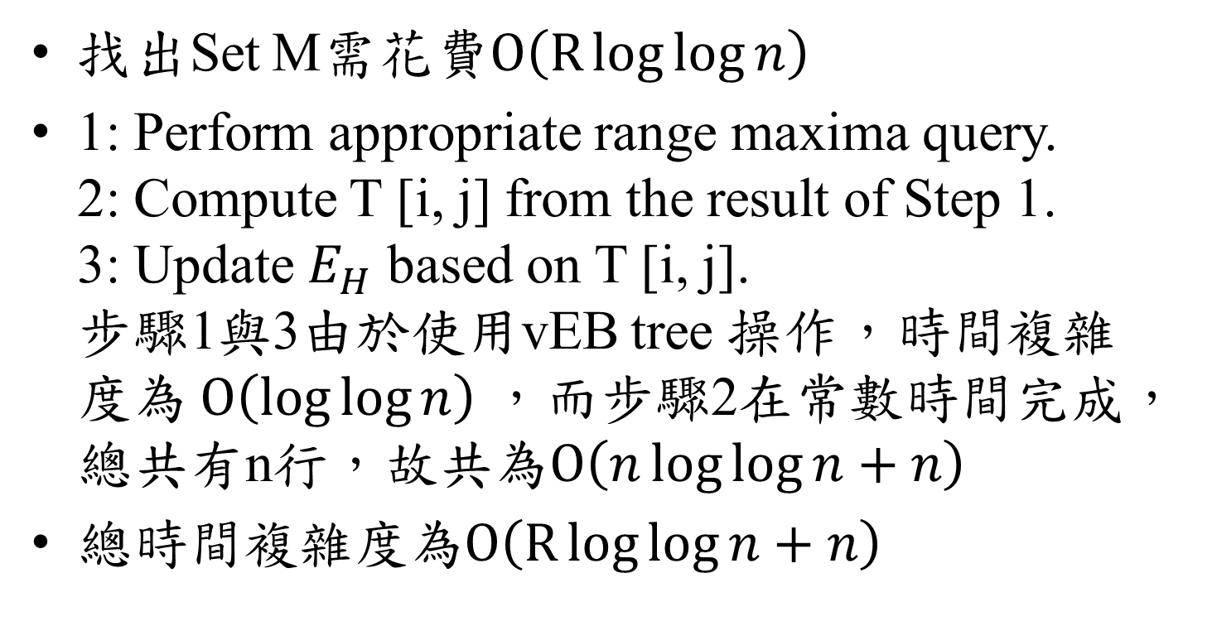
Time Complexity
找出Set M需花費$O\left(R\log{\log{n}}\right)$
1: Perform appropriate range maxima query. 2: Compute T [i, j] from the result of Step 1. 3: Update $E_{H}$ based on T [i, j]. 步驟1與3由於使用vEB tree 操作，時間複雜度為$O\left(\log{\log{n}}\right)$，而步驟2在常數時間完成，總共有n行，故共為$O\left(n\log{\log{n}}+n\right)$
總時間複雜度為$O\left(R\log{\log{n}}+n\right)$

