Slide 1
On a Cyclic String-to-String Correction Problem
Maurice Maes
Information Processing Letters Volume 35, Issue 2, 29 June 1990, pp. 73–78
Presenter：Guan-Cheng Guo Date：2014/9/24

Slide 2
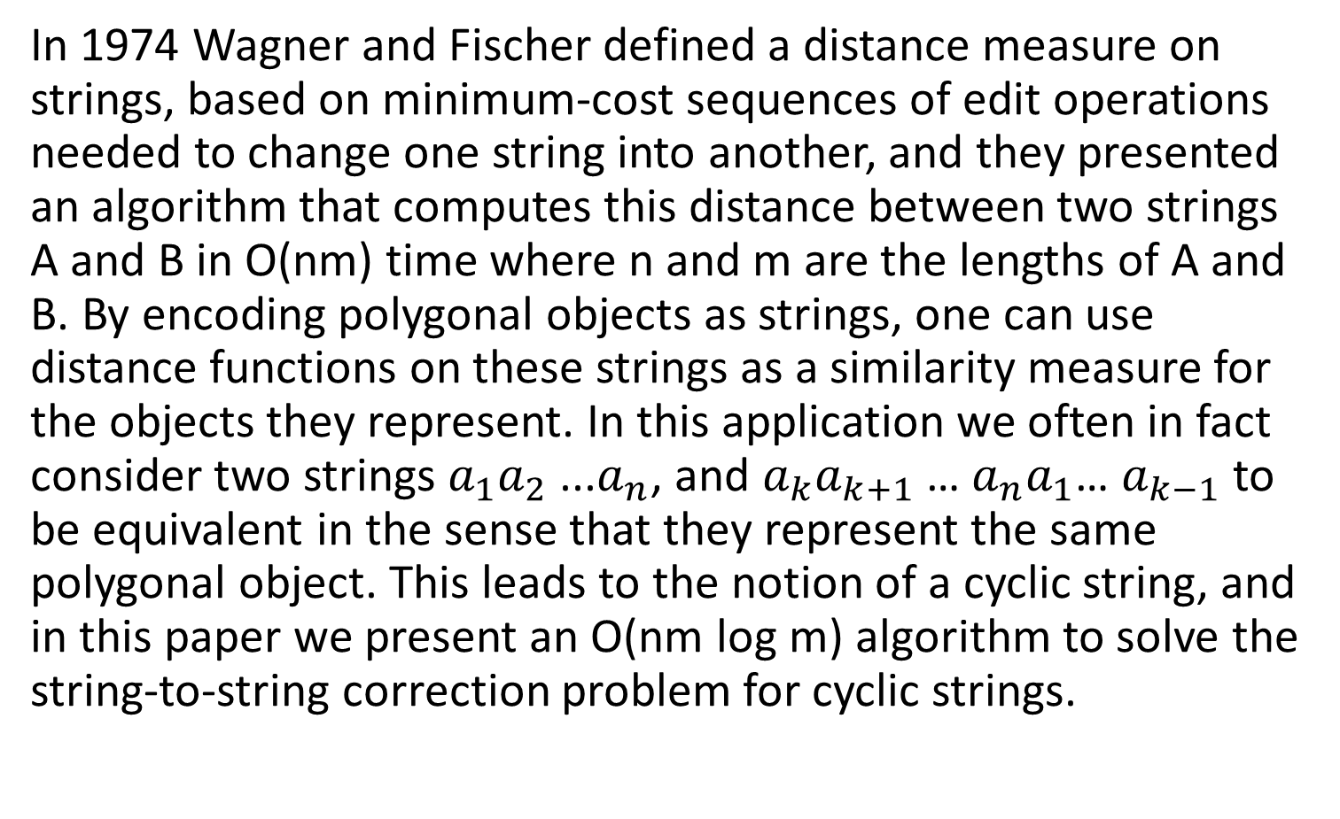
Introduction
In 1974 Wagner and Fischer defined a distance measure on strings, based on minimum-cost sequences of edit operations needed to change one string into another, and they presented an algorithm that computes this distance between two strings A and B in O(nm) time where n and m are the lengths of A and B. By encoding polygonal objects as strings, one can use distance functions on these strings as a similarity measure for the objects they represent. In this application we often in fact consider two strings $a_{1}a_{2}$ ...$a_{n}$, and $a_{k}a_{k+1}$… $a_{n}a_{1}$… $a_{k−1}$ to be equivalent in the sense that they represent the same polygonal object. This leads to the notion of a cyclic string, and in this paper we present an O(nm log m) algorithm to solve the string-to-string correction problem for cyclic strings.

Slide 3
linear string-to-string correction
Two string A, B. Edit A to B
Edit operation s = (a→b), Ʌ denote the null string
Three edit operations: insert: a = Ʌ, Ʌ→b delete: b = Ʌ, a→ Ʌ change: a→b

Slide 4
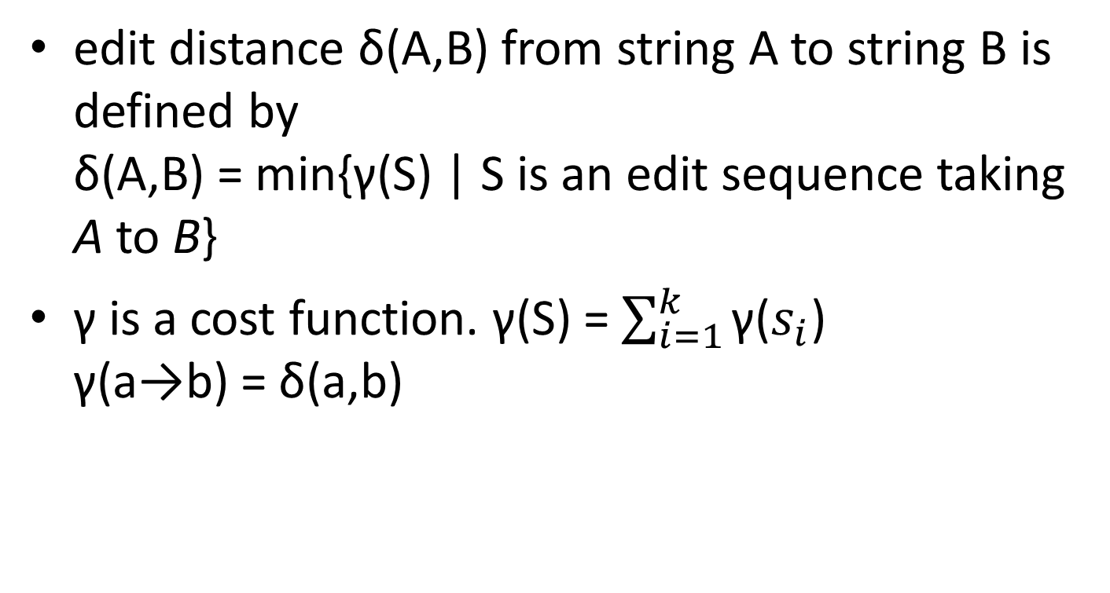
Edit Distance
edit distance δ(A,B) from string A to string B is defined by δ(A,B) = min{γ(S) | S is an edit sequence taking A to B}
γ is a cost function. γ(S) = $\sum_{i=1}^{k}{\text{γ}\text{(}s_{i}\text{)}}$ γ(a→b) = δ(a,b)

Slide 5
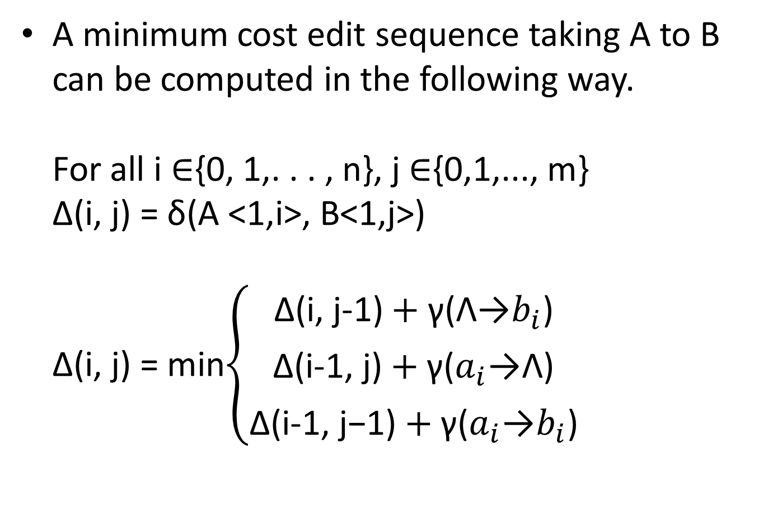
Wagner–Fischer algorithm
A minimum cost edit sequence taking A to B can be computed in the following way. For all i ∈{0, 1,. . . , n}, j ∈{0,1,..., m} Δ(i, j) = δ(A <1,i>, B<1,j>) Δ(i, j) = min$\left\{\begin{aligned}\text{Δ}\text{(}\text{i}\text{, }\text{j}\text{−1}\text{)}+\text{γ}\text{(Ʌ}\text{→}b_{i}\text{)} \\ \text{Δ}\text{(}\text{i}\text{−1}\text{, }\text{j}\text{)}+\text{γ}\text{(}a_{i}\text{→}\text{Ʌ)} \\ \text{Δ}\text{(}\text{i}\text{−1}\text{, }\text{j}\text{−1)}+\text{γ}\text{(}a_{i}\text{→}b_{i}\text{)}\end{aligned}\right.$

Slide 6
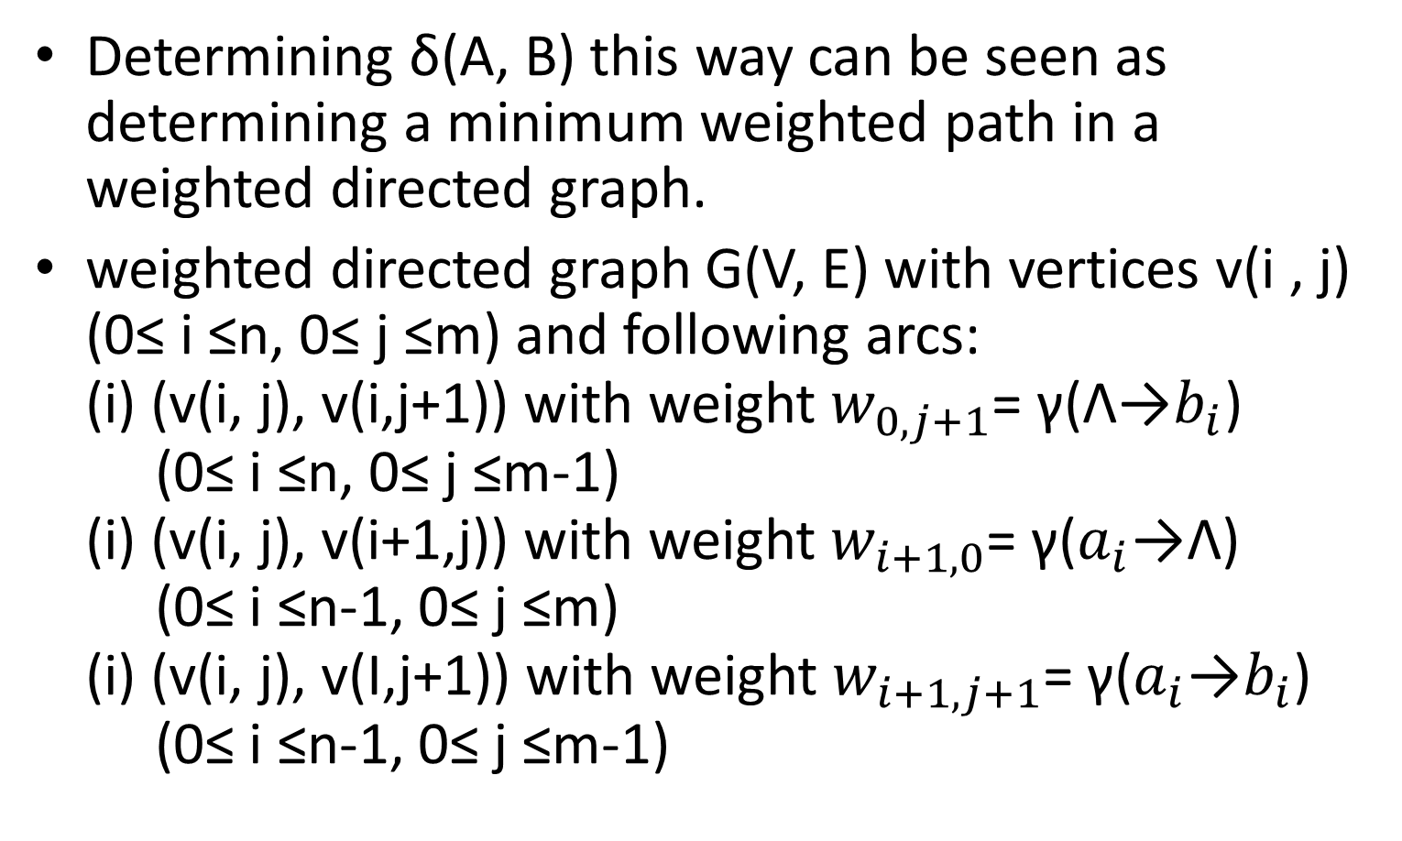
Edit Graph
Determining δ(A, B) this way can be seen as determining a minimum weighted path in a weighted directed graph.
weighted directed graph G(V, E) with vertices v(i , j) (0≤ i ≤n, 0≤ j ≤m) and following arcs: (i) (v(i, j), v(i,j+1)) with weight $w_{0,j+1}$= $\text{γ}\text{(Ʌ}\text{→}b_{i}\text{)}$ (0≤ i ≤n, 0≤ j ≤m-1) (i) (v(i, j), v(i+1,j)) with weight $w_{i+1,0}$= $\text{γ}\text{(}a_{i}\text{→}\text{Ʌ)}$ (0≤ i ≤n-1, 0≤ j ≤m) (i) (v(i, j), v(I,j+1)) with weight $w_{i+1,j+1}$= $\text{γ}\text{(}a_{i}\text{→}b_{i}\text{)}$ (0≤ i ≤n-1, 0≤ j ≤m-1)

Slide 7
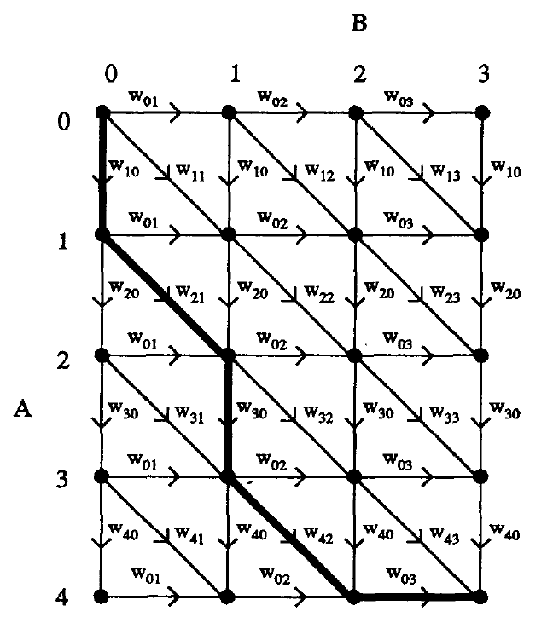
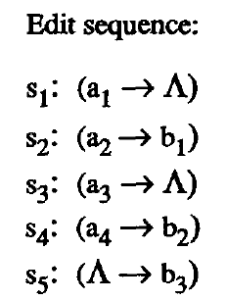
Edit Graph

Slide 8
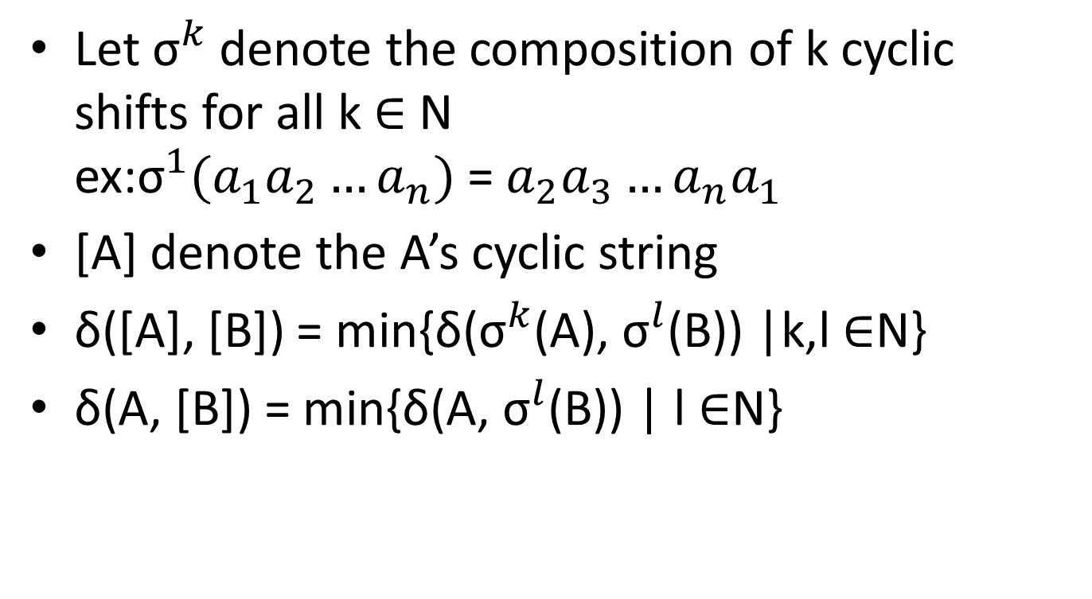
Cyclic Strings
Let ${\text{σ}}^{k}$denote the composition of k cyclic shifts for all k ∈ N ex:${\text{σ}}^{1}(a_{1}a_{2}…a_{n})$ = $a_{2}a_{3}…a_{n}a_{1}$
[A] denote the A’s cyclic string
δ([A], [B]) = min{δ(${\text{σ}}^{k}$(A), ${\text{σ}}^{l}$(B)) |k,l ∈N}
δ(A, [B]) = min{δ(A, ${\text{σ}}^{l}$(B)) | l ∈N}

Slide 9
Cyclic Strings
Lemma 1 : For each representative A of a cyclic string [A] and for each cyclic string [B] we have δ([A], [B]) = δ(A, [B])
So we will solve the problem: Given two strings A and B, determine δ(A, [B]) and an edit sequence S between A and a representative of [B] realizing this minimum cost.

Slide 10
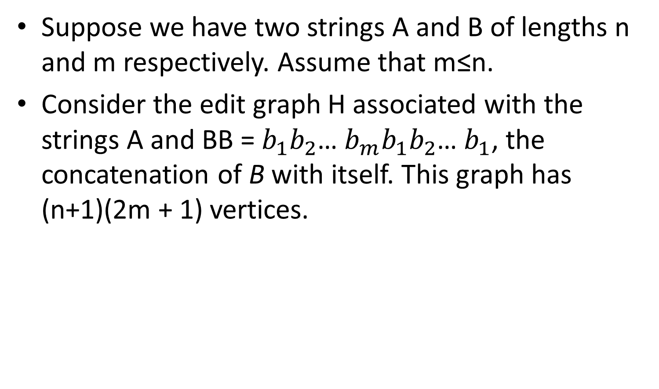
Cyclic String-to-String Correction Problem
Suppose we have two strings A and B of lengths n and m respectively. Assume that m≤n.
Consider the edit graph H associated with the strings A and BB =$b_{1}b_{2}$… $b_{m}b_{1}b_{2}$… $b_{1}$, the concatenation of B with itself. This graph has (n+1)(2m + 1) vertices.

Slide 11
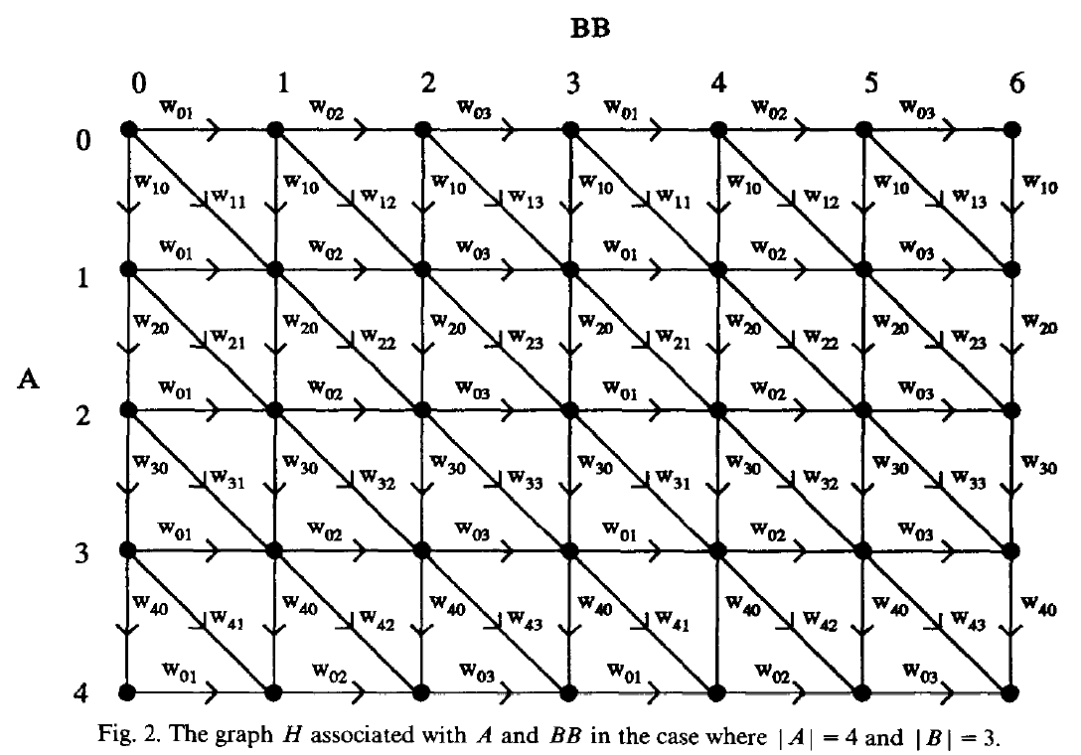
Cyclic String-to-String Correction Problem

Slide 12
Cyclic String-to-String Correction Problem
For all l ∈{0, 1,. . . , m}, P(l) denote a path from v(0,l) to v(n,m+l)
Definition: three integers j, k, and l (0≤ j< k < l ≤ m). We say two path P(k) and P(l) are noncrossing, following two conditions are satisfied: for all x ∈{0, 1,. . . , m}, y ∈{0, 1,. . . , 2m} (i)if v(x,y) ∈P(k),the there is a z∈N with z≥y such that v(x,z) ∈P(l) (ii)if v(x,y) ∈P(l),the there is a z∈N with z ≤ y such that v(x,z) ∈P(k)

Slide 13
Cyclic String-to-String Correction Problem
Three paths P(j), P(k), P(l). We say P(k) is between P(j) and P(l) if P(j) and P(k), as well as P(k) and p(l) are noncrossing.
Lemma 2: Let j, k, and l be three integers such that 0≤ j< k < l ≤ m, and let P(j) and P(l) be two noncrossing minimum weighted paths in H. Then there is a minimum weighted path P(k) that lies between P(j) and P(I).

Slide 14
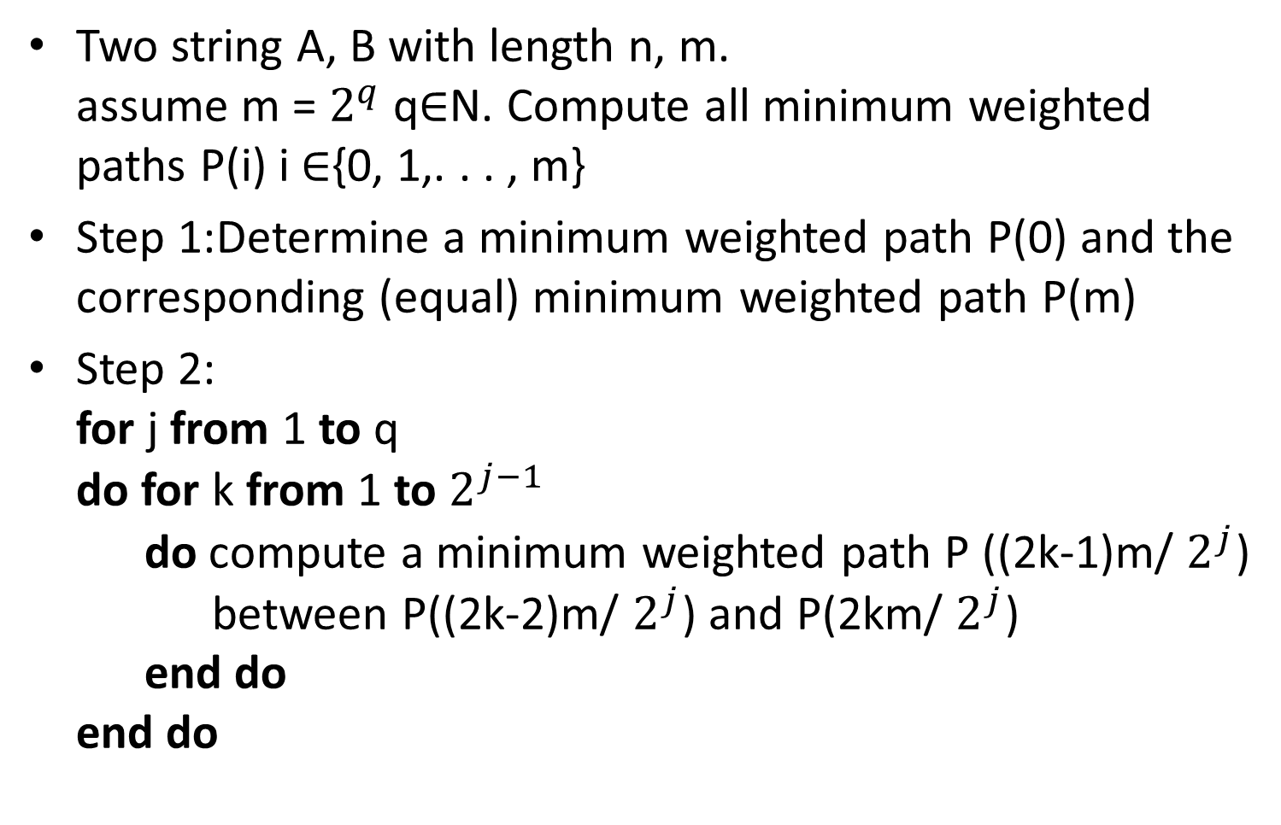
Algorithm
Two string A, B with length n, m. assume m = $2^{q}$ q∈N. Compute all minimum weighted paths P(i) i ∈{0, 1,. . . , m}
Step 1:Determine a minimum weighted path P(0) and the corresponding (equal) minimum weighted path P(m)
Step 2: for j from 1 to q do for k from 1 to $2^{j−1}$ do compute a minimum weighted path P ((2k-1)m/ $2^{j}$) between P((2k-2)m/ $2^{j}$) and P(2km/ $2^{j}$) end do end do

Slide 15
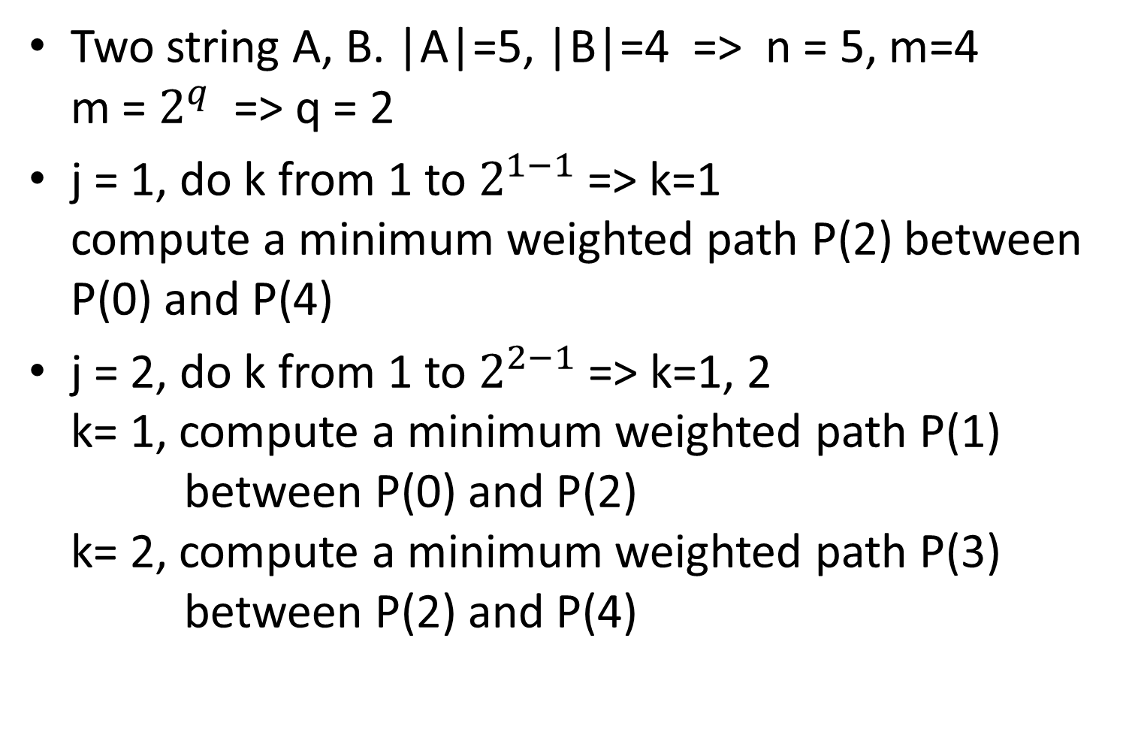
Algorithm
Two string A, B. |A|=5, |B|=4 => n = 5, m=4 m = $2^{q}$ => q = 2
j = 1, do k from 1 to $2^{1−1}$ => k=1 compute a minimum weighted path P(2) between P(0) and P(4)
j = 2, do k from 1 to $2^{2−1}$ => k=1, 2 k= 1, compute a minimum weighted path P(1) between P(0) and P(2) k= 2, compute a minimum weighted path P(3) between P(2) and P(4)

Slide 16
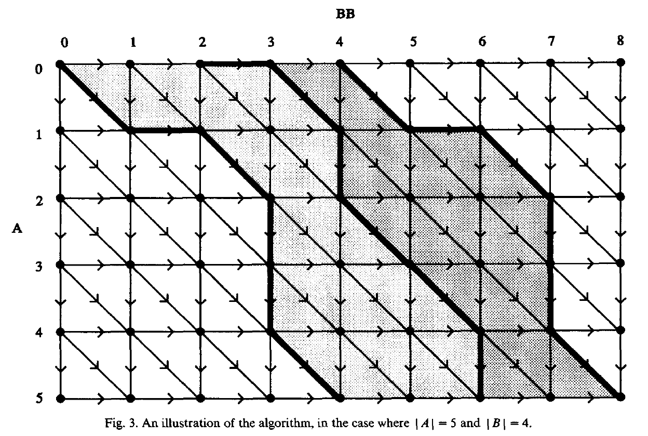
Algorithm
the computation of P(2) involves only vertices that lie within the grey area or on the paths P(0) or P(4).

Slide 17
Algorithm
P(1) can be computed between P(0) and P(2), so only vertices on these paths or within the light grey area need to be considered. P(3) can be computed between P(2) and P(4).

Slide 18
Time Analysis
Step 1 involves (n+1)(m+1) step.
Step 2: within one j-loop of the algorithm. Each vertex of H can occur in at most three paths that are calculates within that loop. Since the total number of vertices equals (n + 1)(2m +1), this leads to a total of less than 3(n + 1)(2m +1) steps for each of the q = log m j-loops. We see that O(nm log m) steps are needed.

