Slide 1
A BSP/CGM Algorithm for the All-Substrings Longest Common Subsequence Problem
C. E. R. Alves, E. N. C´aceres, S. W. Song
Proceedings of the International Parallel and
Distributed Processing Symposium(2003)
Presenter: Ding-Yao Huang
Date:2014/10/01

Slide 2
Abstract
Given two strings X and Y of lengths m and n, respectively, the all-substrings longest common subsequence (ALCS) problem obtains the lengths of the subsequences common to X and any substring of Y.
The sequential algorithm takes O(mn) time and O(n) space. We present a parallel algorithm for ALCS on a coarse-grained multicomputer (BSP/CGM) model with p < √m processors that takes O(mn/p) time and O(n √m ) space per processor, with O(log p) communication rounds.
The proposed parallel algorithm also solves the well-known LCS problem. To our knowledge this is the best BSP/CGM algorithm for the ALCS problem in the literature.

Slide 3
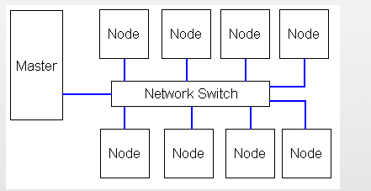
The BSP/CGM Model
A BSP/CGM consists of a set of p processors P₁, . . . , P_{p}, each with O(N/p) local memory.
Each processor is connected to a router that can send messages in a point-to-point fashion.
In the BSP/CGM model
the communication cost is modeled by the number of communication rounds
the main advantage of BSP/CGM algorithms is that they map very well to standard parallel hardware, like Beowulf-type processor clusters
Our goal is to minimize number of communication rounds and achieve a good speed-up

Slide 4

All-Substrings Longest Common Subsequence
string X : baabcbca
string Y : baabcabcabaca
all substrings of Y: ba,baa,baab,baabc…
0
LCS(X_{i-1},Y_{j-1})+1
Max(LCS(X_{i},Y_{j-1}), LCS(X_{i-1},Y_{j}))

Slide 5
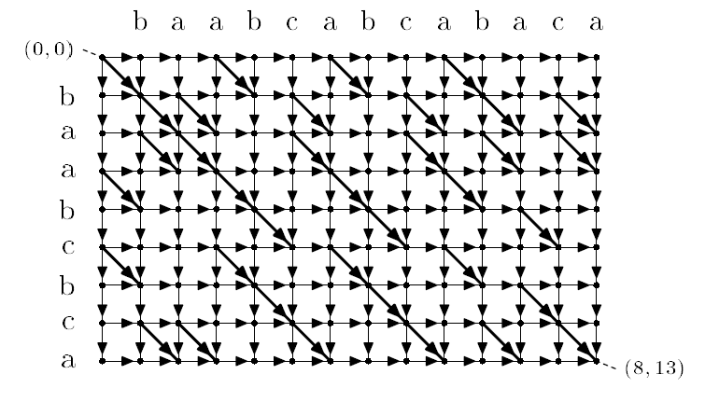
Grid Directed Acyclic Graph for the ALCS
y
x
GDAG for the ALCS

Slide 6
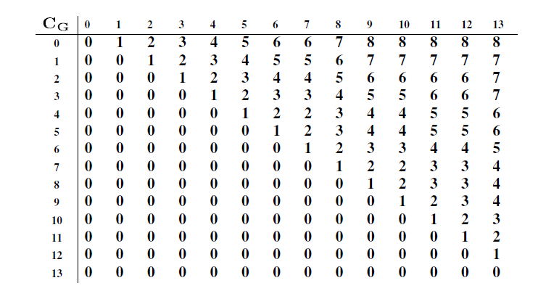
j
i
string X : baabcbca
string Y : baabcabcabaca
EX: C_{G}(0,2)=2
C_{G} (i,j) represent the length of the longest common subsequence between X and the substring Y ^{j}_{i+1}

Slide 7
j
i
string X : baabcbca
string Y : baabcabcabaca
EX: C_{G}(3,6)=3
C_{G} (i,j) represent the length of the longest common subsequence between X and the substring Y ^{j}_{i+1}

Slide 8
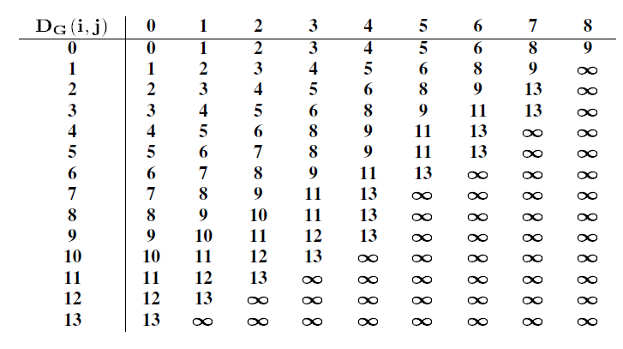
D_{G}(i,j) 是以i為起始位置，j這個分數的最左邊位置 (觀察C_{G})
i是起始的位置 j是LCS分數
D_{G}(0,7)=8

Slide 9

Space complexity: O( m + n )

Slide 10
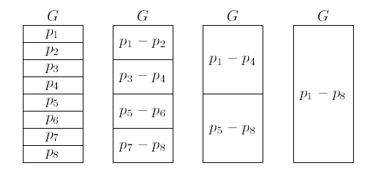
Basic Strategy of the BSP/CGM Algorithm
the BSP/CGM algorithm for ALCS consists of the two phases
Each of the p processors runs the sequential ALCS algorithm on its local strip and computes the local D_{G}.
In log p rounds pairs of the contiguous partial solutions are joined together successively to obtain the solution of the original problem.
O(mn) →O(mn/p)

Slide 11
Basic Strategy of the BSP/CGM Algorithm

Slide 12
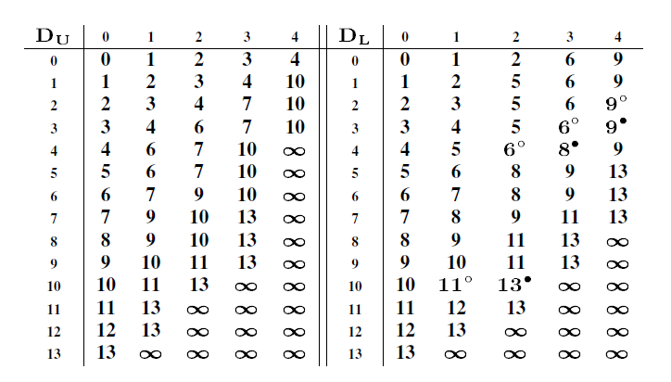
merge

Slide 13
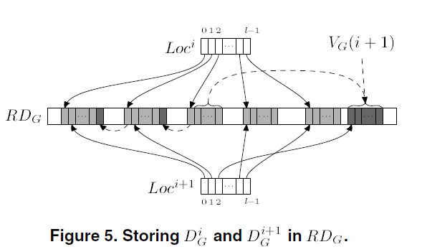

Compact Data Structure for D_{G}

Slide 14
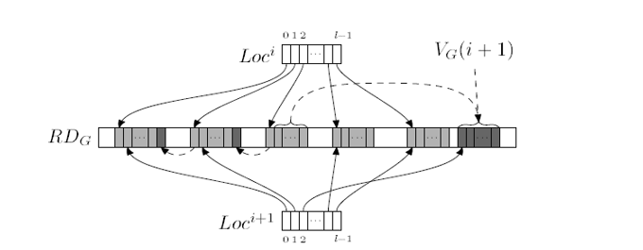
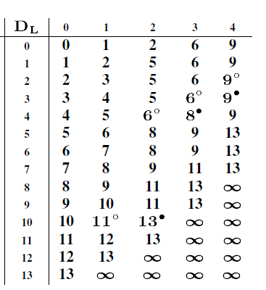
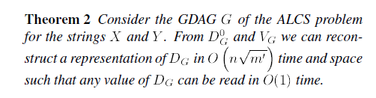
Compact Data Structure for D_{G}
0
6
9
1
2
2
9
1
6
5

Slide 15
The Basic Union Operation of Two Partial Solutions
merge

Slide 16

D_{G}(1,6)=8
D_{U}(1,0)=1 ,D_{L}(1,6)=inf
D_{U}(1,1)=2 ,D_{L}(2,5)=inf
D_{U}(1,2)=3 ,D_{L}(3,4)=9
D_{U}(1,3)=4 ,D_{L}(4,3)=8
D_{U}(1,4)=10,D_{L}(10,2)=11
D_{G}(1,5)=6
D_{U}(1,0)=1 ,D_{L}(1,5)=inf
D_{U}(1,1)=2 ,D_{L}(2,4)=9
D_{U}(1,2)=3 ,D_{L}(3,3)=6
D_{U}(1,3)=4 ,D_{L}(4,2)=6
D_{U}(1,4)=10,D_{L}(10,1)=11

Slide 17
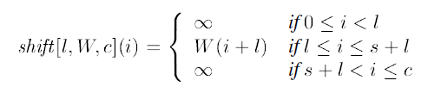




D_{G}(1,6)=8
D_{U}(1,0)=1 ,D_{L}(1,6)=inf
D_{U}(1,1)=2 ,D_{L}(2,5)=inf
D_{U}(1,2)=3 ,D_{L}(3,4)=9
D_{U}(1,3)=4 ,D_{L}(4,3)=8
D_{U}(1,4)=10,D_{L}(10,2)=11
D_{G}(1,5)=6
D_{U}(1,0)=1 ,D_{L}(1,5)=inf
D_{U}(1,1)=2 ,D_{L}(2,4)=9
D_{U}(1,2)=3 ,D_{L}(3,3)=6
D_{U}(1,3)=4 ,D_{L}(4,2)=6
D_{U}(1,4)=10,D_{L}(10,1)=11
=

Slide 18
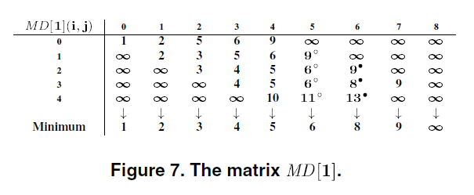
√
√
√
√
√

Slide 19
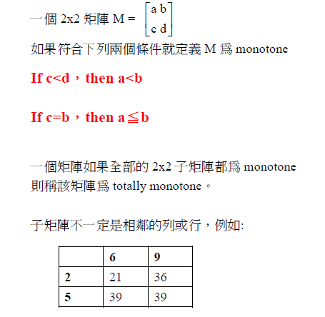
Monotonicity
From: http://www.egr.unlv.edu/~larmore/Courses/CSC477/monge.pdf

Slide 20
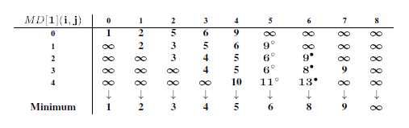
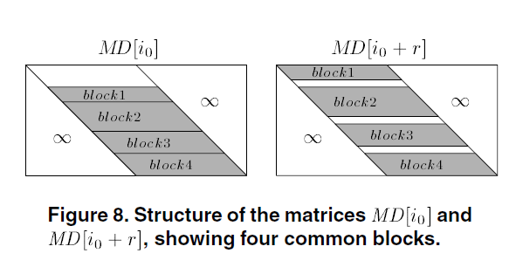
Redundancy Elimination by Exploring Similarities
the total time is still O(nm).
This is not good enough.
因為這些matrix有Monotonicity的特性存在
Queried: O(log m’)
O(r log m’)

Slide 21
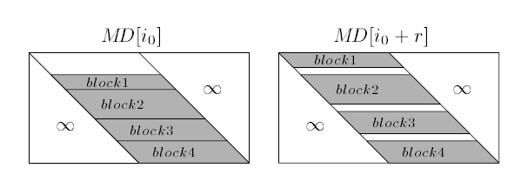
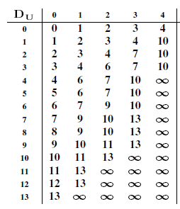

Redundancy Elimination by Exploring Similarities
(0,1,2,3,4)
(2,3,4,7,10)
Common is 2,3,4

Slide 22
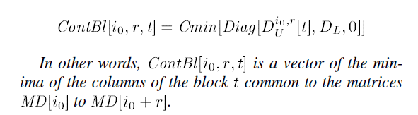
Redundancy Elimination by Exploring Similarities
M’個block
This indirect representation of the column minima can be queried in O(log m’) time for each element of ContBl[i₀, r, t].
O(m’log m’)

Slide 23
Complete Analysis of the Union Process
Redundancy Elimination :O(m log m)
(n+1)/(r+1) groups→ O(mn/r log m) = O(n√m log m)
P個processors → O(n√m log m/p)

Slide 24


Analysis of the CGM Algorithm
O(n√m’(1 + log m’/q))
m’= mq/2p
If p < √m processors , O(mn/p)

Slide 25
Conclusion
We present a parallel algorithm for ALCS on a coarse-grained multicomputer (BSP/CGM) model with p < √m processors that takes O(mn/p) time and O(n √m ) space per processor, with O(log p) communication rounds.
We thus conclude the main result of this paper which is a linear speedup BSP/CGM algorithm for the ALCS problem.

