Slide 1
Spider Monkey Optimization algorithm for numerical optimization
Bansal, Jagdish Chand, et al.
Memetic computing 6 (2014): 31-47.
Presenter : Jing-Xiang Yang
Date : May. 13, 2024

Slide 2
ABSTRACT
Swarm intelligence is one of the most promising area for the researchers in the field of numerical optimization. Researchers have developed many algorithms by simulating the swarming behavior of various creatures like ants, honey bees, fish, birds and the findings are very motivating. In this paper, a new approach for numerical optimization is proposed by modeling the foraging behavior of spider monkeys. Spider monkeys have been categorized as fission–fusion social structure based animals. The animals which follow fission– fusion social systems, split themselves from large to smaller groups and vice-versa based on the scarcity or availability of food. The proposed swarm intelligence approach is named as Spider Monkey Optimization (SMO) algorithm and can broadly be classified as an algorithm inspired by intelligent foraging behavior of fission–fusion social structure based animals.

Slide 3
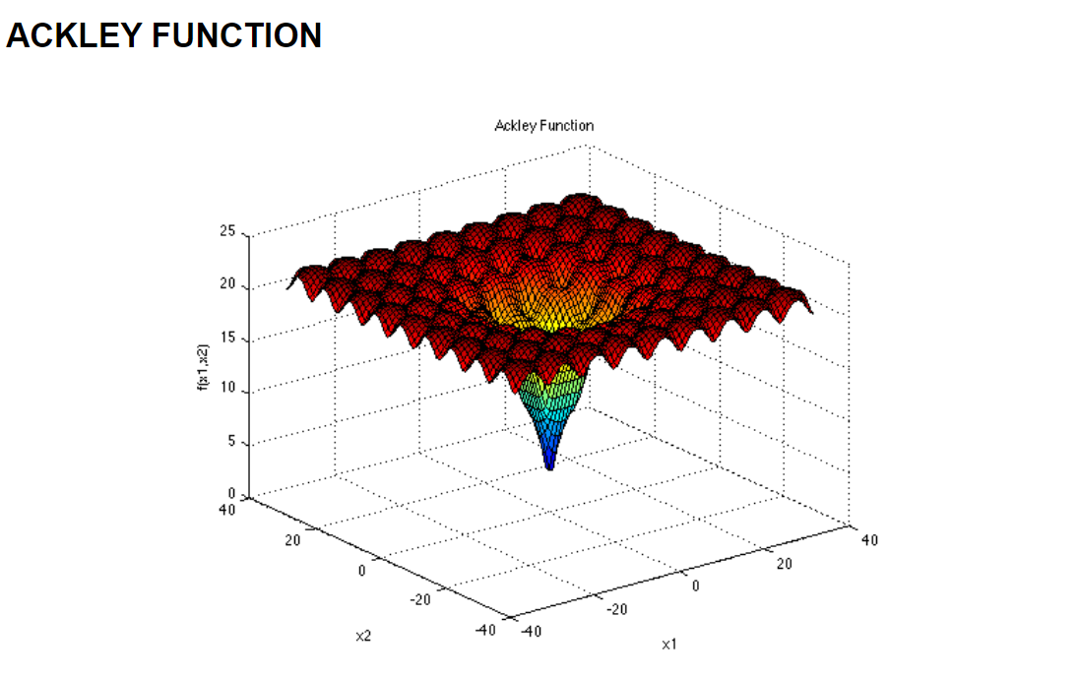
Numerical Optimization
Finding the minimum or maximum value of a certain objective function.

Slide 4
Spider Monkey Optimization algorithm
Based on the foraging behavior of spider monkeys
Spider Monkeys follow fission–fusion social system

Slide 5
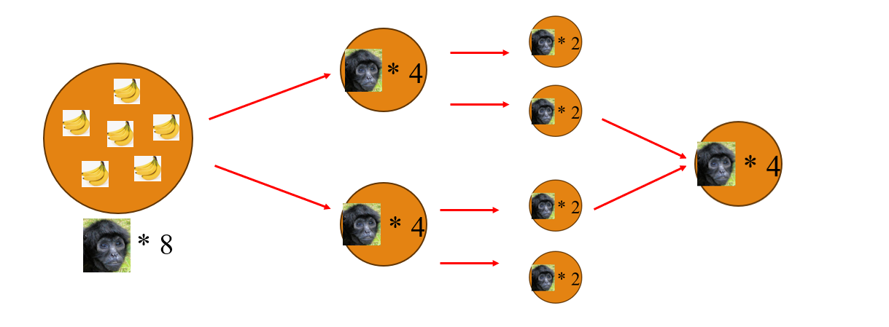
Fission–Fusion Social Structure (FFSS)
FFSS can minimize direct foraging competition among group members

Slide 6
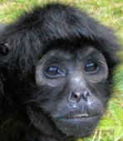
Some Terms
Fitness function evaluate the quality of candidate solutions
Exploration capacity to uncover the global optimum by probing unknown areas
Exploitation improving solutions by leveraging past successes.
(Local Leader ) : with best fitness value in local group
(Global Leader ) : with best fitness value in global group

Slide 7
Main steps of (SMO)
Local Leader phase (Exploitation)
Global Leader phase (Exploitation)
Local Leader Learning phase
Global Leader Learning phase
Local Leader Decision phase (Exploration)
Global Leader Decision phase (Exploration)

Slide 8
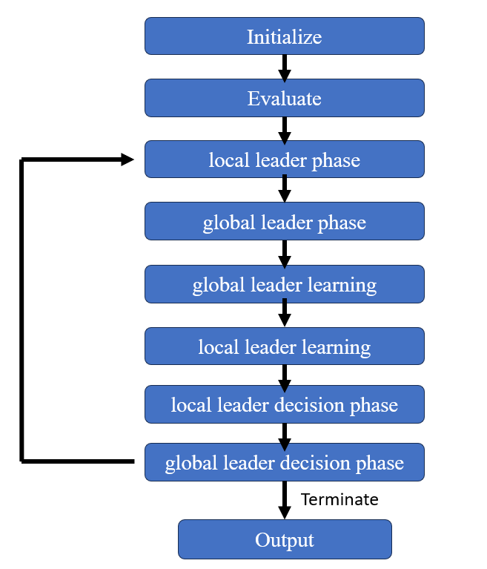

Slide 9
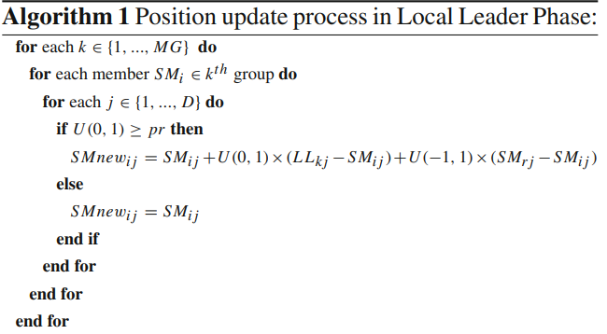
Local Leader phase
Update position based on local leader and group member experience

Slide 10
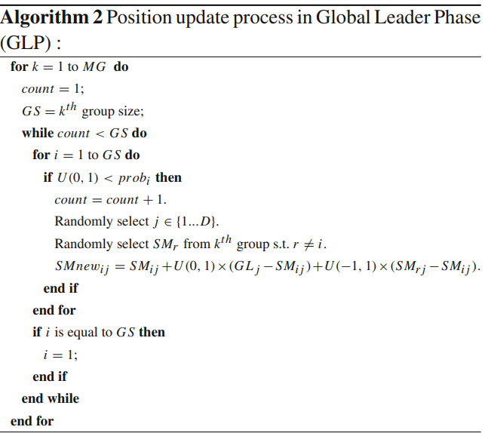
Global Leader phase
Update position based on global leader and group member experience

Slide 11
Local/Global Leader Learning phase
Update Leader position by applying the greedy selection in the population

Slide 12
Local Leader Decision phase
Local Leader position not update for a long time…
Group member update position by
Random
Attracted towards global leader and repel from the local leader

Slide 13
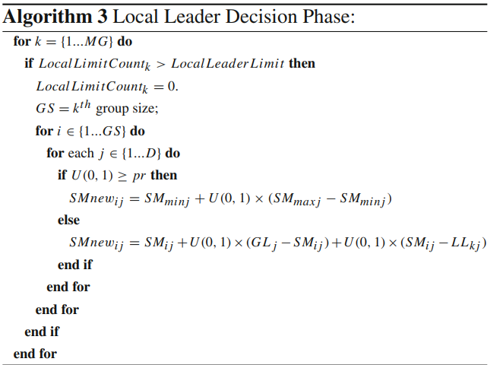

Slide 14
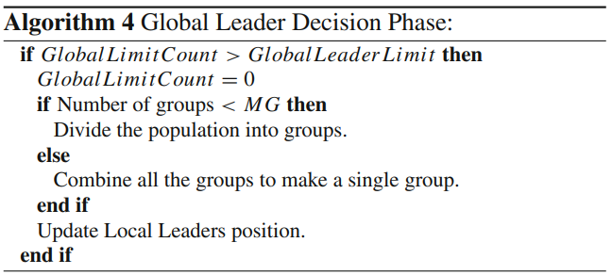
Global Leader Decision phase
Global Leader position not update for a long time…
Group member update position by
Divide the swarms into groups
Combine all the groups to make a single group

Slide 15
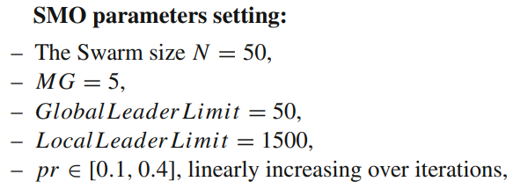
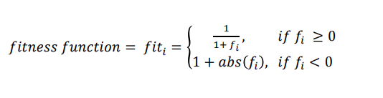
Experiments

Slide 16
Experiments
Use 26 different global optimization function
The number of simulations (or run) =100.
stopping criteria
Reach maximum number of function evaluations (2.0×105)
Reach corresponding acceptable error
Compare with ABC、DE、PSO、CMA-ES
Use standard deviation (SD)、mean error (ME)、average number of function evaluations (AFE)、success rate (SR)

Slide 17
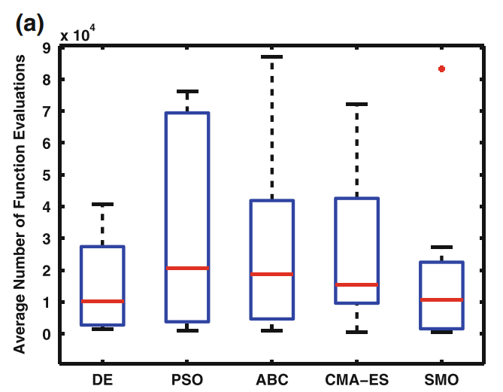
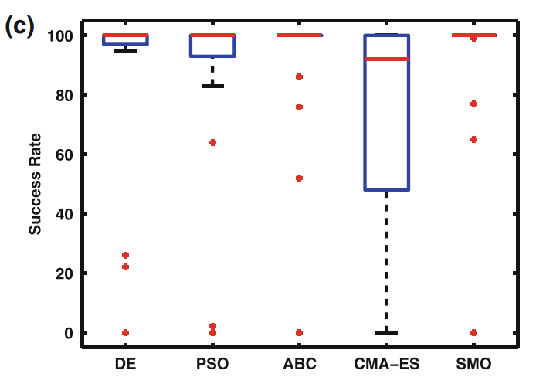
Experiments

Slide 18


Slide 19
Thanks

