Slide 1
Maximal common subsequence algorithms
Yoshifumi Sakai
Theoretical Computer Science 793 (2019) 132–139
Presenter: Wen-Yu Chang
Date: June 11, 2024

Slide 2
Abstract
A common subsequence of two strings is maximal if inserting any character into it no longer yields a common subsequence. The present article proposes a (sub)linearithmic-time, linear-space algorithm for finding a maximal common subsequence of two strings and a linear-time algorithm for determining if a common subsequence of two strings is maximal.

Slide 3

Maximal Common Subsequence
$X=abcde$
$Y=bcade$
LCS$=bcde$
MCS$=ade, bcde$

Slide 4
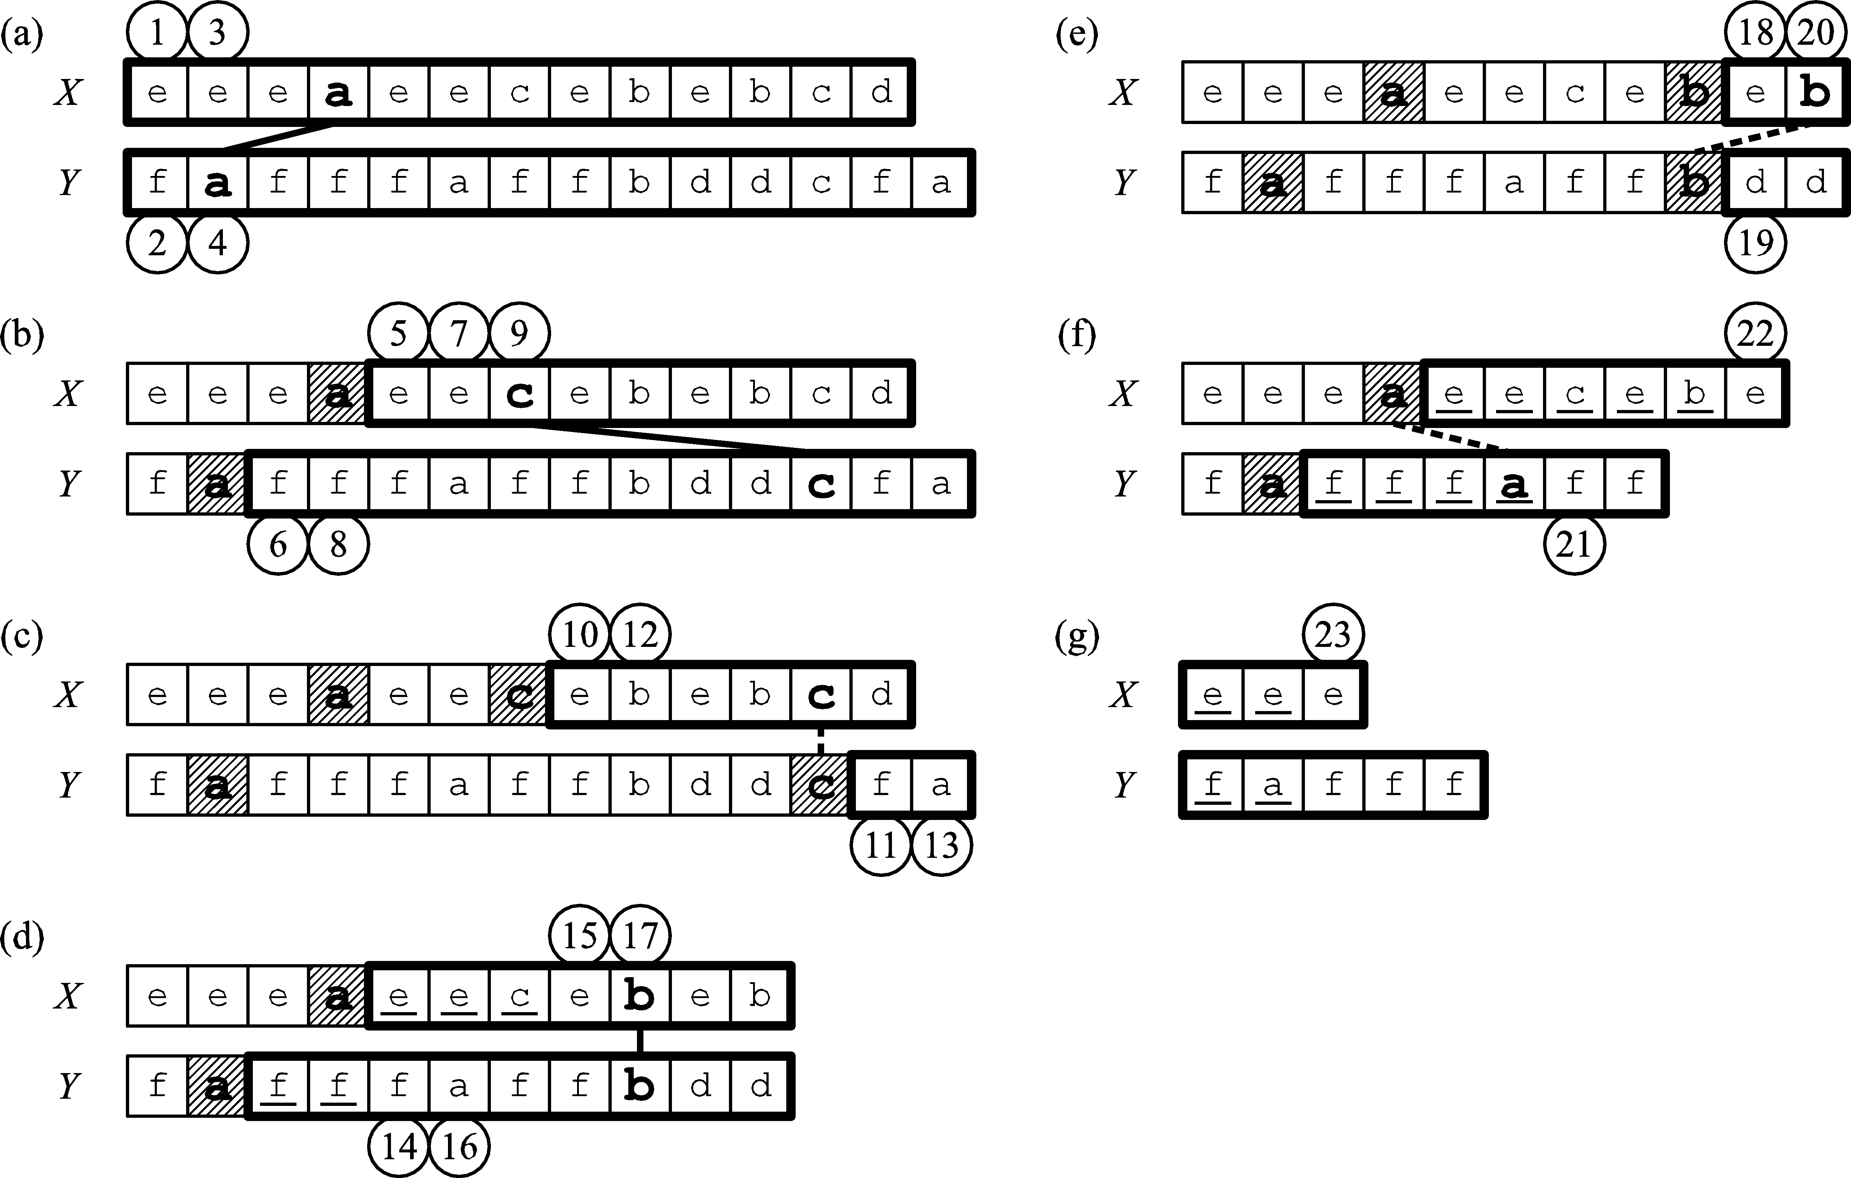
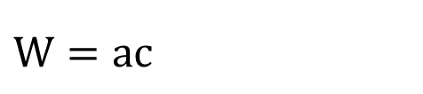
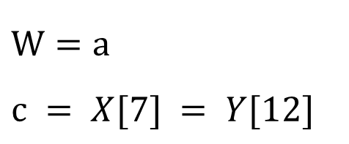
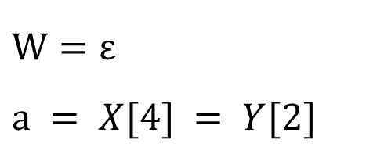
Finding an MCS
$$W=ε$$
$$a = X[4] = Y[2]$$
$$W=a$$
$$c = X[7] = Y[12]$$
$$W=ac$$

Slide 5
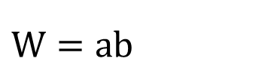
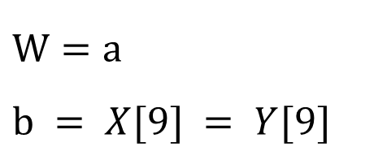
Finding an MCS
$$W=a$$
$$b = X[9] = Y[9]$$
$$W=ab$$

Slide 6
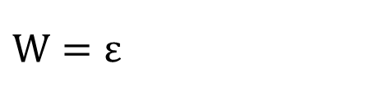
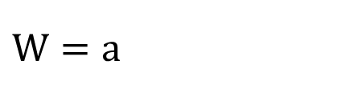
Finding an MCS
$$W=a$$
$$W=ε$$

Slide 7





Finding a constrained MCS
$P=ad$
1
$$X$$
e | e | e | a | e | e | c | e | b | e | b | d | b
$$Y$$
f | a | f | f | f | a | f | f | b | d | d | c | f | a
2
4
6
8
10
$$X$$
e | e | e | a | e | e | c | e | b | e | b
$$Y$$
f | a | f | f | f | a | f | f | b | d
3
5
7
9

Slide 8
Finding a constrained MCS
$P=ad$
11
$$X$$
e | e | e | a | e | e | c | e | b | e | b
$$Y$$
f | a | f | f | f | a | f | f | b | d
12
$$X$$
e | e | e | a | e | e | c | e | b | e
$$Y$$
f | a | f | f | f | a | f | f

Slide 9
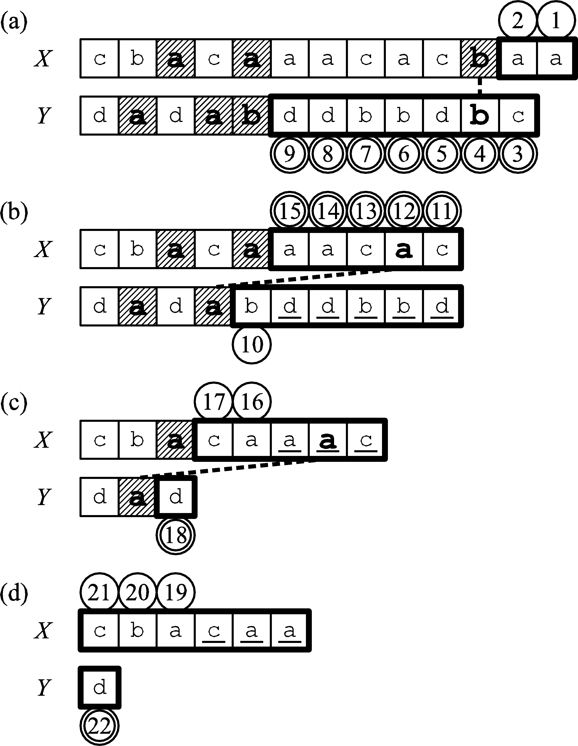

Determining MCS
$W=aab$

Slide 10
Determining MCS
$W=aab$

Slide 11

Time Complexity
Finding MCS & CMCS: O$(n\sqrt{\log{n}/\log{\log{n}}})$ (integer sorting)
Determining MCS: O$(n)$
$n=|X|+|Y|$

