Slide 1
DLCSS: Dynamic Longest Common Subsequences
Daniel Bogdoll, Jonas Rauch , and J. Marius Zollner
2022 International Conference on Electrical, Computer, Communications and Mechatronics Engineering (ICECCME), Maldives, Maldives, 2022, pp. 1-5, doi: 10.1109/ICECCME55909.2022.9988548.
Presenter: Shih-Hong Lee
Date: June 11, 2024

Slide 2
Abstract
Autonomous driving is a key technology towards a brighter, more sustainable future. To enable such a future, it is necessary to utilize autonomous vehicles in shared mobility models. However, to evaluate, whether two or more route requests have the potential for a shared ride, is a compute intensive task, if done by rerouting. In this work, we propose the Dynamic Longest Common Subsequences algorithm for fast and cost-efficient comparison of two routes for their compatibility, dynamically only incorporating parts of the routes which are suited for a shared trip. Based on this, one can also estimate, how many autonomous vehicles might be necessary to fulfill the local mobility demands. This can help providers to estimate the necessary fleet sizes, policymakers to better understand mobility patterns and cities to scale necessary infrastructure.

Slide 3
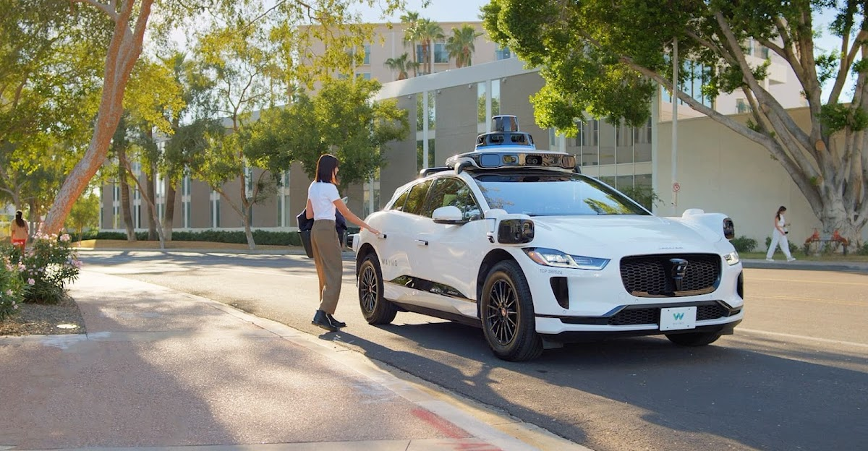
Autonomous vehicles
Notes:
https://waymo.com/intl/zh-tw/

Slide 4
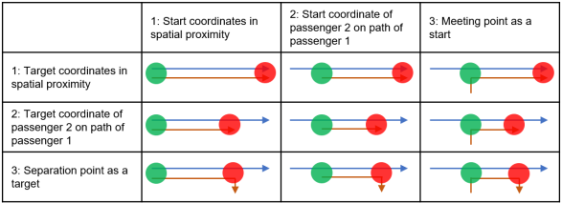
How two people can shared a ride?

Slide 5
Previous research
Only lead to usable results

Slide 6
Previous research
meeting points are considered, but only under the condition of pedestrian accessibility by passengers

Slide 7
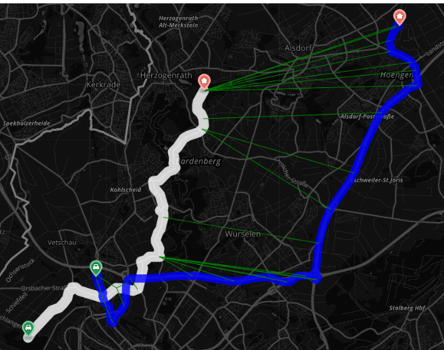
DLCSS
Given a route A from an autonomous vehicle and a requested route R from a potential second passenger, we want to rate the spatio-temporal similarity of the routes based on the partial overlap, but also the distance between these routes within the overlapping section

Slide 8
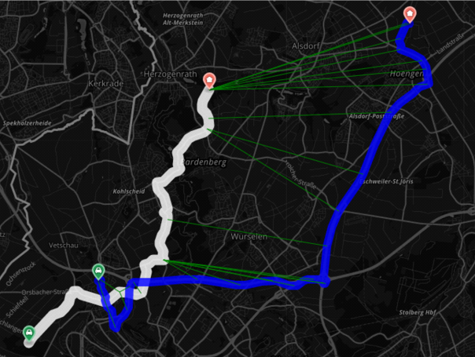
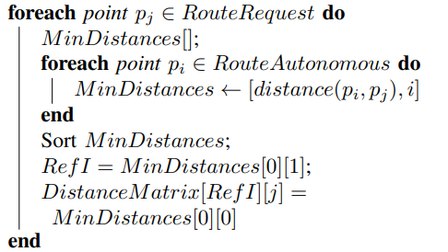
DLCSS
Step 1 :

Slide 9
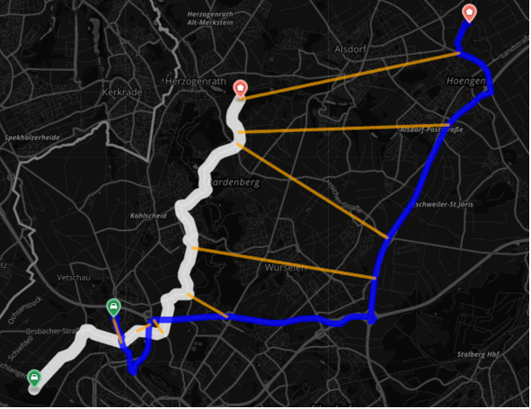
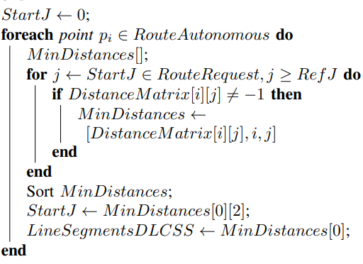
DLCSS
Step 2 :

Slide 10

Single similarity metric
Present the similarity of two route
suitable threshold = 20K
percentage overlap of the routes

Slide 11
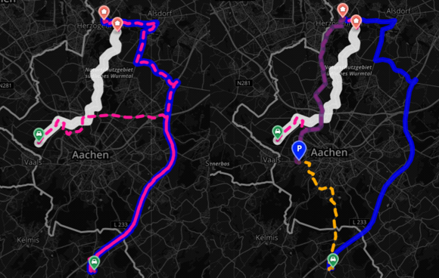
Application : Meeting point

Slide 12
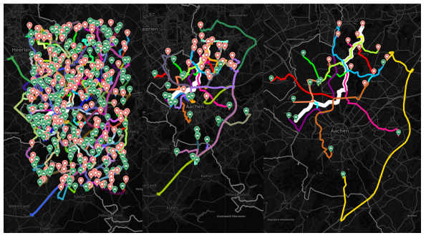
Exemplary results
The DLCSS algorithm reject 87.2% of the entries from the dataset
The comparison with the actual detour showed, that the results contained 47.82% true positives
routing-based comparisons need only to be made for 12.8% of the data

Slide 13
Conclusion
The Dynamic Longest Common Subsequences (DLCSS) algorithm is introduced, which is a dynamic, parameter-free improvement of the LCSS algorithm
Introduced the smDLCSS metric
Can help providers to estimate the necessary fleet sizes, policymakers to better understand mobility patterns and cities to scale necessary infrastructure
Notes:
第二步中，我們引入了smDLCSS度量，這是一種為一對路線分配數值，描述其相似性的方法。運營商可以使用所提出的算法和度量來改進其車隊運營，並作為進一步分析的起點。這可以幫助提供商估算所需的車隊規模，幫助政策制定者更好地理解出行模式，並幫助城市規模化必要的基礎設施

Slide 14
Thanks

