Slide 1
The Frobenius problems for Sexy Prime Triplets
WonTae Hwang, Kyunghwan Song
Int. J. Math. Comput. Sci, (2023), 18, 321-333.
Presenter: Hsin-Chang Yu
Date: June 11, 2024

Slide 2
Abstract
The greatest integer that does not belong to a numerical semigroup S is called the Frobenius number of S. The Frobenius problem, which is also called the coin problem or the money changing problem, is a mathematical problem of finding the Frobenius number. In this paper, we solve the Frobenius problem for sexy prime triplets.

Slide 3
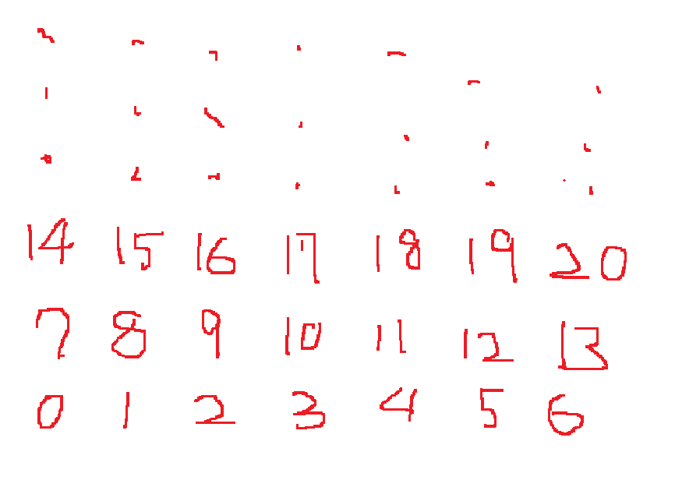
Frobenius problems(Frobenius coin problem)
Coins worth 3, 7 (∞ of them)
Combine 3’s and 7’s
Achievable
Not achievable

Slide 4
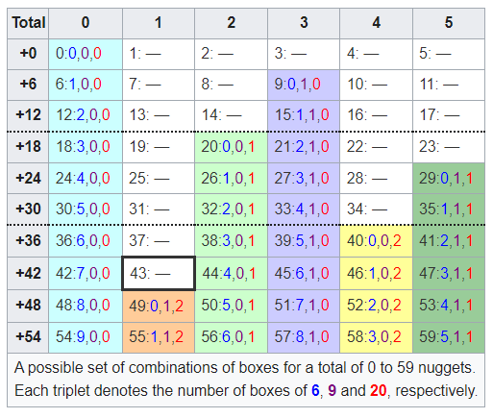

Frobenius problems
Chicken McNugget Theorem Introduced by Henri Picciotto

Slide 5
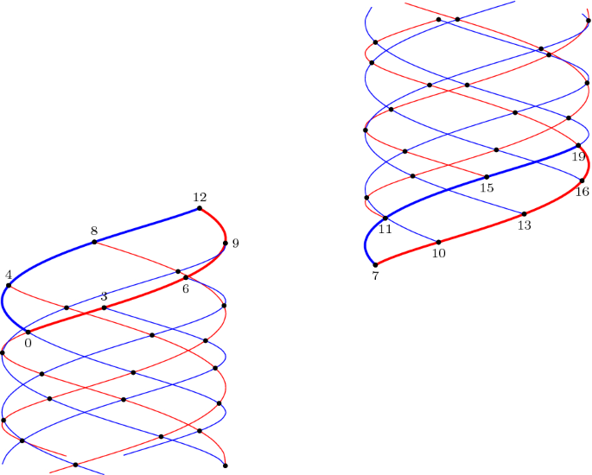
Frobenius problems
Ehrenborg, R. (2020). The Frobenius Coin Problem—A Cylindrical Approach. The Mathematical Intelligencer, 42(2), 78-79.

Slide 6
Sexy prime
In number theory, sexy primes are prime numbers that differ from each other by 6. For example, the numbers 5 and 11 are both sexy primes, because both are prime and 11 − 5 = 6.
(5,11), (7,13), (11,17), (13,19), (17,23), (23,29), (31,37), (37,43), (41,47), (47,53), (53,59), (61,67), (67,73), (73,79), (83,89), (97,103), (101,107), (103,109), (107,113), (131,137), (151,157), (157,163), (167,173), (173,179), (191,197), (193,199), (223,229), (227,233), (233,239), (251,257), (257,263), (263,269), (271,277), (277,283), (307,313), (311,317), (331,337), (347,353), (353,359), (367,373), (373,379), (383,389), (433,439), (443,449), (457,463), (461,467)

Slide 7
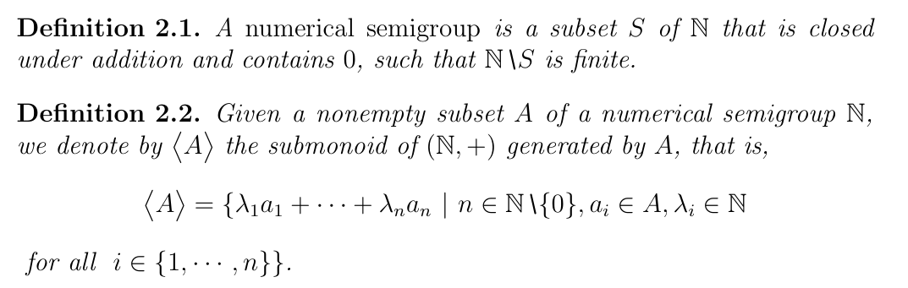
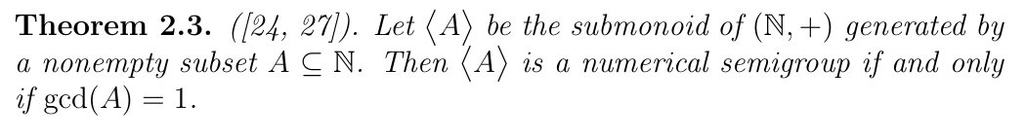
Definition

Slide 8
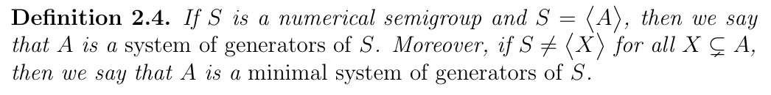
Definition

Slide 9
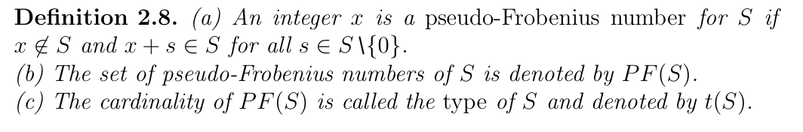
Definition

Slide 10
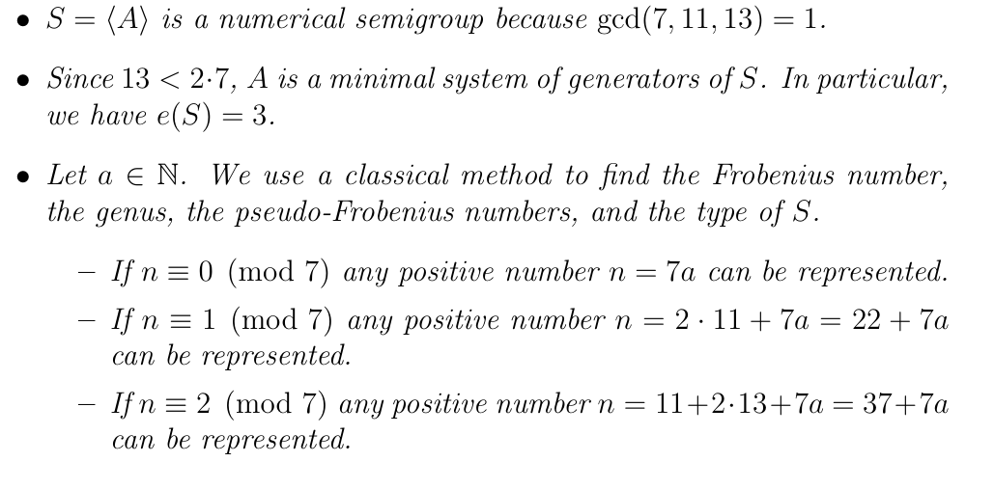
A = {7,11,13}

Slide 11
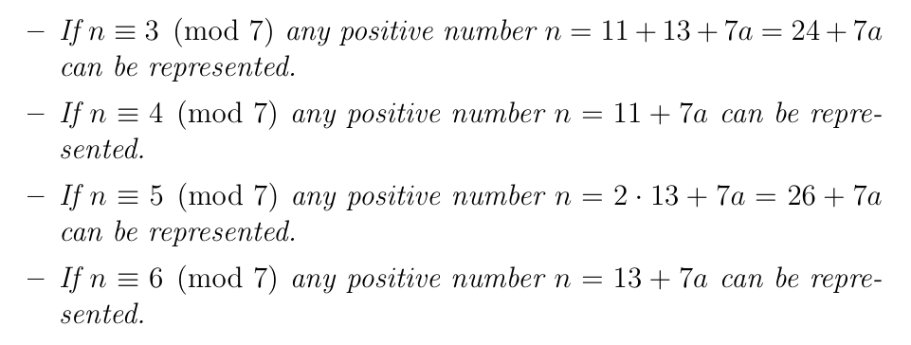
F(S) = 30
g(S) = 6 + 2 + 4 + 2 + 2 = 16, PF(S) = {15,30,19} and t(S) = 3

Slide 12
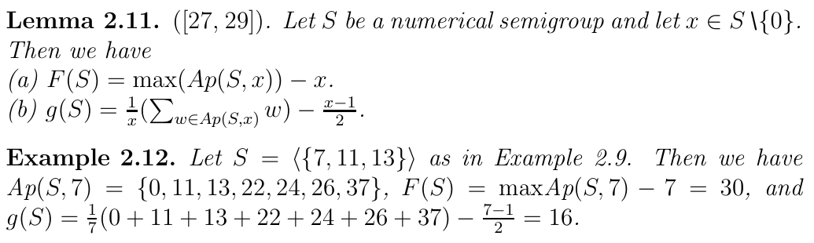
Definition

Slide 13
Sexy prime triplets
(p,p + 6,p + 12)
let p = 60k + α. p+6 = 60k+(α+6), p+12 = 60k+(α+12)
gcd(60,α + 6) ≠ 1, gcd(60,α + 12) ≠ 1
gcd(30,α + 6) ≠ 1, gcd(30,α + 12) ≠ 1

Slide 14
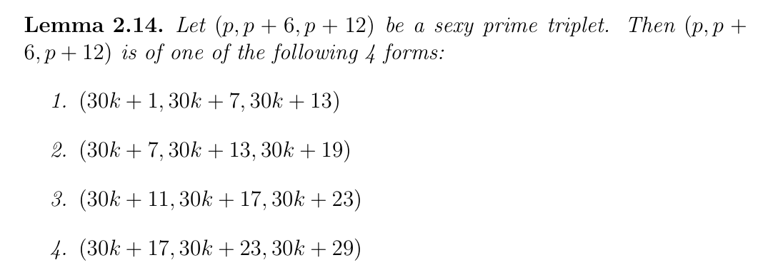
Sexy prime triplets

Slide 15

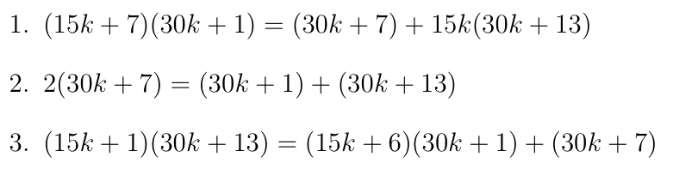
Results

Slide 16
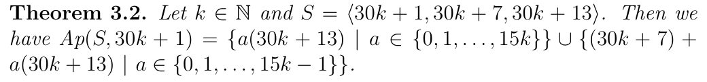
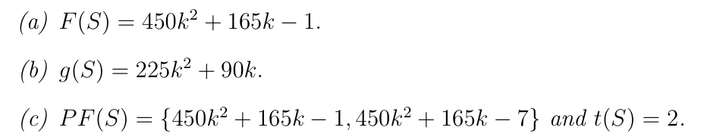
Results

Slide 17

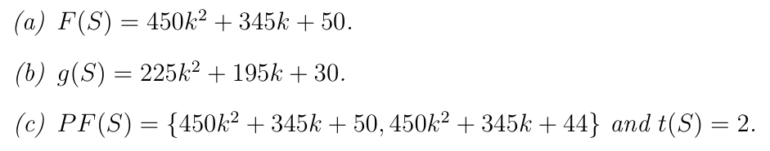
Results

Slide 18

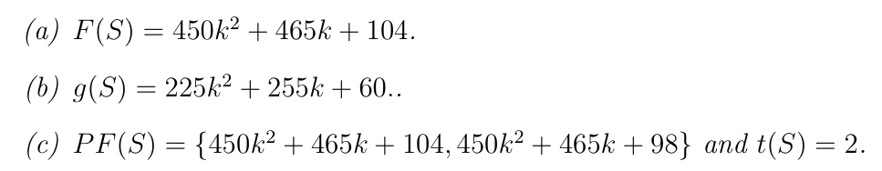
Results

Slide 19

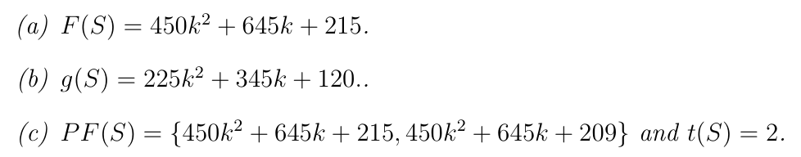
Results

Slide 20
Thanks
Notes:
Given a string S of length n, an integer p ∈ [1..n] is a period of S if S[i] = S[i + p] for all i ∈ [1..n − p].
S[|S| − p + 1] = c

