Slide 1
Solving shortest common supersequence problem using chemical reaction optimization
C.M. Khaled Saifullah and Md. Rafiqul Islam
2016 5th International Conference on Informatics, Electronics and Vision (ICIEV), Dhaka, Bangladesh
Presenter: Wen-Yu Chang
Date: May 20, 2024

Slide 2
Abstract
The Shortest Common Supersequence problem is an NP-hard optimization problem that has a vast use in real world problems. It is used in data compression and different bio-informatics analysis. Different types of approaches were used to solve this problem. Exact algorithms failed to compute for large instances whereas approximation algorithms lack optimality. In this paper, we propose a meta-heuristic approach named as Chemical Reaction Optimization Algorithm (CRO-SCS) to solve the Shortest Common Supersequence (SCS) Problem. The experimental results demonstrate that our proposed method takes less time to find SCS than dynamic programming and have better performance than other well-known approximation algorithms.

Slide 3
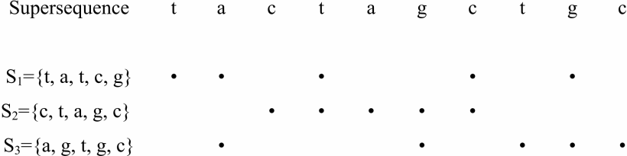
Shortest Common Supersequence

Slide 4
Dynamic Programming
 |  | t | a | t | c | g
 | 0 | 0 | 0 | 0 | 0 | 0
c | 0 | 0 | 0 | 0 | 1 | 0
t | 0 | 1 | 0 | 1 | 1 | 1
a | 0 | 1 | 2 | 2 | 2 | 2
g | 0 | 1 | 2 | 2 | 2 | 3
c | 0 | 1 | 2 | 2 | 3 | 3
The shortest common supersequence is ctatcgc.

Slide 5
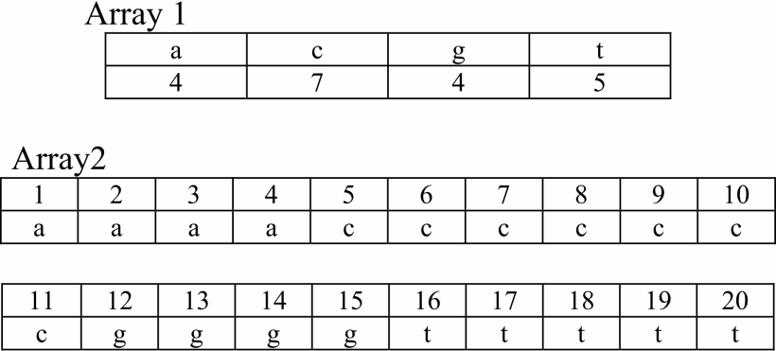

Population Generation
$L=\left\{acctg, cttcg, acact, gtgca\right\}$
$∑=\left\{a, c, g, t\right\}=\{0, 1, 2, 3\}$
Notes:
the symbols from Array 2 are randomly selected to create the population.

Slide 6
Population Generation
The symbols from Array 2 are randomly selected to create the population.
Frequency of the symbols will be considered.
Pop= {acctacgatacg, catctgacgtag,…..}
Notes:
the symbols from Array 2 are randomly selected to create the population.

Slide 7
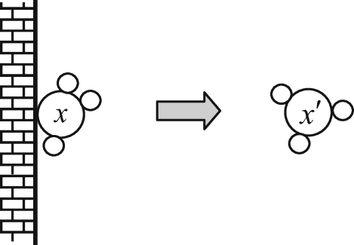
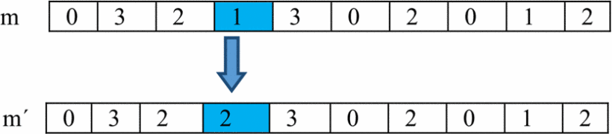
Reaction Operators
On-Wall Ineffective Collision
Using evolutionary algorithm mutation operator
Notes:
A position i in solution m will be chosen and a small value is added or subtracted from the value
A small value will be chosen randomly.

Slide 8
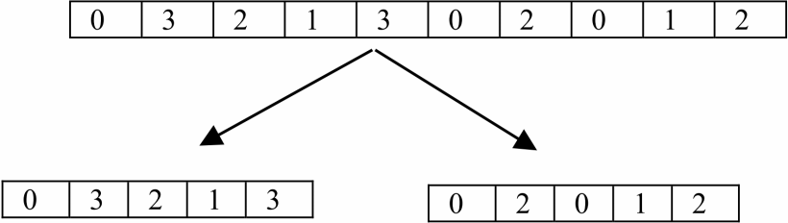
Reaction Operators
Decomposition
Dividing a solution m into two solutions

Slide 9
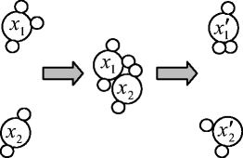
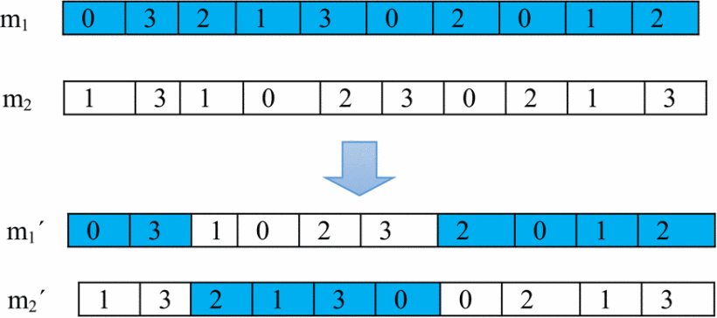

Reaction Operators
Inter-Molecular Ineffective Collision
Taking two solutions $m_{1}$ and $m_{2}$ randomly from the pop
Using two point crossover operators commonly used in the genetic algorithm

Slide 10
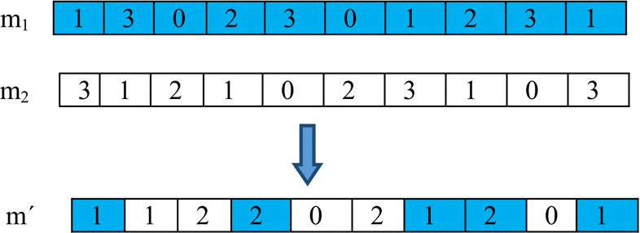

Reaction Operators
Synthesis
Combining two molecules into one solution
Taking one random variable from 0 to 1 to decide to choose the symbol from $m_{1}$ or $m_{2}$

Slide 11
CRO for SCS Problem
Reform Function: the newly formed solution is checked with every string in the set of strings.
Termination Condition: after a particular computation time, the algorithm will be terminated.
Parameter Settings

Slide 12
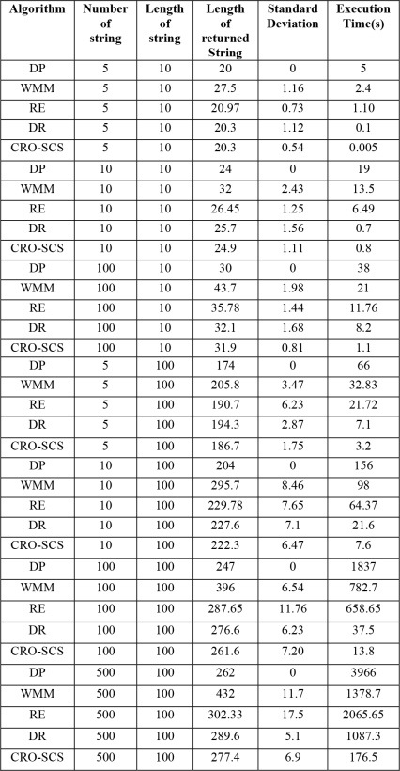
Experimental Result

