Slide 1
Fiboquadratic numbers and Rithmomachia
Tomás Guardia, Douglas Jiménez, Alexander McCurdy
Recreational Mathematics Magazine, (2024), 11(18), 51-64.
Presenter: Hsin-Chang Yu
Date: May 20, 2024

Slide 2
Abstract
This paper shows our discovery of the fiboquadratic numbers, quadratic Fibonacci numbers in rithmomachia. This board game consists in performing mathematical operations to attack an opponent through geometric numbered pieces. We will show that the numbers on the board pieces are the first terms of six sequences that we will define through a recursive pattern of superpartients.

Slide 3
Abstract
We then prove that this extension is the solution of a recurrence relation with initial conditions, and therefore, is unique. The fiboquadratic numbers we introduce in this work are not limited to the context of this board. In general, we can generate any fiboquadratic sequence with arbitrary initial conditions.

Slide 4
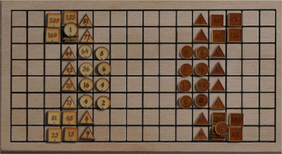
Rithmomachia
It was created in the late 10th or early 11th century.

Slide 5
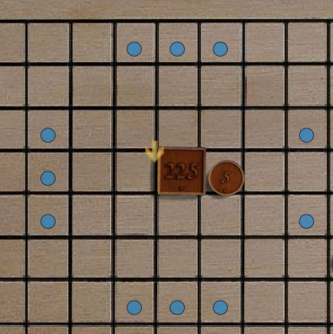
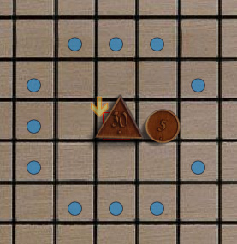
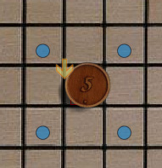
Movement

Slide 6
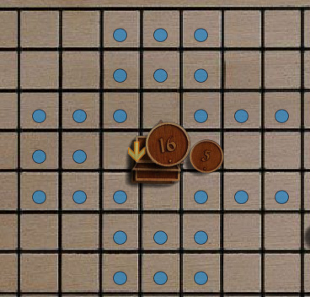
Movement

Slide 7
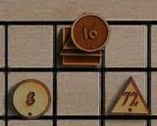
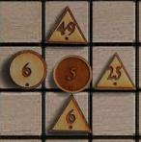
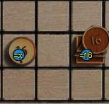
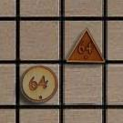
Capturing
Capture by Siege
Capture by Equality

Slide 8

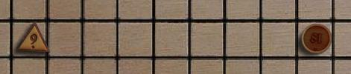
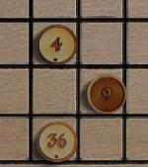
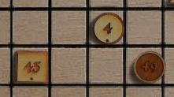
Capturing
Capture by Eruption
Capture by Ambush

Slide 9
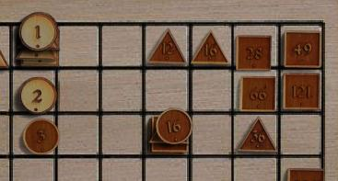
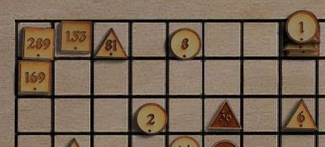
Glorious victories
all three pieces (A,B,C) are on the opponent's side of the board
they form an unobstructed evenly spaced horizontal or vertical line or a triangle.
the values of the pieces form an arithmetic, geometric, or harmonic progression
arithmetic progression, (B-A) = (C-B) examples: 2,4,6 9,81,153
geometric progression, (A*C) = (B*B) examples: 2,4,8 20,30,45
harmonic progression, ((A+C)*B) = (A*C*2) examples: 2,3,6 30,45,90

Slide 10
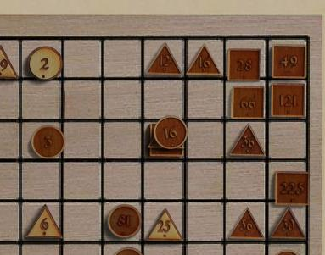
Glorious victories
arithmetic progression, (B-A) = (C-B) examples: 2,4,6 9,81,153
geometric progression, (A*C) = (B*B) examples: 2,4,8 20,30,45
harmonic progression, ((A+C)*B) = (A*C*2) examples: 2,3,6 30,45,90

Slide 11
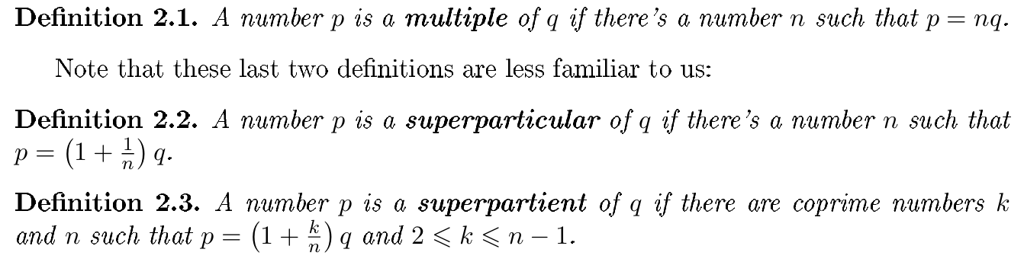
Greek number theory

Slide 12
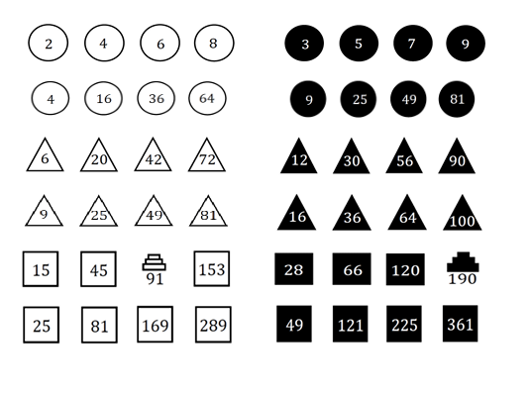
Greek number theory

Slide 13
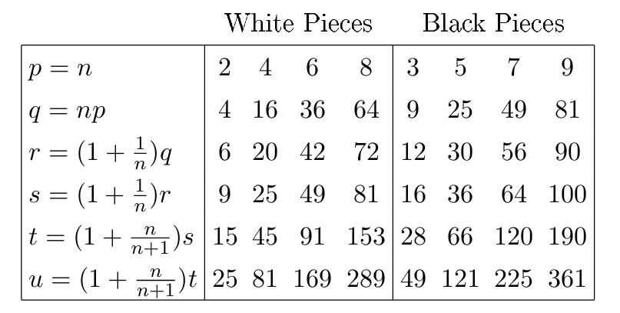
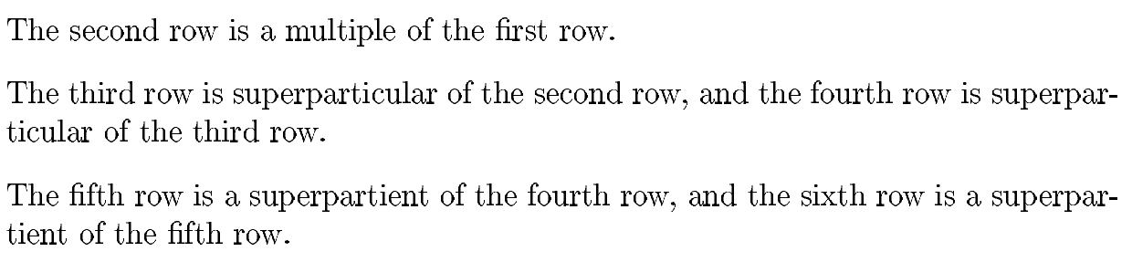
Greek number theory

Slide 14
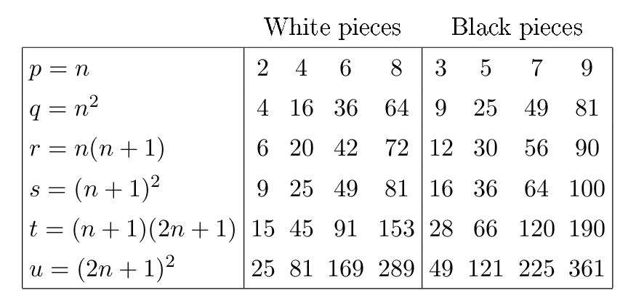
Greek number theory

Slide 15
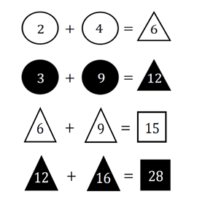
Fibonacci

Slide 16
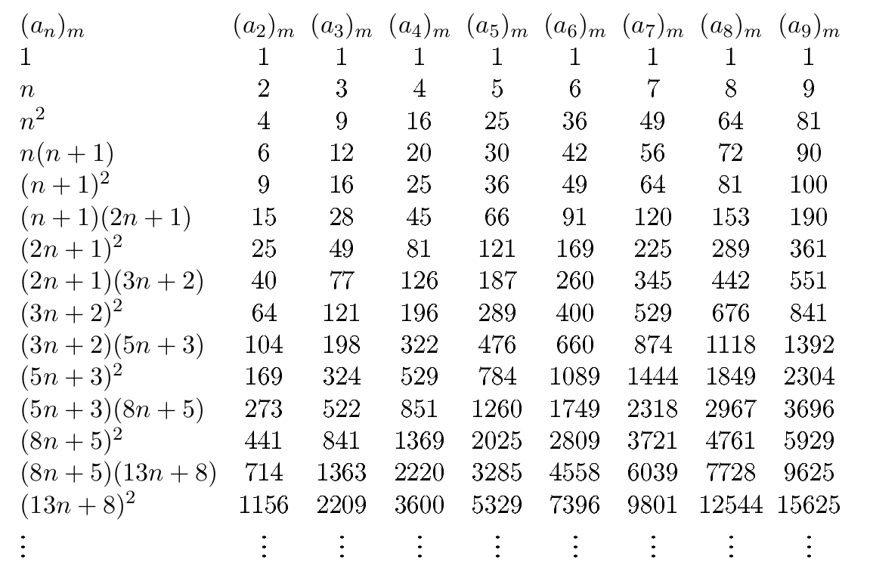
Fiboquadratic sequences

Slide 17
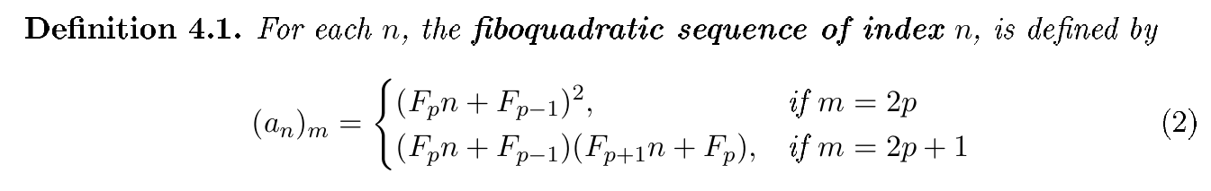
Fiboquadratic sequences

Slide 18
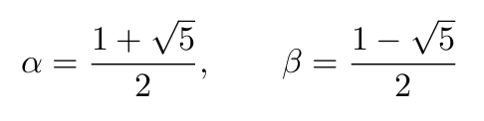
Fiboquadratic sequences

Slide 19
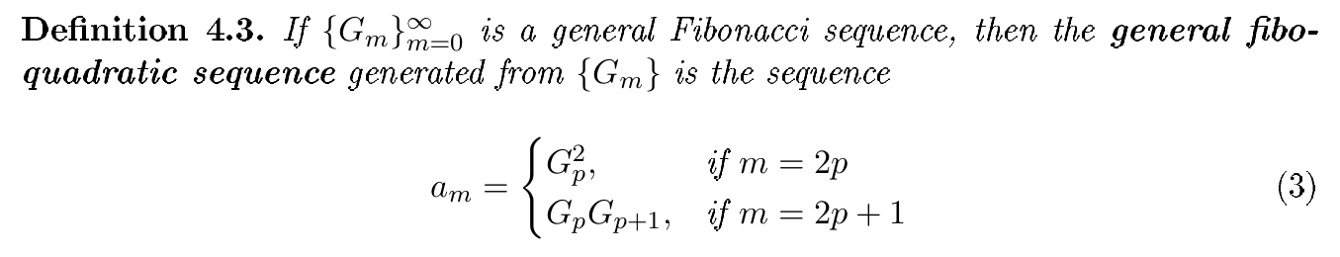
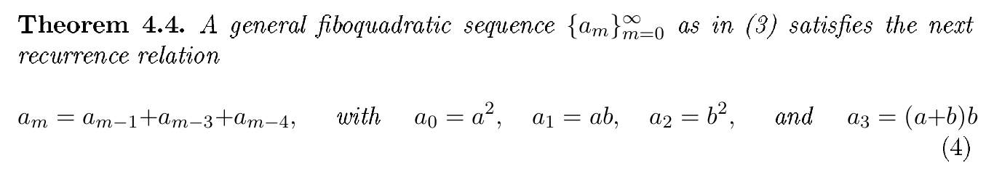
Fiboquadratic sequences

Slide 20
Thanks
Notes:
Given a string S of length n, an integer p ∈ [1..n] is a period of S if S[i] = S[i + p] for all i ∈ [1..n − p].
S[|S| − p + 1] = c

