Slide 1
The GOOGLE FILE SYSTEM
Sanjay Ghemawat, Howard Gobioff, Shun-Tak Leung.
Proceedings of the Nineteenth ACM Symposium on Operating Systems Principles. 2003.
Presenter: Yen-Yu Chen
Date: June 4, 2024

Slide 2
Contents
Introduction
Design
System Interactions
Master Operation
Fault Tolerance and Diagnosis
Measurements
Conclusions

Slide 3
1. Introduction

Slide 4
Background
Previous Distributed File System
Performance
Scalability
Reliability
Availability

Slide 5
Different points in the design space
Component failures are the norm rather than the exception.
Data store as huge file
Files are huge by traditional standards.
Most files are mutated by appending new data.
Sustained bandwidth more critical than low latency.
Notes:
GFS和傳統分散式系統不一樣的地方
發生錯誤是正常的
2. 資料是用大檔案來儲存的， 檔案比傳統檔案大
3. 檔案只會被附加在後面
4. 大bandwidth比低延遲重要
主要是因為要處理big data

Slide 6
2. Design

Slide 7
Interface
Familiar Interface
create
delete
open
close
read
write
Moreover
Snapshot
Atomic Record append

Slide 8
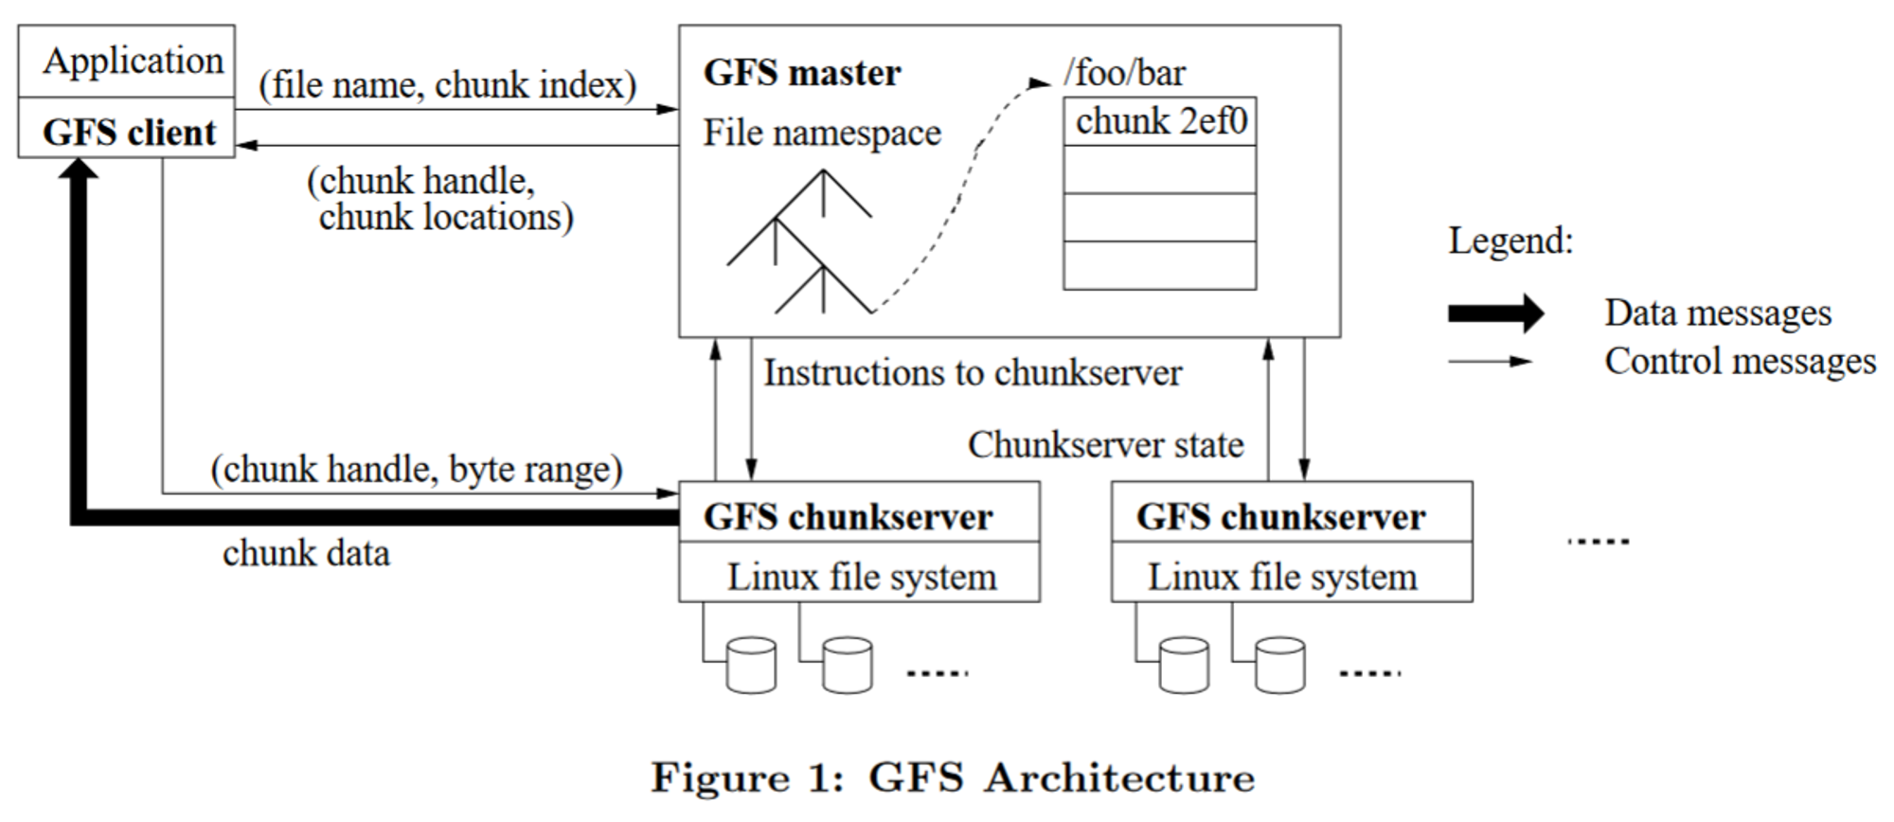
Architecture

Slide 9
Architecture
Chunk
Files are divided into fixed-size chunk
64MB
Larger than typical file system block sizes
Advantages from large chunk size
Reduce interaction between client and master
Client can perform many operations on a given chunk
Reduce size of metadata stored on the master

Slide 10
GFS chunkservers
Store chunks on local disks as Linux files
Read/Write chunk data specified by a chunk handle & byte range

Slide 11
GFS master
Maintains all file system metadata in memory
Namespace
Access-control information
Chunk locations
Lease management

Slide 12
GFS client
Linked into each application
Implements the file system API
Communicates with the master & chunkservers

Slide 13
Process(Read)
Notes:
粗的箭頭是read操作

Slide 14
Process
Metadata only
Data only
Notes:
Metadata的任何變動都會被記錄到log裡永久保存
Metadata存在memory

Slide 15
3. System Interactions

Slide 16
Lease
Objective
Minimize load on master
Master grants lease to one replica
Called primary chunkserver
Notes:
當client要對data進行操作將一群chunkserver租給client使用
Primary是這些chunkserver的leader
Client和 primary溝通

Slide 17
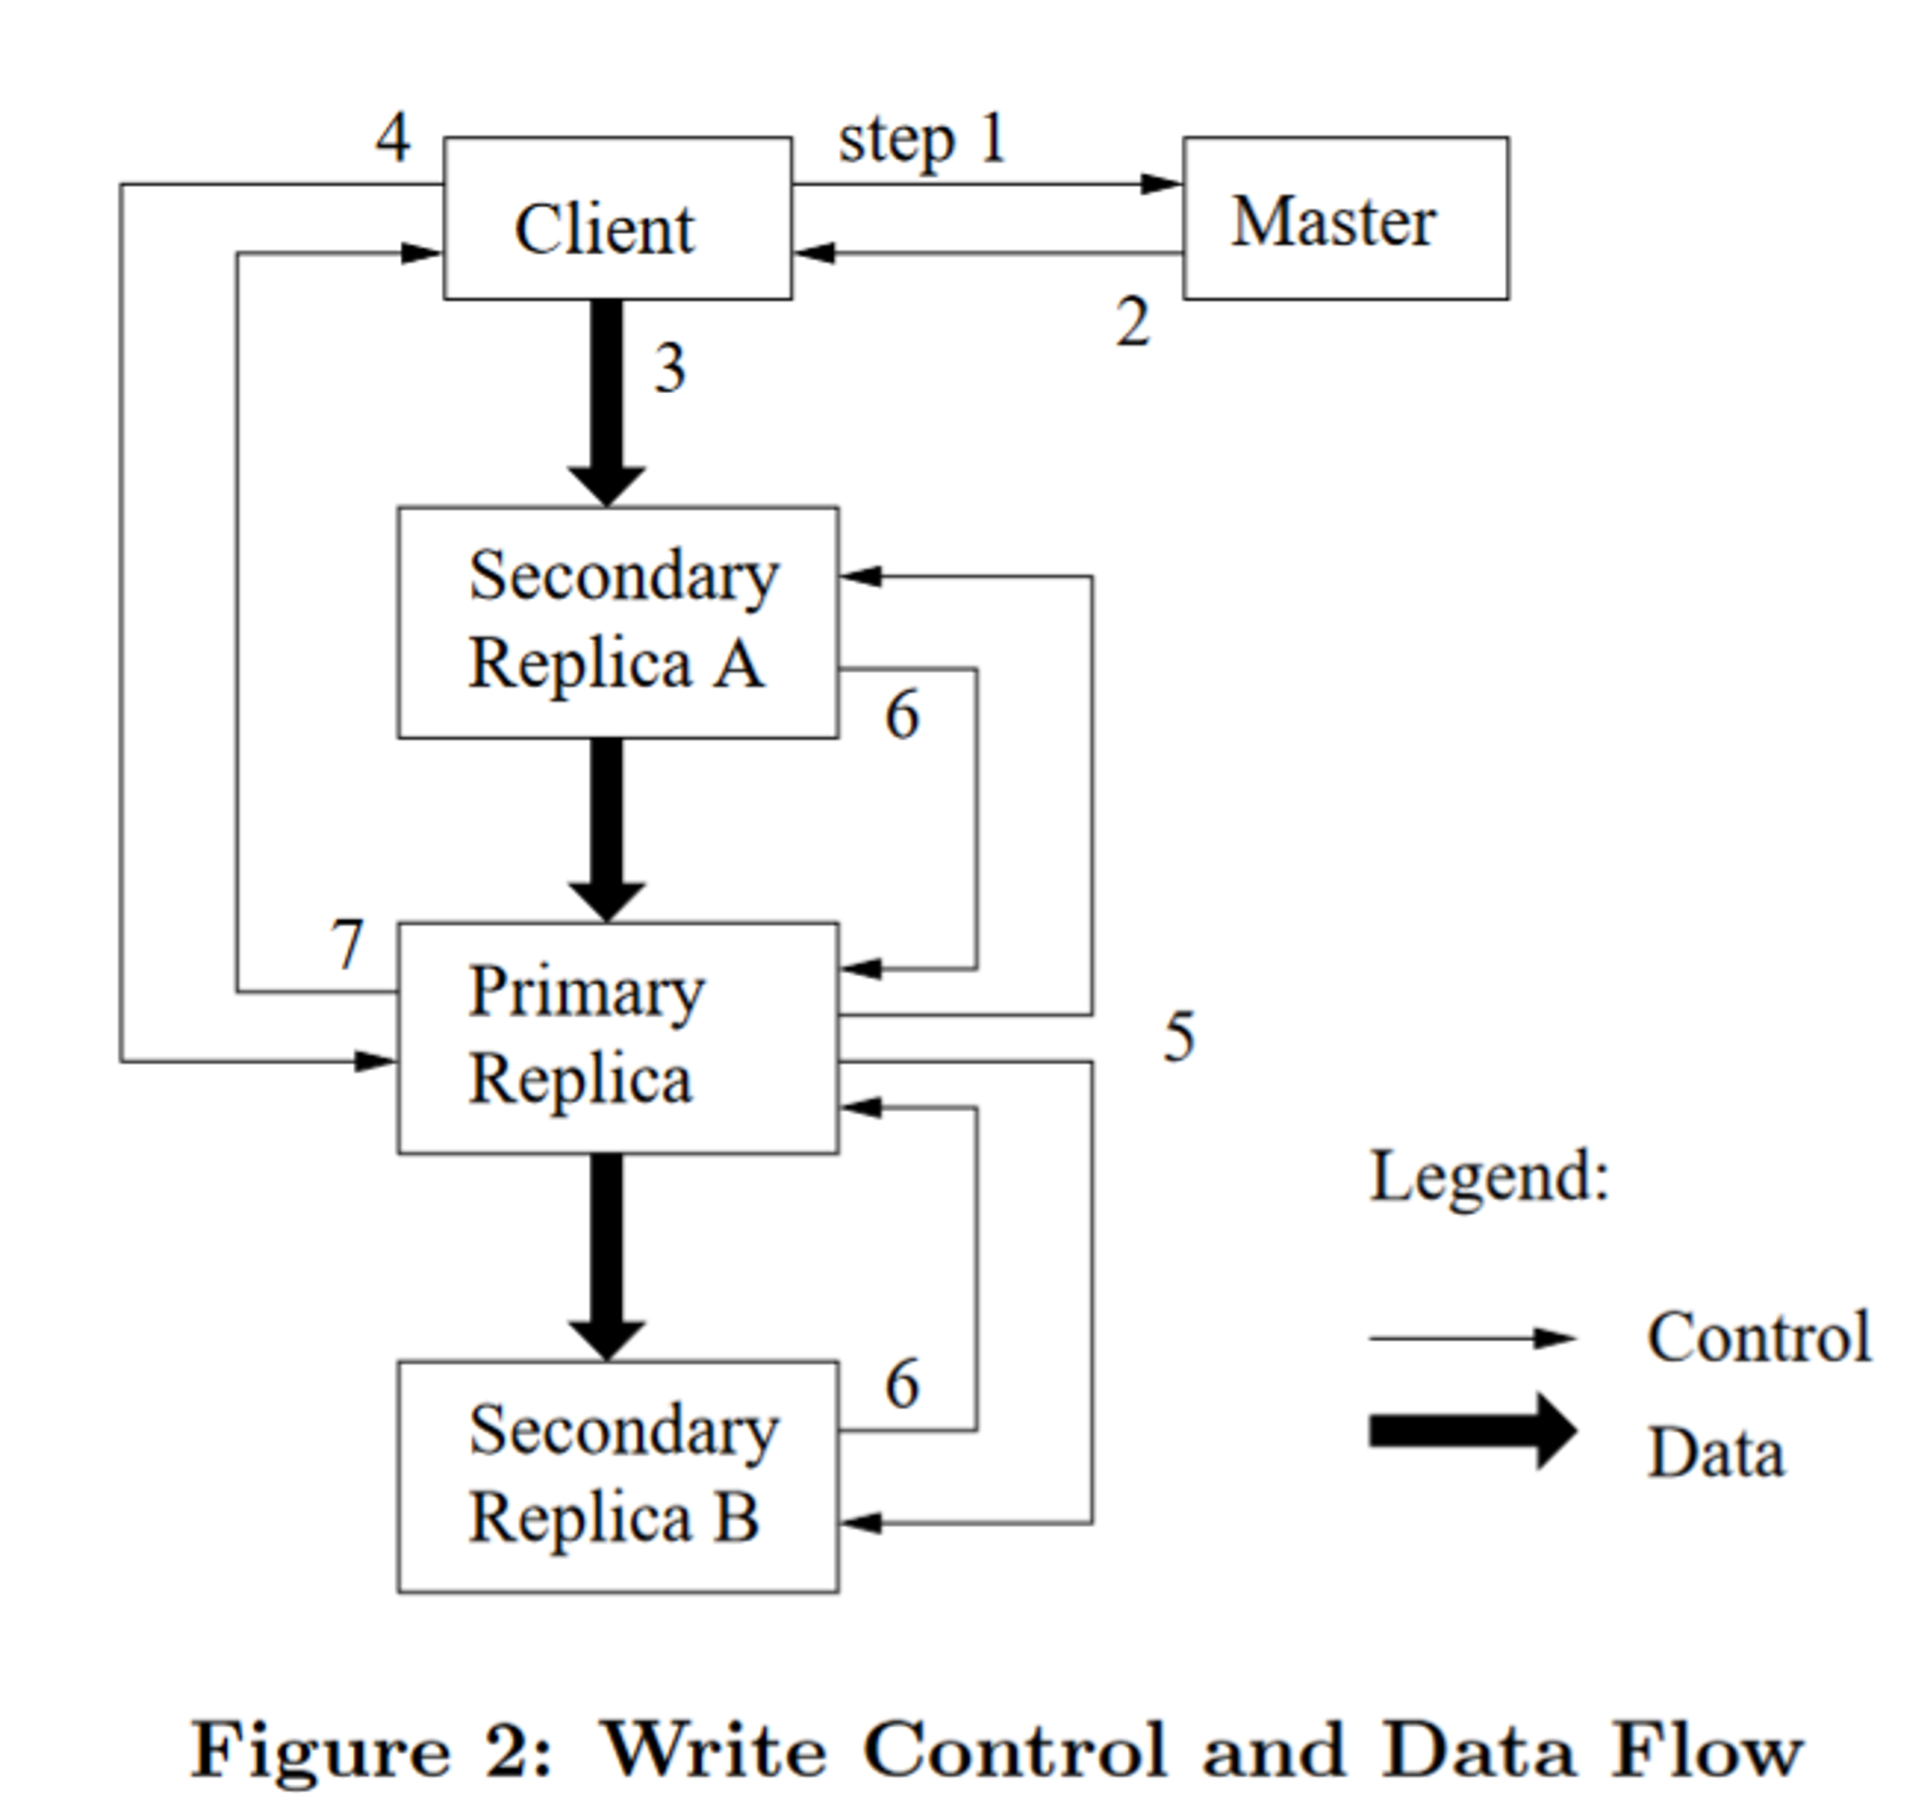
Dataflow
Write step

Slide 18
Atomic Appends
GFS appends data to the file at least once atomically
append
data
data
data

Slide 19
Atomic Appends
GFS appends data to the file at least once atomically
data
append
data
append
data
append

Slide 20
Atomic Appends
GFS appends data to the file at least once atomically
data
append
append
data
append
append
data
append

Slide 21
Snapshot
Goals
To quickly create branch copies of huge data sets
To easily checkpoint the current state
Copy-on-write technique
Metadata for the source file or directory tree is duplicated
Reference count for chunks are incremented
Chunks are copied later at the first write

Slide 22
4. Master Operation

Slide 23
Namespace Management and Locking
Notes:
Namespace tree 可以鎖定某個branch

Slide 24
Creation, Re-replication, Rebalancing
Replicate chunks that do not have a sufficient number of copies.
Prioritize replicating frequently accessed chunks.
Prioritize replicating chunks that have become bottlenecks.
Notes:
複製副本數量不夠的chunk
優先複製常用到的chunk
優先複製成為瓶頸的chunk

Slide 25
Garbage Collection
Deleted files
File is renamed to a hidden name, then may be removed later
Orphaned chunks(unreachable chunks)

Slide 26
5. Fault Tolerance and Diagnosis
Notes:
容錯與診斷

Slide 27
High Availability
Fast Recovery
Operation log and checkpoints
Chunk Replication
Master Replication
Notes:
影子master
Master邏輯上只有一個，但是可以有備份

Slide 28
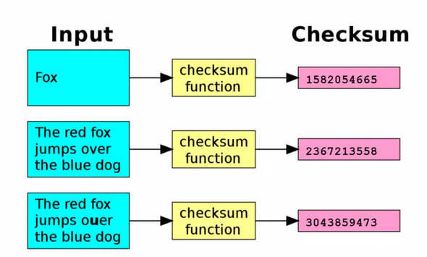
Data Integrity

Slide 29
Diagnostic
Log record all operation on metadata

Slide 30
6. Measurements
Notes:
容錯與診斷

Slide 31
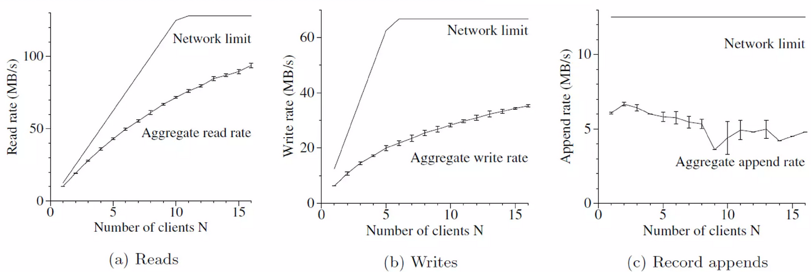

Slide 32
7. Conclusions

Slide 33
Advantages
Divide the file into chunks for storage, which can be accessed concurrently and have high throughput.
Separate control flow and data flow when modifying data, making full use of the bandwidth of each machine
Use lease to reduce master workload
Good fault tolerance
Notes:
花了很多心思讓client跟master溝通的時間變少

Slide 34
Disadvantages
There is only one master. If there is too much metadata, there may not be enough memory.
If the number of clients is large, the load on one master will be too large.
It is too inefficient for the master to perform garbage collection by browsing all chunks.
The consistency is too loose and cannot handle tasks that require high consistency
Notes:
Metadata佔太多memory
只有一個master負擔太大
garbage回收沒效率
一致性太差

