Slide 1
Ageist Spider Monkey Optimization algorithm
Sharma, A., Sharma, A., Panigrahi, B. K., Kiran, D., & Kumar, R. (2016). Swarm and Evolutionary Computation, 28, 58-77.
Presenter : Jing-Xiang Yang
Date : Jun 4, 2024

Slide 2
ABSTRACT
Swarm Intelligence (SI) is quite popular in the field of numerical optimization and has enormous scope for research. A number of algorithms based on decentralized and self-organized swarm behavior of natural as well as artificial systems have been proposed and developed in last few years. Spider Monkey Optimization (SMO) algorithm, inspired by the intelligent behavior of spider monkeys, is one such recently proposed algorithm. The algorithm along with some of its variants has proved to be very successful and efficient. A spider monkey group consists of members from every age group. The agility and swiftness of the spider monkeys differ on the basis of their age groups. This paper proposes a new variant of SMO algorithm termed as Ageist Spider Monkey Optimization (ASMO) algorithm which seems more practical in biological terms and works on the basis of age difference present in spider monkey population. Experiments on different benchmark functions with different parameters and settings have been carried out and the variant with the best suited settings is proposed. This variant of SMO has enhanced the performance of its original version. Also, ASMO has performed better in comparison to some of the recent advanced algorithms.

Slide 3
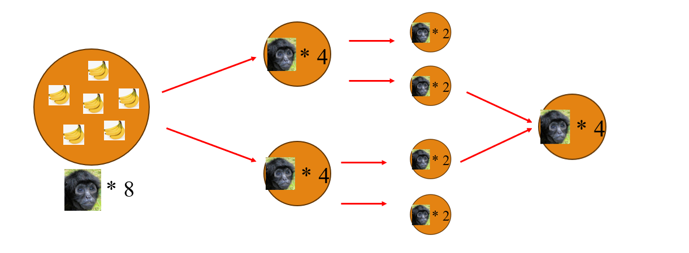
Fission–Fusion Social Structure (FFSS)
FFSS can minimize direct foraging competition among group members

Slide 4
Main steps of (SMO)
Local Leader phase (Exploitation)
Global Leader phase (Exploitation)
Local Leader Learning phase
Global Leader Learning phase
Local Leader Decision phase (Exploration)
Global Leader Decision phase (Exploration)

Slide 5
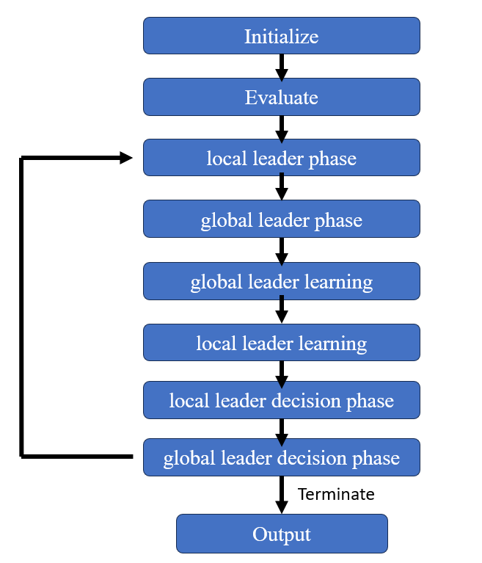

Slide 6
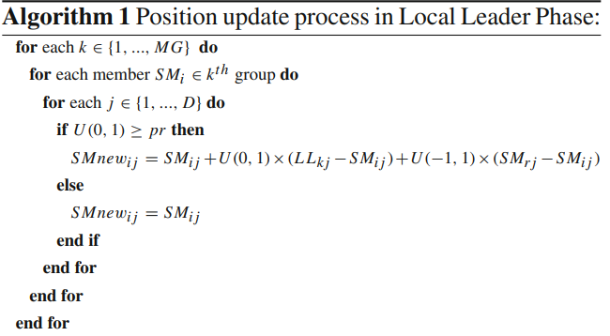
Local Leader phase
Update position based on local leader and group member experience

Slide 7
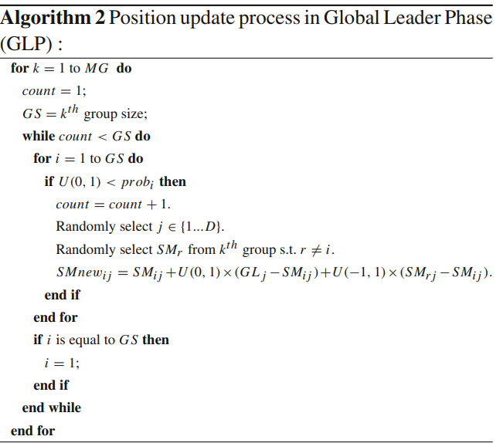
Global Leader phase
Update position based on global leader and group member experience

Slide 8
Local/Global Leader Learning phase
Update Leader position by applying the greedy selection in the population

Slide 9
Local Leader Decision phase
Local Leader position not update for a long time…
Group member update position by
Random
Attracted towards global leader and repel from the local leader

Slide 10
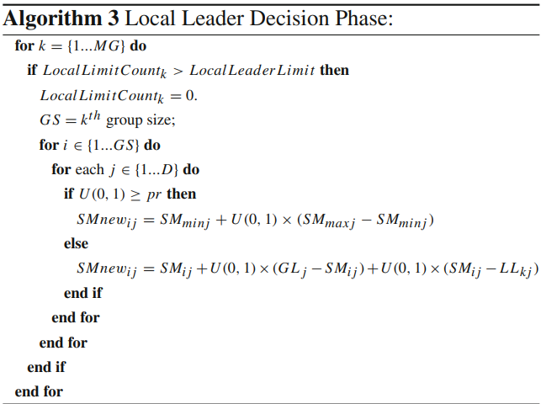

Slide 11
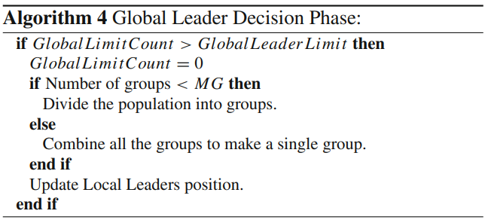
Global Leader Decision phase
Global Leader position not update for a long time…
Group member update position by
Divide the swarms into groups
Combine all the groups to make a single group

Slide 12

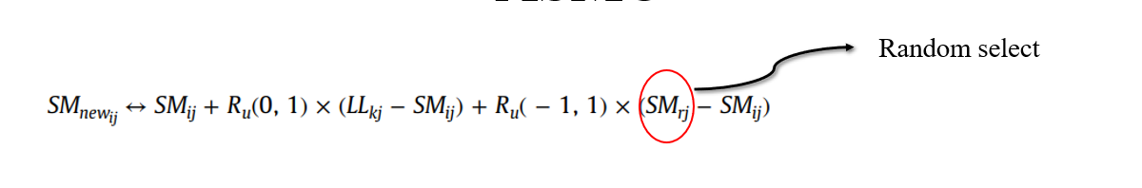
ASMO
position of each spider monkey is updated depending upon the position of another randomly selected spider monkey in LLP and GLP
irrespective of whether the position of randomly selected monkey is better or not

Slide 13
ASMO
Split local group based on fitness values. (young, adult, old)
2. Let the young monkey update first, followed by the adult, and so on...
Old monkeys are more easily abstracted by young ones.

Slide 14
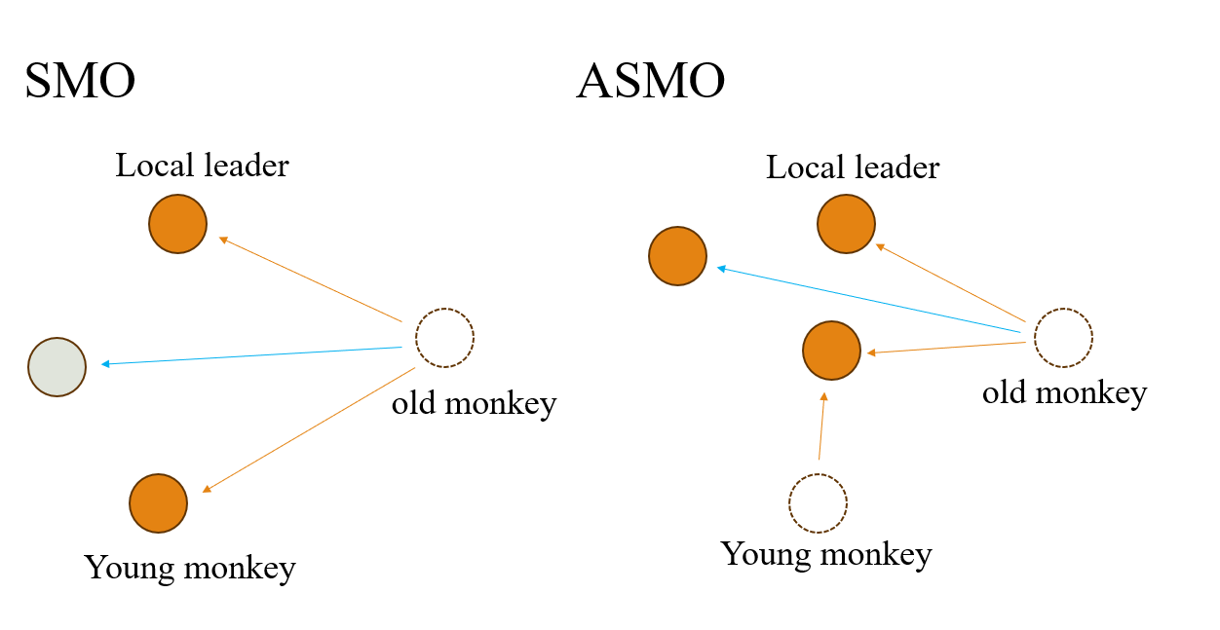

Slide 15
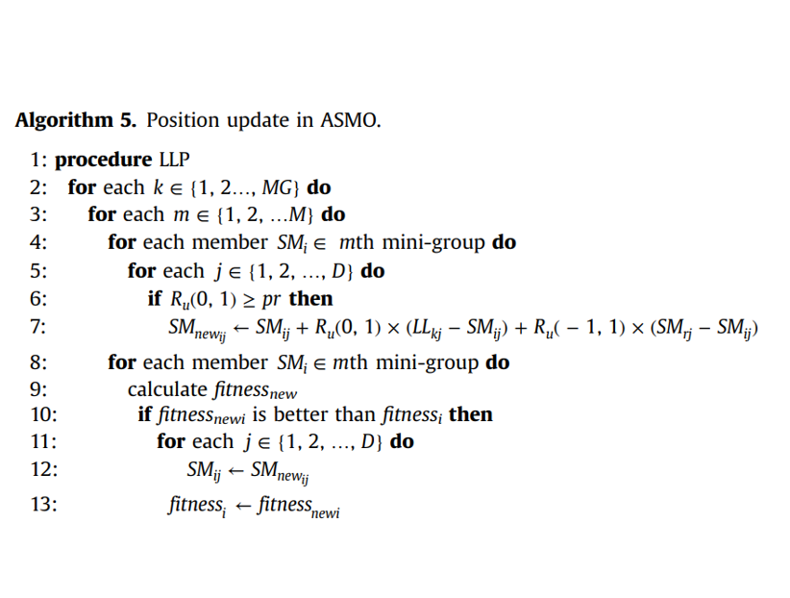
Thanks

Slide 16
Experiments
Use 30 different global optimization function
average error (AE)、average number of function evaluations (AFE)、success rate (SR)
Original SMO
ASMO with M = 4 and ASMO with M = 8
AMSMO with M = 4 and AMSMO with M = 8.

Slide 17
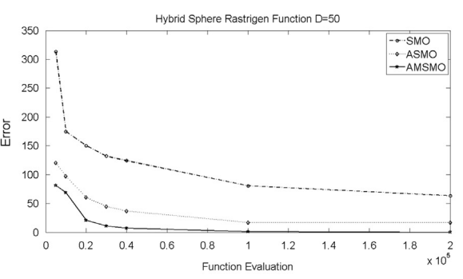
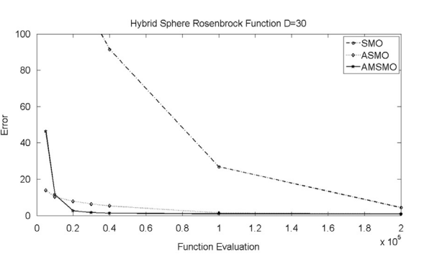

Slide 18
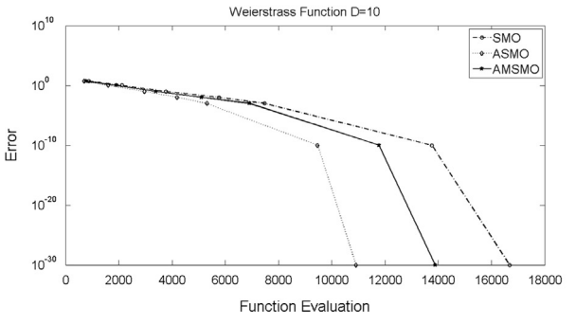
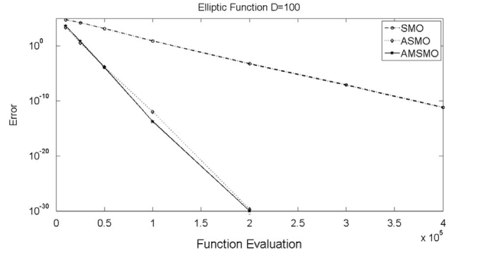

Slide 19
Thanks

