Slide 1
Using multi-data hidden Markov models trained on local neighborhoods of protein structure to predict residue–residue contacts
Patrik Bjorkholm, Pawel Daniluk, Andriy Kryshtafovych, Krzysztof Fidelis, Robin Andersson and Torgeir R. Hvidsten
BIOINFORMATICS, Vol. 25, pp. 1264–1270, 2009
Presenter: Dong-Jian Lin
Date: Oct. 12, 2010

Slide 2
Abstract
Motivation: Correct prediction of residue–residue contacts
in proteins that lack good templates with known structure
would take ab initio （重頭起算法）protein structure
prediction a large step forward. The lack of correct contacts,
and in particular long-range contacts, is considered the
main reason why these methods often fail.

Slide 3
Abstract
Results: We propose a novel hidden Markov model
(HMM)- based method for predicting residue–residue
contacts from protein sequences using as training data
homologous sequences, predicted secondary structure
and a library of local neighborhoods (local descriptors of
protein structure). The library consists of recurring
structural entities incorporating short-, medium- and long-
range interactions and is general enough to reassemble the
cores of nearly all proteins in the PDB. The method is
tested on an external test set of 606 domains with no
significant sequence similarity to the training set as well as
151 domains with SCOP folds not present in the domains

Slide 4
Abstract
with SCOP folds not present in the training set. Considering
the top 0.2 ·L predictions (L = sequence length), our HMMs
obtained an accuracy of 22.8% for long-range interactions
in new fold targets, and an average accuracy of 28.6% for
long-, medium- and short-range contacts. This is a
significant performance increase over currently available
methods when comparing against results published in the
literature.

Slide 5
Definition of Contacts
In this article, we define two residues to be in contact if the
distance between their CB atoms (CA for glycine residues)
is <8 Å.
We divide the contacts into short-, medium- and long-
ranges, which correspond to the sequence separation
equal to 6–11, 12–24 and >24.

Slide 6
Methods: Hidden Markov models
Example:
states = ('Rainy', 'Sunny')
observations = ('walk', 'shop', 'clean')
start_probability = {'Rainy': 0.6, 'Sunny': 0.4}
transition_probability = {
'Rainy' : {'Rainy': 0.7,'Sunny': 0.3},
'Sunny' : {'Rainy': 0.4, 'Sunny': 0.6}, }
emission_probability = {
'Rainy' : {'walk': 0.1, 'shop': 0.4, 'clean': 0.5},
'Sunny' : {'walk': 0.6, 'shop': 0.3, 'clean': 0.1}, }

Slide 7
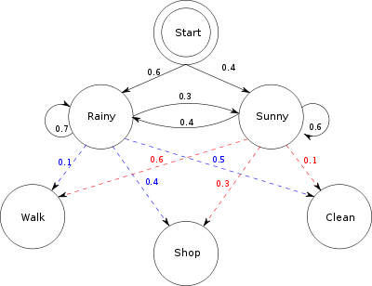

Slide 8
Training Set
The local descriptors of protein structure extracted
from a set of 4013 structures in the ASTRAL release 1.63
Secondary structure predicted using PSI-PRED from
database (NR).
Homology information obtained from running PSI-BLAST
from database (NR).

Slide 9
Test Set
The test set was identified by blasting all sequences in
ASTRAL releases 1.69 and retaining all domains with a
BLAST E-score >0.05.

Slide 10
Local descriptors of protein structure
Local descriptors of protein structure are a recent
development for describing reoccurring 3D substructures in
proteins.
Substructures are composed of all segments of the amino
acid backbone chain that are in proximity to each other in
space but not necessarily along the amino acid sequence.

Slide 11
Local descriptors of protein structure
All local substructures in the training set were organized
into a library consisting of 7151 representative groups of
structurally similar local descriptors.
The local descriptors that are of interest to this study are
those that are composed of three or more segments and
thus contain a number of contacts between different parts
of the protein.

Slide 12
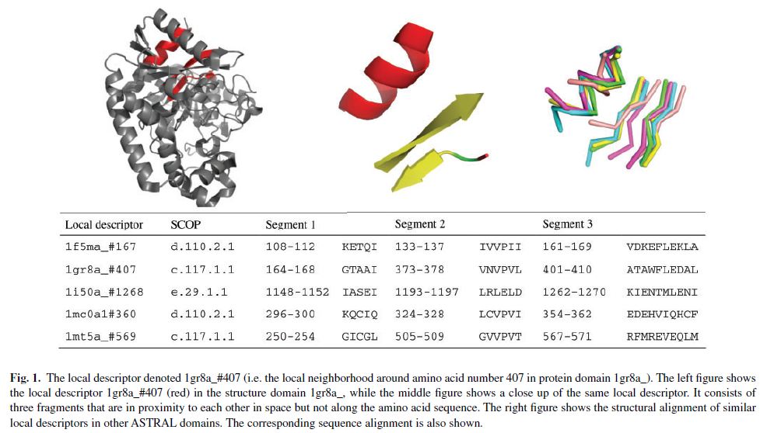

Slide 13
Hidden Markov models
states : match states (M), insert states (I), and delete
states (D_{B},D_{E})
observations : the observed sequence O = {O_{a}, O_{s} }
transition_probability : transition matrix T
emission_probability : emission matrix E_{a} and E_{s}
*Emission probabilities e_{n,m} for each observable amino acid
or secondary structure m in every state n.

Slide 14
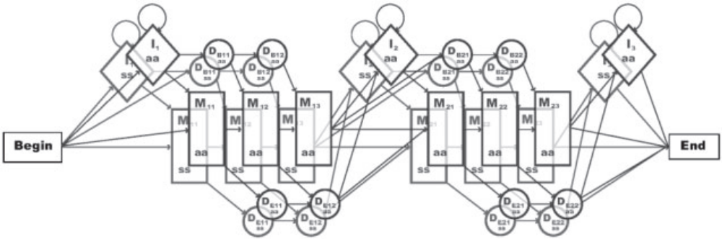
Hidden Markov models

Slide 15
Hidden Markov models
In this article, profile HMMs are used to recognize and align
local descriptors in target sequences.
Given a target sequence and an HMM trained to recognize
a specific local substructure, the Viterbi algorithm gives
both the most probable position of the backbone fragments
of that local substructure on the sequence (i.e. the
alignment) and the corresponding probability of the
alignment.

Slide 16
Predicting contacts
Contact predictions were obtained by matching all HMMs to
the target, and accepting the ones with a score higher than
the associated threshold.
In this study, contacts from the central local descriptor of
each group were transferred, and only contacts between
residues located in different backbone fragments were
considered.

Slide 17
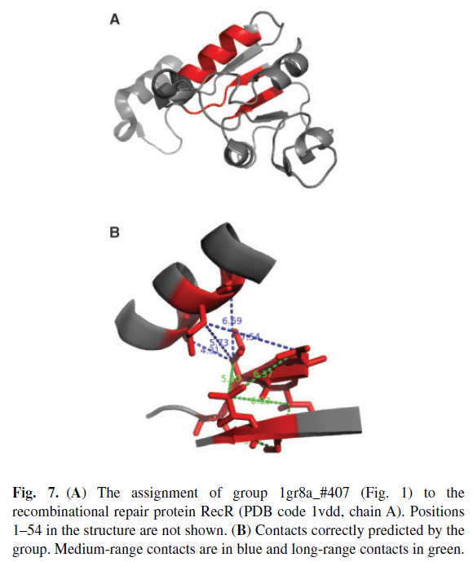

Slide 18
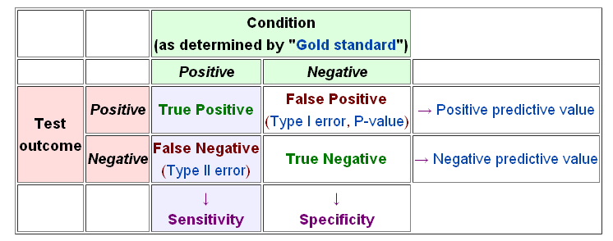
Results
sensitivity = recall = TP / (TP + FN) = Cov = N_{c} / N_{t}
specificity = TN / (TN + FP)
precision = TP / (TP + FP) = Acc = N_{c} / N_{p}
F-score = 2 * precision * recall / (precision + recall )
N_{p} = Pct * L

Slide 19
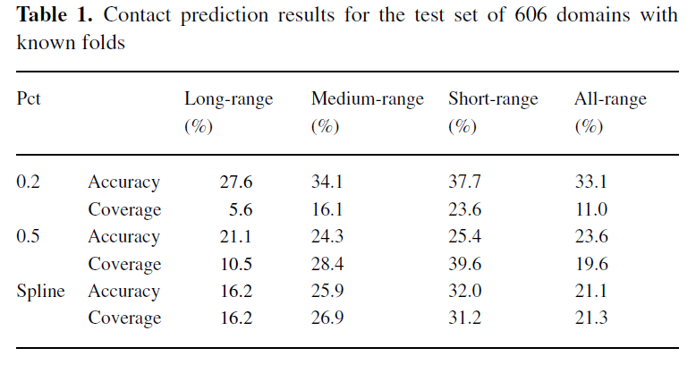
Results
16.51
21.41
21.20

Slide 20
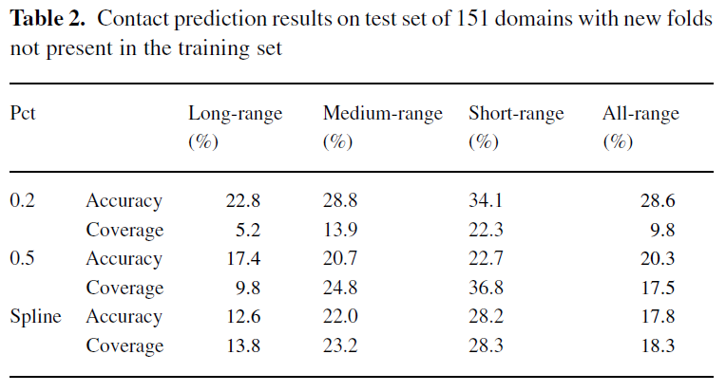
Results
14.60
20.13
18.05

Slide 21
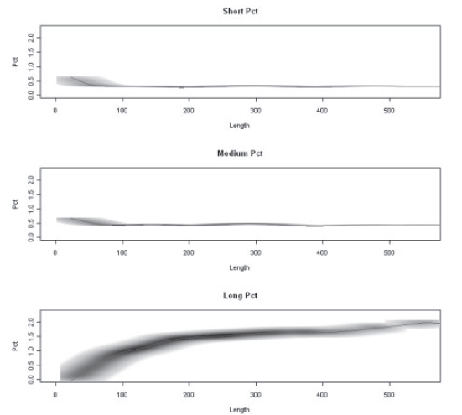

Slide 22
Thanks for your listening!

