Slide 1
Approximate Boyer-Moore String Matching for Small Alphabets
L. Salmela, J. Tarhio and P. Kalsi
Algorithmica, Vol. 58, pp. 591–609, 2010
Presenter: Chiou-Ting Tseng
Date: Oct. 12, 2010

Slide 2
Abstract
Recently a new variation of approximate Boyer-Moore string matching was presented for the k-mismatch problem. The variation, called FAAST, is specifically tuned for small alphabets. We further improve this algorithm gaining speedups in both preprocessing and searching. We also present three variations of the algorithm for the k-difference problem. We show that the searching time of the algorithms is average-optimal and the preprocessing also has a lower time complexity than FAAST.

Slide 3
Abstract
Our experiments show that our algorithm for the k-mismatch problem is about 30% faster than FAAST and the new algorithms compare well against other state-of-the-art algorithms for approximate string matching.

Slide 4
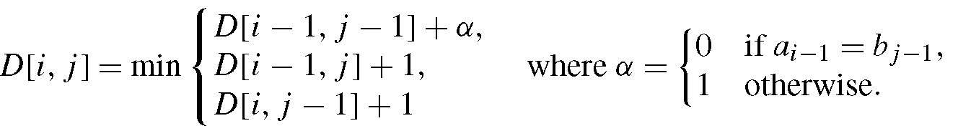
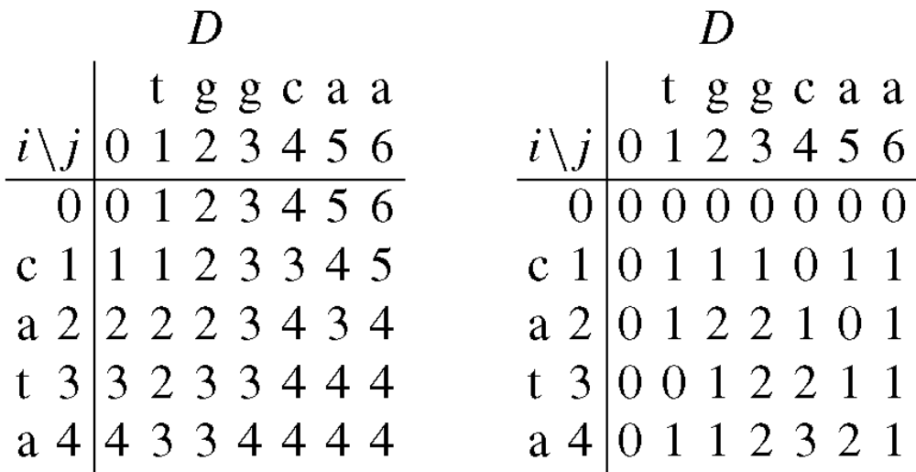
Edit Distance

Slide 5
String Matching Problem
Given a text string T of length n and a pattern string P of length m, the exact string matching problem is to find all occurrences of P in T.
Example: T=“AGCTTGA” P=“GCT”

Slide 6
Boyer and Moore Algorithm
The algorithm compares the pattern P with the substring of sequence T within a sliding window in the right-to-left order.
The bad character rule and good suffix rule are used to determine the movement of sliding window.

Slide 7
Bad Character Rule
Suppose that P₁ is aligned to T_{s} now, and we perform a pair-wise comparing between text T and pattern P from right to left. Assume that the first mismatch occurs when comparing T_{s+j-1} with P_{j} .
Since T_{s+j-1} ≠P_{j} , we move the pattern P to the right such that the largest position c in the left of P_{j} is equal to T_{s+j-1}. We can shift the pattern at least (j-c) positions right.
s
s +j -1
T |  |  | x | t
P |  | x |  | y | t
1
c
j
m
Shift
P |  | x |  | y | t
1
j
m

Slide 8
Ex: Suppose that P₁ is aligned to T₆ now. We compare pair-wise between T and P from right to left. Since T_{16,17} = P_{11,12} = “CA” and T₁₅ =“G” ≠P₁₀ = “T”. Therefore, we find the rightmost position c=7 in the left of P₁₀ in P such that P_{c} is equal to “G” and we can move the window at least (10-7=3) positions.
directing of the scan
s=6
 | 1 | 2 | 3 | 4 | 5 | 6 | 7 | 8 | 9 | 10 | 11 | 12 | 13 | 14 | 15 | 16 | 17 | 18 | 19 | 20
T | A | A | A | A | A | A | T | C | A | C | A | T | T | A | G | C | A | A | A | A
mismatch
P | A | T | C | A | C | A | G | T | A | T | C | A
 | 1 | 2 | 3 | 4 | 5 | 6 | 7 | 8 | 9 | 10 | 11 | 12
c
j=10
m=12
P | A | T | C | A | C | A | G | T | A | T | C | A
 | 1 | 2 | 3 | 4 | 5 | 6 | 7 | 8 | 9 | 10 | 11 | 12

Slide 9
Approximate String Matching
Text string T, |T|=n
Pattern string P, |P|=m
k errors, where errors can be substituting, deleting, or inserting a character.
Example:
T =“pttapa”, P =“patt”, k =2,
T_{1,2} ,T_{1,3} ,T_{1,4} and T_{5,6} are all up to 2 errors with P.

Slide 10
Approximate String Matching
Solved by dynamic programming
Let E(i,j) denote the suffix edit distance between T_{1,j} and P_{1,i}.
E(i, j) = E(i–1, j–1) if P_{i}=T_{j}
E(i, j) = min{E(i, j–1), E(i–1, j), E(i–1, j–1)}+1 if P_{i} ≠T_{j}

Slide 11
Example for Appr. String Matching
Example: T =“pttapa”, P =“patt”, k=2
 |  |  | T
 |  |  | 0 | 1 | 2 | 3 | 4 | 5 | 6
 |  |  |  | p | t | t | a | p | a
P | 0 |  | 0 | 0 | 0 | 0 | 0 | 0 | 0
 | 1 | p | 1 | 0 | 1 | 1 | 1 | 0 | 1
 | 2 | a | 2 | 1 | 1 | 2 | 1 | 1 | 0
 | 3 | t | 3 | 2 | 1 | 1 | 2 | 2 | 1
 | 4 | t | 4 | 3 | 2 | 1 | 2 | 3 | 2

Slide 12
Two Variants
In the k-difference problem the distance between two strings is the standard edit distance where mismatches, deletions, and insertions are allowed.
The k-mismatch problem is a more restricted one using the Hamming distance where only mismatches are allowed.

Slide 13
k-Mismatch Algorithm
Preprocessing:
  For each q-gram s₀, . . . , s_{q−1}, computes the Hamming distance when aligning the q-gram against the end of all prefixes of the pattern
  We will also look at the bottom row of the table, and find the rightmost cell D[q, j] with a value h ≤ k, except for the last cell D[q,m].

Slide 14
k-Mismatch Algorithm
Searching:
  If the Hamming distance between the length q suffix and T ≤ k, it is a possible matching. So we continue to compare the prefixes.
  Use the shift table to shift to the next candidate.

Slide 15
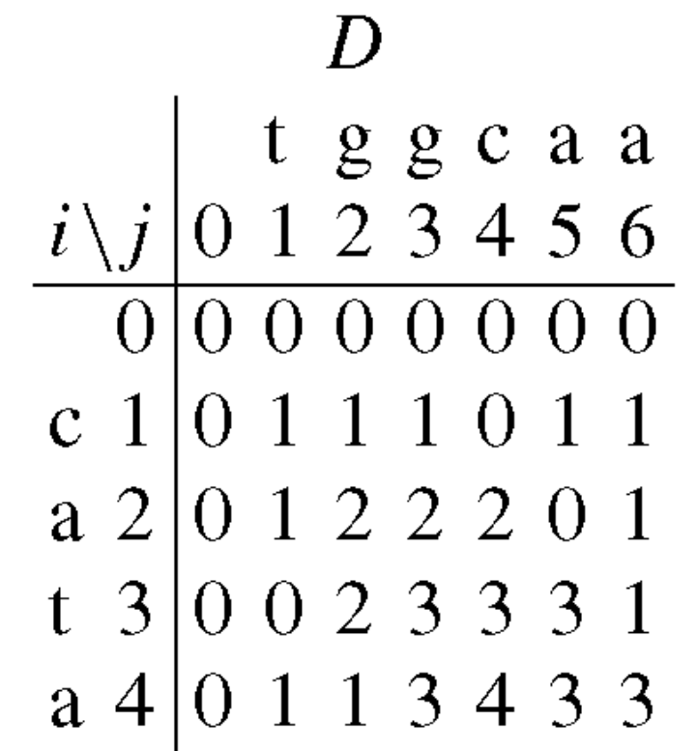
Preprocessing
 |  |  | t | g | g | c | a | a
 |  | 0 | 1 | 2 | 3 | 4 | 5 | 6
 | 0 | 0 | 0 | 0 | 0 | 0 | 0 | 0
c | 1 | 0 | 1 | 1 | 1 | 0 | 1 | 1
a | 2 | 0 | 1 | 2 | 2 | 2 | 0 | 1
t | 3 | 0 | 0 | 2 | 3 | 3 | 3 | 1
t | 4 | 0 | 0 | 1 | 3 | 4 | 4 | 4
q=4

Slide 16
Preprocessing
 |  |  | t | g | g | c | a | a
 |  | 0 | 1 | 2 | 3 | 4 | 5 | 6
 | 0 | 0 | 0 | 0 | 0 | 0 | 0 | 0
a | 1 | 0 | 1 | 1 | 1 | 1 | 0 | 0
g | 2 | 0 | 1 | 1 | 1 | 2 | 2 | 1
c | 3 | 0 | 1 | 2 | 2 | 1 | 3 | 3
a | 4 | 0 | 1 | 2 | 3 | 3 | 1 | 3
q=4

Slide 17
Example
T | a | a | g | g | c | a | t | a | a | c | a | t | t | a | g | c | a | a | a | a
P | t | g | g | c | a | a
P | t | g | g | c | a | a
P | t | g | g | c | a | a

Slide 18
Preprocessing Improvement
If the q-grams are generated in the lexicographical order, the dynamic programming table differs only by the last few rows in most cases. Therefore we can speed up the preprocessing if we only recalculate the last rows of the table at each step, starting from the first changed character.
This can be implemented by traversing the tree built of all q-grams in depth first order.

Slide 19
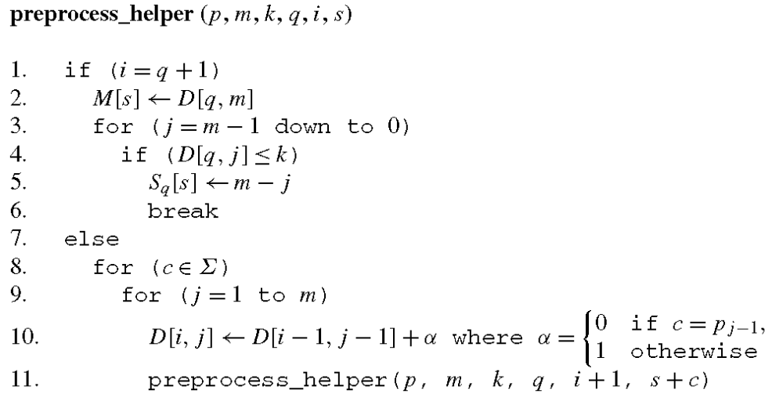
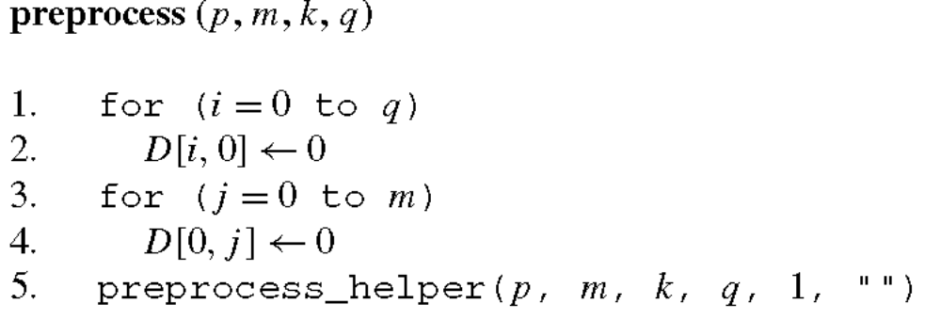

Slide 20
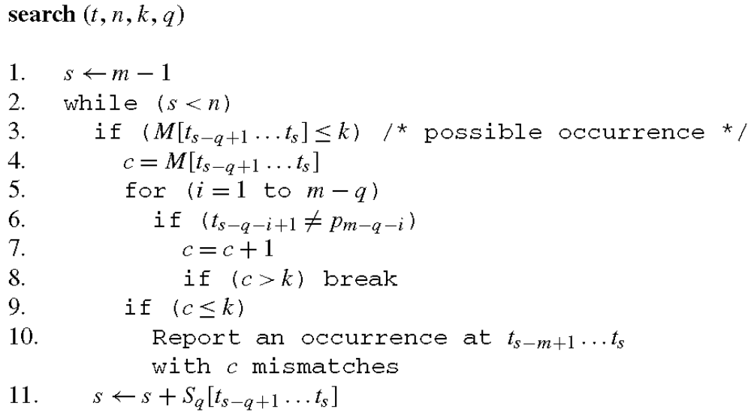

Slide 21
Complexity
If we have the dynamic programming table for a node in the tree, the tables for the children nodes can be obtained by calculating one more row to the dynamic programming table taking O(m) time per child so calculating the dynamic programming tables for all nodes in the tree takes O(σ^{q}m) time.

Slide 22
Complexity
At the leaf nodes we have the dynamic programming table for the corresponding q-gram and we need to figure out the number of mismatches entered to table M and the shift value entered to table S_{q} which takes O(m) time. The extra calculation needed at leaf nodes is thus O(mσ^{q} ) because there are σ^{q} leaf nodes.

Slide 23
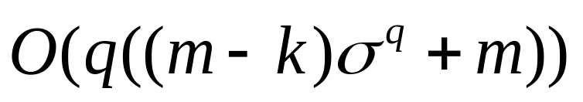
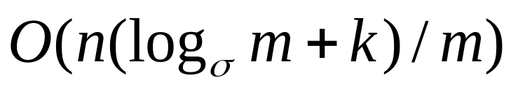
Complexity
Therefore the time complexity of the preprocessing phase is O(mσ^{q}).
The preprocessing complexity of FAAST is
The average case time complexity of searching are both

Slide 24
k-Difference Algorithm
Preprocessing
  For each q-gram s₀, . . . , s_{q−1}, computes the Edit distance when aligning the q-gram against the end of all prefixes of the pattern.
  We will also look at the bottom row of the table, and find the rightmost cell D[q, j] with a value h ≤ k, except for the last cell D[q,m].

Slide 25
k-Difference Algorithm
Searching:
  If the edit distance between the length q suffix and T ≤ k, it is a possible matching. So we do a full compare by the dynamic programming.
  Use the shift table to shift to the next candidate.

Slide 26
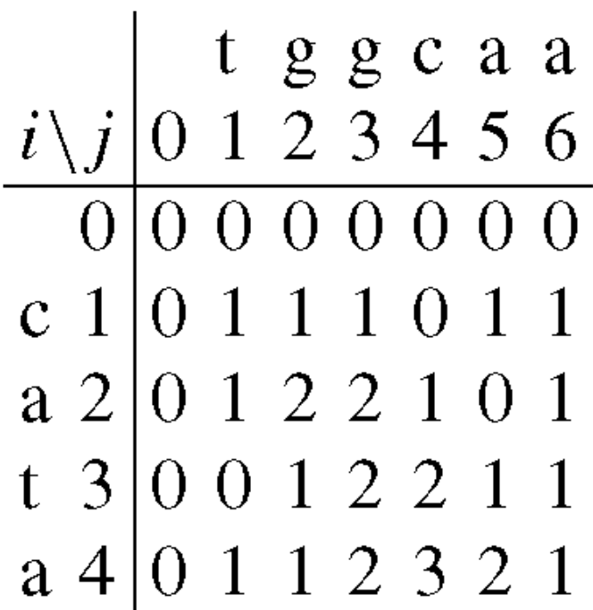
Preprocess
 |  |  | t | g | g | c | a | a
 |  | 0 | 1 | 2 | 3 | 4 | 5 | 6
 | 0 | 0 | 0 | 0 | 0 | 0 | 0 | 0
c | 1 | 0 | 1 | 1 | 1 | 0 | 1 | 1
a | 2 | 0 | 1 | 2 | 2 | 1 | 0 | 1
t | 3 | 0 | 0 | 1 | 2 | 2 | 1 | 1
t | 4 | 0 | 0 | 1 | 2 | 3 | 2 | 2
q=4

Slide 27
Preprocess
 |  |  | t | g | g | c | a | a
 |  | 0 | 1 | 2 | 3 | 4 | 5 | 6
 | 0 | 0 | 0 | 0 | 0 | 0 | 0 | 0
X | 1 | 0 | 1 | 1 | 1 | 1 | 1 | 1
X | 2 | 0 | 1 | 1 | 1 | 1 | 1 | 1
a | 3 | 0 | 1 | 2 | 2 | 2 | 1 | 1
a | 4 | 0 | 1 | 2 | 3 | 3 | 2 | 1
g | 5 | 0 | 1 | 1 | 2 | 3 | 3 | 2
g | 6 | 0 | 1 | 1 | 1 | 2 | 3 | 3
c | 7 | 0 | 1 | 2 | 2 | 1 | 2 | 3
a | 8 | 0 | 1 | 2 | 3 | 2 | 1 | 2
 |  |  | t | g | g | c | a | a
 |  | 0 | 1 | 2 | 3 | 4 | 5 | 6
 | 0 | 0 | 0 | 0 | 0 | 0 | 0 | 0
g | 1 | 0 | 1 | 0 | 0 | 1 | 1 | 1
g | 2 | 0 | 1 | 1 | 0 | 1 | 2 | 2
c | 3 | 0 | 1 | 2 | 1 | 0 | 1 | 2
a | 4 | 0 | 1 | 2 | 2 | 1 | 0 | 1

Slide 28
Example
T | a | a | g | g | c | a | t | a | a | c | a | t | t | a | g | c | a | a | a | a
P | t | g | g | c | a | a
P | t | g | g | c | a | a
P | t | g | g | c | a | a
t

Slide 29
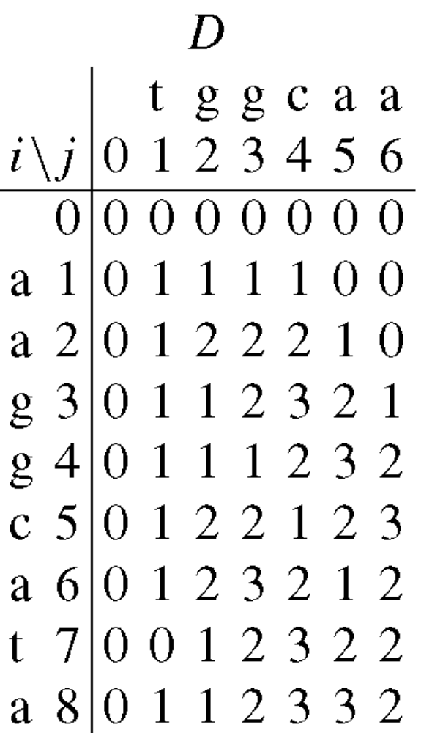
Example
 |  |  | t | g | g | c | a | a
 |  | 0 | 1 | 2 | 3 | 4 | 5 | 6
 | 0 | 0 | 0 | 0 | 0 | 0 | 0 | 0
X | 1 | 0 | 1 | 1 | 1 | 1 | 1 | 1
a | 2 | 0 | 1 | 2 | 2 | 2 | 1 | 1
a | 3 | 0 | 1 | 2 | 3 | 3 | 2 | 1
g | 4 | 0 | 1 | 1 | 2 | 3 | 4 | 4
g | 5 | 0 | 1 | 1 | 1 | 2 | 3 | 3
c | 6 | 0 | 1 | 2 | 2 | 1 | 2 | 3
a | 7 | 0 | 1 | 2 | 3 | 2 | 1 | 2
t | 8 | 0 | 0 | 1 | 2 | 3 | 2 | 2
q=4
m=6
k=2
m+k

Slide 30
Example

Slide 31
Improvement
To avoid rereading the last q-gram of an alignment for constructing the edit distance table, we can calculate the reversed edit distance table for each q-gram and the pattern during preprocessing.
We store the last row of the reversed table D_{r}[q, j], j ∈ [0,m] for each q-gram during the preprocessing phase.
During searching we can then check for a complete occurrence by filling the rest of the table rows from t_{s−q} down to t_{s−(m+k−1)}.

Slide 32
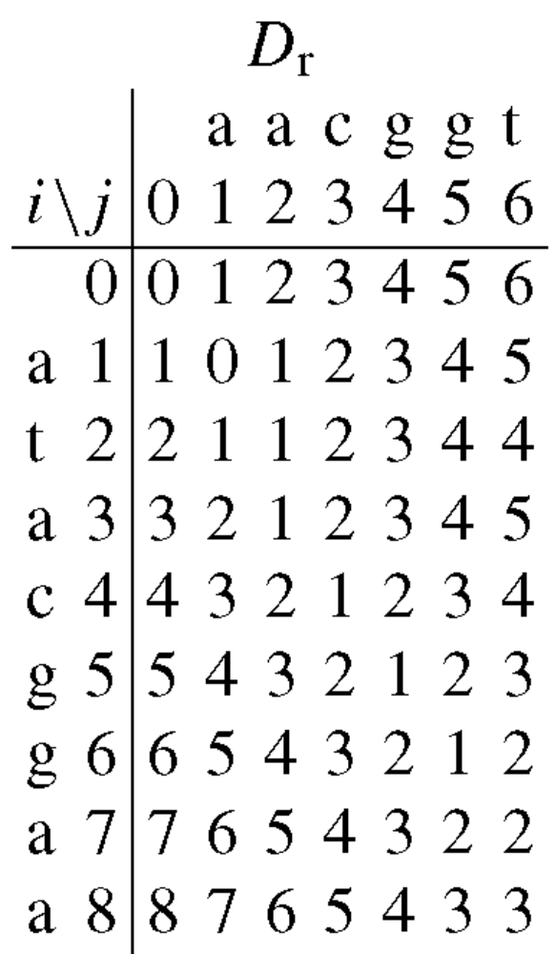
Example
 |  |  | a | a | c | g | g | t
 |  | 0 | 1 | 2 | 3 | 4 | 5 | 6
 | 0 | 0 | 1 | 2 | 3 | 4 | 5 | 6
a | 1 | 1 | 0 | 1 | 2 | 3 | 4 | 5
t | 2 | 2 | 1 | 1 | 2 | 3 | 4 | 4
a | 3 | 3 | 2 | 1 | 2 | 3 | 4 | 5
c | 4 | 4 | 3 | 2 | 1 | 2 | 3 | 4
m-k
m+k

Slide 33
Note
We still need the normal edit distance table to obtain the values for tables S_{q} and M.
Choosing q ≤ m − k guarantees that all the needed rows will be available when verifying an occurrence.

Slide 34
Complexity
In the worst case the algorithms degenerate to calculating the dynamic programming table at each position of the text. Thus the worst case complexity is O(nm²).
The worst case complexity can be improved to O(nm) by doing the verification forward and incrementally.

Slide 35
Verification
We now store the end position of the previous verification and also the last row of the dynamic programming table of the previous verification.
When we need to perform another verification, we first check if the starting position of this new verification is before the end position of the previous verification. If so, we continue the verification from the end position of the previous verification.

Slide 36
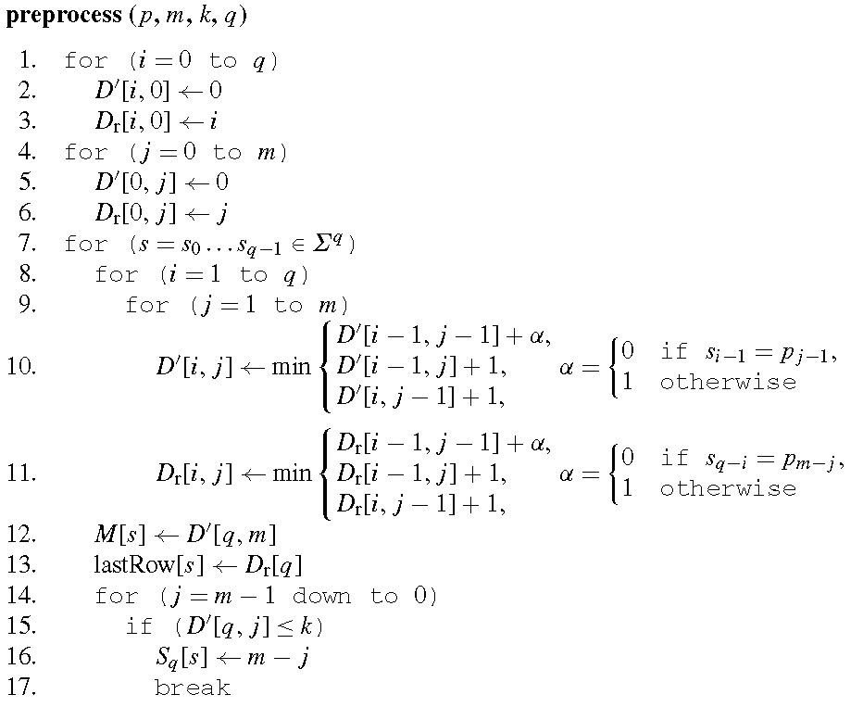

Slide 37
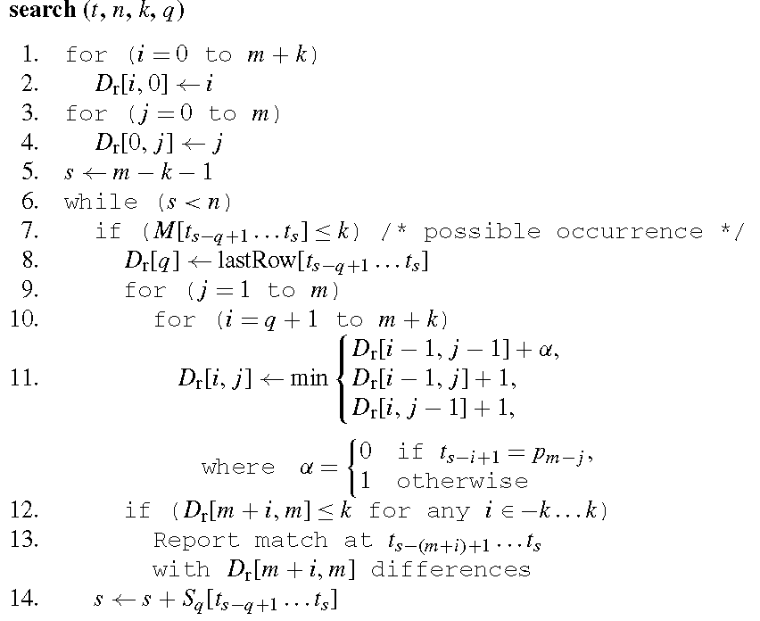

Slide 38
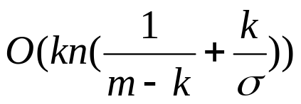
k-mismatch Algorithms
Algorithm | Preprocess | Search
ABM | O(m+kσ)
FAAST
FN | NA | NA
Algorithm 1 | O(mσ^{q})

Slide 39
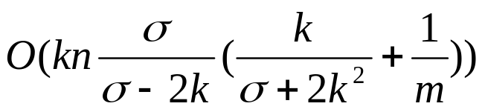

k-difference Algorithms
Algorithm | Preprocess | Search
ABM | O(m(k+σ))
Myers |  | O(nm/w)
BYP |  | O(n) average mostly
FN | O(mσ^{q})
Algorithm 2 | O(mσ^{q}) | O(m²n)
Algorithm 3 | O(mσ^{q}) | O(m²n)

Slide 40
Test Data
The searched text is a 22 MB long sequence of the fruit fly genome.
The patterns have been extracted randomly from the text.
Each pattern set consists of 200 different patterns of the same length, and they are searched sequentially.

Slide 41
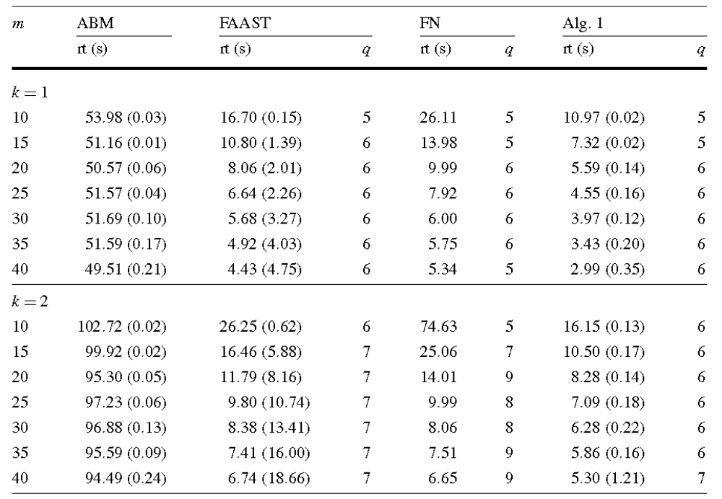
k-mismatch Result

Slide 42
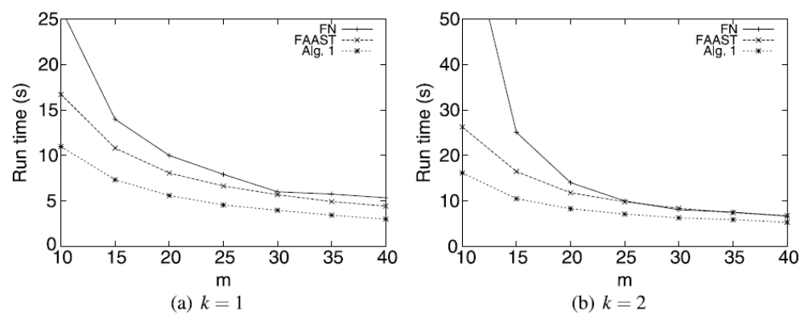
k-mismatch Result

Slide 43
k-mismatch Result
Algorithm 1 is the fastest of the compared algorithms and it is generally about 30% faster than FAAST in the k-mismatch case for k ∈ [1, 2].
The preprocessing phase of Algorithm 1 is 10 to 30 times faster than that of FAAST.

Slide 44
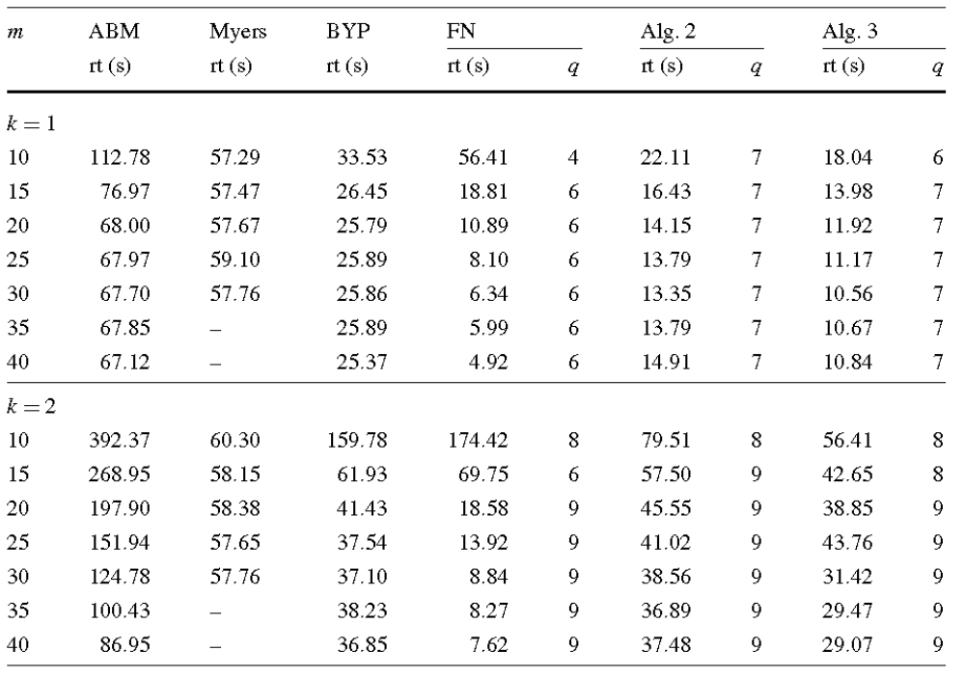
k-difference Result

Slide 45
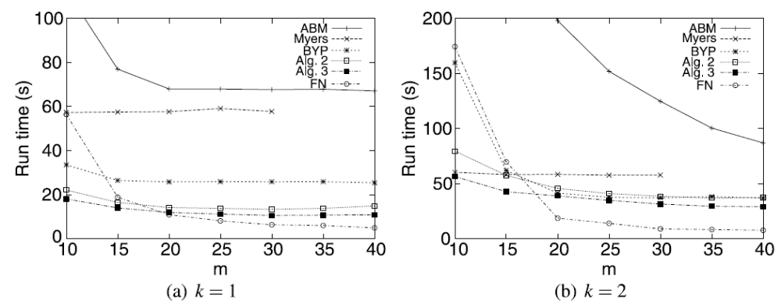
k-difference Result

Slide 46
k-difference Result
In the k-difference problem, our new algorithms are faster than the Myers, BYP, and ABM algorithms. They are also faster than the FN algorithm with short patterns but with longer patterns the FN algorithm is faster.
The basic version of the Myers algorithm is limited by the 32-bit word size, and it cannot handle patterns where m > 32.
The modifications in Algorithm 3 decrease search time by 20–30%, when compared to Algorithm 2.

Slide 47
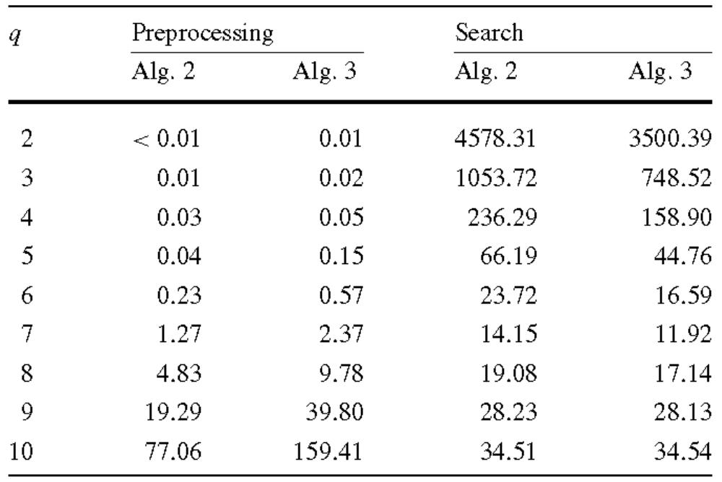
Table Size Effect
k=1, m=20

Slide 48
Table Size Effect
With small values of q, the search time decreases as the amount of preprocessing increases, but after a certain limit increasing the q-value will begin to slow down the search.

