Slide 1
DBCP: a web server for disulfide bonding connectivity pattern prediction without the prior knowledge of the bonding state of cysteines
Hsuan-Hung Lin(林宣宏) and Lin-Yu Tseng(曾怜玉)
Nucleic Acids Research, 2010, Vol. 38, Web Server issue W503–W507
Speaker: Chong-Jie Wang
Date: October 18, 2010

Slide 2
Abstract
The proper prediction of the location of disulfide bridges is efficient in helping to solve the protein folding problem. Most of the previous works on the prediction of disulfide connectivity pattern use the prior knowledge of the bonding state of cysteines. The DBCP web server provides prediction of disulfide bonding connectivity pattern without the prior knowledge of the bonding state of cysteines. The method used in this server improves the accuracy of disulfide connectivity pattern prediction (Qp) over the previous studies reported in the literature.

Slide 3
System
MODELLER:used to predict the coordinate (X, Y, Z) of the C_{α}
http://140.120.14.136/dbcp/

Slide 4
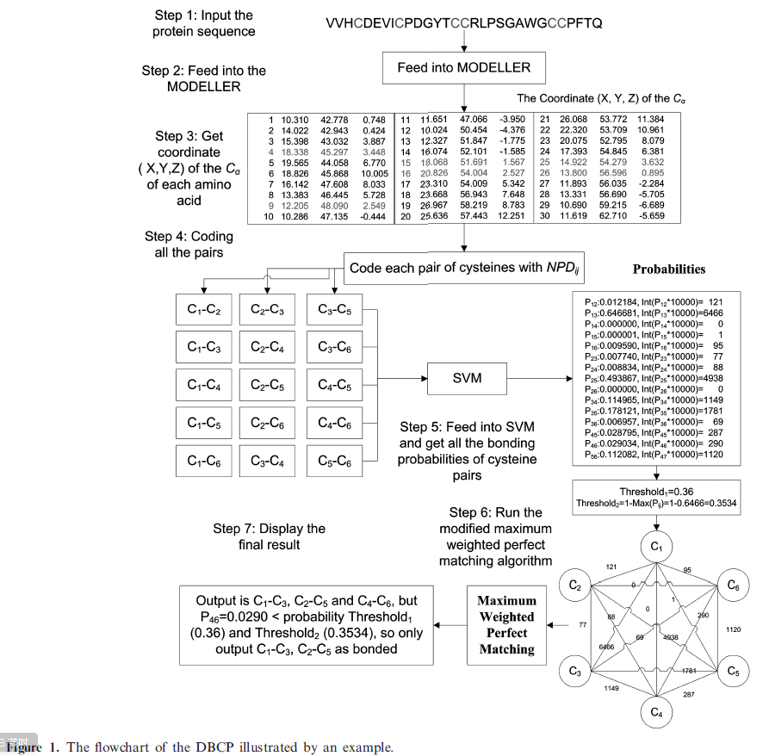

Slide 5
Feature
D_{ij}: the Euclidean distance between the amino acid at the i-th position and the amino acid at the j-th position.
PD: pair distance
The PD between cystein i and cystein j is defined to be a vector (D_{pi-[w/2],Pj-[w/2]} , . . . , D_{pi-1, Pj-1}, D_{Pi, Pj}, D_{Pi+1, Pj+1},. . ., D_{Pi+[(w1)/2], Pj+[(w1)/2])} that contains w Euclidean distances, where w is the window size.

Slide 6
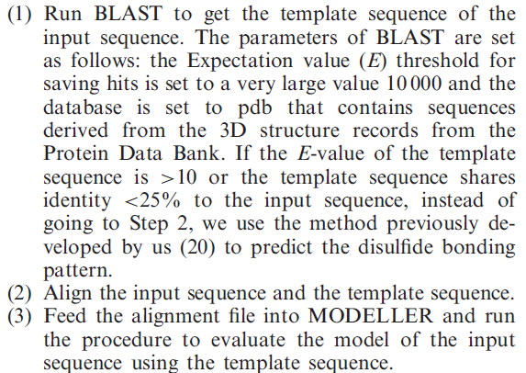
Methodology(1)

Slide 7
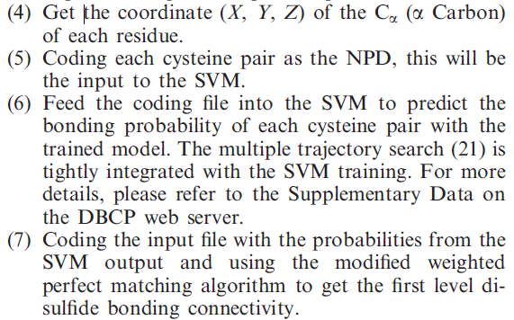

Methodology(2)

Slide 8
Databases
SPX: sequences from PDB
SP56NS: sequences from SP56.3,that are neither in SP39 nor in SPX
SP56NS_25: sequences from SP56.3,that are neither in SP39 nor in SPX,and has identity <25% with SPX
CHK25: sequences from the SP56.3, where either the sequence shares identity <25% to the template sequence found by the BLAST or the E-value of the template sequence is >10.

Slide 9
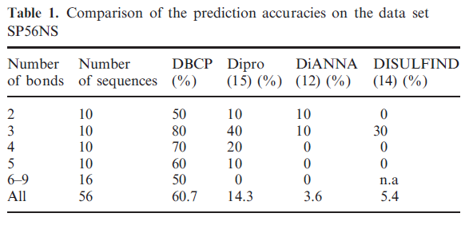
Results

Slide 10
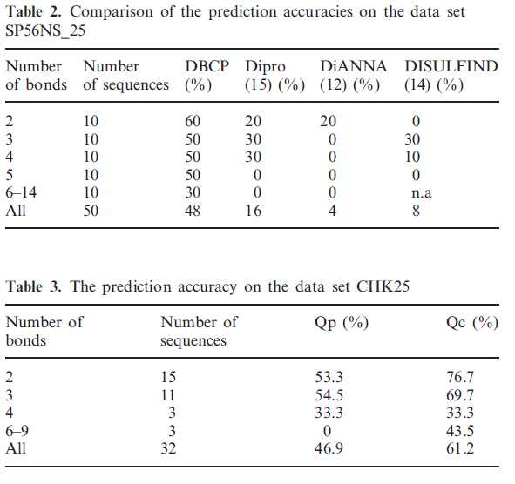

Slide 11
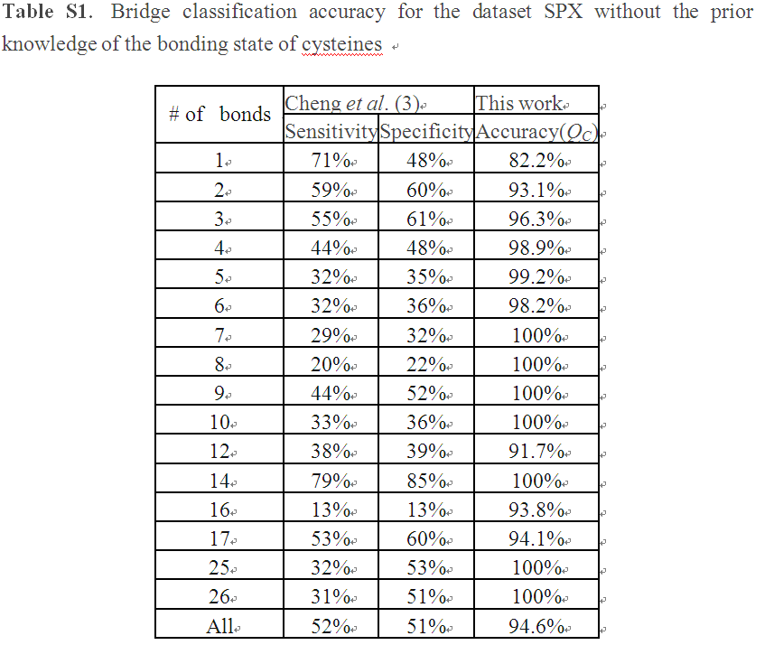

Slide 12
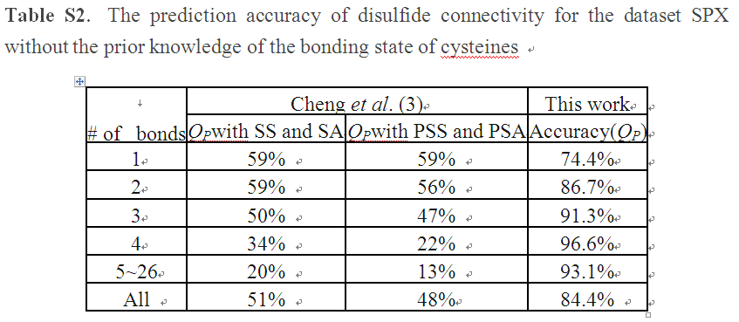

Slide 13
Thank you!

