Slide 1
A Fuzzy Time Series-Based Neural Network Approach to Option Price Forecasting
呂永和(Yungho Leu), 李建邦(Chien-Pang Lee), and陳佳宏(Chen-Chia Hung)
Lecture Notes in Computer Science, 2010, Volume 5990/2010, 360-369
Presenter: Siao-ming Jhou
Date: Nov. 30, 2010

Slide 2
Abstract
Recently, option price forecasting has become a popular financial issue. Being affected by many factors, option price forecasting remains a challenging problem. This paper proposes a new method to forecast the option price. The proposed method, termed as fuzzy time series-based neural network (FTSNN), is a hybrid method composed of a fuzzy time series model and a neural network model. In FTSNN, the fuzzy time series model is used to select a dataset for training the neural network model for prediction. The experiment results show that FTSNN outperforms several existing methods in terms of MAE and RMSE.

Slide 3
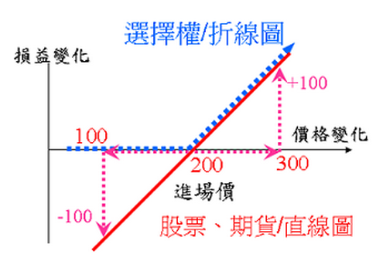
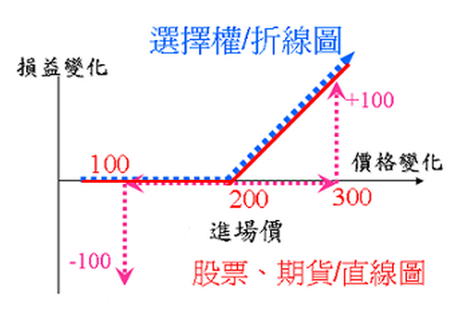
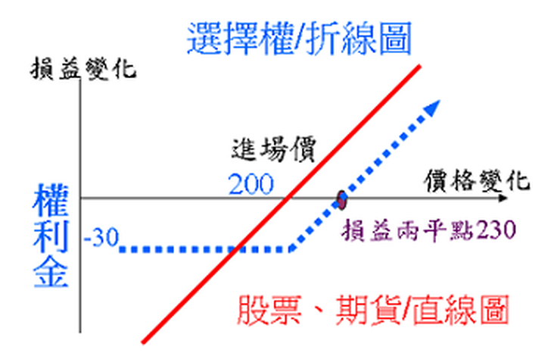
選擇權

Slide 4
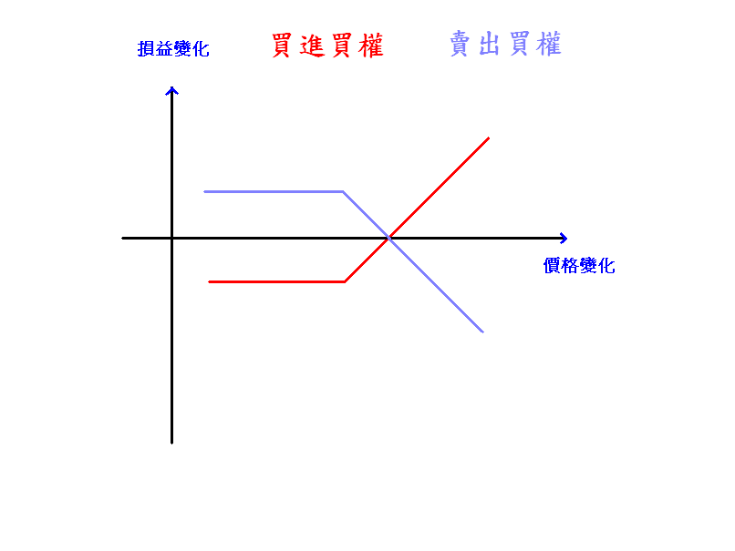
買權

Slide 5
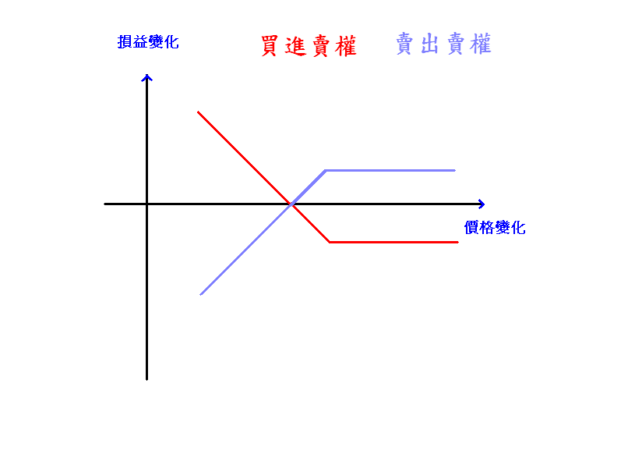
賣權

Slide 6
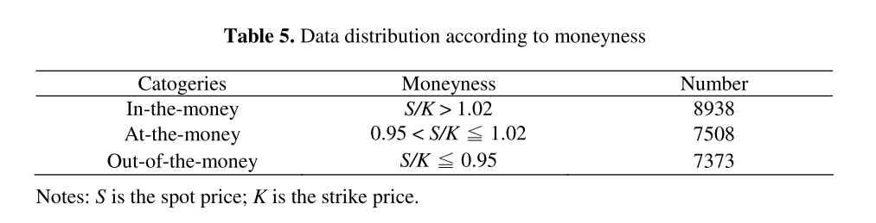
Experiment
Data period:2005/1/3~2006/12/29
Data number:23819 call(買權) option price data

Slide 7

Algorithm
1.U=[0,1000]
  u₁=[0,10],u₂=[10,20],…,u₁₀₀=[990,1000]
  V=[3000,13000]
  v₁=[3000,3050],v₂=[3050,3100],…,v₂₄₀=[12950,13000]

Slide 8
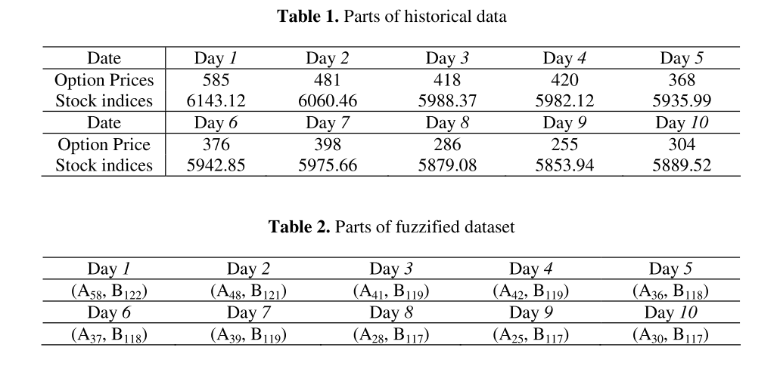
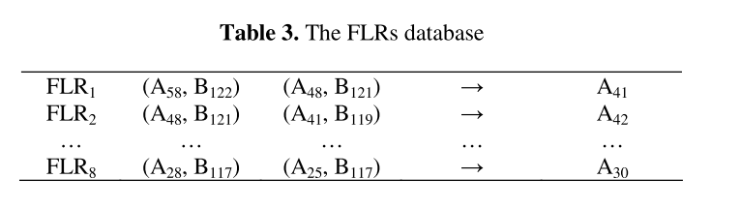
2.

Slide 9
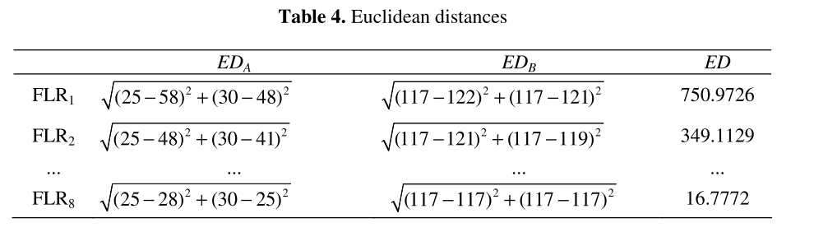
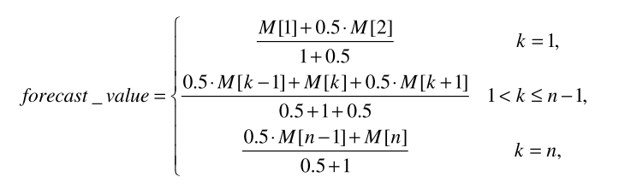
3.找出最小5個ED值的Pair，當成Neural Network的input data.
4.Neural Network的output ->k=35
(0.5*345+355+0.5*365)/(0.5+1+0.5)=355

Slide 10
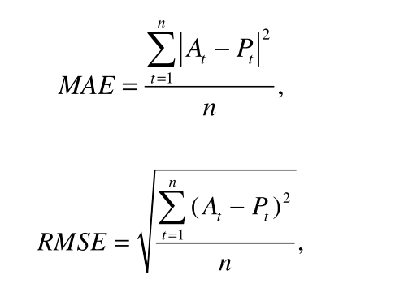
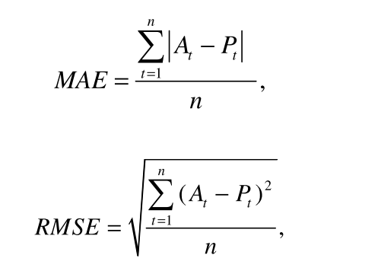
5.

Slide 11
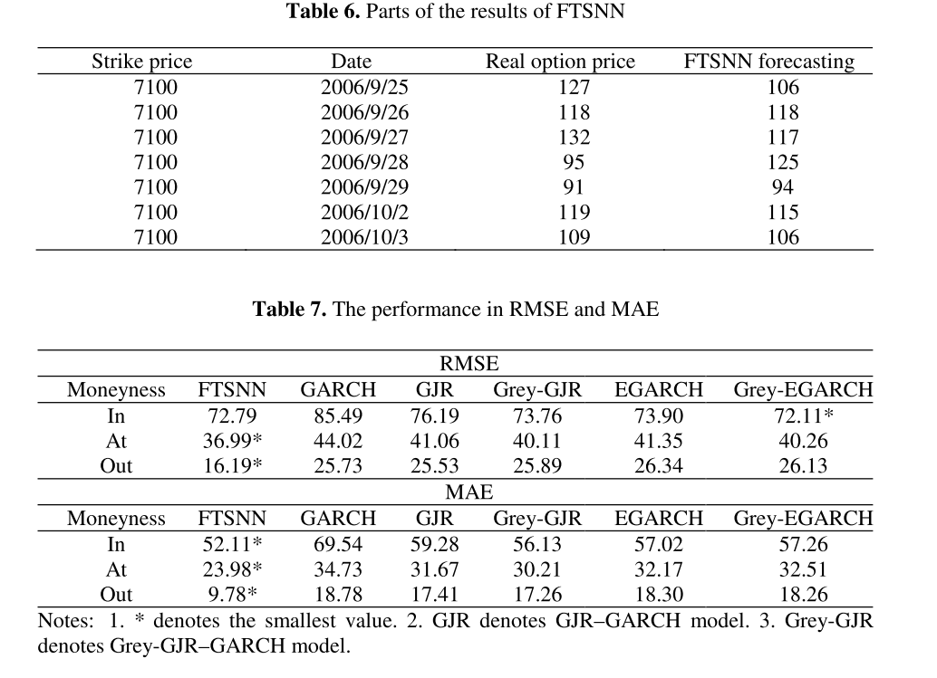
Result

Slide 12
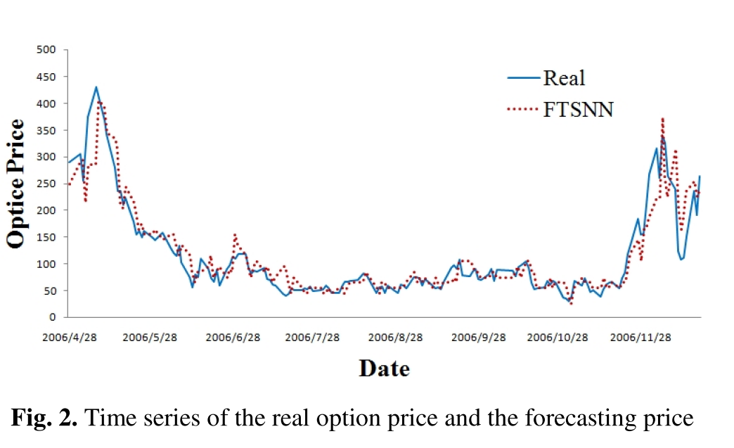

Slide 13
End

