Slide 1
On Some Variants of the Longest Increasing Subsequence Problem
Sebastian Deorowicz
Theoretical and Applied Informatics, Vol. 21, No. 3-4, pp. 135–148, 2009
Presenter: Chiou-Ting Tseng
Date: Nov. 30, 2010

Slide 2
Abstract
The problem of finding a longest increasing subsequence (LIS) is a well known task in sequence processing. There are many variants of the basic task. We discuss a recently introduced variant of LIS, a minimal height longest increasing subsequence problem and propose a new algorithm for it, which improves its time complexity. Moreover, we define a family of similar problems and introduce algorithms solving them.

Slide 3
Longest Increasing Subsequence
The longest among the increasing subsequences of a given string.
e.g. 4 1 5 7 3
4 1 7
1 3 5 7
4 7
1 5 7
4 5 7
are not increasing subsequences
are increasing subsequences
Find the longest among them

Slide 4
Representative Increasing Subsequence (RIS)
The i-th element is the smallest ending symbol of increasing subsequences of S of length i.
For 41573, increasing subsequences are {4, 1, 5, 7, 3}, {45, 47, 15, 17, 13, 57} and {457, 157}, so RIS=137.

Slide 5
Representative Increasing Subsequence
For every new element s_{i}, replace the smallest element larger than s_{i} in the previous RIS.
Record the previous element in RIS as the predecessor .
4 | 1 | 5 | 7 | 3
4 | 1 | 1 | 1 | 1
 |  | 5 | 5 | 3
 |  |  | 7 | 7
[Sche61]

Slide 6
Minimal Height Longest Increasing Subsequence
Input: A string S.
Output: A longest increasing subsequence of S with minimal height.
Height: The difference between the largest number and the smallest number in an increasing sequence.
S’=457, height=7-4=3

Slide 7
My Algorithm
For every element s_{e} of S, if the LIS of s_{e} is of length L, we record the largest element among the length L-1 increasing subsequences smaller than s_{e} as its predecessor.
Decide L by representative increasing subsequence.

Slide 8
Example
S = 6251476
Input | 6 | 2 | 5 | 1 | 4 | 7 | 6
RIS | 6 | 2 | 25 | 15 | 14 | 147 | 146
L=1 | 6 | 26 | 26 | 126 | 126 | 126 | 126
L=2 |  |  | 5 | 5 | 45 | 45 | 45
L=3 |  |  |  |  |  | 7 | 67
H | 0 | 0 | 3 | 0 | 2 | 5 | 4

Slide 9
Time Complexity
If we record each set in an AVL tree, for each element of S
  Find L: O(log n) time.
  Modify RIS: O(1) time.
  Find predecessor in T(L-1): O(log n) time.
  Insert into T(L): O(log n) time.
  Calculate H: O(1) time.
Trace out the LIS: O(n) time.
Total: O(n log n) time, O(n) space.

Slide 10
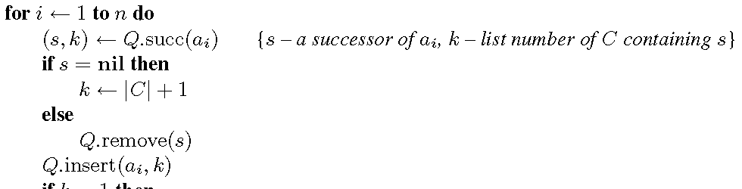
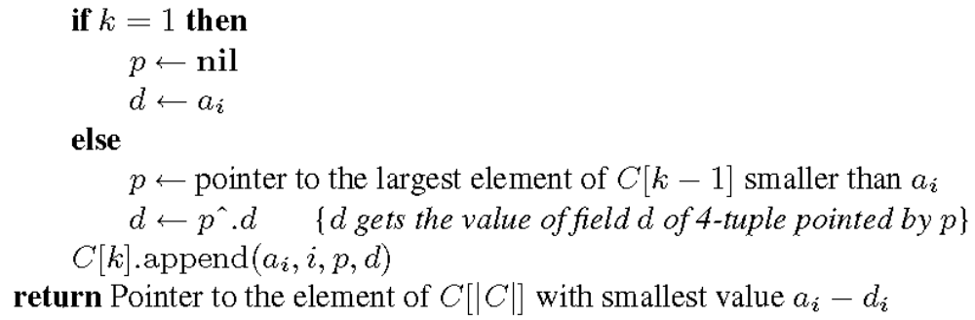
His Algorithm

Slide 11
Example
Input: 4,6,2,8,1,3,12,9,5,7,11,10
Pointer | symbol | index | first value
 | 4 | 1 | 4
 | 6 | 2 | 4
 | 8 | 4 | 4
 | 12 | 7 | 4
 | 11 | 11 | 4
 | 2 | 3 | 2
 | 3 | 6 | 2
 | 5 | 9 | 2
 | 9 | 8 | 4
 | 10 | 12 | 4
 | 1 | 5 | 1
 | 7 | 10 | 2
L=1
L=2
L=3
L=4
L=5

Slide 12
Time Complexity
The time complexity is determined by two terms: the time necessary to make operations on a priority queue and on a cover.
There are at most n operations of each kind (insert, remove, successor) on a priority queue.
There are n constant-time operations of appending the symbols to the cover lists.

Slide 13
Time Complexity
Concerning the cost of determining the pointer, we can notice that browsing each list of the cover we never go backward. Once we started browsing the list we always go forward or stay at the same element. Since, the search is performed O(n) times, the total number of elements in cover C is O(n), and the number of lists in cover C is O(n), the total cost of searching the cover lists is O(n).
Other operations in the main loop take also constant time per symbol (O(n) in total).

Slide 14
Other Variants
Maximal height LIS – LIS中最後一個元素和第一個元素的差最大的。
Minimal width LIS – LIS中最後一個元素和第一個元素最近的。
Maximal width LIS – LIS中最後一個元素和第一個元素最遠的。
Minimal sum LIS – LIS中元素和最小的。
Maximal sum LIS – LIS中元素和最大的

Slide 15
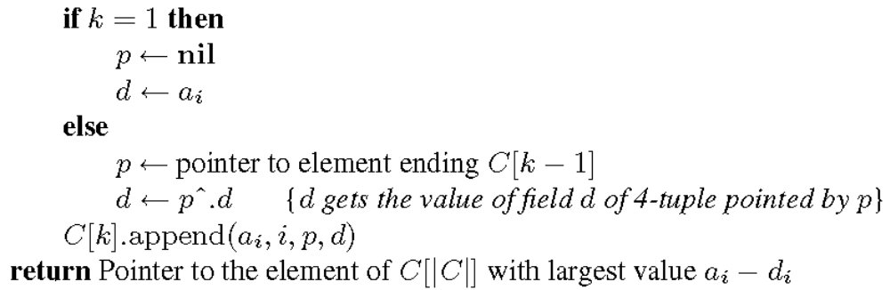
Maximal Height LIS

Slide 16
Example
Input: 4,6,2,8,1,3,12,9,5,7,11,10
Pointer | symbol | index | first value
 | 4 | 1 | 4
 | 6 | 2 | 4
 | 8 | 4 | 4
 | 12 | 7 | 4
 | 11 | 11 | 1
 | 2 | 3 | 2
 | 3 | 6 | 1
 | 5 | 9 | 1
 | 9 | 8 | 4
 | 10 | 12 | 1
 | 1 | 5 | 1
 | 7 | 10 | 1
L=1
L=2
L=3
L=4
L=5

Slide 17
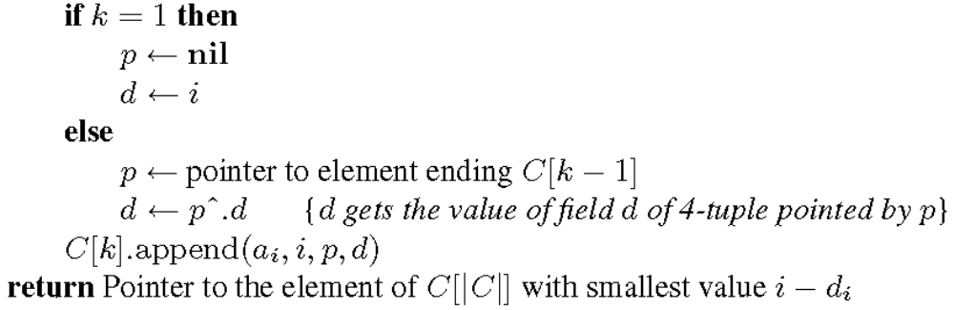
Minimal Width LIS

Slide 18
Example
Input: 4,6,2,8,1,3,12,9,5,7,11,10
Pointer | symbol | index | first position
 | 4 | 1 | 1
 | 6 | 2 | 1
 | 8 | 4 | 1
 | 12 | 7 | 1
 | 11 | 11 | 5
 | 2 | 3 | 3
 | 3 | 6 | 5
 | 5 | 9 | 5
 | 9 | 8 | 1
 | 10 | 12 | 5
 | 1 | 5 | 5
 | 7 | 10 | 5
L=1
L=2
L=3
L=4
L=5

Slide 19

Maximal Width LIS
largest value of i –d_{i}

Slide 20
Example
Input: 4,6,2,8,1,3,12,9,5,7,11,10
Pointer | symbol | index | first position
 | 4 | 1 | 1
 | 6 | 2 | 1
 | 8 | 4 | 1
 | 12 | 7 | 1
 | 11 | 11 | 5
 | 2 | 3 | 3
 | 3 | 6 | 3
 | 5 | 9 | 3
 | 9 | 8 | 1
 | 10 | 12 | 5
 | 1 | 5 | 5
 | 7 | 10 | 3
L=1
L=2
L=3
L=4
L=5

Slide 21
Minimal Sum LIS

Slide 22
Example
Input: 4,6,2,8,1,3,12,9,5,7,11,10
Pointer | symbol | index | first value
 | 4 | 1 | 4
 | 6 | 2 | 4
 | 8 | 4 | 4
 | 12 | 7 | 4
 | 11 | 11 | 1
 | 2 | 3 | 2
 | 3 | 6 | 1
 | 5 | 9 | 1
 | 9 | 8 | 4
 | 10 | 12 | 1
 | 1 | 5 | 1
 | 7 | 10 | 1
L=1
L=2
L=3
L=4
L=5

Slide 23
Maximal sum LIS

Slide 24
Example
Input: 4,6,2,8,1,3,12,9,5,7,11,10
Pointer | symbol | index | first value
 | 4 | 1 | 4
 | 6 | 2 | 4
 | 8 | 4 | 4
 | 12 | 7 | 4
 | 11 | 11 | 4
 | 2 | 3 | 2
 | 3 | 6 | 2
 | 5 | 9 | 2
 | 9 | 8 | 4
 | 10 | 12 | 4
 | 1 | 5 | 1
 | 7 | 10 | 2
L=1
L=2
L=3
L=4
L=5

Slide 25
Time Complexity
The worst case time complexity is identical for all the proposed algorithms and is t_{PQ} + O(n), where t_{PQ} is the total cost of operations on a priority queue (PQ): O(n) inserts, O(n) removals, O(n) successor queries.
A balanced binary search tree, e.g., red-black tree, handle all this operations in time O(log n), which can be also stated as O(log l) if we allow to express the result in terms of the output size.

