Slide 1
Distinct squares in run-length encoded strings
J. J. Liu(劉嘉傑)
Vol. 411, 2010, pages 4235–4241
Theoretical Computer Science
Speaker: Kai-Yuan Cheng
Date: Jun. 15, 2011

Slide 2
Abstract
Squares are strings of the form ww where w is any nonempty string. Two squares ww and w′w′ are of different types if and only if w ≠ w′. Fraenkel and Simpson [Avieri S. Fraenkel, Jamie Simpson, How many squares can a string contain? Journal of Combinatorial Theory, Series A 82 (1998) 112–120] proved that the number of square types contained in a string of length n is bounded by O(n). The set of all different square types contained in a string is called the vocabulary of the string. If a square can be obtained by a series of successive right-rotations from another square, then we say the latter covers the former. A square is called a c-square if no square with a smaller index can cover it and it is not a trivial square. The set containing all c-squares is called the covering set.Note that every string has a unique covering set. Furthermore, the vocabulary of the covering set are called c-vocabulary. In thispaper, we prove that the cardinality of c-vocabulary in a string is less than 14N/3, where N is the number of runs in this string.

Slide 3
Square
An immediately repeated nonempty string
aa
abab
xyzxyz
indicated by (p, 2|w|)

Slide 4
c-square
if (i, 2|w|), (i + 1, 2|w|), (i + 2, 2|w|), . . ., (j, 2|w|) are all squares, then we say that (i, 2|w|) covers (j, 2|w|).
A square (p, 2|w|) is called a c-square if no square
(q, 2|w|) with q < p can cover it and (p, 2|w|) is not a trivial square.
trivial square: (p, 2|w|) = a^{2|w|}

Slide 5
c-square
Ex:
aaabaaabaa
aaabaaabaa
aaabaaabaa
aaabaaabaa

Slide 6
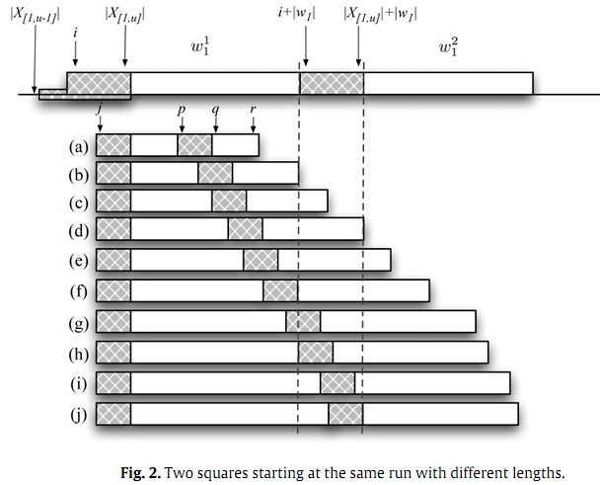

Slide 7
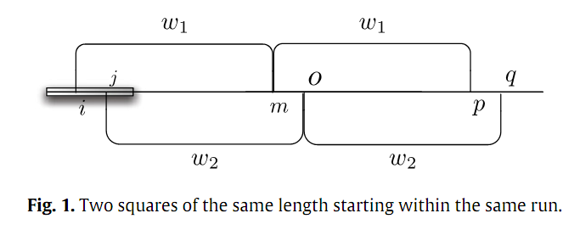
Lemma 1. If there exist two squares (i, 2|w1|) and (j, 2|w2|) starting within the same run, say rℓu u , where i < j and |w1| = |w2|,then (j, 2|w2|) must be covered by (i, 2|w1|).

Slide 8

Lemma 2. If two distinct rc-occurrences (i, 2|w1|) and (j, 2|w2|) with i < j and |w1| > |w2| start within the same run, say r ,then j + 2|w2| − 1 > |X[1,u]| + |w1|.
Lemma 3. If two distinct rc-occurrences (i, 2|w1|) and (j, 2|w2|) with i < j and |w1| > |w2| start from the same run, say r , then |X[1,u]| + |w2| + 1 < i + |w1| < |X[1,u]| + |w1| < j + 2|w2| − 1.

Slide 9
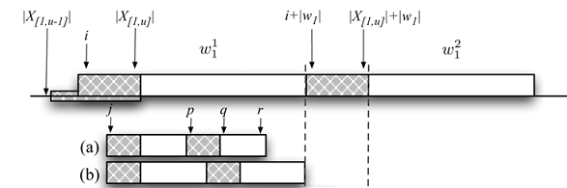


Slide 10
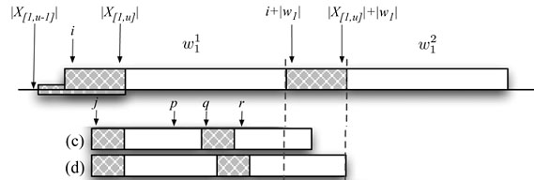

Slide 11
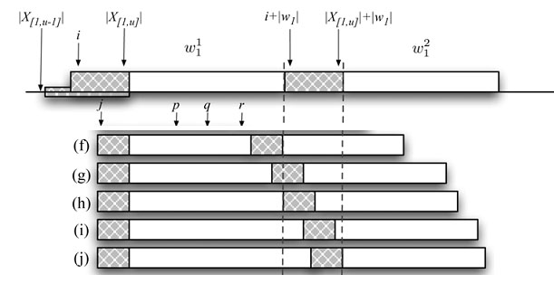

Slide 12
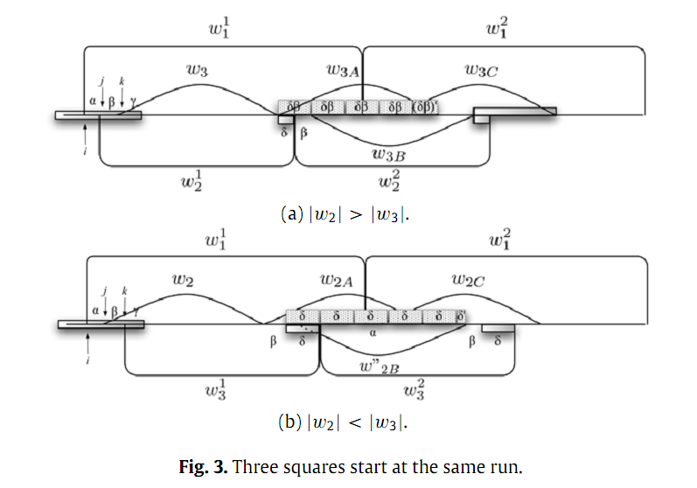
Lemma 4. For any rc-occurrence (i, 2|w1|), there is at most one rc-occurrence (j, 2|w2|) starting within the same run, say r with i < j and |w1| > |w2|.

Slide 13
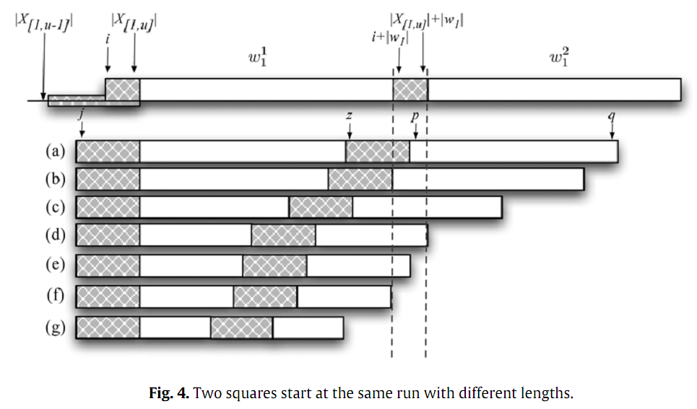

Slide 14
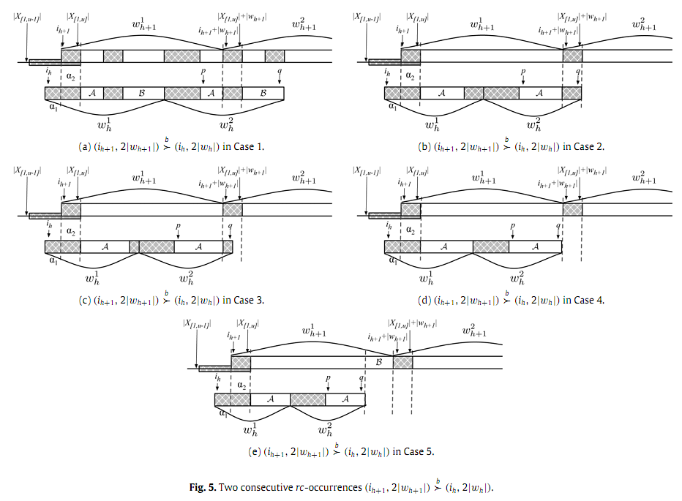

Slide 15
|IR(S)| to denote the number of rc-occurrences in S.
Given an rc-occurrence t = (u, 2|w|)
|IR(t)| = |cross(t)| + |IR(w²)|.
Theorem 1 ([8]). Suppose that a string x of length n is partitioned into two nonempty strings u of length p and v of length q, where p + q = n and u_{p} ≠ v₁. The number of c-squares in x such that each one starts in u and ends in v is less than or equal to r(x).
Lemma 7. Let t = w¹w² be a nontrivial square. The number of c-squares that starts in w1 and finishes in w2 is at most 2r(t).

Slide 16
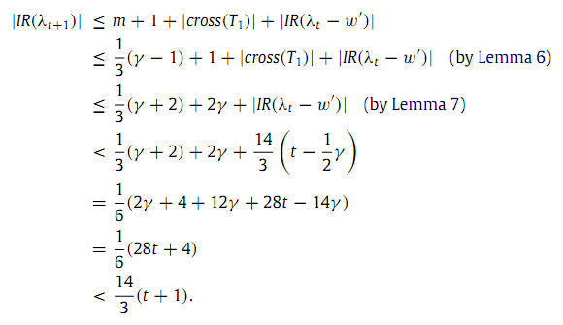
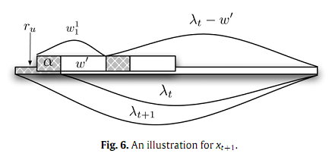

Slide 17
Thank you!!!

