Slide 1
The Black-Litterman Model in Detail
Jay Walters
Harvard Management Company
Working paper, available at SSRN: http://ssrn.com/abstract=1314585, (February 16, 2009), 51 pages
Presenter: Hung-Hsin Chen (陳紘昕)
Date: June 15, 2011

Slide 2
Abstract
In this paper, we survey the literature on the Black-Litterman model. This paper provides a complete description of the model including full derivations from underlying principles. The model is derived both from Theil’s mixed Estimation model and from Baye’s Theory. The various parameters of the model are also considered, along with information on their computation or calibration. Further consideration is given to several of the key papers, with worked examples illustrating the concepts.

Slide 3
Introduction
Proposed by Fischer Black and Robert Litterman in 1992.
The model makes two contributions to the asset allocation problem.
Using CAPM equilibrium market portfolio as a starting point for estimation of asset returns.
Blending the investors view with prior information.

Slide 4
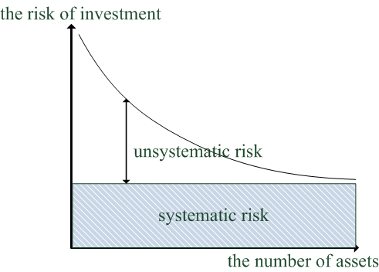
Portfolio theory
The definition of the risk:
The variance of the expected return
Two main risks:
Systematic risk
Unsystematic risk (can be reduced by portfolio)

Slide 5
Expected return of the portfolio
Portfolio expected return:
Example:
 | Expected return | Weight
Asset 1 | 6% | 20%
Asset 2 | 7% | 50%
Asset 3 | 5% | 30%
The expected return of the portfolio is
20% * 6% + 50% * 7% + 30% * 5% = 6.2%

Slide 6
Variance of the portfolio
Taking 2 assets for example:

Slide 7
Correlation of the assets
Pearson correlation coefficient
Γ₁₂ = 1 (完全正相關)
Γ₁₂ = -1(完全負相關)
-1 < Γ₁₂ < 1 (部分相關)

Slide 8
A、B、C 證券之報酬率

Slide 11


CAPM (capital asset pricing model) equilibrium returns
CAPM describes the linear relationship between risk and return when the market is equilibrium.
E(r_{i}) = r_{f} + β_{i}*r_{m} + α_{i}
r_{f}: risk free rate
r_{m}: excess return of the market portfolio
β_{i}: regression coefficient， β = ρ * σ_{p}/ σ_{m}
α_{i}: residual (specific excess return)
較常見的寫法(from wikipedia):

Slide 12
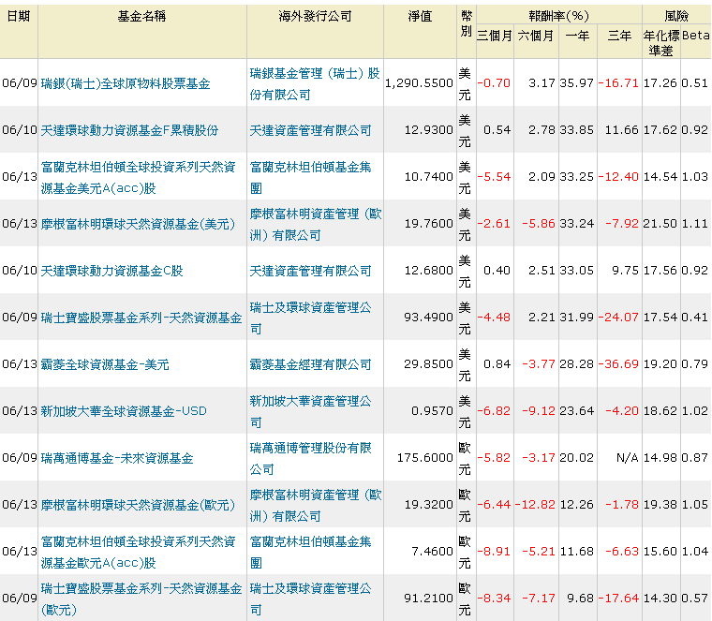
E(r_{i}) = r_{f} + β_{i}*r_{m} + α_{i}
α_{i}代表個別資產獨有的超額報酬，其風險可由投資組合減少
β_{i}與市場投資組合報酬有關，其風險無法由投資組合消除的系統性風險。
β_{i}可視為個別資產與市場投資組合相關的波動程度(常用)

Slide 13
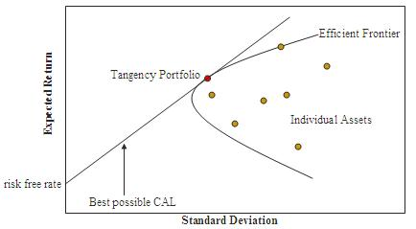
Market portfolio
風險性資產加上無風險資產所形成的效率前緣
完全以風險性資產所形成的效率前緣
CAL(capital allocation line):
資金投資在無風險資產與風險資產時，在不同比例下所產生的最佳結果
與單純只投資在風險性資產所得到的效率前緣有切點
此切點之投資組稱為market portfolio (tangency portfolio)

Slide 14
Portfolio without risk-free asset

Slide 15
Portfolio with risk-free asset
Add risk free asset with return R₀ and weight W₀
(無風險資產不會產生價格變動)

Slide 16
Let excess return: r_{i}=R_{i}-R₀
Given r_{p}
minimize σ_{p}²
Subject to Wr^{T}=r_{p}
Then we get:

Slide 17
因為只含風險性資產與包含無風險性資產投資組合的efficient frontier只交於一點T，T的return R_{T}，且T不包含任何risk-free asset
此時R_{T}為market portfolio之return

Slide 18
由market portfolio R_{T}可算出各資產之β值:
由β值可算出各資產在市場均衡時的期望報酬率:

Slide 19
Reverse optimization (MV model)
Portfolio equilibrium return
Portfolio risk
U: object function
w: weights for each asset (unknown)
Π: vector of equilibrium returns for each asset (from CAPM)
δ: risk aversion parameter of the market (user specified)
Σ: covariance matrix for the asset (from historical return)

Slide 20
假設equation U無任何限制式
δ為使用者自訂
可算出在給訂equilibrium return Π 及 δ時具有最小風險資金配置 權重w
若使用historical excess return 而非使用equilibrium excess return來計算求得w，則w之值的變動量會相當大。

Slide 21
The reference model
假設資產(投資組合)expected return率為normal distribution
E(r) ~ N(μ, Σ)
假設mean return μ為normal distribution
(無法很精確的算出 μ之值, 即μ為隨機變數)
μ ~ N(π, Σ_{π})
or π = μ + ε, ε ~ N(0, Σ_{π})
ε is white noise and to be uncorrelated with μ then
Σ_{r} = Σ + Σ_{π}
The reference model for Black-Litterman model expected return:
E(r) ~ N(π, Σ_{r})

Slide 22
Estimation of the mean return
已經計算出各資產的equilibrium return Π (from CAPM)
真正covariance matrix仍未知
只知以historical return所算出的covariance matrix Σ
假設每次抽樣均為i.i.d，則可用 τΣ來估計
This is the prior distribution

Slide 23
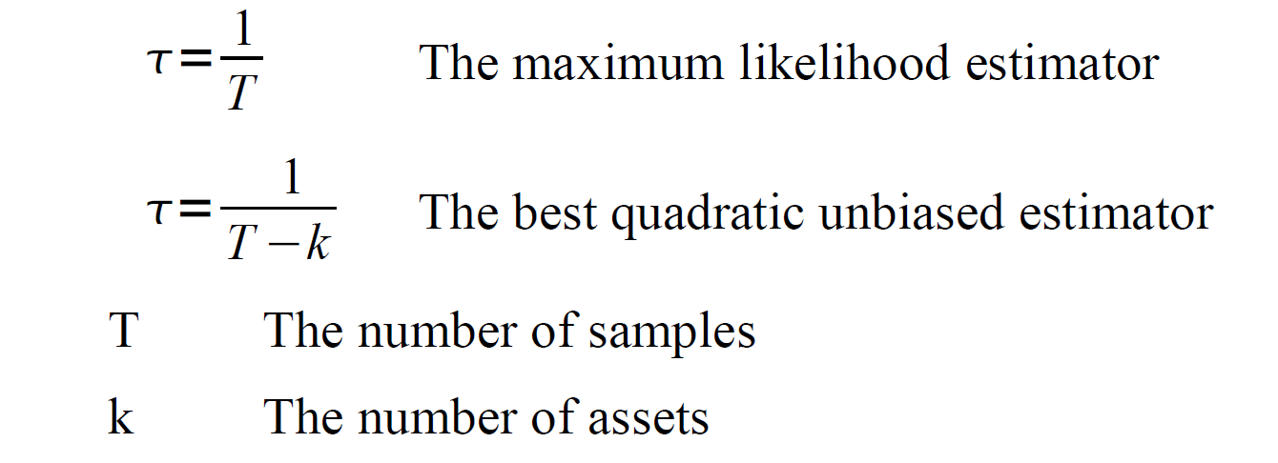
Calibrating τ

Slide 24
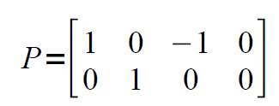
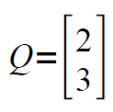
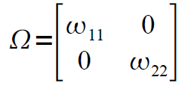
The views
使用者可自訂對資產報酬率的看法(views)
假設有4個資產，2個看法
使用者對各資產的看法
Relative views: 資產1比資產3報酬率高2%, 但有ω₁₁的不確定性
Absolute views: 資產2報酬率為3%, 但有 但有ω₂₂的不確定性
Covariance of the views (must be diagonal),
Need to be estimated

Slide 25
(Estimation of the mean return)
(Given the mean return, estimation of the mean return)
Q已知，只需估計Ω之值。
由上式可知:

Slide 26
Baye’s theory

Slide 27
We have get the posterior distribution of mean return
We want to get the distribution of expected mean
Prior
Posterior

Slide 28
Calculating new weight for each asset
得到新的E(r)的return與covariance，可重新計算新的資金分配

Slide 29

Thank you!!

