Slide 1
Stock trend prediction based on fractal feature selection and support vector machine
＊
Li-Ping Ni , Zhi-Wei Ni, Ya-Zhuo Gao
Expert Systems with Applications 38 (2011) 5569–5576
Presenter:Chang-Hao Huang
Date:June 28, 2011

Slide 2
Abstract(1/2)
Stock trend prediction is regarded as a challenging task. Recently many researches have shown that a successful feature selection method can improve the prediction accuracy of stock market. This paper hybridizes fractal feature selection method and support vector machine to predict the direction of daily stock price index. Fractal feature selection method is suitable for solving the nonlinear problem and it can exactly spot how many important features we should choose. To evaluate the prediction accuracy of this method, this paper compares its performance with other five commonly used feature selection methods.

Slide 3
Abstract(2/2)
The results show fractal feature selection method selects the relatively smaller number of features and it achieves the best average prediction accuracy.

Slide 4
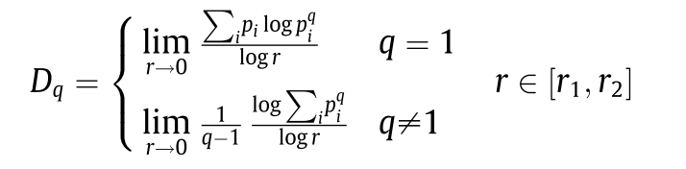
The multifractal dimension Dq

Slide 5
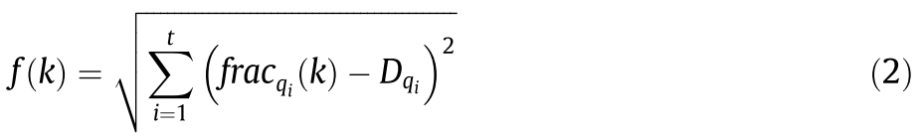
Improved fractal feature selection
Given the qith order fractal dimension Dqi ( i = 1, 2, . . . , t) (the
value of qi is determined in accordance with the dataset) of the
dataset:
(1) Optimization goal by ant colony is to find the optimal feature
subset which contains m ( m = D , D = max(Dqi) ) features
and its fractal dimension is closest to the fractal dimension of original dataset.
(2) During once searching process, each ant visits m nodes; here
one node represents a feature.
(3) Each ant releases pheromone on the nodes it travels according
to fitness. The fitness function is defined as Eq. (2)

Slide 6
m = 4
ant a
ant b

Slide 7
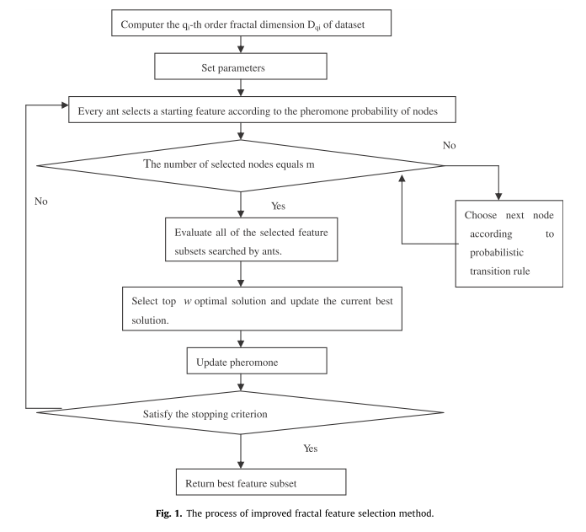

Slide 8
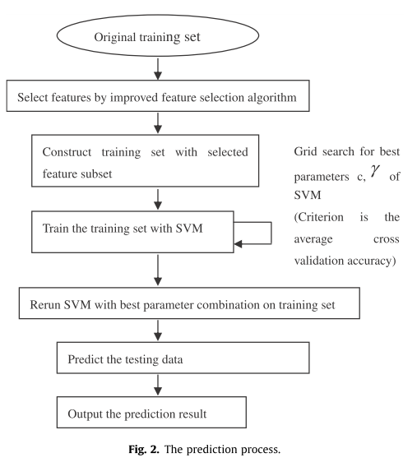

Slide 9

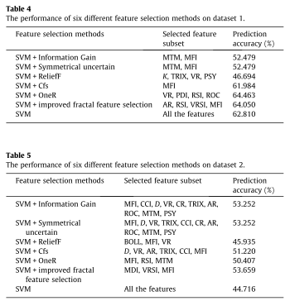
Average prediction accuracy
Imformation gain : 52.87
Symmetrical uncertain : 52.87
Relief : 46.32
Cfs : 56.60
OneR : 57.44
Improved fractal feature selection : 58.86

Slide 10
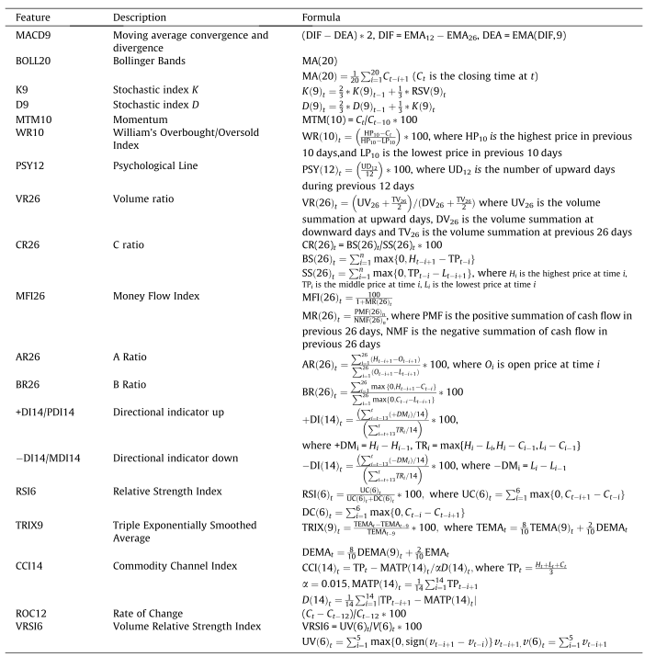

Slide 11
Thanks for your listening !

