Slide 1
A novel clustering approach: Artificial Bee Colony (ABC) algorithm
Dervis Karaboga and Celal Ozturk
Applied Soft Computing, Vol.11, pp. 652–657
Presenter: Chiou-Ting Tseng
Date: June 28, 2011

Slide 2
Abstract
Artificial Bee Colony (ABC) algorithm which is one of the most recently introduced optimization algorithms, simulates the intelligent foraging behavior of a honey bee swarm. Clustering analysis, used in many disciplines and applications, is an important tool and a descriptive task seeking to identify homogeneous groups of objects based on the values of their attributes. In this work, ABC is used for data clustering on benchmark problems and the performance of ABC

Slide 3
Abstract
algorithm is compared with Particle Swarm Optimization (PSO) algorithm and other nine classification techniques from the literature. Thirteen of typical test data sets from the UCI Machine Learning Repository are used to demonstrate the results of the techniques. The simulation results indicate that ABC algorithm can efficiently be used for multivariate data clustering.

Slide 4
AN IDEA BASED ON HONEY BEE SWARM FOR NUMERICAL OPTIMIZATION
D. Karaboga
TECHNICAL REPORT-TR06, Erciyes University, Engineering Faculty, Computer Engineering Department, 2005

Slide 5
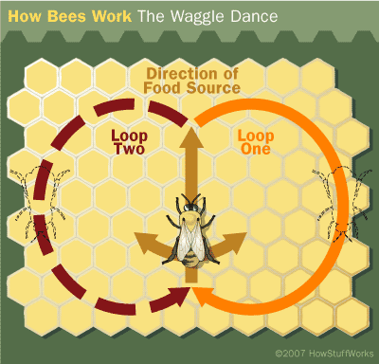
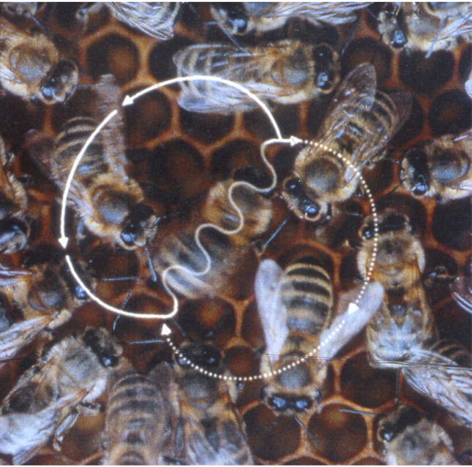
Dancing bees—bee algorithm

Slide 6
waggle dance
one to 100 or more circuits,
two phases: the waggle phase and the return phase.
a waggle run followed by a turn to the right to circle back to the starting point ，another waggle run, followed by a turn and circle to the left, and so on
meanwhile, the Waggle-dancing bees produce info-chemical onto their abdomens and into the air

Slide 7
Colony communication by dancing
three pieces of information regarding a flower patch:
----the direction in which it will be found,
---- its distance from the hive
---- its quality rating (sugar content).
This information helps the colony to send its bees to flower patches precisely, without using guides or maps

Slide 8
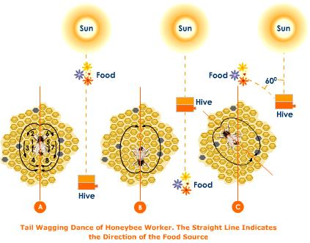

Slide 9
Artificial Bee Colony Algorithm (ABC)
An optimization algorithm based on the intelligent foraging behavior of honey bee swarm.

Slide 10
ABC model
Three groups of bees:
---employed bees,
--- onlookers
---scouts

Slide 11
Employed Bees
They are associated with a particular food source which they are currently exploiting or are “employed” at. They carry with them information about this particular source, its distance and direction from the nest, the profitability of the source and share this information with a certain probability.

Slide 12
Onlookers
Waiting in the nest and establishing a food source through the information shared by employed foragers.

Slide 13
Scouts
Searching the environment surrounding the nest for new food sources

Slide 14
The main steps of the algorithm
Send the scouts onto the initial food sources
REPEAT
  Send the employed bees onto the food sources and determine their nectar amounts
  Calculate the probability value of the sources with which they are preferred by the onlooker bees
  Send the onlooker bees onto the food sources and determine their nectar amounts
  Stop the exploitation process of the sources exhausted by the bees
  Send the scouts into the search area for discovering new food sources, randomly
  Memorize the best food source found so far
UNTIL (requirements are met)

Slide 15
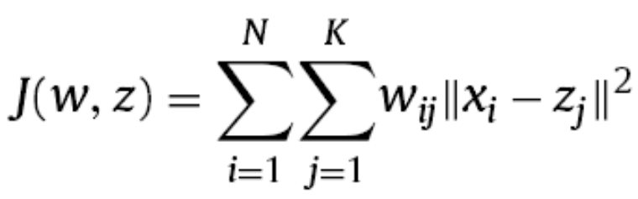
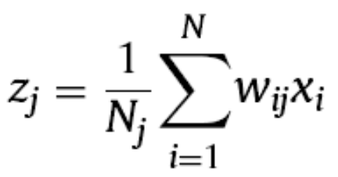
Clustering
Given N objects, allocate each object to one of K clusters and minimize the sum of squared Euclidean distances between each object and the center of the cluster belonging to every such allocated object.

Slide 16
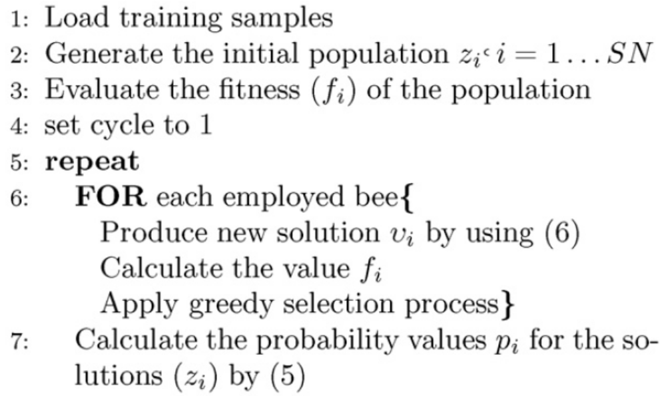
Algorithm

Slide 17
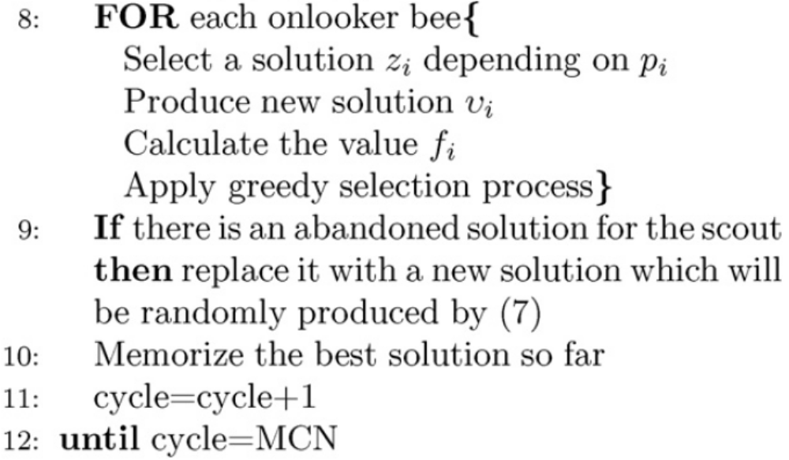
Algorithm

Slide 18
Bees
The number of the employed bees or the onlooker bees is equal to the number of solutions (the cluster centers) in the population

Slide 19
Initial Population
At the first step, the ABC generates a randomly distributed initial population P(C = 0) of SN solutions (food source positions), where SN denotes the size of population. Each solution z_{i} where i = 1, 2, . . . , SN is a D-dimensional vector.
D is the number of product of input size and cluster size for each data set, i.e. the number of optimization parameters. (把中心的座標串起來)

Slide 20
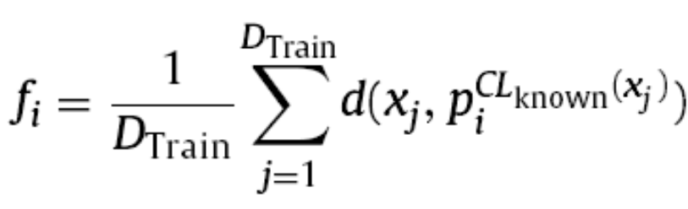
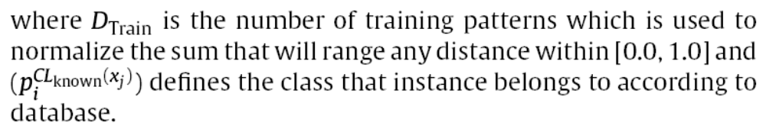
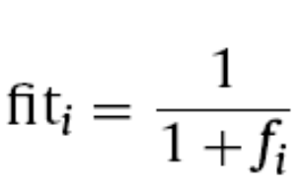
Fitness

Slide 21
Employee Bees
An employed bee produces a modification on the position (solution) in her memory depending on the local information (visual information) and tests the nectar amount (fitness value) of the new source (new solution).

Slide 22
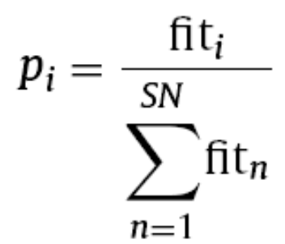
Onlooker Bees
An onlooker bee evaluates the nectar information taken from all employed bees and chooses a food source with a probability related to its nectar amount.

Slide 23
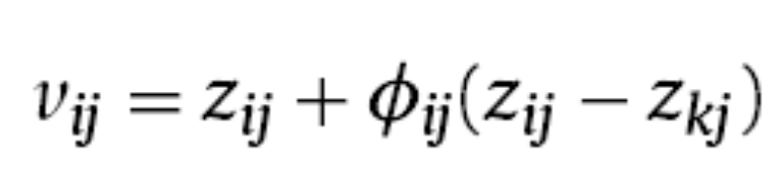
Modification
k ∈ {1, 2, . . . , SN} and j ∈ {1, 2, . . . , D} are randomly chosen indexes.
Φ_{i,j} is a random number between [−1, 1]. It controls the production of neighbor food sources around z_{i,j} and represents the comparison of two food positions visible to a bee.

Slide 24
Abandoned Food Source
Providing that a position cannot be improved further through a predetermined number of cycles, then that food source is assumed to be abandoned.

Slide 25
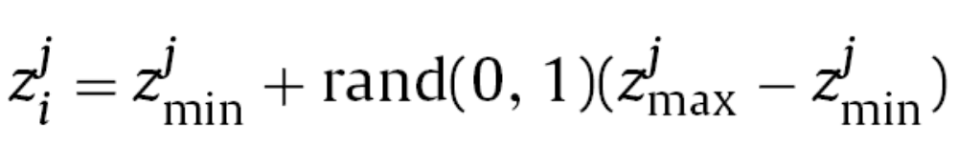
Scout Bee

Slide 26
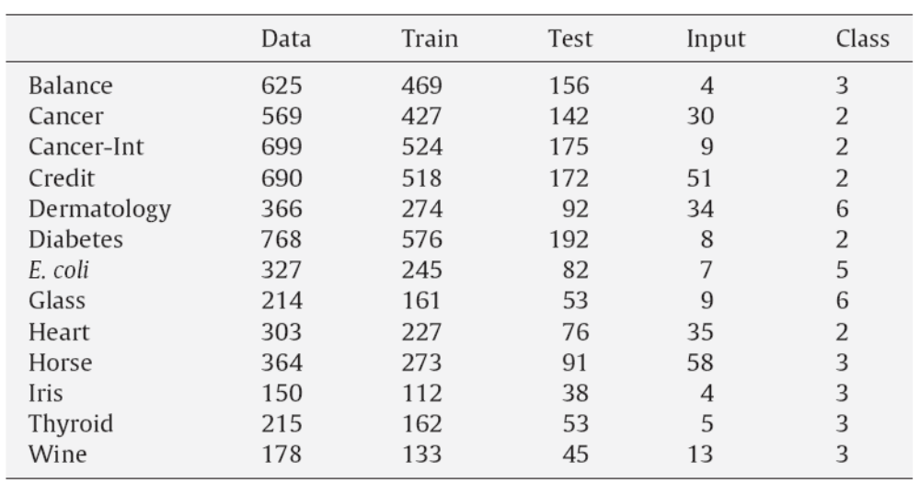
Testing Data
13 classification problems from the UCI database.
75% training, 25% testing

Slide 27
Parameter
The parameters of PSO algorithm are: n = 50, T_{max} = 1000, v_{max} = 0.05, v_{min} = −0.05, c₁ = 2.0, c₂ = 2.0, w_{max} = 0.9, w_{min} = 0.4
ABC: colony size 20, maximum cycle/generation number (MCN) 1000, and limit value 1000

Slide 28
Other Methods
PSO
BayesNet [34] from the Bayesian
MultiLayer Perceptron Artificial Neural Network (MLP) and the Radial Basis Function Artificial Neural Network (RBF) from the function-based
KStar from the lazy
Bagging and the MultiBoostAB from the meta-techniques
Naive Bayes Tree (NBTree) from the tree-based ones
Ripple Down Rule (Ridor) from the rulebased ones
Voting Feature Interval (VFI)

Slide 29
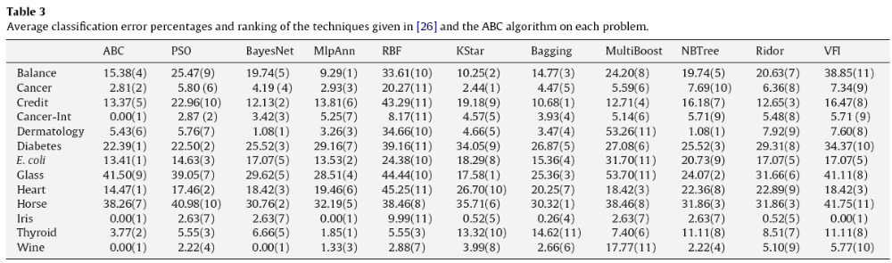
Result

Slide 30
Reference
http://mf.erciyes.edu.tr/abc/ 當初提出本方法的作者蒐集的各種資源
朝陽科大有人用來作protein folding http://ethesys.lib.cyut.edu.tw/ETD-db/ETD-search-c/view_etd?URN=etd-0731109-110359

