Slide 1
Ant Colony Optimization
Artificial Ants as a
Computational Intelligence Technique
Marco Dorigo, Mauro Birattari, and Thomas Stützle
IEEE COMPUTATIONAL INTELLIGENCE MAGAZINE | NOVEMBER 2006
Presenter: Chang-Hao Huang
Date: July 28, 2011

Slide 2
Abstract(1/2)
Swarm intelligence is a relatively new approach to problem solving that takes inspiration from the social behaviors of insects and of other animals. In particular, ants have inspired a number of methods and techniques among which the most studied and the most successful is the general purpose optimization technique known as ant colony optimization. Ant colony optimization (ACO) takes inspiration from the foraging behavior of some ant species. These ants deposit pheromone on the ground in order to mark some favorable path that should be followed by other members of the colony.

Slide 3
Abstract(2/2)
Ant colony optimization exploits a similar mechanism for solving optimization problems. From the early nineties, when the first ant colony optimization algorithm was proposed, ACO attracted the attention of increasing numbers of researchers and many successful applications are now available. Moreover, a substantial corpus of theoretical results is becoming available that provides useful guidelines to researchers and practitioners in further applications of ACO. The goal of this article is to introduce ant colony optimization and to survey its most notable applications.

Slide 4
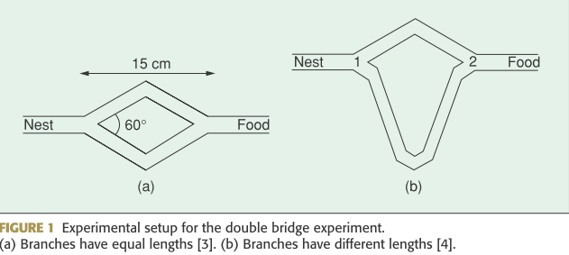
Biological Inspiration

Slide 5
Main ACO Algorithms
1. Ant System (AS)
2. MAX −MIN Ant System (MMAS)
We use the traveling salesman problem as a concrete example.

Slide 6
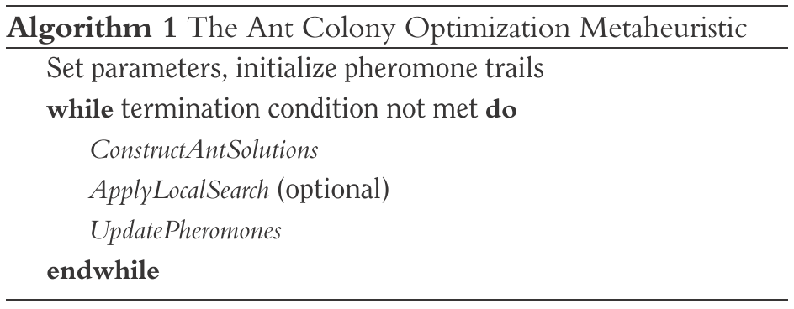

Slide 7
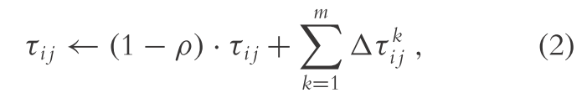
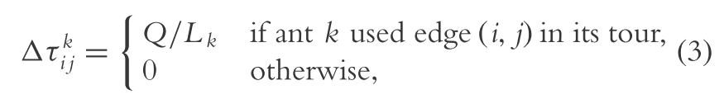
Ant System (AS)
Update

Slide 8
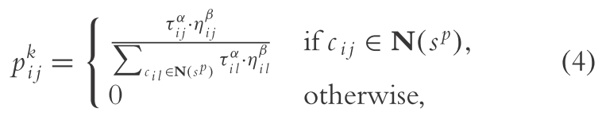
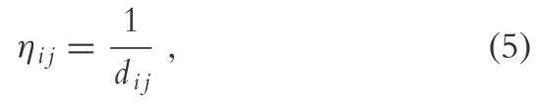
Choose next city

Slide 9

Nest
Food
A
100
D
x
y
z
20
40
60
70
B
C
10
Food
Food

Slide 10
1
Initial set
p=0.5, α=1, β=1, τ_{i,j} =1andQ=100
Iteration 1
p = (1/60)/(1/100+1/20+1/60) = 0.2173
p = 300/460 = 0.6521
P = 60/460 = 0.1304
A
D
1
1
1
1
B
C
1
A,B
A,C
A
100
D
A,D
20
40
60
70
y
z
x
B
C
10

Slide 11
p = (1/10) / (1/70 + 1/10) = 0.875
p = 0.125
p = (1/10) / (1/40 + 1/10) = 0.5
p = 0.2
C,B
C,D
B,C
A
100
D
B,D
20
40
60
70
y
B
C
z
x
10

Slide 12
A
0.5
D
Pheromone update:
Ant x : A→C →B →D Lx = 70
Ant y : A→C →D →B Ly = 130
Ant z : A →B →C →D Lz = 140
τ = (1-0.5)*1 + 100/70 + 100/130 = 2.697
τ = (1-0.5)*1 + 100/70 + 100/140 = 2.642
τ = (1-0.5)*1 + 100/70 + 100/130 = 2.697
τ = (1-0.5)*1 + 100/140 = 1.214
τ = (1-0.5)*1 + 100/140 + 100/130 = 1.983
1.214
1.983
2.697
2.697
B
C
2.642
AC
BC
BD
AB
CD

Slide 13
Iteration 2
p_{A,B} = (1.214/60)/(0.5/100+2.697/20+1.214/60)
= 0.126
p_{A,C} = 0.842
p_{A,D} = 0.031
p_{C,B} = (2.642/10)/(2.642/10+1.983/70) = 0.903
p_{C,D} = 0.096
A
0.5
D
1.214
1.983
2.697
2.697
B
C
2.642

Slide 14
A
100
D
20
40
60
70
B
C
10

Slide 15
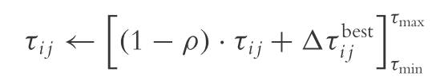
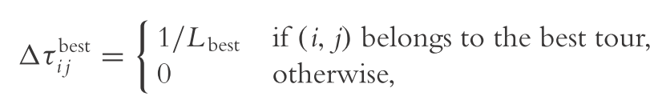
MAX −MIN Ant System (MMAS)
Update
1

Slide 16
