Slide 1
Protein structure prediction and model quality assessment
Andriy Kryshtafovych and Krzysztof Fidelis
Drug Discovery Today, Vol. 14, Issues 7-8, pp. 386-393, April 2009
Presenter: Hsin-Fang Wu
Date: July 25, 2011

Slide 2
Abstract
Protein structures have proven to be a crucial piece of information for biomedical research. Of the millions of currently sequenced proteins only a small fraction is experimentally solved for structure and the only feasible way to bridge the gap between sequence and structure data is computational modeling. Half a century has passed since it was shown that the amino acid sequence of a protein determines its shape, but a method to translate the sequence code reliably into the 3D structure still remains to be developed. This review summarizes modern protein structure prediction techniques with the emphasis on comparative modeling, and describes the recent advances in methods for theoretical model quality assessment.

Slide 3
Method
Modern experimental methods for determining protein structure through X-ray crystallography or NMR spectroscopy can solve only a small fraction of proteins sequenced, because of technology limitations and time constraints.
Currently, there are more than 6,800,000 protein sequences accumulated in the nonredundant protein sequence database and fewer than 50,000 protein structures in the PDB.

Slide 4
Protein structure modeling and CASP
The proteins suggested for prediction are either structures soon-to-be solved or structures already solved.
The Prediction Center at the University of California, Davis performs an evaluation of the submitted models comparing them to the ‘gold standard’ – the experimental structures.
The papers by the assessors and by the most successful prediction groups are published in special issues of the journal Proteins: Structure, Function and Bioinformatics.

Slide 5
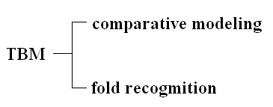
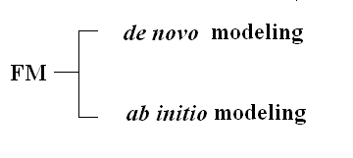
Prediction methods
As defined by the current CASP classification, protein structure prediction methods can be divided into two broad categories: template-based modeling (TBM) and free modeling (FM). Each of these categories can be further split into two subcategories: TBM – into comparative modeling and fold recognition, and FM – into knowledge-based de novo modeling and ab initio modeling from first principles.

Slide 6
Template-based modeling in light of CASP
The template-based methods currently offer the most reliable prediction results, but their applicability is limited to cases where it is possible to identify a structurally similar protein that can be used as a template for building the model.
Chothia and Lesk have shownthat similar sequences normally yield similar 3D structures.
If at least a single structure within a family is determined experimentally, then homology modeling can be used to model the structures of all members of that family.

Slide 7
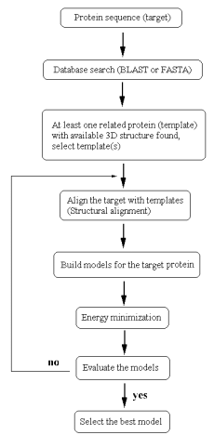
同源模擬法是根據同源蛋白質三級結構的保留性超過蛋白質序列的理論，通常在 蛋白質序列上稍微的改變其三級結構亦改變很小。在蛋白質序列之一致性 大於30% 的前提下，一個未知結構的蛋白質可以利用一個或一個以 上與其相關的結構來建立其三維結構。
同源模擬法五個主要的步驟：
(1)資料庫搜尋及選擇模版（templates）
(2)多重序列排列（multiple sequence alignment）
(3)骨架的建構，環狀結構模擬及側鏈模擬
(4)能量最小化（energy minimization）
(5)結構合理性評估

Slide 8
Template-based modeling in light of CASP
Even if a template for a modeled protein cannot be identified using sequence similarity, suitable templates may still exist among the already known structures. The methods that check compatibility of a protein with existing folds using more sophisticated analysis may stand the chance of identifying the correct fold.
Starting in CASP7 (2006), comparative modeling and fold recognition methods are assessed together in one template-based difficulty category.

Slide 9
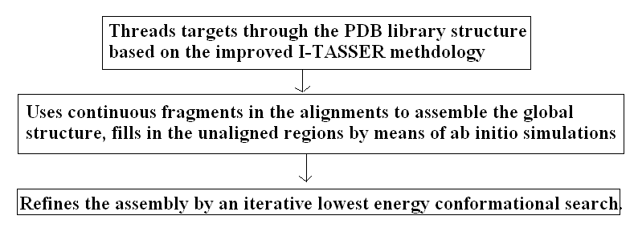
The top two teams using template-based modeling
Yang Zhang (University of Kansas):

Slide 10
The top two teams using template-based modeling
David Baker (University of Washington): Baker’s group utilized hundreds of thousands of CPUs to build the optimal model.
Baker’s TBM approach uses three different strategies depending on the target length and target–template sequence similarity, and in general relies on computationally demanding sampling of conformational space coupled with an iterative all-atom refinement.

Slide 11
Template-based modeling in light of CASP
In general, in CASP7 servers were at least on par with humans (three or more models in the best six) for about 20% of targets; and significantly worse than the best human model for only very few targets.
If the target–template sequence identity falls below the 20% level, as many as half of the residues in the model may be misaligned.
The best models for the majority of targets with greater than 30% sequence identity to a template have practically all residues correctly aligned.

Slide 12
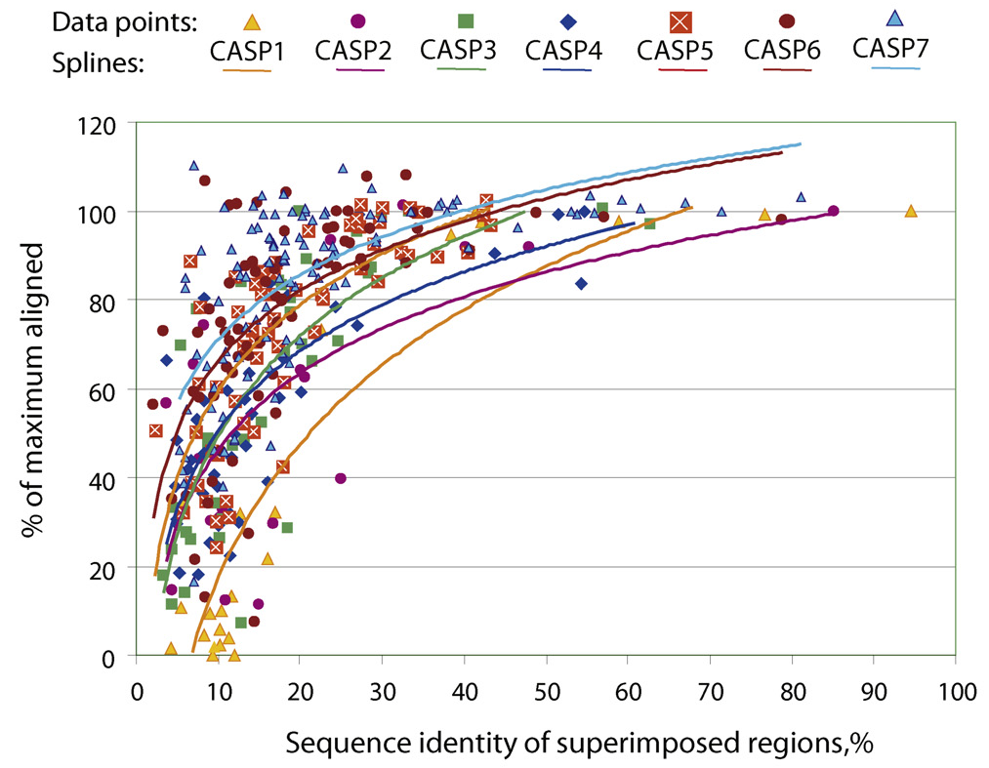
Template-based modeling in light of CASP
model quality提昇. 可能藉由使用其他的模板、refinement或TF 方法
用best model 正確預測的殘基數
由best template 和 target structure 得到的最大殘基數

Slide 13
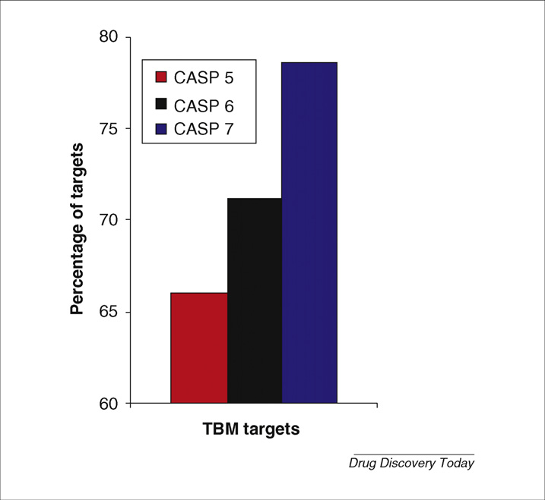
Template-based modeling in light of CASP
Figure shows that the percentage of targets where the best submitted models are better than a naïve single template model is steadily growing for the latest three CASPs. In CASP7, almost 80% of the best models in this category have registered added value over the naïve model.

Slide 14
Modeling proteins of unknown fold
As the sequence similarity between the target and the available templates falls into the so-called twilight zone (sequence identity <25%), the resulting models become less accurate. In the most challenging cases, where neither significant sequence similarity nor structural similarity can be detected, FM methods are called upon.
CASP experiments demonstrate that the quality of FM predictions remains in general poor compared with predictions that are based on templates and insufficient for many biomedical applications. These methods do occasionally produce quite accurate models for a few of the smaller targets.

Slide 15
CASP7 assessment of MQA programs
Typically, the features taken into account are the molecular environment, hydrogen bonding, secondary structure, solvent exposure, pair-wise residue interactions and molecular packing.
The predictors were asked to submit a single global quality score for the entire model as well as assign error estimates on per-residue basis.
Pcons (Sweden) and LEE (Korea), outperformed other CASP7 participants in a statistically significant manner based on the results of the paired t-test assessment.
The LEE group, based their technique on a comparison of query models with their own, and assigned rank in accordance with the distance between the models.

Slide 16
CASP7 assessment of MQA programs
Pcons is a consensus-based method capable of a quite reliable ranking of model sets for both easy and hard targets. Pcons uses a meta-server approach to calculate a quality score reflecting the average similarity of a model to the model ensemble.
While the consensus-based methods are useful in model ranking, they can be biased by the composition of the set and, in principle, are incapable of assessing the quality of a single model.
Consensus-based assessment expands on the common practice of consensus decision-making and the theoretical observation that expertise can be closely approximated by large numbers of novices or journeymen. It creates a method for determining measurement standards for very ambiguous domains of knowledge, such as emotional intelligence, politics, religion, values and culture.

Slide 17
Recent advances in MQA methods
Chen and Kihara examined the stability of the target–template alignments relative to the corresponding sets of suboptimal alignments and developed a model quality estimator based on these parameters, called SPAD.
Gao et al. addresses a very similar problem by predicting a C-alpha RMSD between the aligned ungapped template fragments and the corresponding fragments in the native structure. This is done using support vector regression on features extracted from the alignment of the two sequences and those of the template structure, called FragQA.
SVR 的目標為尋找空間中的最適平面(hyperplane)。和SVM 不同的是,SVM 找的是能將資料一分為二的平面,而SVR 所找的則是能準確預測資料分佈的平面。

Slide 18
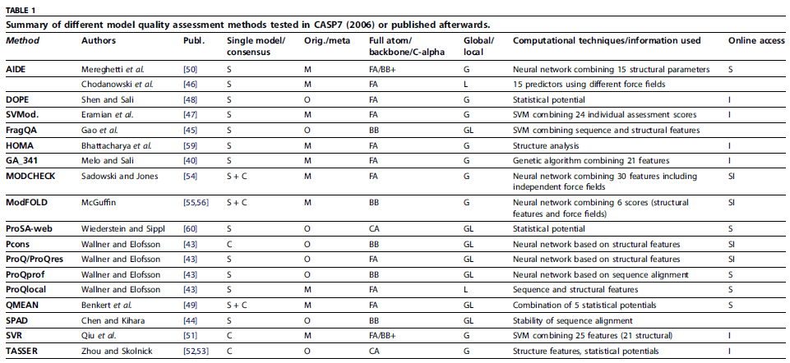
Recent advances in MQA methods

Slide 19
Conclusion
In cases of high homology, is sufficient for applications as demanding as drug design.
FM methods are not mature enough for routine biomedical applications, but the first instances of high-resolution structure prediction in the absence of templates have now been reported.
Development of tools to assess model quality reliably is needed.

Slide 20
Thanks for your listening !!

