Slide 1
An Immunological Approach to Dynamic Behavior Control for Autonomous Mobile Robots
IEEE International Conference on Intelligent Robots and Systems 95.’Human Robot Interaction and Cooperative Robots’, Proceedings. 1995, vol. 1, pp.495-500, 5-9
Aug., 1995.
Presenter: Yun-Shiun Chen
Data:2011/08/09

Slide 2


Slide 3
Abstract
Conventional AI (Artificial Intelligence) technology has been criticized on many grounds such as brittleness under dynamically changing environments. To overcome this problem, another approaches called New AI, Emergent Computation, Animat Approach, Behavior-Based AI and so on were proposed and confirmed their usefulness. On the other hand, biological information processing systems have many interesting functions and are expected to provide various feasible ideas to engineering fields, especially robotics. Immune system plays important roles to maintain its own system against dynamically changing environments. Therefore, we believe that immune system would provide a new paradigm suitable for dynamic problem dealing with unknown environments rather than static problem. In this paper, we propose a new approach to behavior-based AI by paying attention to biological immune system. We confirm the feasibility of our proposed method by applying to a behavior control of an autonomous mobile robot in cluttered environment as a practical example.
Notes:
Paradigm 範例

Slide 4
Conventional artificial systems
Conventional artificial systems
a functional decomposition
"sense-model-plan-action" cycle
brittleness for environmental changes
required much computing time for mapping complex sensory inputs into complex internal models before action can be taken
In recent years much attention has been focused on the reactive planning systems
behavior-based AI
new AI
emergent computation
animat approach
Notes:
Emergent computaion is a type of computation that is bottom-up and not globally nor totally programmed. Only local information or very limited amount of information is used for a unit of computation.
Animats are artificial animals, a contraction of anima-materials.

Slide 5
Biological information system
Biological information system in living organisms can be mainly classified into the following four systems
(1) brain-nervous system
(2) genetic system
(3) endocrine system
(4) immune system

Slide 6
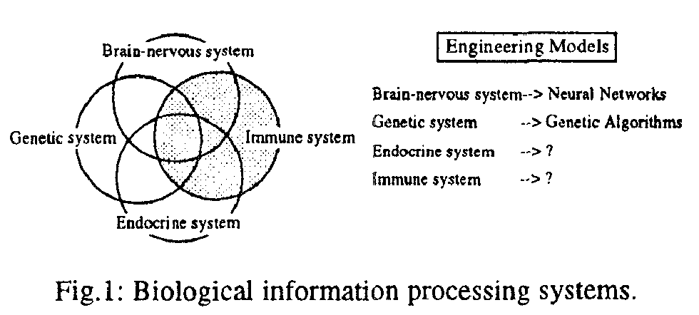
Biological information system
Notes:
Brain-nervous system : 腦神經系統
endorcrine [en do crime] : 內分泌系統

Slide 7
Immune System
Immune system, in particular, have various interesting features such as
immunological memory
immunological tolerance
micro-pattern recognition
Nonhierarchical distributed structure
not only detect and eliminate the non-self materials called antigen, but plays important roles to maintain its own system against dynamically changing environments.

Slide 8
Overview of Immue System
The basic components of the immune system are
B-lymphocytes
T-lymphocytes
B-lymphocytes
produced by bone marrows
Roughly 10⁷ distinct types of B-lymphocytes in human body
produces many "Y" shaped antibodies from its surfaces
The antibody specifically recognizes an antigen like a key and lock relationship.
The portion on the antigen recognized by the antibody is called epitope (antigen determinant), and the one on the antibody that recognizes the corresponding antigen determinant is called paratope.
Notes:
antigen : 抗原
epitope (antigen determinant): 抗原決定簇 (就像key)
paratope: 〔抗原〕互補位 (就像lock)

Slide 9
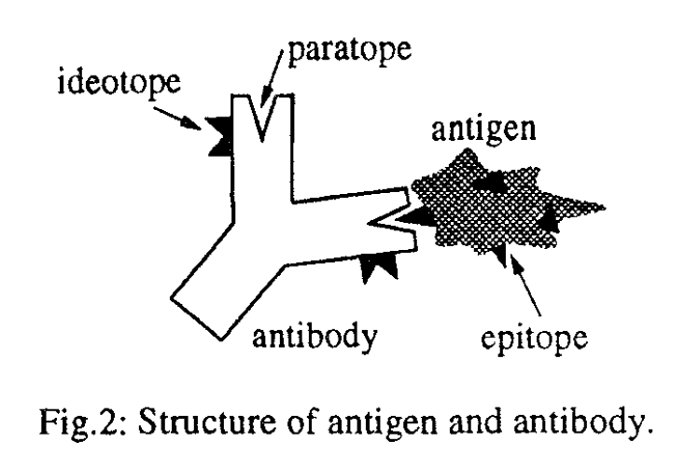
Overview of Immune System
Notes:
早期對抗體抗原的概觀，抗原彼此是獨立運作的 遇到某種抗原，可以對付他的抗體會自行運作
為求講解方便
ideotope簡稱 i-key
paratope簡稱 ilock
epitope簡稱 e-key

Slide 10
Immune network hypothesis
Based on the above fact, N.K.Jerne who is an immunologist proposed a remarkable hypothesis: idiotypic network hypothesis.
This hypothesis explains that antibodies do not exist independently in living organisms, but communicate with each other through idiotope and paratope.

Slide 11
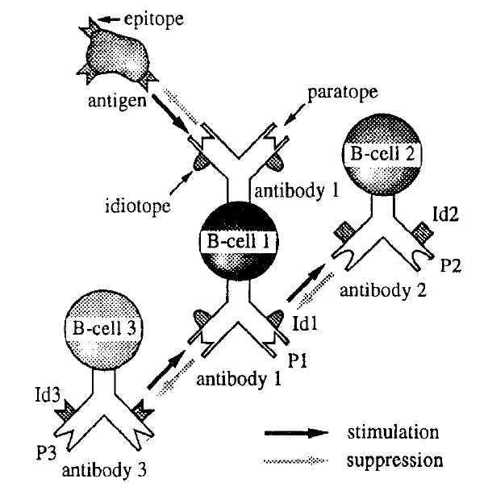
Immune network hypothesis

Slide 12
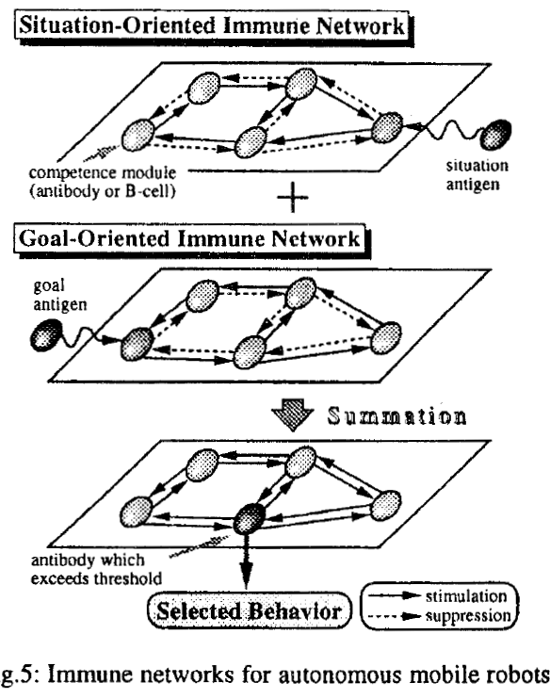
Behavior control system
Notes:
上下網路的點數目一樣
Stimulation和suppression為相反方向

Slide 13
Behavior control system
In the situation-oriented immune network layer, antigen has the information on the current situation such as the existence of obstacles and the direction of destination.
paratope : represents conditions that have to be fulfilled before the antibody can be selected
idiotope : represents the expected situation of the antibody concerned implements its own action to real world.
the interaction (i.e., stimulation and suppression) between paratope and idiotope is generated based on the chain of causality.
Notes:
paratope: 表示選擇該抗體需要的先滿足的條件(想要做這件事要受到怎樣的刺激)
idiotope: 表示該抗體要表現出自己的行為時期望的狀況(做了這件事情會給怎樣的刺激)
兩者的關系為一種連鎖的因果關係
situation-oriented : cause-to-effect -> 你這樣做，所以會有那樣結果
goal-oriented : effect-to-cause -> 你想要這結果，所以要那樣做

Slide 14
Behavior control system
In the goal-oriented immune network layer, antigen has the information on given demand such as approaching goal and so on.
Note that the directions of stimulation and suppression links in this network are opposite to those in the situation-oriented immune network.
This is because the effect-to-cause chain of behaviors is required for accomplishment of given demand.
In other words, situation-oriented and goal-oriented immune networks play the roles of data-driven and conceptually-driven processing system, respectively.

Slide 15
Dynamics of antibody selection mechanisms
The total concentration of antibody I, a_{i} , is defined as follows:

Slide 16
Dynamics of antibody selection mechanisms
The concentration of i-th antibody in the situation-oriented immune network:
1st term : activation level that other antibodies spread to antibody i (stimulation from other antibodies)
2nd term : activation level that antibody i spreads to other antibodies (suppression from other antibodies)
3rd term : external input of activation to antibody I (from antigens)
4th term : dissipation (natural death)
The concentration of i-th antibody in the goal-oriented immune network can be calculated in the same way.

Slide 17
Maes's approach
An agent in Maes's behavior network is described by a tuple (Ip, la, id, a).
lp : a list of preconditions ( antibodies )
la : add lists ( paratope )
Id : delete lists ( idiotope )
a : activation level ( contracention )
There are many correspondences between our proposed methods and Maes's approach.
Moreover, situation detected by agents and goals given to the society of agents works as antigen or epitope, and the interaction between agents corresponds to stimulation and suppression between antibodies.

Slide 18
Maes's approach
The equations of antibody's selection based on the immunological dynamics are different from those of Maes's behavior networks.
In the proposed method, quantity of spreading activation to the other antibodies are taken into account of both the concentrations of source and sink antibodies,
whereas in Maes's network the above quantity considers merely the activation of the agent concerned.
Notes:
本篇論文中activation的進出都有考慮，但是Maes’s的沒有，此為最大差別。

Slide 19
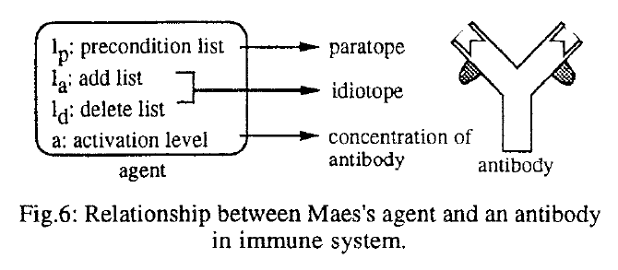
Maes's approach

Slide 20
Application to behavior control of autonomous mobile robots
We equipped this robot with two kinds of detector:
obstacle detectors
Intalled in eight directions and they can detect the existence of obstacles
detectable range is assumed to be as three times as the radius of the robot
goal detectors.
recognizes the direction of destination at any position
Notes:
障礙偵測為機器人的三倍大遠
終點位置偵測為無限遠(只知道方向)

Slide 21
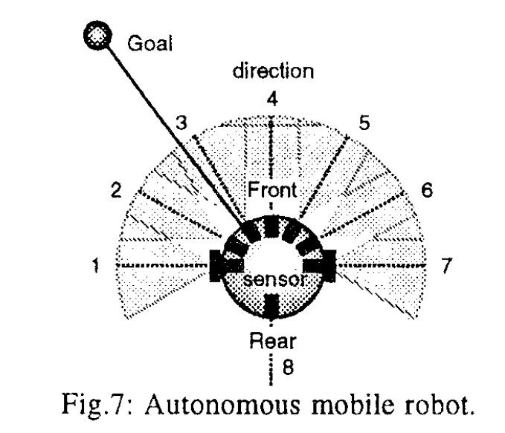
Application to behavior control of autonomous mobile robots

Slide 22
Application to behavior control of autonomous mobile robots
To be able to cope with the surrounding environment properly, we must set various kinds of antibodies (i.e., repertoires of simple behavior modules).
eight kinds of simple behaviors:
move forward, move backward, turn right (30 60 90), turn left (30 60 90).
paratope : precondition which have to be fulfilled before the antibody can be selected
idiotope : the expected situation of the antibody concerned implements its own action to real world

Slide 23
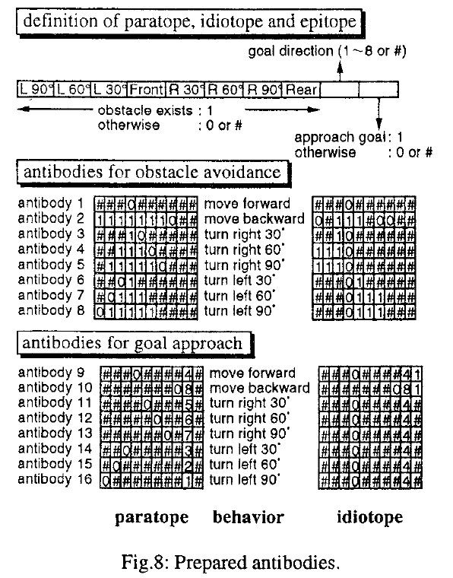

Slide 24
Application to behavior control of autonomous mobile robots

Slide 25
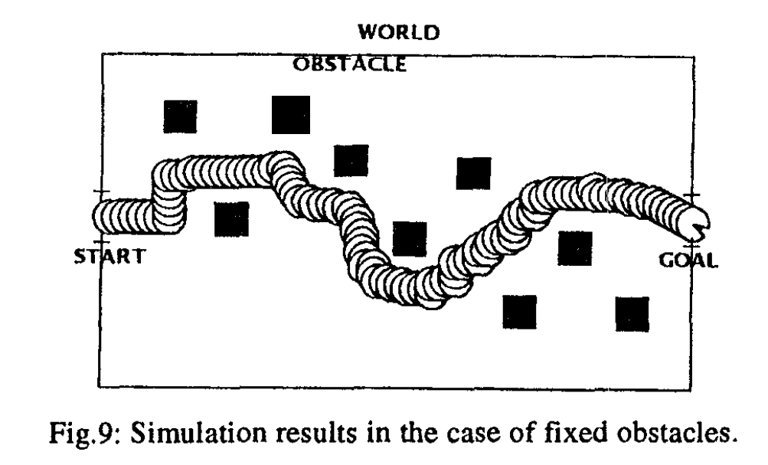
Simulation results in the case of fixed obstacles

Slide 26
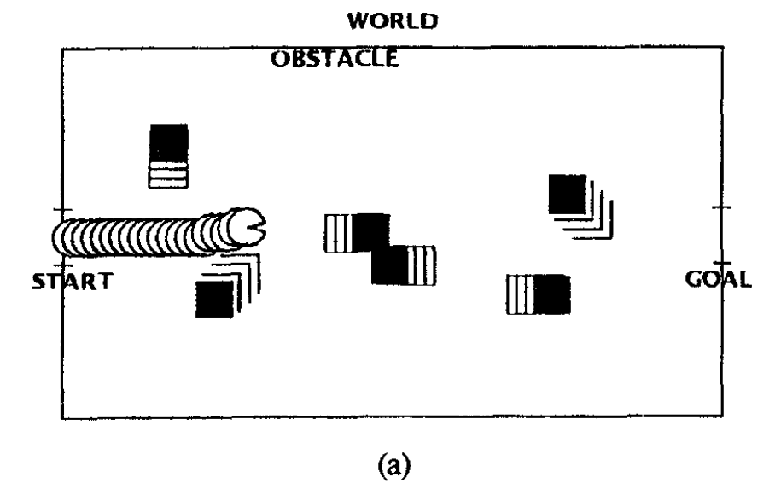
simulation results in the case of moving obstacle environment (1)

Slide 27
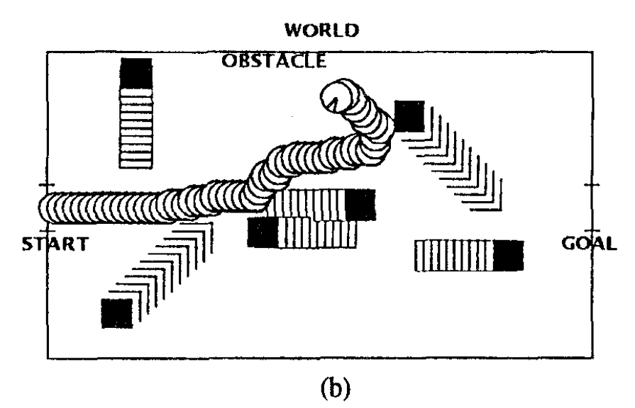
simulation results in the case of moving obstacle environment (2)

Slide 28
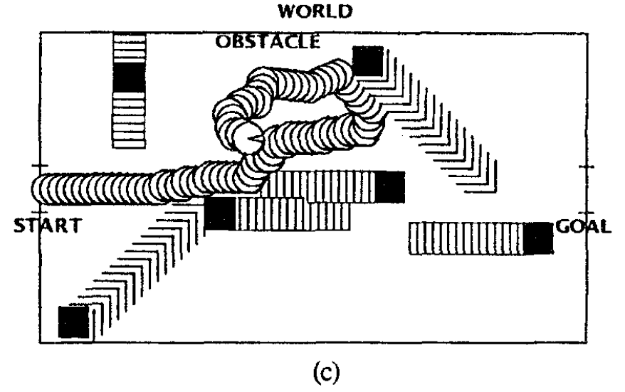
simulation results in the case of moving obstacle environment (3)

Slide 29
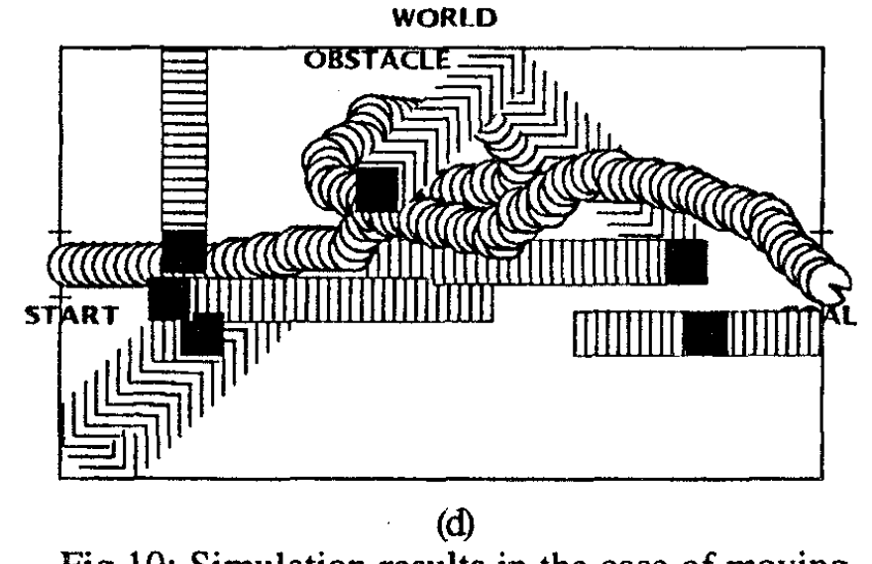
simulation results in the case of moving obstacle environment (4)

Slide 30
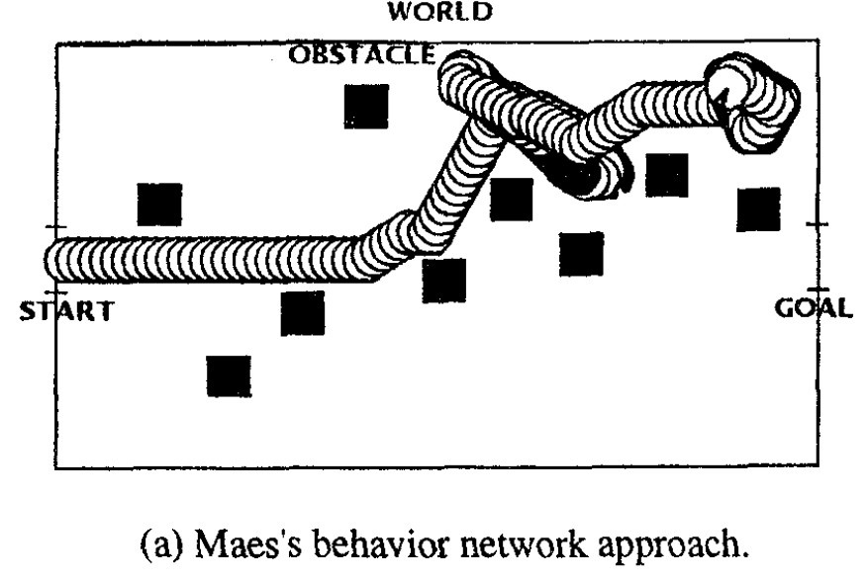
Comparison proposed method with Maes’s

Slide 31
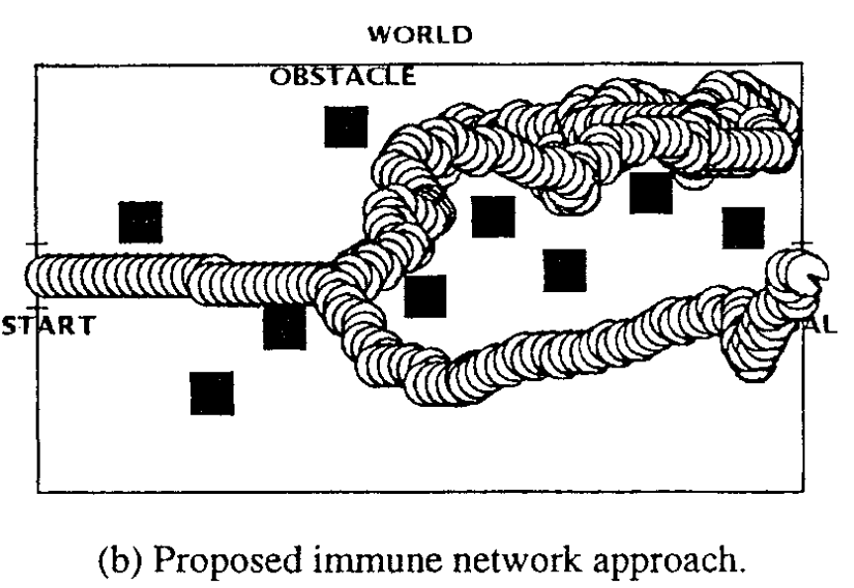
Comparison proposed method with Maes’s

Slide 32
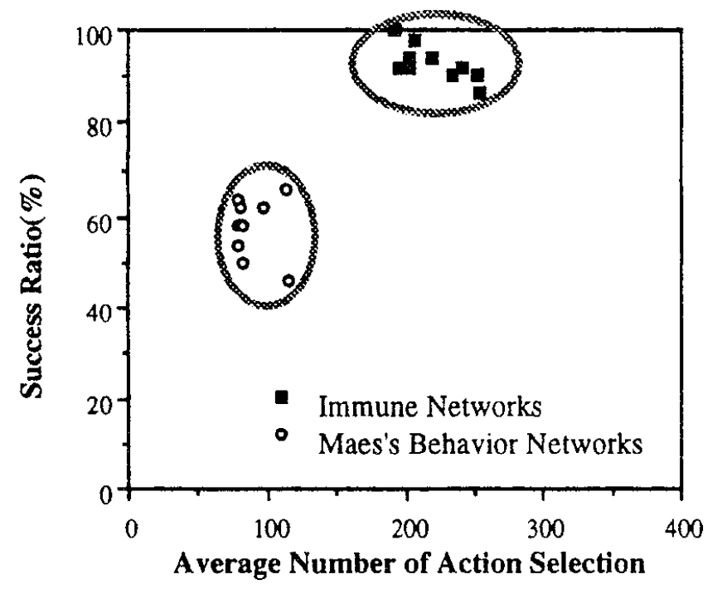
Comparison proposed method with Maes’s

Slide 33
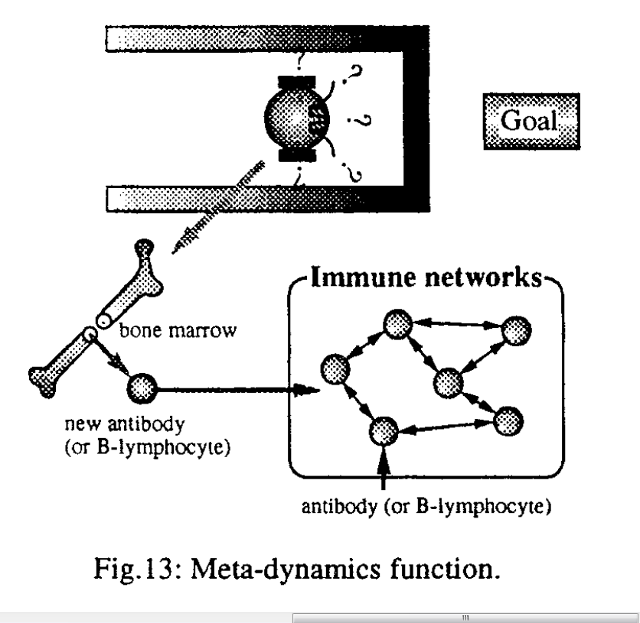
Conclusions and Future Work
Notes:
在現實中，免疫系統會自動不斷產生新的抗體，並自動加入原本免疫系統網路中，該特徵稱為”Meta-dynamics function”
作者希望未來可以將此特徵加入他們系統中

Slide 34
Thank you!!

