Slide 1
The accessible surface area and stability of oligomeric proteins [寡聚蛋白質]
Miller Susan, Lesk Arthur M., Janin Joel and Chothia Cyrus
Nature, Volume 328, Issue 6133, pp. 834-836,1987

Slide 2
Abstract
Protein structures are stabilized by hydrophobic[疏水的] and van der Waals forces, and by hydrogen bonds. The relation between these ther-modynamic quantities and the actual three-dimensional structure of proteins can not be calculated precisely. However, certain empirical relations have been discovered. Hydrophobic energy is gained by the reduction of surface in contact with water. For monomeric[單體的] proteins, the area of the surface accessible to solvent, and of that buried in the interior, is a simple function of molecular weight. Proteins with different shapes and secondary structures, but of the same molecular weight, have the same accessible surface area.

Slide 3
Abstract
It has been argued that there is no similar relationship for large oligomeric proteins. In this paper we show that the surface areas of oligomeric proteins, and the areas of the surface buried within them, are directly related to relative molecular mass. Although oligomers of the same molecular weight bury the same amounts of surface, the proportions buried within and between subunits vary. This has important implications for the role of subunit interfaces in the stability and activity of oligomeric proteins.

Slide 4
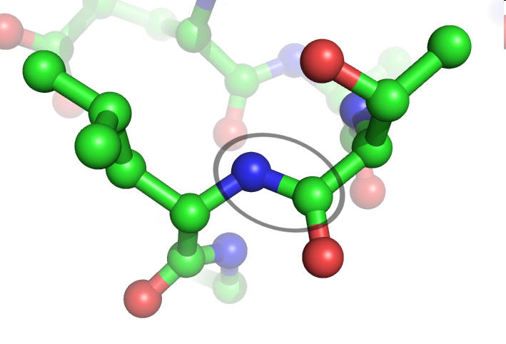
Peptide
A peptide bond (circled) between Leu and Thr in a protein structure. Green=carbon, red=oxygen, blue=nitrogen. Hydrogens atoms are omitted for clarity. (氨基酸間靠一個氨基酸的羧基與相鄰氨基酸的氨基形成肽鍵而連在一起)
http://www.google.com.tw/imgres?imgurl=http://upload.wikimedia.org/wikipedia/commons/e/e5/Peptide_bond.png&imgrefurl=http://zh.wikipedia.org/zh-hant/File:Peptide_bond.png&usg=__kVncumA2fJRO5hFP1fbFvR9hDKc=&h=482&w=709&sz=113&hl=zh-TW&start=10&sig2=1A2cVnB29Q9Lc3nvocGVtw&zoom=1&itbs=1&tbnid=0qZisJqY00P4zM:&tbnh=95&tbnw=140&prev=/images%3Fq%3DPeptide%26hl%3Dzh-TW%26client%3Dopera%26sa%3DX%26rls%3Dzh-tw%26tbs%3Disch:1%26prmd%3Divns&ei=zhlSTduPF4akvgOuqP33CA
Notes:
數個氨基酸靠一個氨基酸的羧基與相鄰氨基酸的氨基形成肽鍵而連在一起

Slide 5
Complexes
Peptides are short polymers of amino acids linked by peptide bonds.
A polypeptide is a single linear chain of amino acids bonded together by peptide bonds.
A multiprotein complex (or protein complex) is a group of two or more associated polypeptide chains.
Complexes of proteins are non-covalent protein assemblies that fold separately and associate under certain physiological[生理學的] conditions.
Can be determined by X-ray crystallography
http://en.wikipedia.org/wiki/Multiprotein_complex

Slide 6
Interfaces
Protein-protein interaction sites or interfaces can be defined as those protein surface residues or atoms that become buried upon complex formation.
Protein interface regions clearly differ on average from the rest of the protein surface in terms of physicochemical properties and geometric characteristics.
Simon Leis et al., "In Silico Prediction of Binding Sites on Proteins "

Slide 7
Interfaces
The interactions between proteins are very diverse. It is therefore not possible to distinguish a binding site from the rest of the protein surface based on a single surface attribute.
Interface regions are enriched in aliphatic (Leu, Val, Ile, Met) and aromatic (His, Phe, Tyr, Trp) residues, and depleted in charged residues (Asp, Glu, Lys) with the exception of arginine.
Simon Leis et al., "In Silico Prediction of Binding Sites on Proteins "

Slide 8
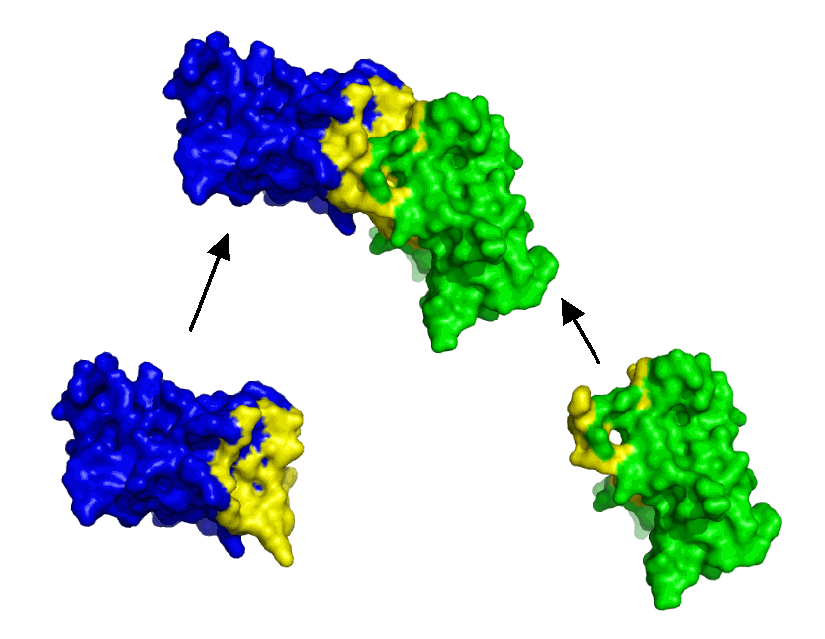
Interfaces
http://www.stats.ox.ac.uk/~hamer/images/complex.png

Slide 9
Monomer
The term "monomeric protein" may be used to describe one of the proteins making up a multiprotein complex.
The lower molecular weight compounds built from monomers are also referred to as dimers, trimers, tetramers, pentamers, octamers, 20-mers, etc. if they have 2, 3, 4, 5, 8, or 20 monomer units, respectively.
Molecules made of a small number of monomer units, up to a few dozen, are called oligomers
http://en.wikipedia.org/wiki/Monomer

Slide 10
Oligomer
In chemistry, an oligomer is a molecule that consists of a few monomer units (oligos, is Greek for "a few").
In biochemistry, it can also refer to a protein complex made of two or more subunits. In this case, a complex made of several different protein subunits is called a hetero-oligomer or heteromer. When only one type of protein subunit is used in the complex, it is called a homo-oligomer or homomer.
Oligomerization is a chemical process that converts monomers to a finite degree of polymerization. The actual figure is a matter of debate, often a value between 10 and 100.
http://en.wikipedia.org/wiki/Oligomer

Slide 11
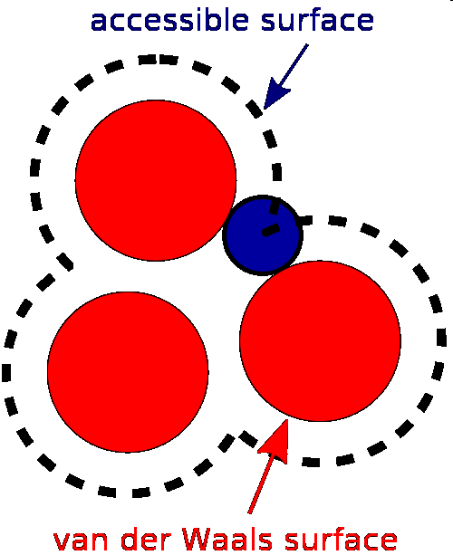
Accessible surface area
The accessible surface area (ASA) is the surface area of a biomolecule that is accessible to a solvent.
Illustration of the solvent accessible surface in comparison to the van der Waals surface. The van der Waals surface as given by the atomic radii is shown in red. The accessible surface is drawn with dashed lines and is created by tracing the center of the probe sphere (in blue) as it rolls along the van der Waals surface. Note that the probe radius depicted here is of smaller scale than the typical 1.4Å.
http://en.wikipedia.org/wiki/Accessible_surface_area
http://en.wikipedia.org/wiki/Van_der_Waals_radius

Slide 12
Solvent-excluded surface
The ASA is closely related to the concept of the solvent-excluded surface (also known as the molecular surface or Connolly surface), which is imagined as a cavity in bulk solvent (effectively the inverse of the solvent-accessible surface).
http://en.wikipedia.org/wiki/Accessible_surface_area

Slide 13
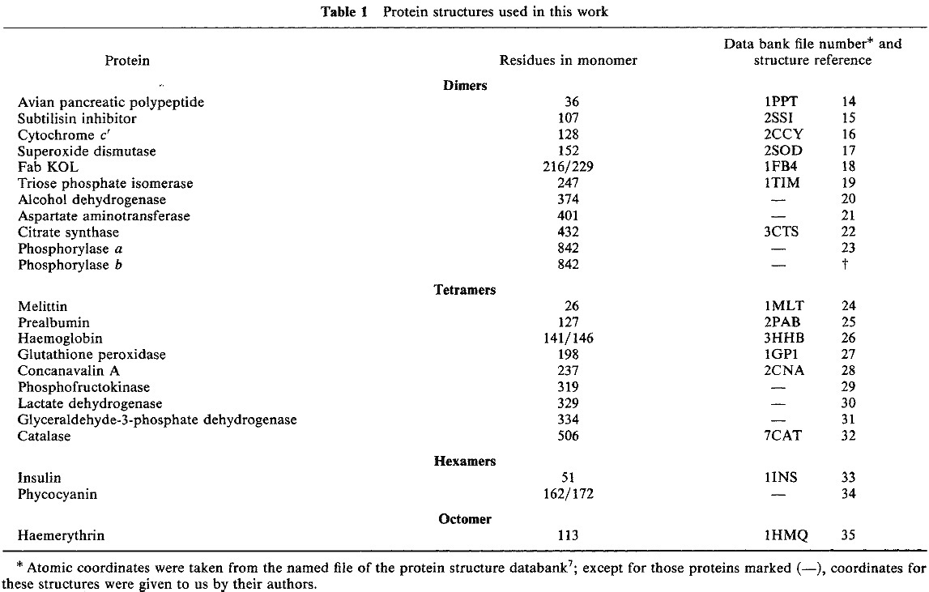
Experiment data

Slide 14
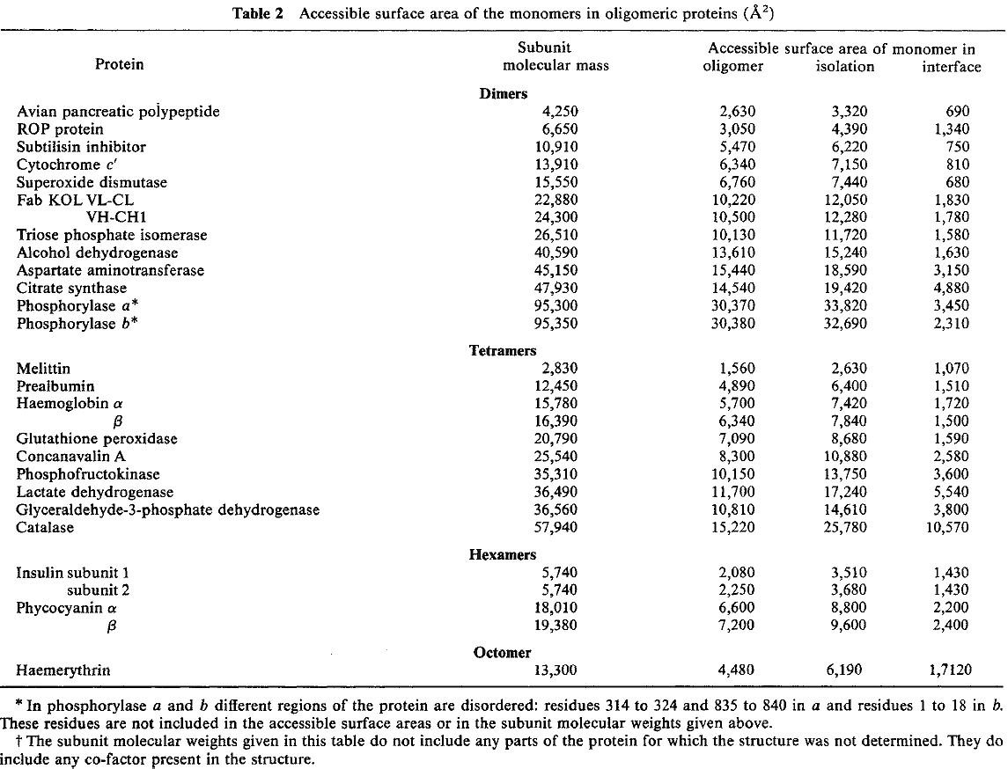
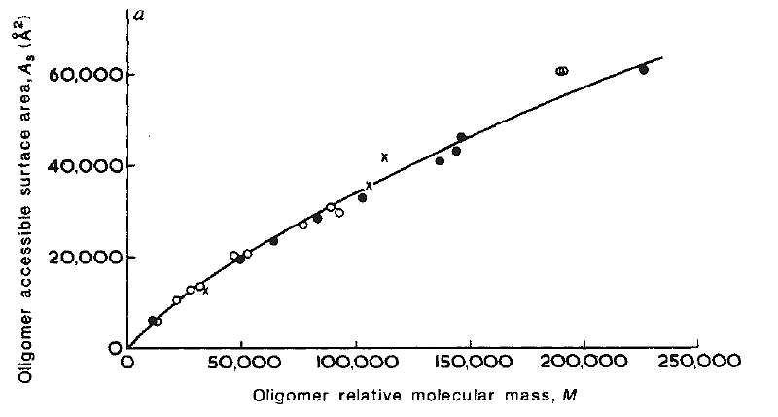
o
•
x
x

Slide 15
Oligomers with different shapes, secondary structure and number of subunits, but with the same molecular mass (M), have very similar accessible surface area (As). As = 5.3M^{0.76}

Slide 16
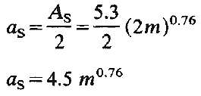
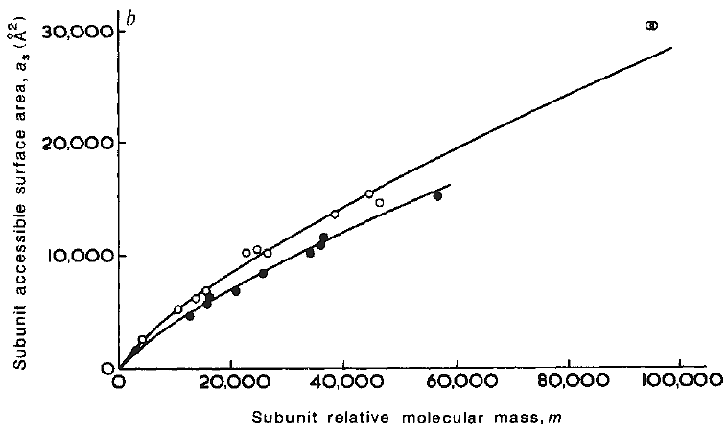
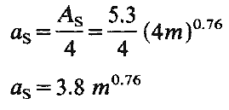
If m is the molecular weight of a subunit, the accessible surface area (a_{s}), then
for dimer
for teramer

Slide 17


If the total accessible surface area of the unfolded protein and the molecular mass are A_{T} and M respectively, then
Consequently, the surface buried within oligomers A_{T}-A_{S} is

