Slide 1
Evaluation of CASP8 model quality predictions
Domenico Cozzetto, Andriy Kryshtafovych, Anna Tramontano
Proteins: Structure, Function, and Bioinformatics, Volume 77, Issue Supplement S9, pages 157–166, 2009
Presenter: Hsin-Fang Wu
Date: Aug. 9, 2011

Slide 2
Abstract (1/2)
The model quality assessment problem consists in the a priori estimation of the overall and per-residue accuracy of protein
structure predictions. Over the past years, a number of methods have been developed to address this issue and CASP
established a prediction category to evaluate their performance in 2006. In 2008 the experiment was repeated and its results are reported here. Participants were invited to infer the correctness of the protein models submitted by the registered
automatic servers. Estimates could apply to both whole models and individual amino acids. Groups involved in the tertiary structure prediction categories were also asked to assign local error estimates to each predicted residue in their own models and their results are also discussed here.

Slide 3
Abstract (2/2)
The correlation between the predicted and observed correctness measures was the basis of the assessment of the results. We observe that consensus based methods still perform significantly better than those accepting single models, similarly to what was concluded in the previous edition of the experiment.

Slide 4
Introduction
The bioinformatics community has focused on the Model Quality Assessment (MQA) problem, i.e., on the possibility to predict the global and local accuracy of 3D models when experimental structural data are not yet available.
As in other research areas, the objective evaluation of such predictions is an essential step to identify effective strategies and assist further progress. The CASP7 organizers recognized the importance of this issue and launched MQA as a new category of critical judgement in 2006.

Slide 5
Introduction
The Prediction Center website publicly released the server models submitted for assessment in the tertiary structure prediction categories. Predictors were invited to download such models, generate quality estimates and submit them to CASP.
QM1 : The prediction format for the overall reliability of models, required scores as real numbers ranging from 0.0 to 1.0. A score of 1.0 should correspond to a perfect model.
For the per-residue accuracy analysis, scores should report distances in Angstroms (Å) between the corresponding residue Cα atoms after a sequence-dependent superposition of the 3D model to the native structure.
QM2 : local confidence values
QM3 : local correctness

Slide 6
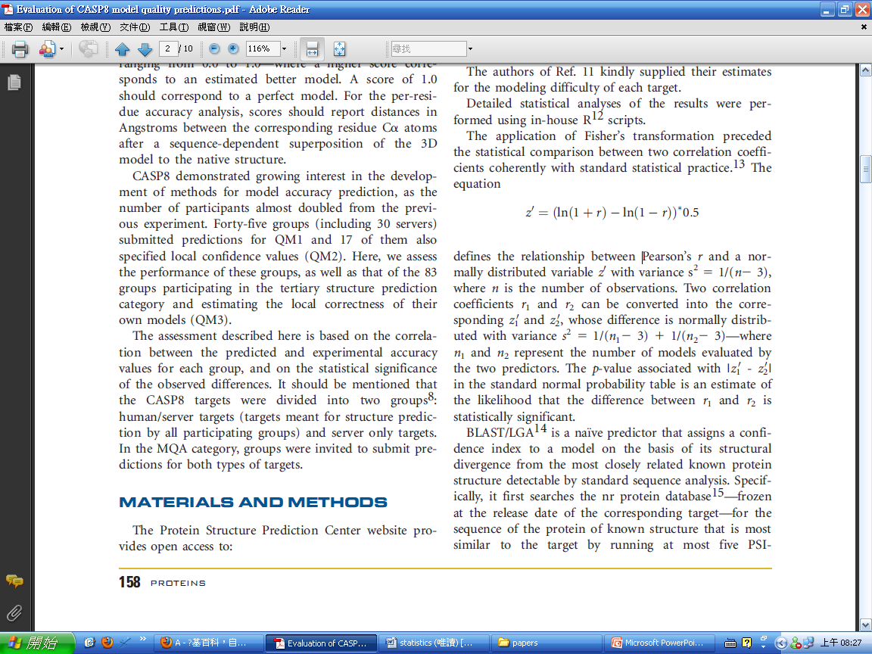
Method: Fisher’s transformation
The application of Fisher’s transformation preceded the statistical comparison between two correlation coefficients coherently with standard statistical practice.
The equation defines the relationship between Pearson’s r and a normally distributed variable z’ with variance s^2=1/(n-3)
Two correlation coefficients r1 and r2 can be converted into the corresponding z1’ and z2’, whose difference is normally distributed with variance s^2 =1/(n1-3) + 1/(n2-3)—where n1 and n2 represent the number of models evaluated by the two predictors.

Slide 7
Method: BLAST/LGA
BLAST/LGA is a naїve predictor that assigns a confidence index to a model.
1. Searches the nr protein database.
2. Finds the protein of known structure that is most similar to the target by running at most five PSI- BLAST iterations with default parameters.
3. Superimposes the selected structure onto the input protein
model by running LGA with default parameters in sequence independent mode.
4. Finally, the resulting LGA_S score is divided by 100 to obtain a number between 0.0 and 1.0.

Slide 8
QM1: global accuracy of models
The distributions of Pearson’s r were first calculated for each target separately. Target-based r distributions of 108/121 turned out to be normal after visual inspection and quantitative Shapiro-Wilk tests at the 0.01 significance level.
* Shapiro–Wilk test: 用來檢定常態分布的假設前提(虛無假
設),當樣本數小於50時適用。
*虛無假設(null hypothesis):當我們認為一件事情是對的，但是找不到方法可以證實的時候便先假設這件事情是錯的，然後找方法來證實它是錯的，到最後當無法證實這件事情是錯的時候，理所當然這件事情便是對的。
*顯著水準(significant level):拒絕了「實際上成立的虛無假設」之機率
假如100次檢測中有5次或少於5次會誤判，則以α= .05表示；設定α值愈小，表示希望檢測時的誤判機率愈低(即希望檢測能愈準確)。
Notes:
Shapiro–Wilk test：http://en.wikipedia.org/wiki/Shapiro%E2%80%93Wilk_test
http://mail.cmu.edu.tw/~tcli/%B2%C4%A4Q%A4%AD%B3%B9.pdf
null hypothesis：http://zansky.blogspot.com/2008/11/null-hypothesis.html
significant level：http://homepage.ntu.edu.tw/~clhsieh/biostatistic/6/6-7.htm

Slide 9
QM1: global accuracy of models
The results obtained by each group for each target were converted into Z-scores. Negative values were set to zero, and the performance of each group was measured by the average of such modified Z-scores. The choice of neglecting negative Z-scores is meant not to penalize groups that, by attempting novel and riskier methods, might obtain negative scores in some cases.
* Z-score: 標準分數（Standard Score）(又被稱為Z-分數、標準化值），Z值的量代表著原始分數和母體平均值之間的距離，是以標準差為單位計算。
* The paired Student’s t-test : used to assess the statistical significance of the observed differences between groups.

Slide 10
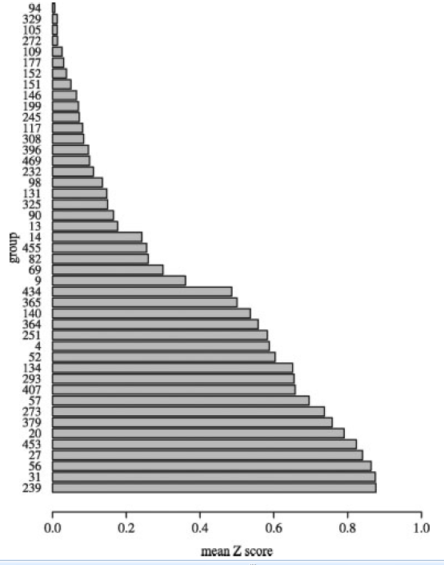
QM1: global accuracy of models

Slide 11
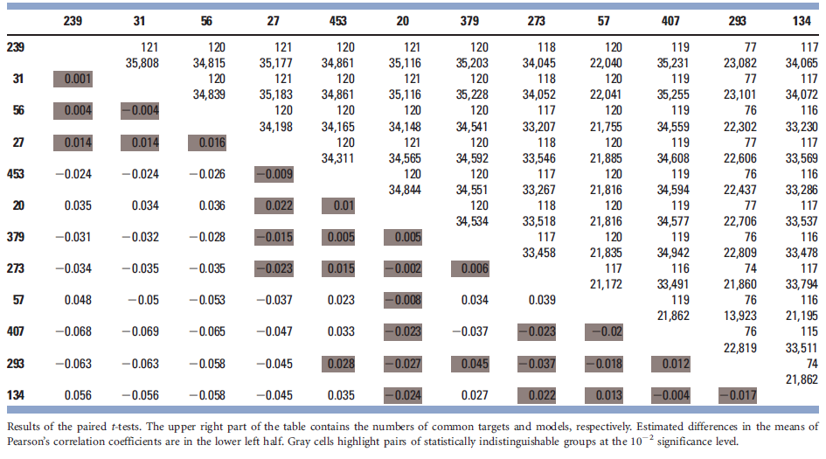
QM1: global accuracy of models
前四名沒什麼差異
Number of common models
Number of common targets
相關係數
Pairs of statistically indistinguishable

Slide 12
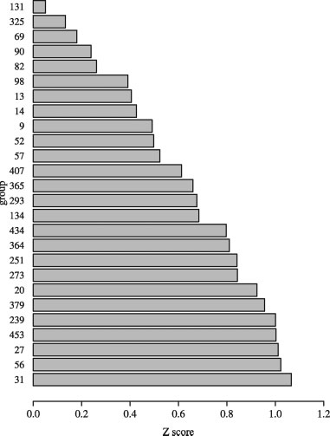
QM1: global accuracy of models
The target-by-target analysis of the correlation described above does not reflect the predictor ability to assign an absolute estimate to a model that would permit to compare the expected quality of models for different proteins.
In the context of the global correlation analysis, we making use of their Fisher’s z transformation.

Slide 13
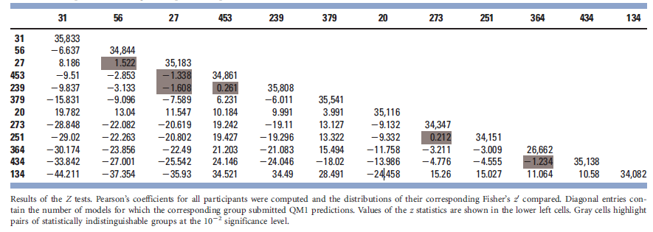
QM1: global accuracy of models
Number of models
Value of the z statistics

Slide 14
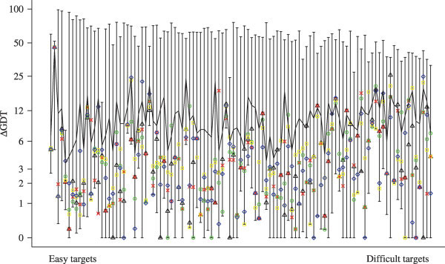
QM1: global accuracy of models
The mean line
the average GDT-TS difference (ΔGDT) between the rank-one model(s) of a group and the most accurate one(s).
none of them can consistently select the best model for all targets.

Slide 15
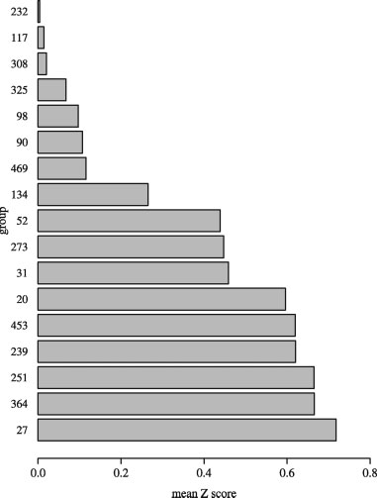
QM2: residue-level accuracy of models
We evaluated the correlation between such values and the distances in Angstroms between the predicted and observed positions of each Cα after optimal sequence-based superposition of targets and models.
For each server model we computed the Pearson’s r coefficients and the corresponding Z-scores. The final score of each predictor was determined by the average Z-score over the set of predicted models—after replacing negative values with 0.

Slide 16
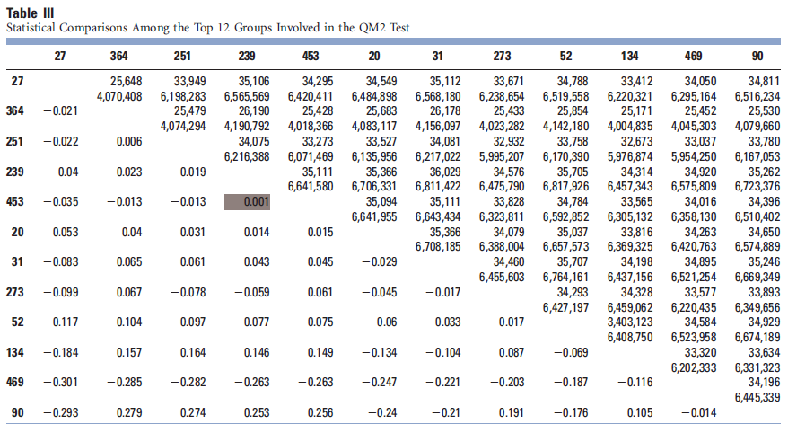
QM2: residue-level accuracy of models
The statistical significance of the results was assessed by paired Student’s t tests on the common residues of the common models

Slide 17
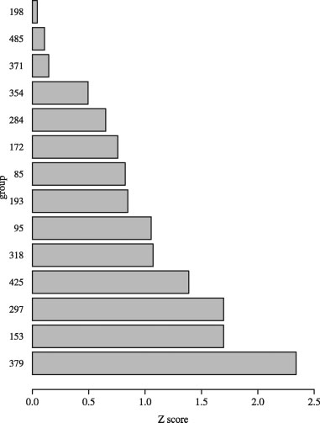
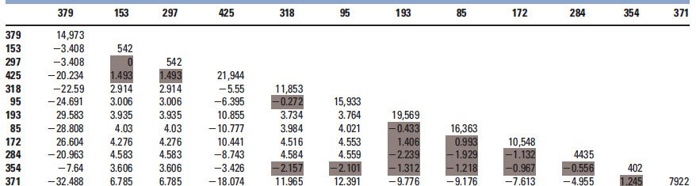
QM3: self assessment of residue-level accuracy
In CASP, modeling groups have long had the possibility of labeling predicted residues with error estimates through the B-factor field in the TS format.

Slide 18
Conclusion
The ability to rank models by consensus methods, that is, to sort a set of models for the same target according to their quality. However, it is of very limited usage to the end users of models.
We would like to stress once more the relevance of the MQA experiments in all their flavors. It is one area of protein structure prediction where success benefits both developers and users and is particularly important to encourage structure prediction groups to provide quality estimates with their models.

Slide 19
Thanks for your listening !!

