Slide 1
Using Dynamic Time Warping to Find Patterns in Time Series
Donald J. Bemdt, James Clifford
AAAI94 workshop on knowledge discovery
in databases (1994) 359-370
Presenter: Chang-Hao Huang
Date: Aug. 16, 2011

Slide 2
Abstract
Knowledge discovery in databases presents many interesting challenges within the context of providing computer tools for exploring large data archives. Electronic data repositories are growing qulckiy and contain data from commercial, scientific, and other domains. Much of this data is inherently temporal, such as stock prices or NASA telemetry data. Detecting patterns in such data streams or time series is an important knowledge discovery task. This paper describes some preliminary experiments with a dynamic programming approach to the problem. The pattern detection algorithm is based on the dynamic time warping technique used in the speech recognition field.

Slide 3
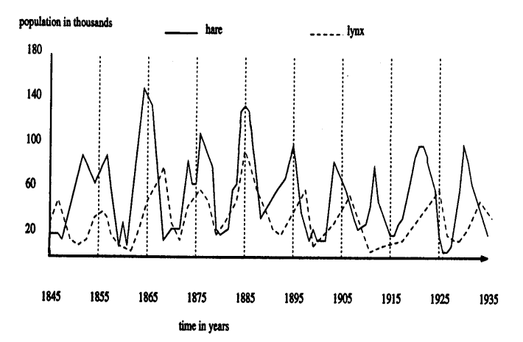

Slide 4
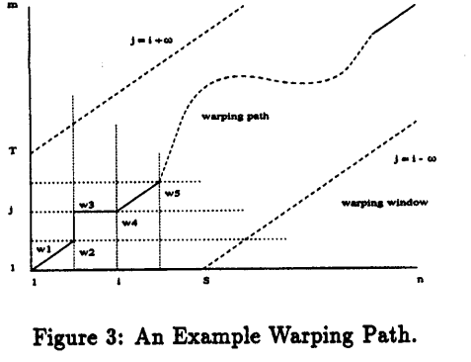
Dynamic Time Warping
Time series S, S = s₁, s₂ , …, s_{i},… s_{n}
Template T, T = t₁, t₂ , …, t_{j},… t_{m}
Warping path W, W = w₁, w₂ , …, w_{k}

Slide 5


Distance function,δ
We can formally define the dynamic time warping problem a minimization over potential warping paths based on the cumulative distance for each path.

Slide 6
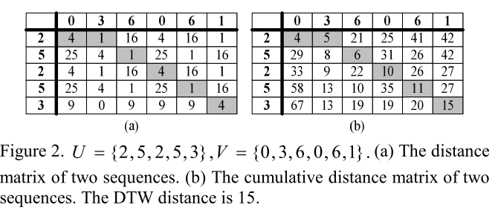
Dynamic programming formulation
Example

Slide 7
Measures of Fit
One possible measure is based on the ratio of the cumulative warping path distance to a baseline distance.
In this example, the baseline is a relative band centered around the series. For instance, a data point of 50 would be bounded by 25 and 75, assuming the band width to be 100% of the data value. The sum of these boundary intervals makes a reasonable baseline, with the score set to zero if the warping path distance exceeds the baseline (thereby keeping the score in the [0,1] range).

Slide 8
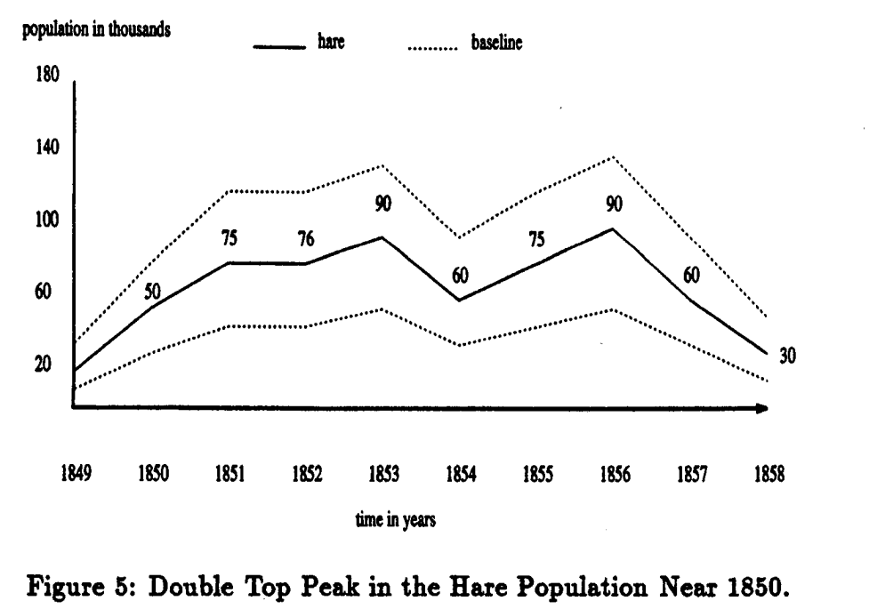

Slide 9
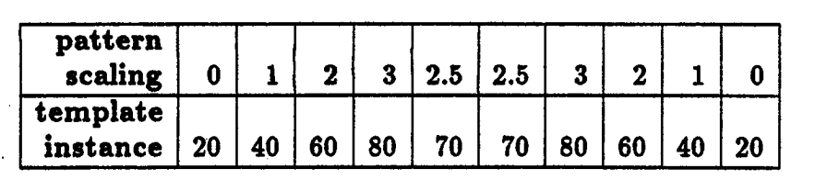
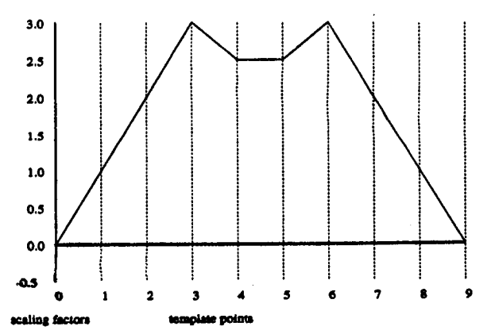
Predator/Prey Experiments

Slide 10
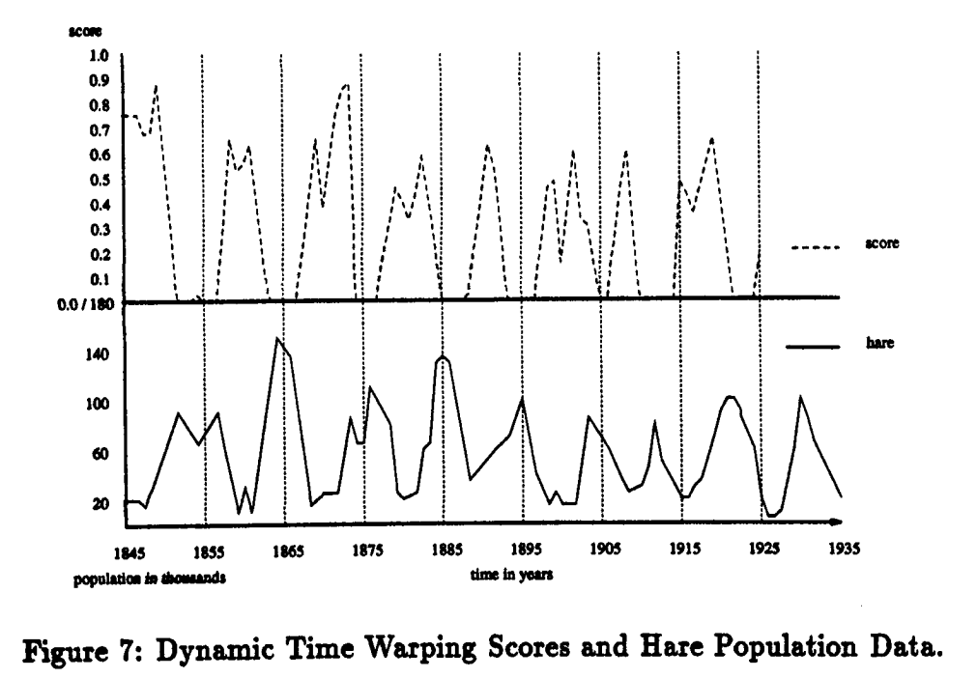

Slide 11
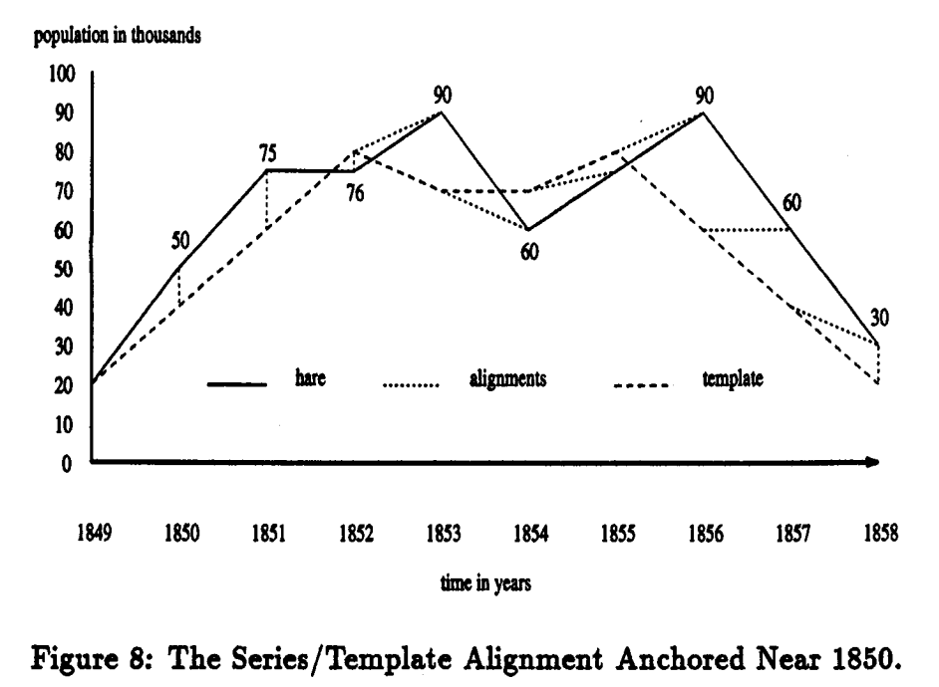

Slide 12
Conclusion
Once we can detect patterns such ass double top peak, we can express higher-level relationships or "knowledge" as rules, For example, the following rule expresses one possible relationship, where t₁ and t₂ represent s time interval.

