Slide 1
Optimal algorithms for locating the longest and shortest segments satisfying a sum or an average constraint
Information Processing Letters 96 (2005) 197–201
Kuan-Yu Chen, Kun-Mao Chao
Presenter: Jen-Hui Wang
Date: March 17, 2006

Slide 2
Abstract
We study several fundamental problems arising from biological sequence analysis.
Given a sequence of real numbers, we present two linear-time algorithms, one for locating the “longest” sum-constrained segment, and the other for locating the “shortest” sum-constrained segment.
These two algorithms are based on the same framework and run in an online manner, hence they are capable of handling data stream inputs.
Our algorithms also yield online linear-time solutions for finding the longest and shortest average constrained segments by a simple reduction.

Slide 3
Introduction
Computer analysis of newly determined DNA sequences,
i.e., strings of the four letters A, C, G, and T, usually includes a task that identifies GC-rich segments.
Segments of a DNA sequence that are rich in nucleotides G and C are usually biologically significant.
As a consequence, two lines of investigation into such segments arise. One line tries to locate a segment whose length is constrained and GC-ratio is maximized, and the other tries to locate a segment whose GC ratio is constrained and length is maximized.
By assigning G, C a number one and A, T a number zero, the latter problem, can be described as: finding the longest segment of a number sequence satisfying the average of the numbers in that segment is greater than or equal to a lower bound L

Slide 4
Example
A DNA sequence GACGTCCCAGCAACAAA, ratio L = 0.8
the longest segment whose GC ratio is at least 0.8 is the segment from position 3 to position 8, CGTCCC.
This segment contains 4 C’s, 1 G’s, and 1 T’s, thus it has a CG ratio of 0.83 with the maximum length of 6.

Slide 5
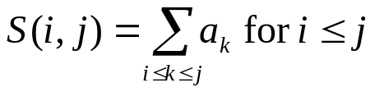
Preliminaries
Given a nonempty sequence A = (a₁, a₂, . . . , a_{n}) of real numbers, and a lower bound L
A(i, j) : the segment a_{i} , . . . , a_{j} of A
S(i, j) : the sum of A(i, j ), defined as
The average of A(x, y) is S(x, y)/(y −x +1)

Slide 6
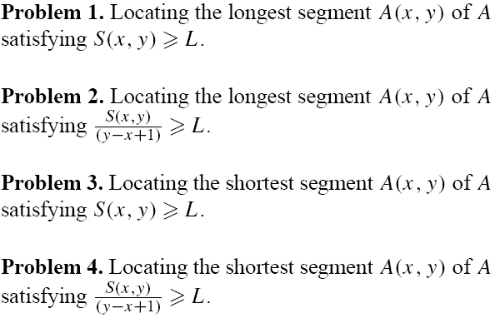
Preliminaries (cont.)
There are four problems of concern in this paper:

Slide 7
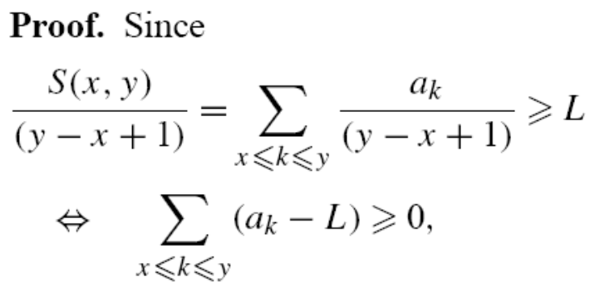
Preliminaries (cont.)
Lemma 1. The average-constrained segment problems,
i.e., Problems 2 and 4, can be reduced to a special case
of their corresponding sum-constrained segment problems,
i.e., Problems 1 and 3 with L = 0.
It suffices to find the longest and shortest segment with a
non-negative sum in a new sequence B = (a₁ − L,a₂ −L, . . . , a_{n} − L).

Slide 8

Locating the longest segment satisfying a sum lower bound
In order to achieve the online property, we adopt a dynamic programming approach.
Suppose,
at the (i −1)th iteration,
the longest segment of A(1, i − 1) with sum at least L has been computed as A(x, y).
The goal is to locate, at the ith iteration,
the longest segment of A(1, i) with sum at least L.
It suffices to find the smallest index k ∈ [0, i − y + x − 1) satisfying S(k+1, i) = C[i]−C[k] L. If such k exists, then
A(k+1, i) is the longest segment of A(1, i). Otherwise,
A(x, y) remains the answer. Instead of searching for k
by brute force, the algorithm proceeds in the “safest”
way to avoid unnecessary search steps.

Slide 9
Locating the longest segment satisfying a sum lower bound
k
y-x+1
1
i-(y-x+1)
i
y-x+1
1
C[k]
k
S(k+1, i)
i
It suffices to find the smallest index k ∈ [0, i − y + x − 1) satisfying S(k+1, i) = C[i]−C[k] L. If such k exists, then
A(k+1, i) is the longest segment of A(1, i). Otherwise,
A(x, y) remains the answer

Slide 10



Locating the longest segment satisfying a sum lower bound
Definition 1. For each index i ∈ [1,n], we define inductively
an ordered list of the “safest” indices,
where μ(i) denotes the size of the list
the last index of the list is index 0, .
k
y-x+1
I _{i, μ(i)} 1
C[k]
I_{i,j+1}
I_{i,j}
I_{i,0}
i
C[I_{i,j} ] has the minimum cumulative sum of C[l] for all l ∈ [0, I_{i,j−1}).

Slide 11
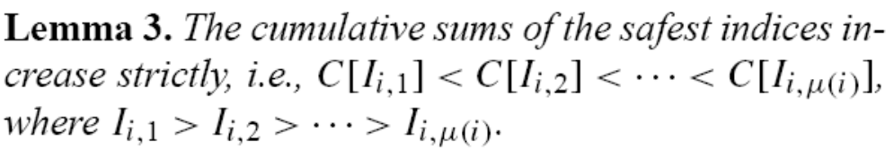
Locating the longest segment satisfying a sum lower bound
Proof.
C[I_{i,j} ] < C[l] for all l ∈ [0, I_{i,j−1})
I_{i,j+1} ∈ [0, I_{i,j} ) ⊂ [0, I_{i,j−1})
we have C[I_{i,j} ]<C[I_{i,j+1}] with I_{i,j} > I_{i,j+1}
C[I_{i,j+1} ]
I_{i,j+1}
y-x+1
I_{i,0}
i
C[I_{i,j} ]
I_{i,j}
The main role of the “safest” index is to inform, without the need of examining the whole interval, the algorithm when to stop

Slide 12

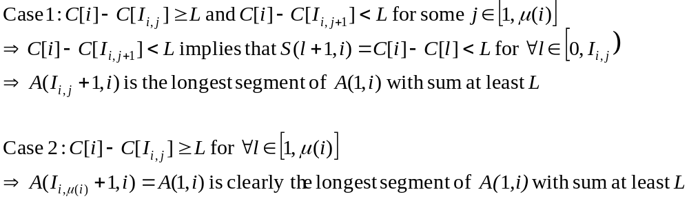
Locating the longest segment satisfying a sum lower bound
The algorithm retrieves one by one until it finds:
Since the length of the longest segment at the end is less than or equal to n, the cost is bounded by O(n)

Slide 13
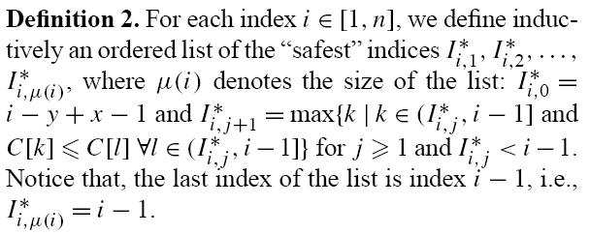
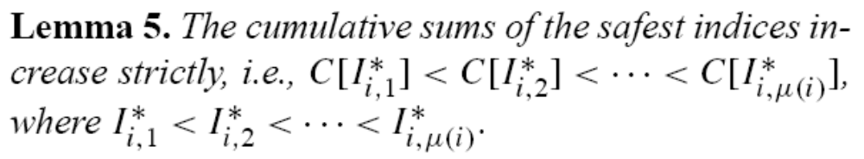




Locating the shortest segment satisfying a sum lower bound
y-x+1
i-(y-x+1)
…
i
…

Slide 14

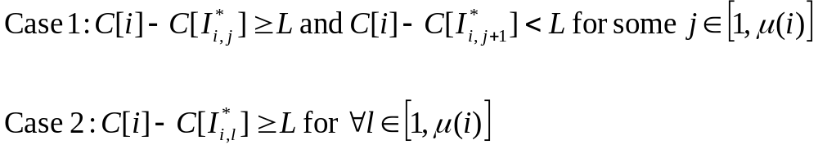
Locating the shortest segment satisfying a sum lower bound
The algorithm retrieves one by one until it finds:
y-x+1
i-(y-x+1)
i
…
…
Time complexity: O(n)

Slide 15
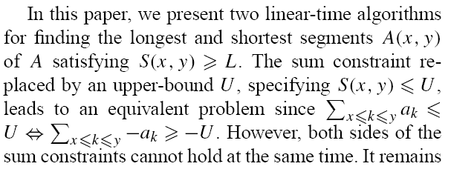
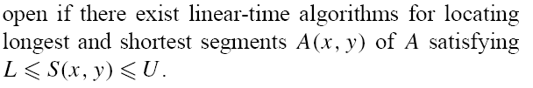
Conclusion

