Slide 1
Inverse Pattern Matching
Amir, Apostolico and Lewenstein
Journal of Algorithms, Vol. 24, pp. 325-339, 1997
Date: April 21, 2006
Introducer: Hsing-Yen Ann

Slide 2
Abstract
Let a textstring T of n symbols from some alphabet Σ and an integer m < n be given. A pattern P of length m over Σ is sought such that P minimizes (alternatively, maximizes) the total number of pairwise character mismatches generated when P is compared with all m-character substrings of T. Two additional variants of the problem are obtained by adding the constraint that P be (respectively, not be) a substring of T. Efficient sequential algorithms are proposed in this paper for the problem and its variants.

Slide 3

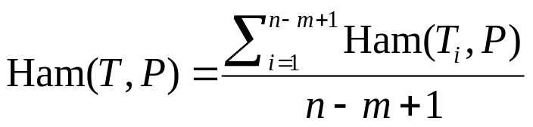
Problem Definition – Inverse Pattern Matching
1
2
3
4
5
6
7
8
9
Hamming distance:
Pattern matching:
Given text T and pattern P,
to find the location i,
such that is minimum.
(1) Inverse pattern matching (general):
Given text T and pattern length m,
to find the pattern P,
such that is minimum.
T
a
b
b
b
c
a
a
b
c
P
a
b
c
Ham(T₃, P)=1

Slide 4



Problem Definition – Two Additional Variants
(2) Internal inverse pattern matching:
Given text T and pattern length m,
to find the pattern ,
such that is minimum.
(3) External inverse pattern matching:
Given text T and pattern length m,
to find the pattern ,
such that is maximum.

Slide 5
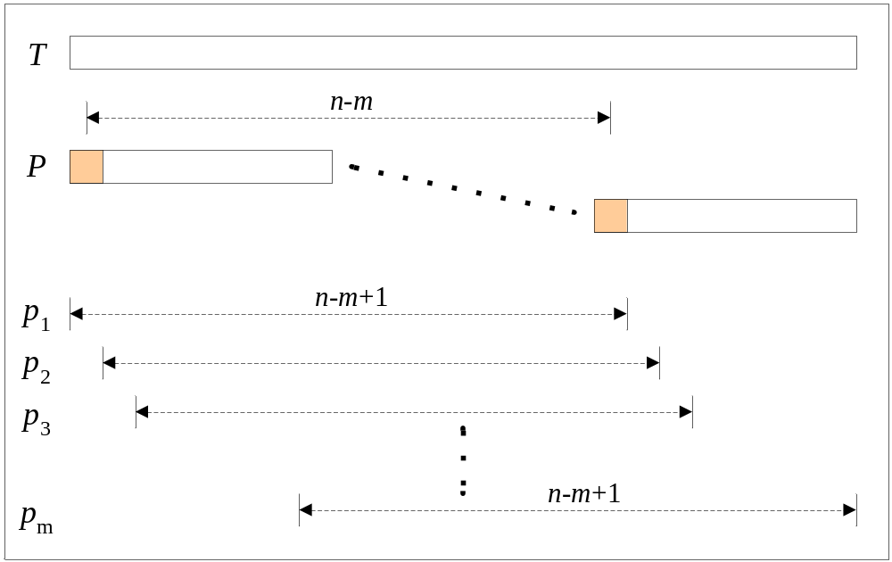
Algorithm 1 (General)
Naïve algorithm: exponential time
Counting on alphabets: conceptual O(nm)
p_{i}: the best alphabet to make the distance smallest.
Counting by incremental update

Slide 6





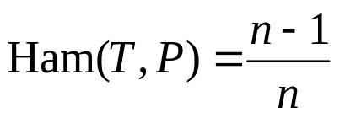
Analysis (Algorithm 1)
If : O(n)
If elements in are ordered:
If elements in are incomparable:
Element Distinctness Inverse Pattern Matching
➔ This algorithm is OPTIMAL!
Reduction: take m = 1
elements are distinct ⬅➔

Slide 7











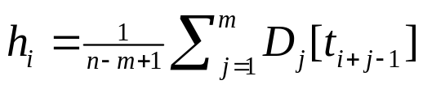


Algorithm 2-1 (Internal)
Naïve algorithm: O(n² m)
This one: O(n m)
Preprocessing: construct an table D
: counts on , where
: distance from if
Pattern construction:
1. compute , where
2. choose smallest , then solution is

Slide 8

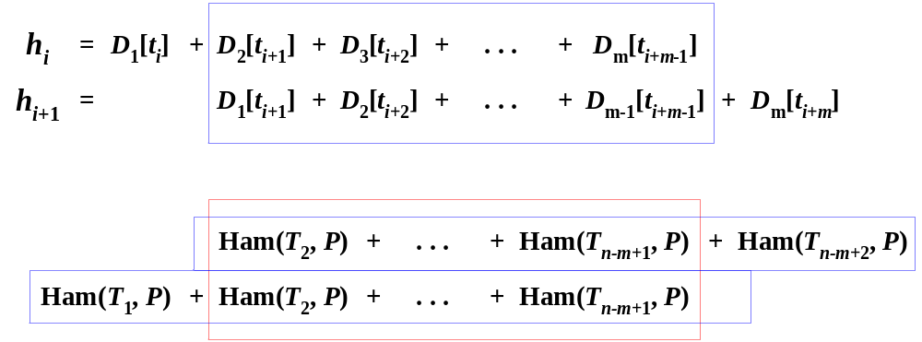
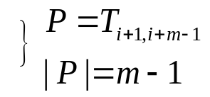
Algorithm 2-2 (Internal)
By add preprocessing, h_{i+1} can be produced by h_{i} in constant time.

Slide 9
Analysis (Algorithm 2-2)
O(n) for computing C₁, C_{m} and h₁.
for computing H_{prefix} and H_{sufffix} .
O(n) for computing h_{i} , i = 2, …, (n-m+1)
By using Karloff’s approximation algorithm to computing H_{prefix} and H_{sufffix}
➔ total time: O(n log m)

Slide 10



Properties of Problem 3 (External)
A pattern P computed by algorithm 1:
If P is external, P is the solution.
If P is internal, the solution is a special external pattern Q with a smaller distance. (P=p₁…p_{m} , Q=q₁…q_{m})
There may be no solution for the given pattern length m.
m-stem: a pattern X of length m,
such that x₁…x_{g} is a substring of , and x₁…x_{g+1} is not, then x₁…x_{g+1} is called an m-stem.
p₁ is a substring of with length 1.
There must be an m-stem q₁…q_{g+1} in solution Q=q₁…q_{m}.

Slide 11
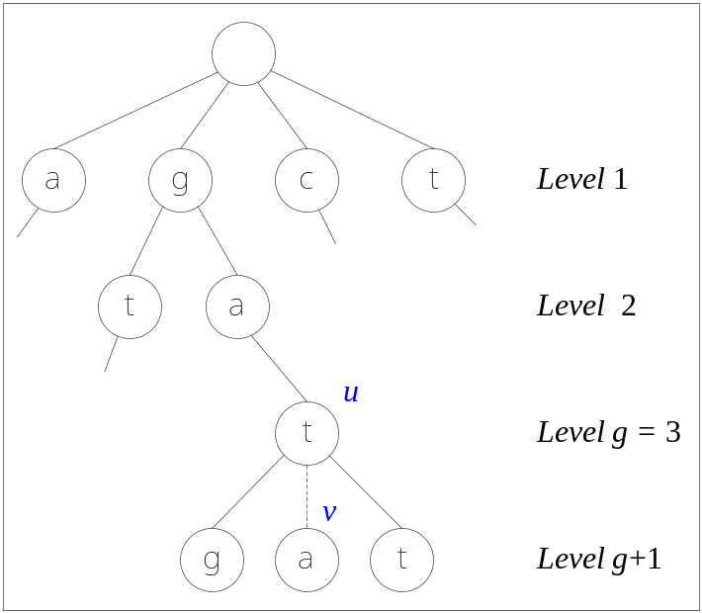
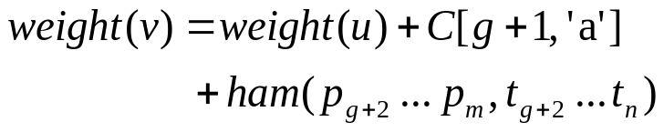
Algorithm 3 (External)
The m-stem q₁…q_{g+1} and the rest part q_{g+2}…q_{m} can be choose independently.
q₁…q_{g+1} is maximum among all m-stems for T of length g.
q_{g+2}…q_{m} can be choose by algorithm 1.
Build a tree from all m-substrings of T.
v is the most frequent alphabet,
such that Path(v) is not a substring of T^{(g)}.
Then Path(v) is a m-stem.
Compute the weight on each v,
and the maximum is the final solution.

Slide 12
Conclusion
Inverse pattern matching (general):
Time: O(n); O(n log|Σ|); O(n |Σ|) Optimal !!
Internal inverse pattern matching:
Time:
External inverse pattern matching:
Time: O(nm log|Σ|)

