Slide 1
Dropout: A Simple Way to Prevent Neural Networks from Overﬁtting
Nitish Srivastava, Geoﬀrey Hinton, Alex Krizhevsky, Ilya Sutskever, Ruslan Salakhutdinov
Journal of Machine Learning Research 15(Jun):1929−1958, 2014.
Presenter : Chia-Lin, Chen
April 2, 2019
Notes:
http://www.jmlr.org/papers/ 的 paper 的 15 的dropout那篇論文
All of authors are from Unovesity of Toronto.
此篇論文被放入維基百科droput一詞的refference。
Geoﬀrey Hinton(加拿大人)被譽為深度學習之父，也是反向傳播算法的發明者之一，甚至榮獲2018年圖靈獎。
他研究了使用神經網絡進行機器學習、記憶、感知和符號處理的方法，並在這些領域發表了超過200篇論文。
目前任職於Google的Google Brain、多倫多大學任教。
2018年又發表了一篇論文:Targeted Dropout因此未來python的dropout或許會被改寫(?)

Slide 2
Abstract(1/2)
Deep neural nets with a large number of parameters are very powerful machine learning systems. However, overﬁtting is a serious problem in such networks. Large networks are also slow to use, making it diﬃcult to deal with overﬁtting by combining the predictions of many diﬀerent large neural nets at test time.
Dropout is a technique for addressing this problem. The key idea is to randomly drop units (along with their connections) from the neural network during training. This prevents units from co-adapting too much.
Notes:
Dropout一詞由Hinton先生(本論文作者之一)於2012年另一篇論文首次提到。
Improving neural networks by preventing co-adaptation of feature detectors
此篇為該篇進化版且展示眾多dropout實作研究結果。

Slide 3
Abstract(2/2)
During training, dropout samples from an exponential number of diﬀerent “thinned” networks. At test time, it is easy to approximate the eﬀect of averaging the predictions of all these thinned networks by simply using a single unthinned network that has smaller weights. This signiﬁcantly reduces overﬁtting and gives major improvements over other regularization methods. We show that dropout improves the performance of neural networks on supervised learning tasks in vision, speech recognition, document classiﬁcation and computational biology, obtaining state-of-the-art results on many benchmark data sets.

Slide 4
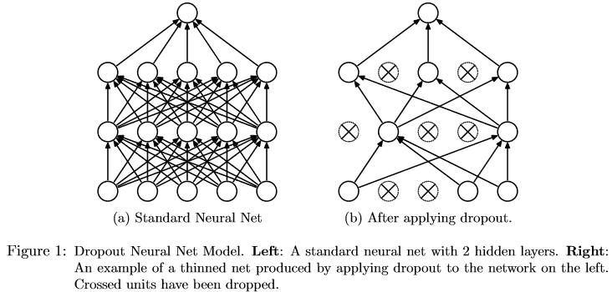

Slide 5
Motivation(1/2)
“A motivation for dropout comes from a theory of the role of sex in evolution.”
“Sexual reproduction involves taking half the genes of one parent and half of the other, adding a very small amount of random mutation, and combining them to produce an offspring. “
“Since a gene cannot rely on a large set of partners to be present at all times, it must learn to do something useful on its own or in collaboration with a small number of other genes. According to this theory, the role of sexual reproduction is not just to allow useful new genes to spread throughout the population, but also to facilitate this process by reducing complex co-adaptations that would reduce the chance of a new gene improving the ﬁtness of an individual.”

Slide 6
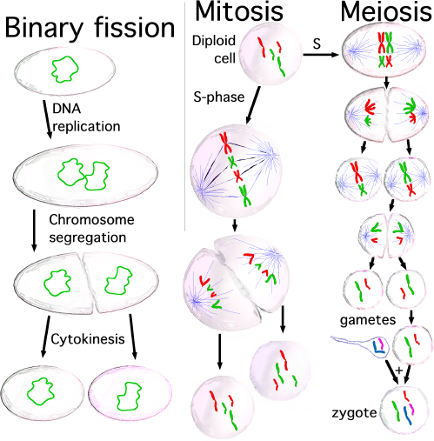
Motivation(2/2)

Slide 7
Related Work(1/2)
“Dropout can be interpreted as a way of regularizing a neural network by adding noise to its hidden units, this idea is from (DAEs) by Vincent et al. (2008, 2010) where noise is added to the input units of an autoencoder and the network is trained to reconstruct the noise-free input.”
“Our work extends this idea by showing that dropout can be eﬀectively applied in the hidden layers as well and that it can be interpreted as a form of model averaging.”
“We also show that adding noise is not only useful for unsupervised feature learning but can also be extended to supervised learning problems.In fact, our method can be applied to other neuron-based architectures, for example, Boltzmann Machines.”
“While 5% noise typically works best for DAEs, we found that dropping out 20% of the input units and 50% of the hidden units was often found to be optimal.”

Slide 8
Related Work(2/2)
“In this paper, we show that, in simple cases, dropout can be analytically marginalized out to obtain deterministic regularization methods. “
“Recently, van der Maaten et al. (2013) also explored deterministic regularizers corresponding to different exponential-family noise distributions, including dropout (which they refer to as “blankout noise”). However, they apply noise to the inputs and only explore models with no hidden layers.”
“In dropout, we minimize the loss function stochastically under a noise distribution. This can be seen as minimizing an expected loss function”

Slide 9
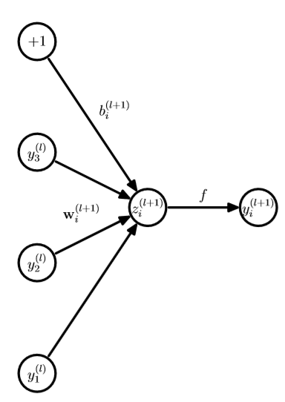
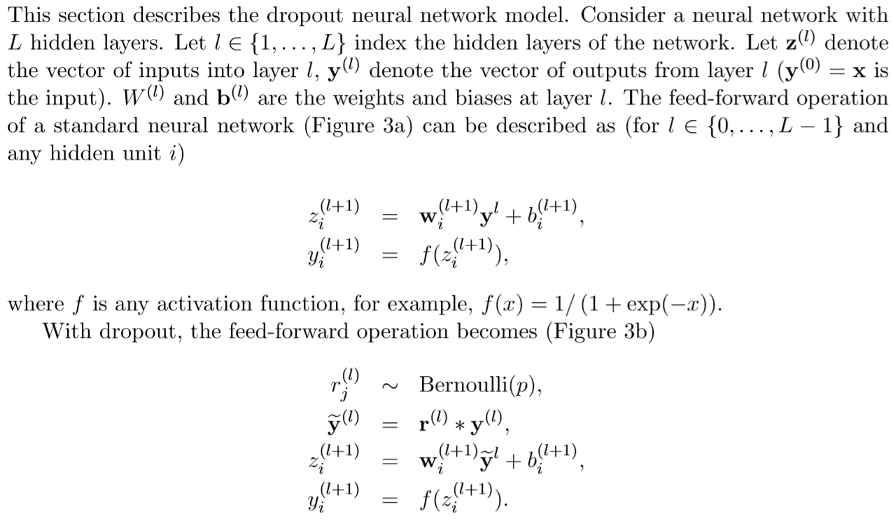
Model Description(1/2)
Consider a neural network with L hidden layers.
Let l ∈ {1, . . . , L} index the hidden layers of the network.
Let z (l) denote the vector of inputs into layer l, y (l) denote the vector of outputs from layer l.
W(l) and b (l) are the weights and biases at layer l. The feed-forward operation of a standard neural network (Figure 3a) can be described as (for l ∈ {0, . . . , L − 1} and any hidden unit i)
where f is any activation function, for example, f(x) = 1/(1 + exp(−x)).
(Figure 3a)

Slide 10
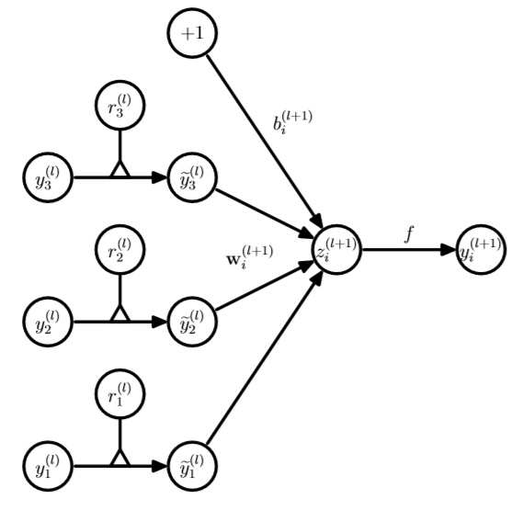
Model Description(2/2)
(Figure 3b)

Slide 11
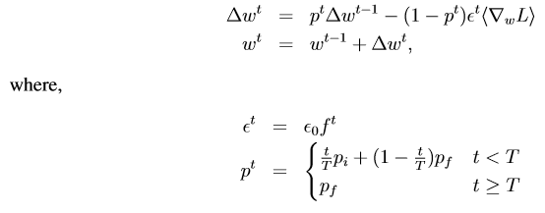
V.S.
Improving neural networks by preventing co-adaptation of feature detectors (Geoﬀrey Hinton, 2012)

Slide 12
Learning Dropout Nets(1/3)
“This section describes a procedure for training dropout neural nets."
Backpropagation
Unsupervised Pretraining

Slide 13
Learning Dropout Nets(2/3)
Backpropagation
“Dropout neural networks can be trained using stochastic gradient descent in a manner similar to standard neural nets. The only diﬀerence is that for each training case in a mini-batch, we sample a thinned network by dropping out units.”
“The gradients for each parameter are averaged over the training cases in each mini-batch. Any training case which does not use a parameter contributes a gradient of zero for that parameter. Many methods have been used to improve stochastic gradient descent such as momentum, annealed learning rates and L2 weight decay. Those were found to be useful for dropout neural networks as well. “

Slide 14
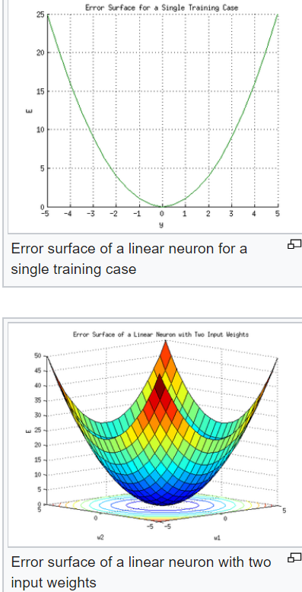
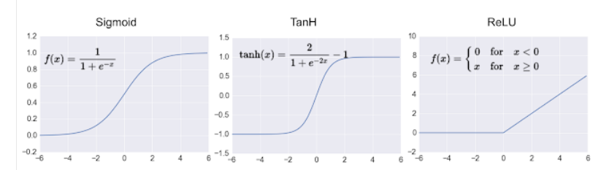
Learning Dropout Nets(3/3)
Backpropagation
Activate
Step1-1: use an activation function f
Step1-2:calculate an error e
Update
Step2-1:multiply error e with f as a result g
Step2-2:multiply g with a ratio r and plus it to the weight

Slide 15
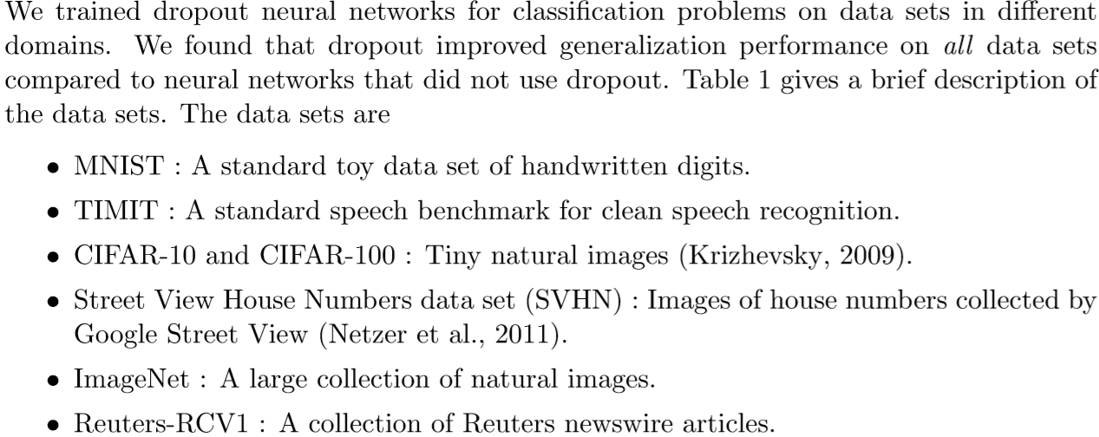
Experimental Results(1/8)

Slide 16
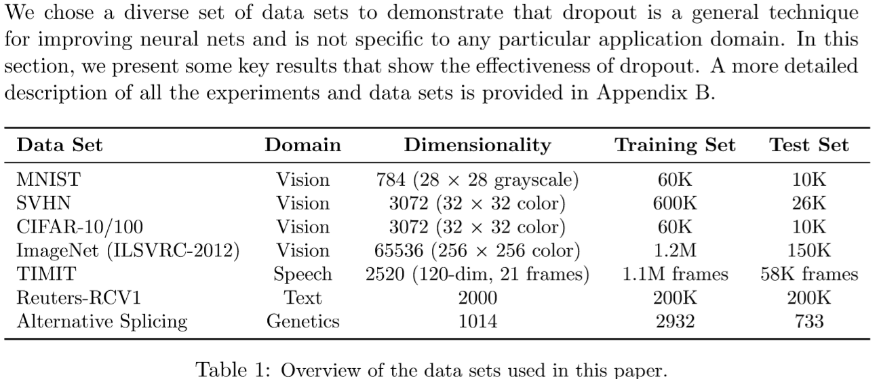
Experimental Results(2/8)

Slide 17
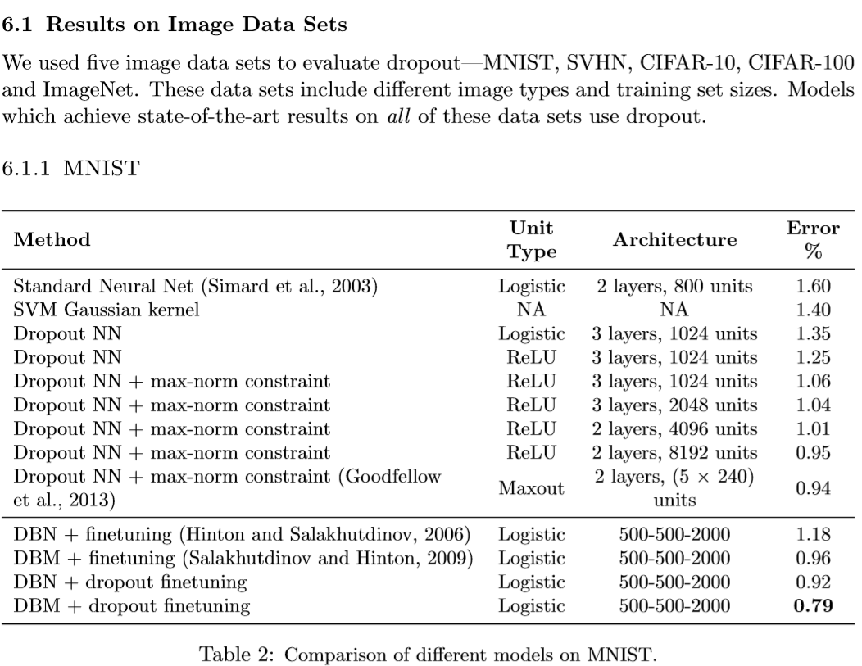
Experimental Results(3/8)

Slide 18
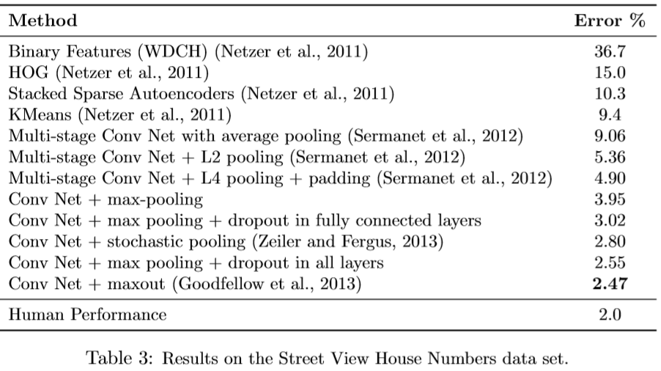
Experimental Results(4/8)

Slide 19
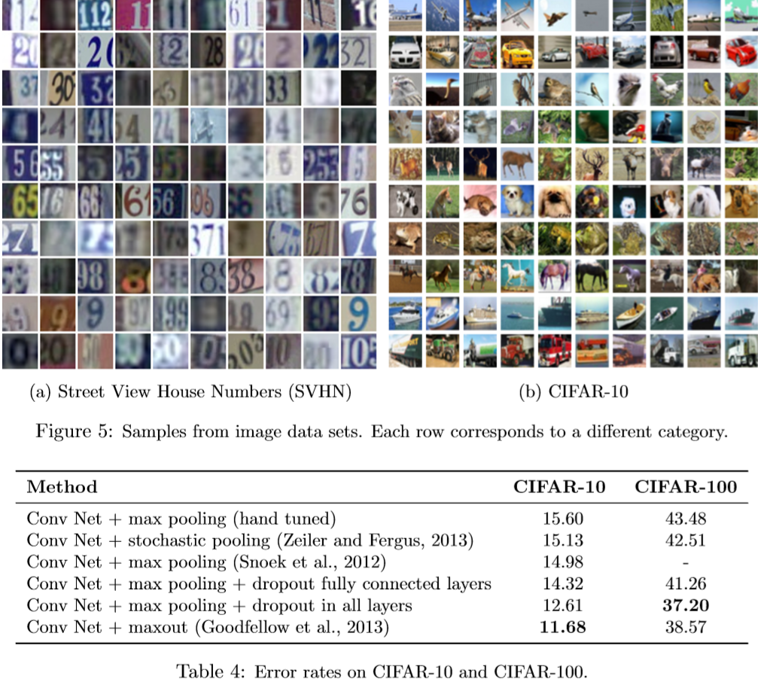
Experimental Results(5/8)

Slide 20
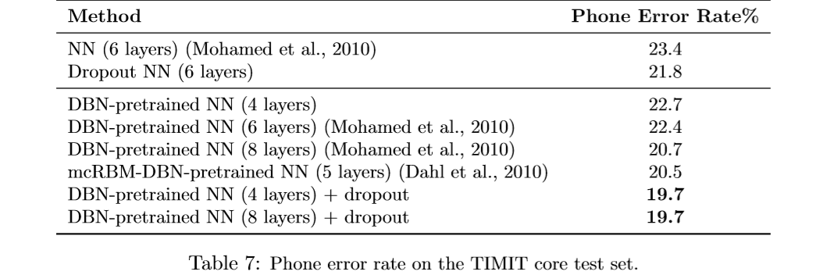
Experimental Results(6/8)
6.2 Results on TIMIT
Next, we applied dropout to a speech recognition task. We use the TIMIT data set which consists of recordings from 680 speakers covering 8 major dialects of American English reading ten phonetically-rich sentences in a controlled noise-free environment.

Slide 21
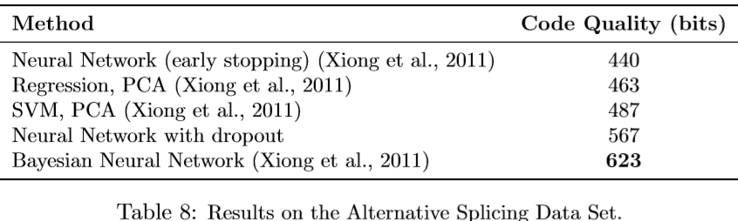
Experimental Results(7/8)
Comparison with Bayesian Neural Networks

Slide 22
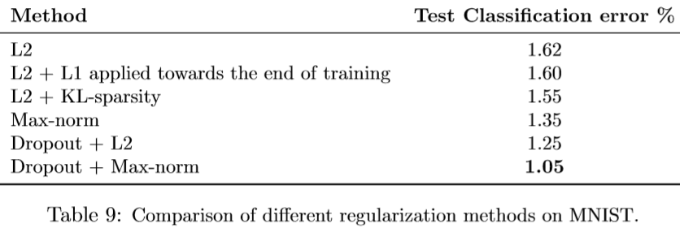
Experimental Results(8/8)
Comparison with Standard Regularizers

Slide 23
Thank you!

