Slide 1
MolDock: A New Technique for High-Accuracy Molecular Docking
René Thomsen, and Mikael H. Christensen
Journal of Medicinal Chemistry,2006, Pages 3315 - 3321, Aarhus C, Denmark
Speaker: Jheng-Yan Lyu
Date: Apr. 02, 2019

Slide 2
Abstract (1/2)
In this article we introduce a molecular docking algorithm called MolDock. MolDock is based on a new heuristic search algorithm that combines differential evolution with a cavity prediction algorithm. The docking scoring function of MolDock is an extension of the piecewise linear potential (PLP) including new hydrogen bonding and electrostatic terms. To further improve docking accuracy, a re-ranking scoring function is introduced, which identifies the most promising docking solution from the solutions obtained by the docking algorithm.

Slide 3
Abstract (2/2)
The docking accuracy of MolDock has been evaluated by docking flexible ligands to 77 protein targets. MolDock was able to identify the correct binding mode of 87% of the complexes. In comparison, the accuracy of Glide and Surflex is 82% and 75%, respectively. FlexX obtained 58% and GOLD 78% on subsets containing 76 and 55 cases, respectively.

Slide 4
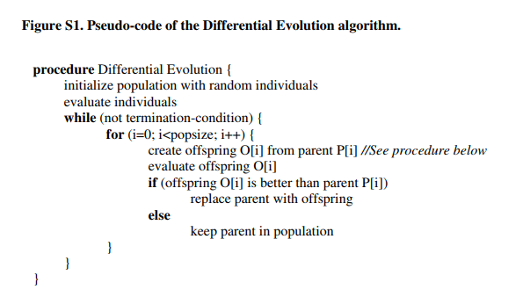
Guided Differential Evolution
Initialization: Use uniform random rotations by Shoemake, K
Population size=50
Crossover rate=0.9
Scaling factor=0.5
Max evaluations=100,000

Slide 5
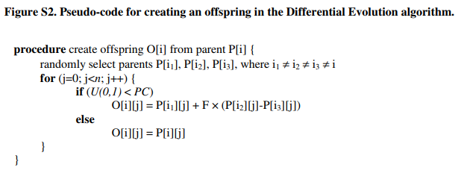
Guided Differential Evolution
U(0,1) is a uniformly distributed number between 0 and 1.
PC is the probability of crossover (crossover rate)
F is the scaling factor, and n is the number of problem parameters.

Slide 6
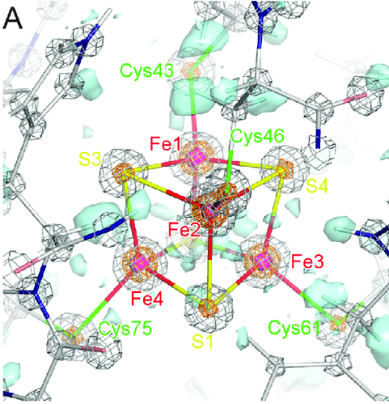
Cavity Prediction
To determine the potential binding sites
Create a discrete grid with a resolution of 0.8 Å, covering the protein
At every grid point, a sphere of radius 1.4 Å is placed.

Slide 7
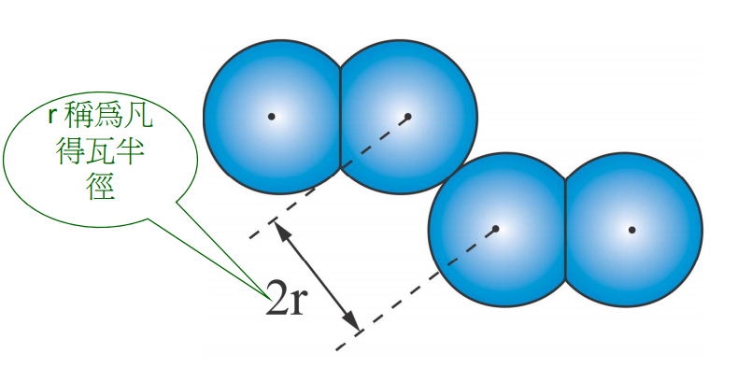
van der Waals radii
凡得瓦半徑＝兩個相鄰非鍵結原子間距離的一半

Slide 8
Cavity Prediction
The cavity prediction algorithm works as follows: first, a discrete grid with a resolution of 0.8 Å, covering the protein, is created. At every grid point, a sphere of radius 1.4 Å is placed. Whether this sphere will overlap with any of the spheres determined by the van der Waals radii of the protein atoms was checked. Grid points where the probe clashes with the protein atom spheres will be referred to as part of the inaccessible volume; all other points are referred to as accessible. Second, each accessible grid point is checked to see whether it is part of a cavity using the following procedure. From the current grid point, a random direction is chosen, and this direction (and the opposite direction) is followed until the grid boundaries are hit, checking if an inaccessible grid point is hit on the way. This is repeated a number of times, and if the percentage of lines hitting an inaccessible volume is larger than a given threshold, the point is marked as being part of a cavity.

Slide 9
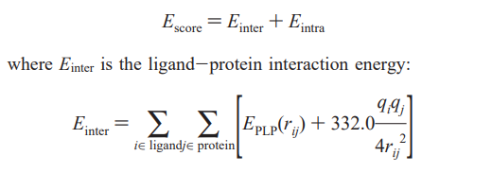
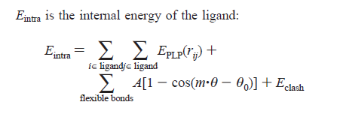
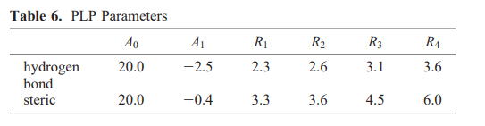
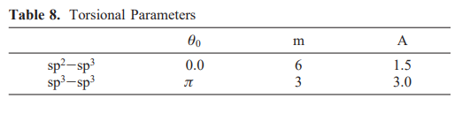
Scoring Function
E_{PLP}(0)=A₀
E_{PLP}(R₁)=0
E_{PLP}(R₂)=A₁
E_{PLP}(R₃)=A₁
E_{PLP}(r)=0,r>= R₄

Slide 10
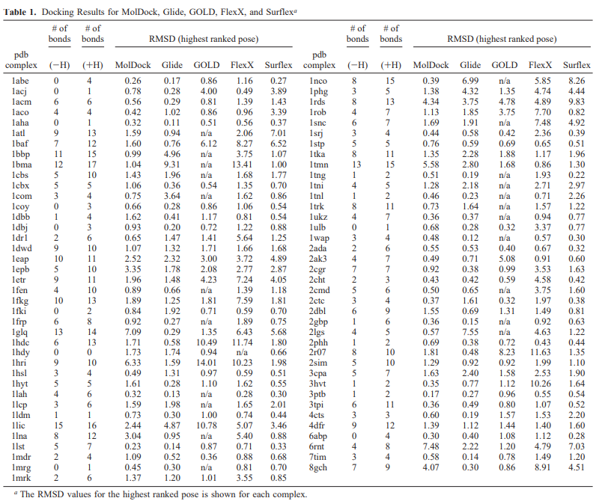
Results
Overall Accuracy

Slide 11
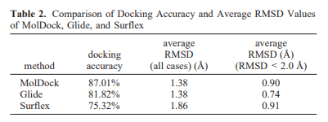
Comparison with Glide and Surflex
Glide compares the RMSD of the predicted poses to energy-minimized ligands and not to the cocrystallized native ligands.

Slide 12
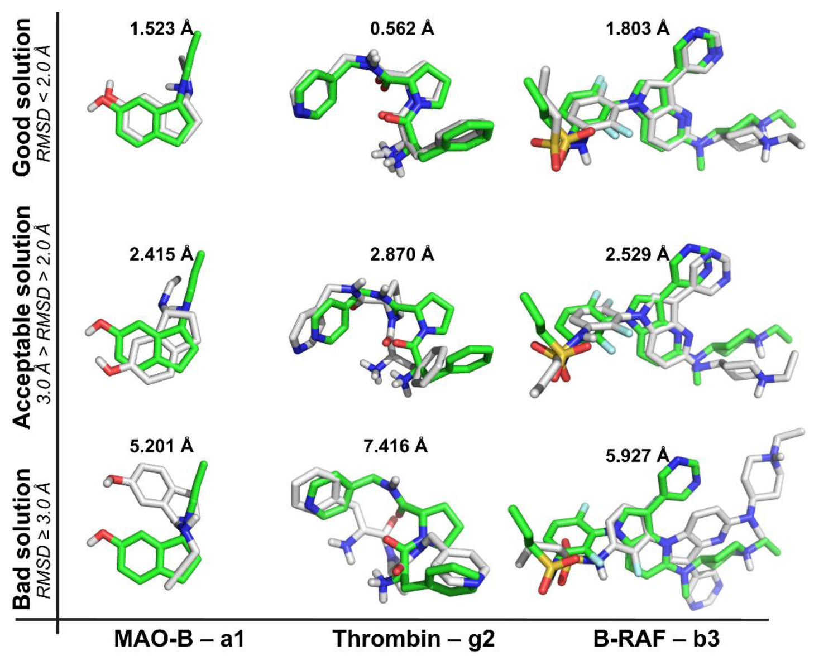
RMSD

Slide 13
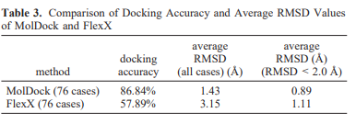
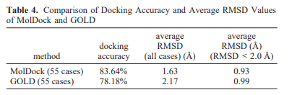
Comparison with FlexX and GOLD

Slide 14
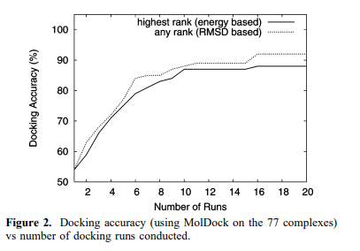
Search Robustness

Slide 15
Å
埃格斯特朗（Ångström, 簡稱埃，符號Å）是一個長度計量單位。
它不是國際制單位，但是可與國際制單位進行換算，即1 Å = 10^{–10} 米 = 0.1奈米。
一般用於原子直徑、化學鍵長和可見光的波長。原子的共價半徑在0.3埃（氫）和1.7埃（鈾，最重的天然元素）之間。它還被廣泛應用於結構生物學。

