Slide 1
BAYESIAN DEEP CONVOLUTIONAL NETWORKS WITH MANY CHANNELS ARE GAUSSIAN PROCESSES
Novak R, Xiao L, Bahri Y, et al.
Published as a conference paper at ICLR 2019, May 6-9, New Orleans.
Presenter: Ke-Xin Zhu
Date: 2019/04/02
Notes:
https://iclr.cc/

Slide 2
Abstract (1/2)
There is a previously identified equivalence between wide fully connected neural networks (FCNs) and Gaussian processes (GPs). This equivalence enables, for instance, test set predictions that would have resulted from a fully Bayesian, infinitely wide trained FCN to be computed without ever instantiating the FCN, but by instead evaluating the corresponding GP. In this work, we derive an analogous equivalence for multi-layer convolutional neural networks (CNNs) both with and without pooling layers, and achieve state of the art results on CIFAR10 for GPs without trainable kernels. We also introduce a Monte Carlo method to estimate the GP corresponding to a given neural network architecture, even in cases where the analytic form has too many terms to be computationally feasible.

Slide 3
Abstract (2/2)
Surprisingly, in the absence of pooling layers, the GPs corresponding to CNNs with and without weight sharing are identical. As a consequence, translation equivariance, beneficial in finite channel CNNs trained with stochastic gradient descent (SGD), is guaranteed to play no role in the Bayesian treatment of the infinite channel limit – a qualitative difference between the two regimes that is not present in the FCN case. We confirm experimentally, that while in some scenarios the performance of SGD-trained finite CNNs approaches that of the corresponding GPs as the channel count increases, with careful tuning SGD-trained CNNs can significantly outperform their corresponding GPs, suggesting advantages from SGD training compared to fully Bayesian parameter estimation.

Slide 4
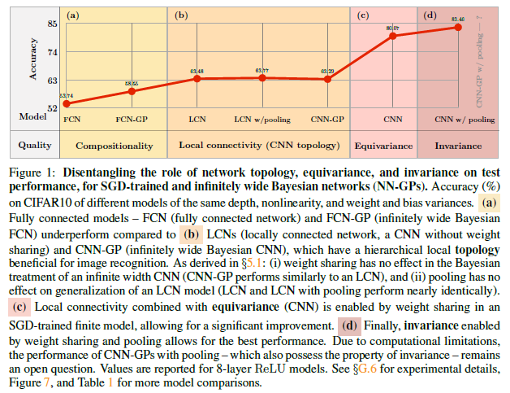
1.INTRODUCTION

Slide 5
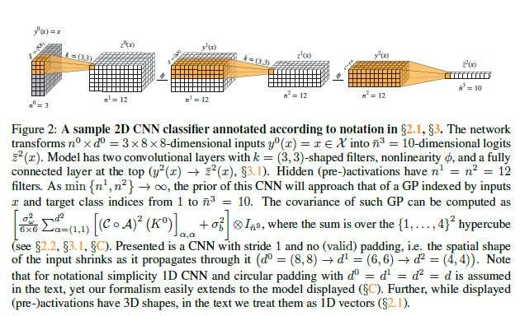
2. MANY-CHANNEL BAYESIAN CNNS ARE GAUSSIAN PROCESSES

Slide 6
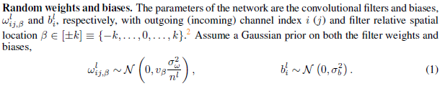
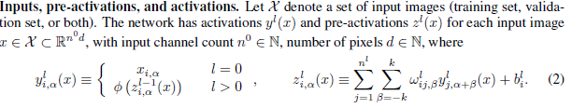

2. MANY-CHANNEL BAYESIAN CNNS ARE GAUSSIAN PROCESSES

Slide 7
2. MANY-CHANNEL BAYESIAN CNNS ARE GAUSSIAN PROCESSES

Slide 8
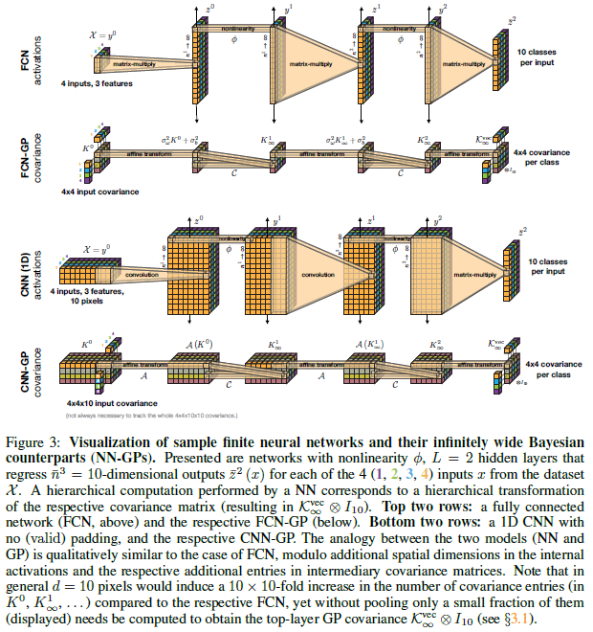
2.2 CORRESPONDENCE BETWEEN GAUSSIAN PROCESSES AND BAYESIAN DEEP CNNS WITH INFINITELY MANY CHANNELS

Slide 9
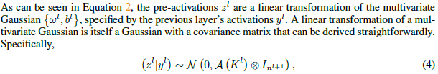
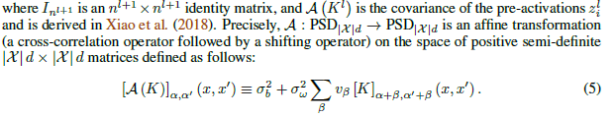
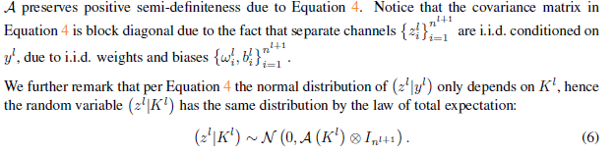
2.2.1 A SINGLE CONVOLUTIONAL LAYER IS A GP CONDITIONED ON THE UNCENTERED COVARIANCE MATRIX OF THE PREVIOUS LAYER’S ACTIVATIONS

Slide 10
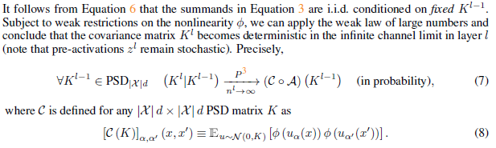
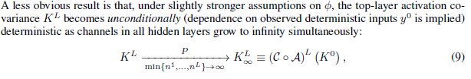
2.2.2 ACTIVATION COVARIANCE MATRIX BECOMES DETERMINISTIC WITH INCREASING CHANNEL COUNT

Slide 11
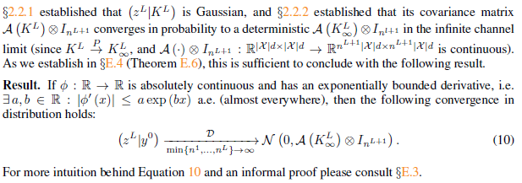
2.2.3 A CONDITIONALLY NORMAL RANDOM VARIABLE BECOMES NORMAL IF ITS COVARIANCE BECOMES DETERMINISTIC

Slide 12
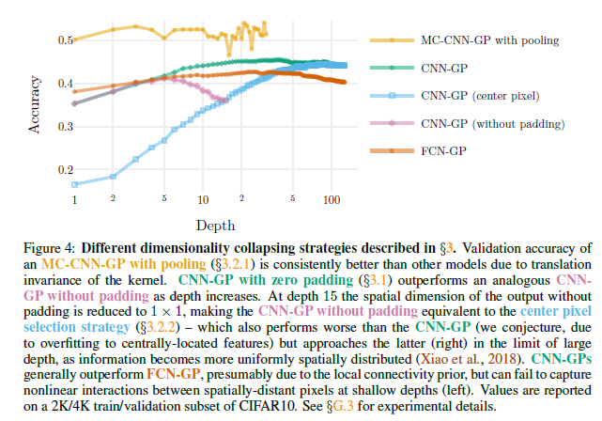
3. TRANSFORMING A GP OVER SPATIAL LOCATIONS INTO A GP OVER CLASSES

Slide 13
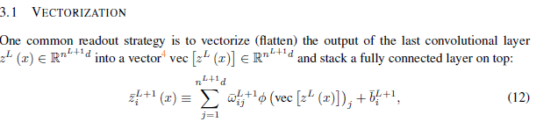
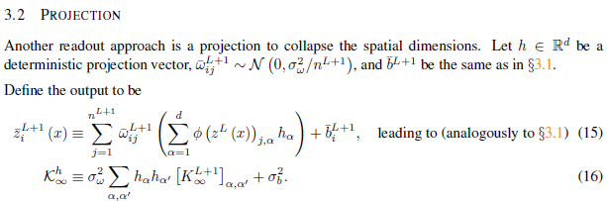
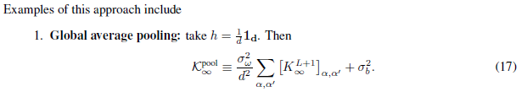
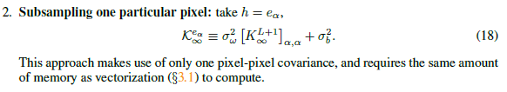
3. TRANSFORMING A GP OVER SPATIAL LOCATIONS INTO A GP OVER CLASSES

Slide 14

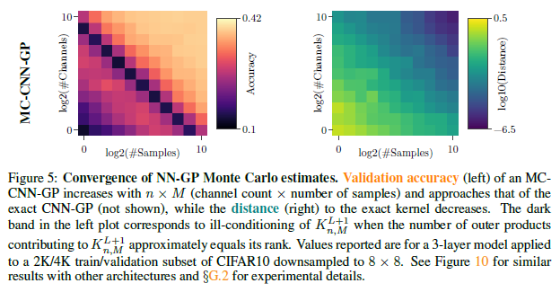
4 MONTE CARLO EVALUATION OF INTRACTABLE GP KERNELS

Slide 15
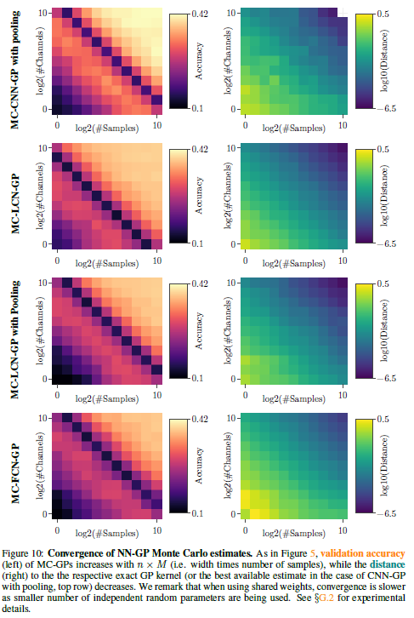
4 MONTE CARLO EVALUATION OF INTRACTABLE GP KERNELS

Slide 16
5 DISCUSSION

Slide 17
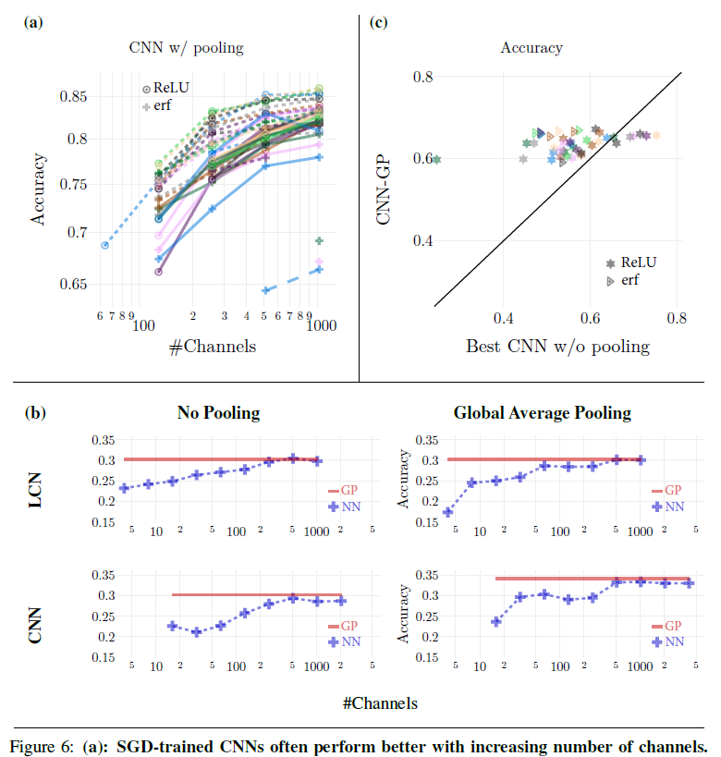
6 CONCLUSION

Slide 18
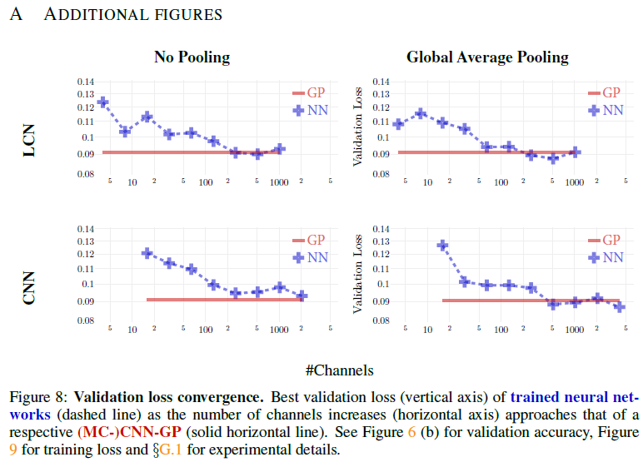
6 CONCLUSION

Slide 19
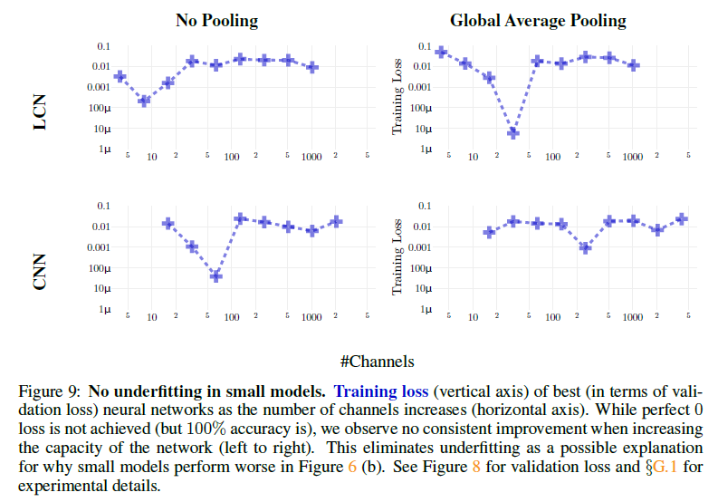
6 CONCLUSION

Slide 20
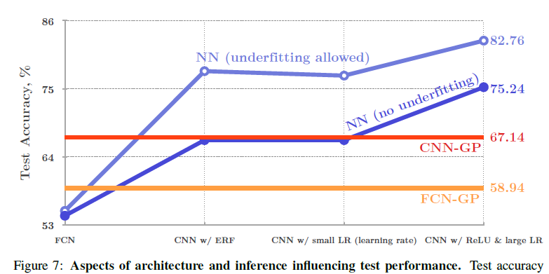
6 CONCLUSION

Slide 21
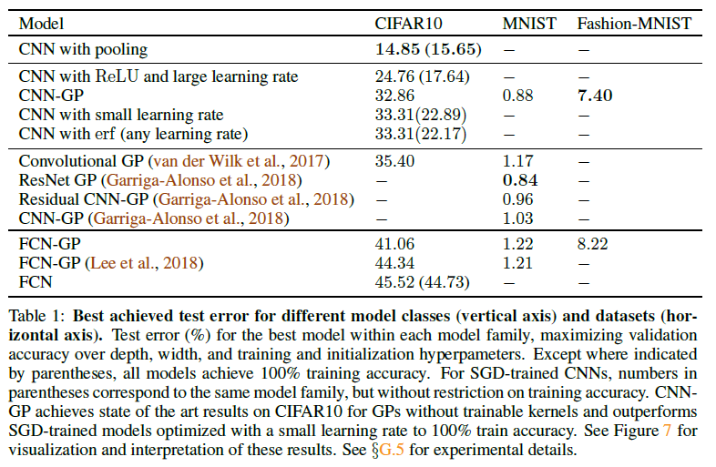
6 CONCLUSION

Slide 22
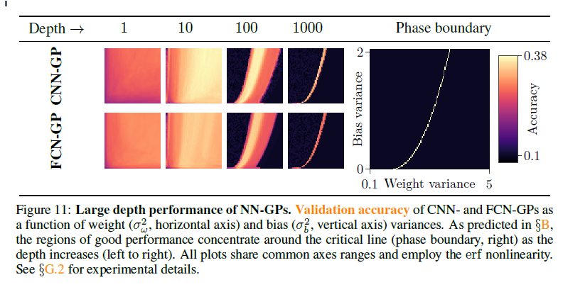
6 CONCLUSION

