Slide 1
A Novel Method of Characterizing Genetic Sequences: Genome Space with Biological Distance and Applications
Mo Deng, Chenglong Yu, Qian Liang, Rong He, and ShingTung Yau(丘成桐)
PLoS One Volume 6, Issue 3, 2011.
Presenter : Feng-Yang Tsai
Date:Apr. 9, 2019.

Slide 2
Abstract(1/3)
Most existing methods for phylogenetic analysis involve developing an evolutionary model and then using some type of computational algorithm to perform multiple sequence alignment. There are two problems with this approach: (1) different evolutionary models can lead to different results, and (2) the computation time required for multiple alignments makes it impossible to analyse the phylogeny of a whole genome. This motivates us to create a new approach to characterize genetic sequences. To each DNA sequence, we associate a natural vector based on the distributions of nucleotides. This produces a one-to-one correspondence between the DNA sequence and its natural vector. We define the distance between two DNA sequences

Slide 3
Abstract(2/3)
to be the distance between their associated natural vectors. This creates a genome space with a biological distance which makes global comparison of genomes with same topology possible. We use our proposed method to analyze the genomes of the new influenza A (H1N1) virus, human rhinoviruses (HRV) and mammalian mitochondrial. The result shows that a triple-reassortant swine virus circulating in North America and the Eurasian swine virus belong to the lineage of the influenza A (H1N1) virus. For the HRV and mammalian mitochondrial genomes, the results coincide with biologists’ analyses. Our approach provides a powerful new tool for analyzing and annotating genomes and their phylogenetic relationships. Whole or partial genomes can be

Slide 4
Abstract(3/3)
handled more easily and more quickly than using multiple alignment methods.

Slide 5




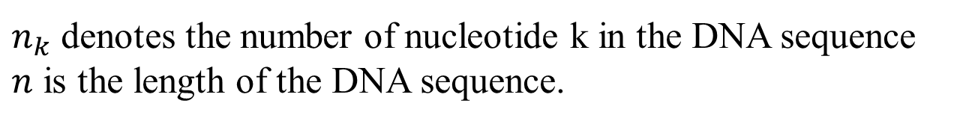
Natural Vector:
$n_{k}$ denotes the number of nucleotide k in the DNA sequence
$n$ is the length of the DNA sequence.
EX:
GTTCAATACT

Slide 6




Natural Vector:

Slide 7


Natural Vector:
if there are 19 A, 15 C, 21 G and 22 T in the sequence.

Slide 8
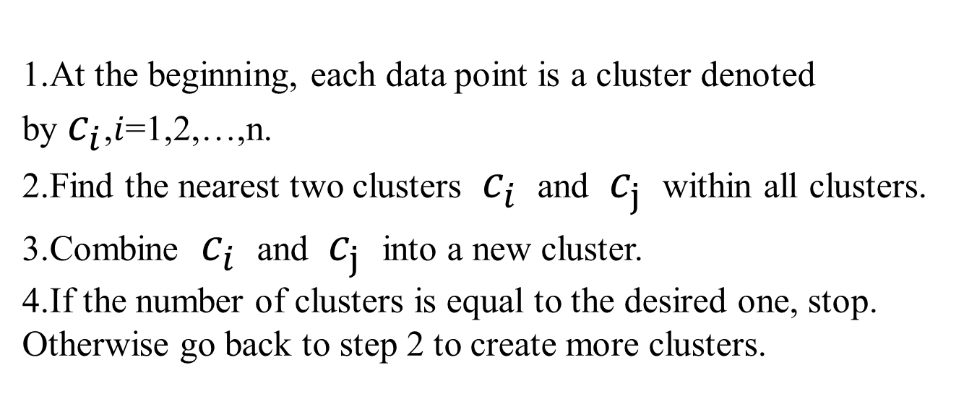
Agglomerative Hierarchical Clustering:
At the beginning, each data point is a cluster denoted by $c_{i}$,$i$=1,2,…,n.
Find the nearest two clusters $c_{i}$ and $c_{j}$ within all clusters.
Combine $c_{i}$ and $c_{j}$ into a new cluster.
If the number of clusters is equal to the desired one, stop. Otherwise go back to step 2 to create more clusters.

Slide 9
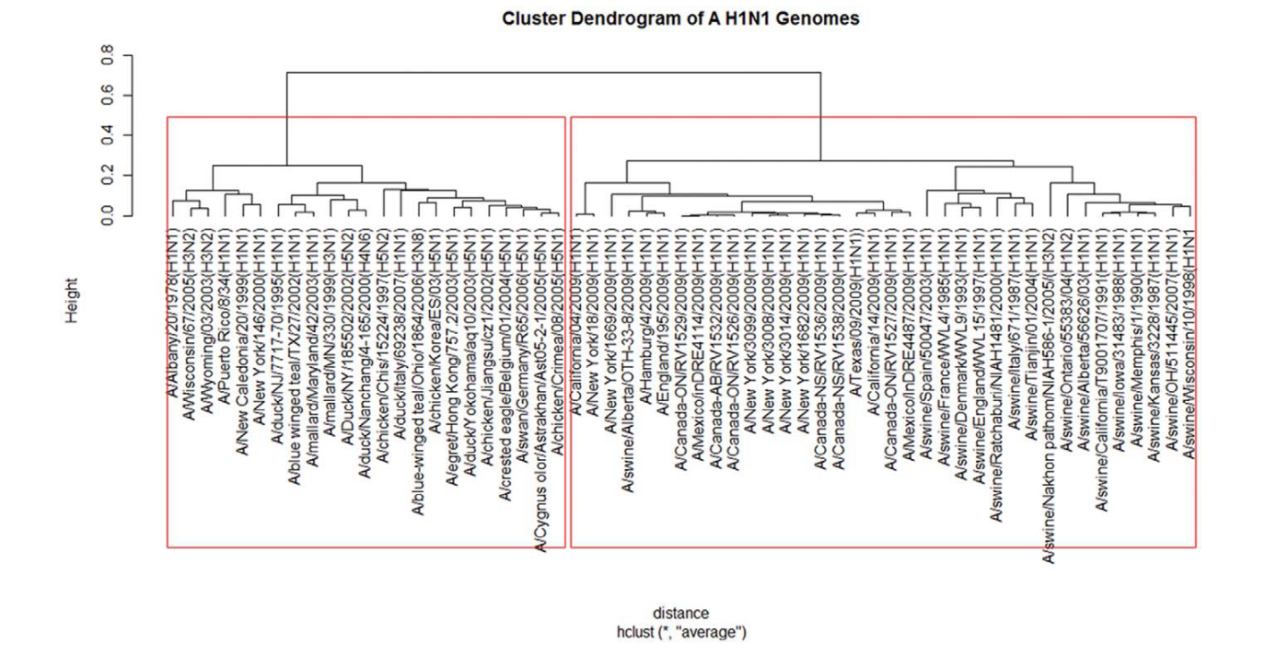
Results:

Slide 10
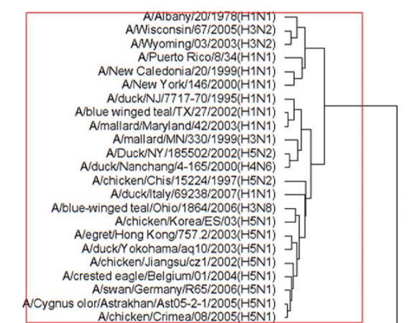
Notes:
A /藍翅teal / Ohio / 1864/2006（H3N8）與2003年至2006年亞洲國家的H5N1禽流感病毒爆發有關。

Slide 11
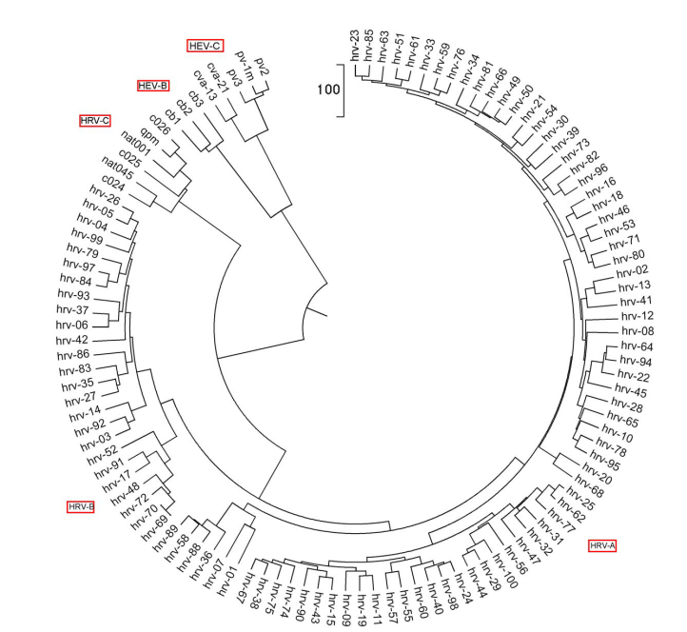

Slide 12
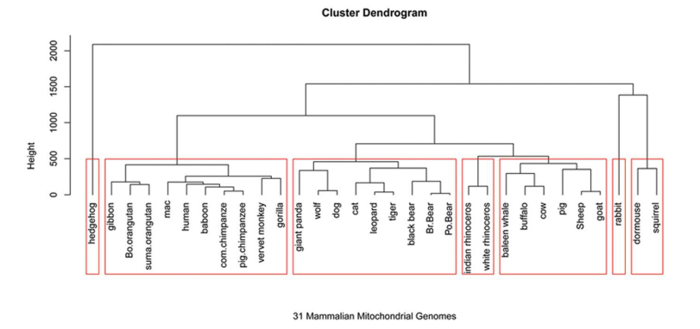
1.猬形目
2.靈長目
3.食肉目
4.奇蹄目
5.鯨目和偶蹄目
6.兔形目
7.囓齒目
Notes:
https://www.ncbi.nlm.nih.gov/nuccore/V00662.1/
大貓熊具備肉食動物的生理特徵卻不以肉為主食」，是因為一個名叫「T1R1」的基因失活了，造成貓熊無法感覺肉類的鮮味。但牠們的消化系統仍然是食肉動物的消化系統，因此只能依靠腸內細菌分解竹葉

Slide 13
