Slide 1
An Efficient Algorithm for a New Constrained LCS Problem
Daxin Zhu, Yingjie Wu, and Xiaodong Wang
8th Asian Conference, Intelligent Information and Database Systems,
Da Nang, Vietnam, March 14–16, 2016, pp 261-267
Presenter: Du-Cheng Wu
Date: Apr. 4, 2019
Notes:
https://www.google.com/maps/place/%E8%B6%8A%E5%8D%97%E5%B3%B4%E6%B8%AF%E6%B5%B7%E6%B4%B2%E9%83%A1%E5%B3%B4%E6%B8%AF/@16.1951659,107.4695442,8.75z/data=!4m5!3m4!1s0x314219c792252a13:0xfc14e3a044436487!8m2!3d16.0544068!4d108.2021667

Slide 2
Abstract
The solution to a generalized longest common subsequence
problem is addressed in this paper. In this problem, two given sequences
of their length s and t must be included as the subsequences of the
two main sequences A and B, and the result subsequences must be the
longest. If the lengths of the two main sequences A and B are n and m,
and the lengths of their two constrained sequences are s and t respectively,
the time complexity of the dynamic programming algorithm presented
in this paper to solve the new generalized LCS problem must be
O(nmst).

Slide 3
SEQ-IC-SEQ-IC-LCS
X = BDABCADA
Y = CBADCADBABD
U = AB
V = BAA
LCS = BDCADA, BACADA
SEQ-IC-SEQ-IC-LCS = BABAD

Slide 4
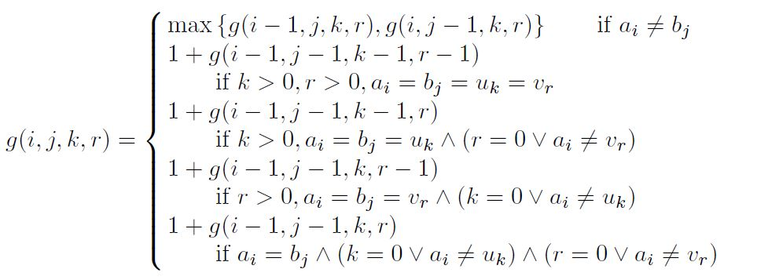
SEQ-IC-SEQ-IC-LCS

Slide 5
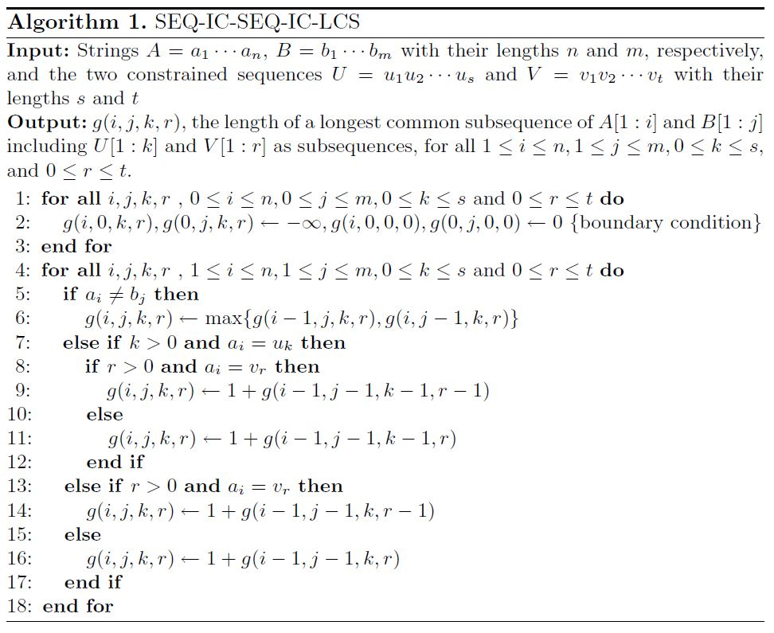
SEQ-IC-SEQ-IC-LCS algorithm

Slide 6
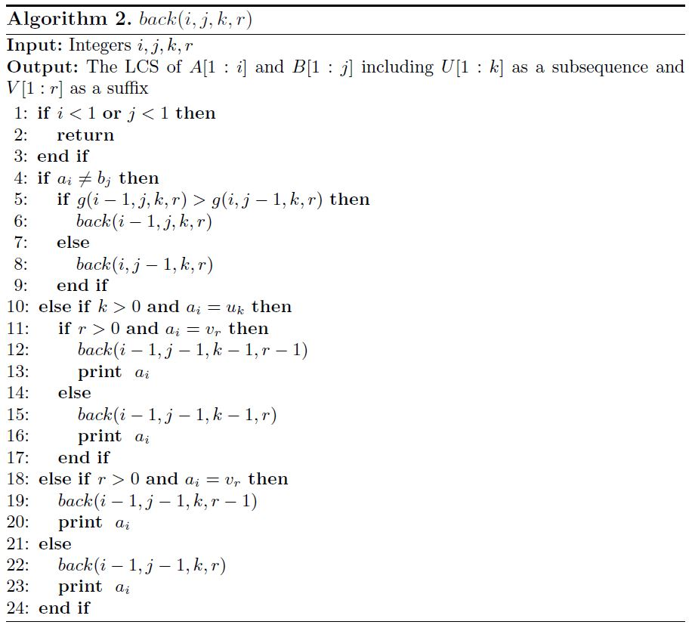
Back algorithm

Slide 7
Time complexity O(nmst)
Space complexity O(nmst)
Back algorithm time complexity O(n+m)

