Slide 1
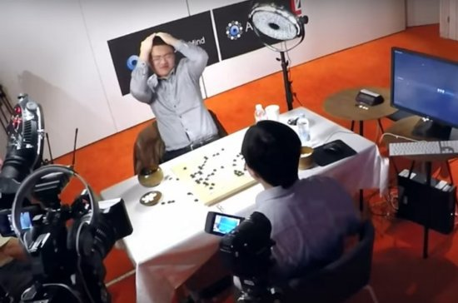
A Survey of Monte Carlo Tree
Search Methods
Cameron Browne, Edward Powley, Daniel Whitehouse, Simon Lucas,
Peter Cowling, Philipp Rohlfshagen, Stephen Tavener, Diego Perez, Spyridon Samothrakis, Simon Colton
IEEE TRANSACTIONS ON COMPUTATIONAL INTELLIGENCE AND AI IN GAMES, VOL. 4, NO. 1, MARCH 2012
Presenter : Chia-Lin Chen
May 27, 2019

Slide 2
Abstract(1/2)
Monte Carlo tree search (MCTS) is a recently proposed
search method that combines the precision of tree search with the generality of random sampling.
It has received considerable interest due to its spectacular success in the difficult problem of computer Go,
but has also proved beneficial in a range of other domains.

Slide 3
Abstract(2/2)
This paper is a survey of the literature to date, intended to provide a snapshot of the state of the art after the first five years of MCTS research. We outline the core algorithm’s derivation, impart some structure on the many variations and enhancements that have been proposed, and summarize the results from the key game and nongame domains to which MCTS methods have been applied. A number of open research questions indicate that the field is ripe for future work.

Slide 4
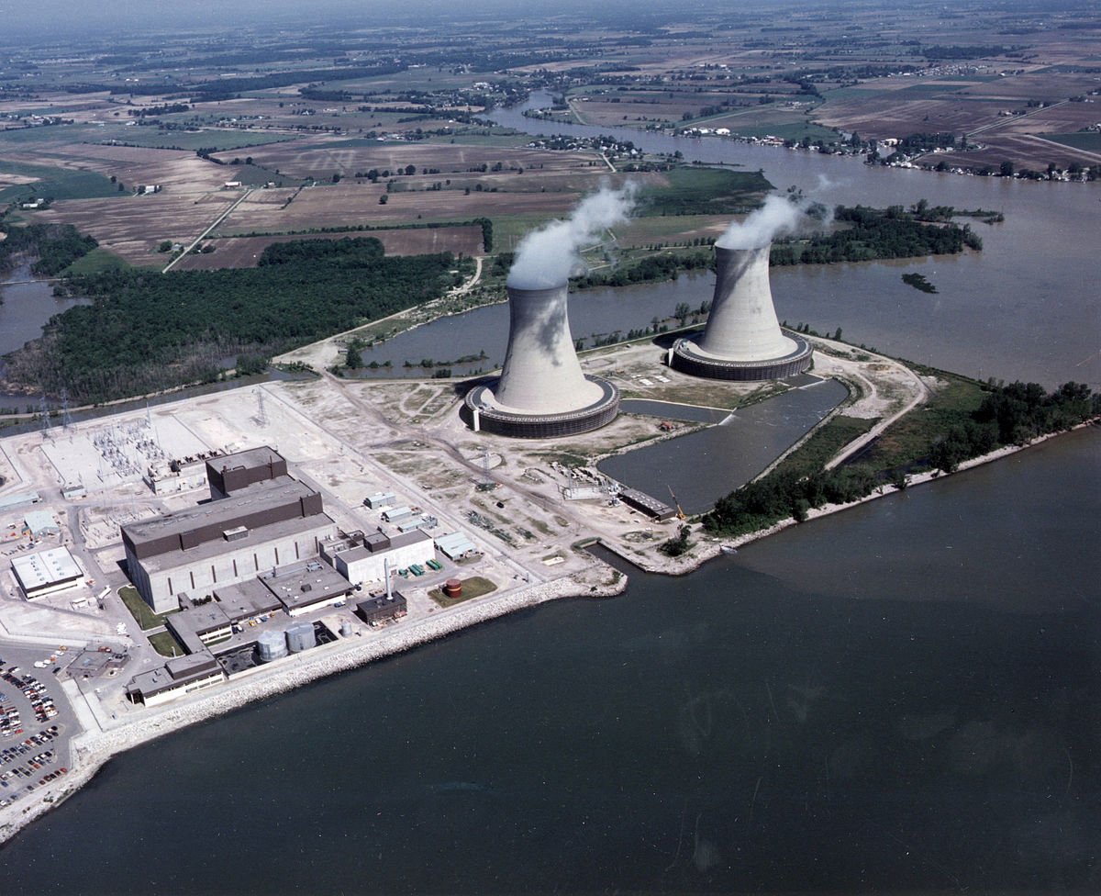
1940s, the USA want to know how the power of nuclear weapons could be.

Slide 5
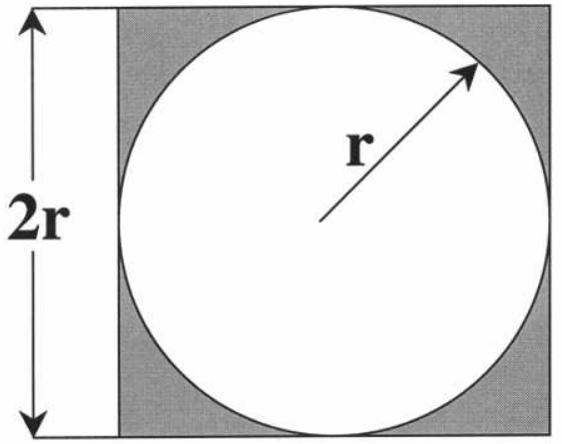
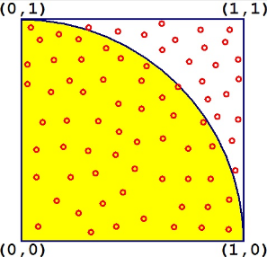
The first Monte Carlo application is used in calculating pi.
white area/gray area = pi/4

Slide 6
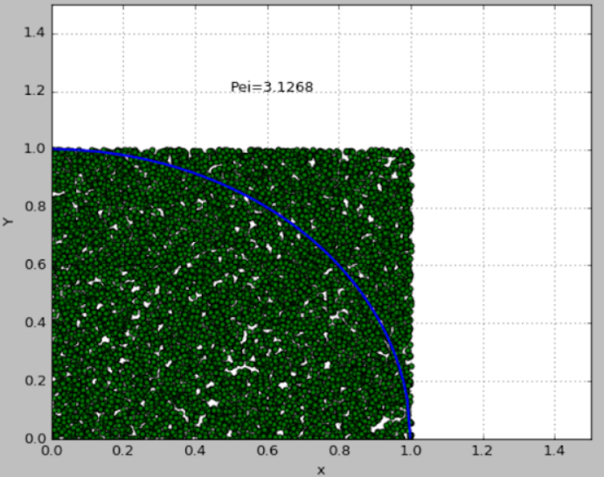
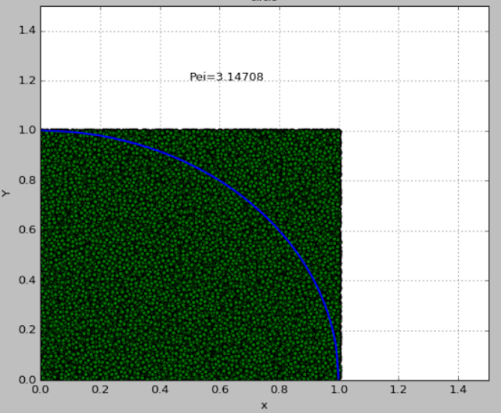
The first Monte Carlo application is used in calculating Pi.
Random numbers =10000
Random numbers =100000

Slide 7
Monte Carlo Approach
and
Monte Carlo Search Tree(MCTS)
Notes:
narrowly speaking Monte Carlo Approach
適合用於兩人對弈遊戲，比如tic-tac-toe、圍棋
其中採用minmax(最小化對手最大增益)。

Slide 8
Why use Monte Carlo Search Tree?
Reinforcement with MCTS
and
Reinforcement without MCTS

Slide 9
Reinforcement:
State、Action、Q-value、Reward
Monte Carlo Search Tree:
Two strategy: tree strategy + rollout strategy

Slide 10
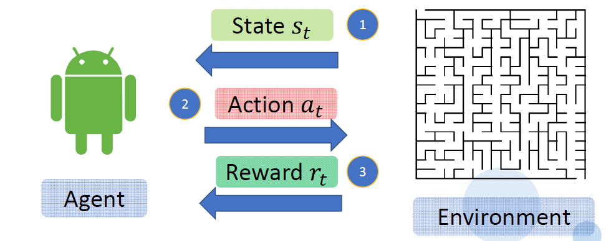
Reinforcement

Slide 11
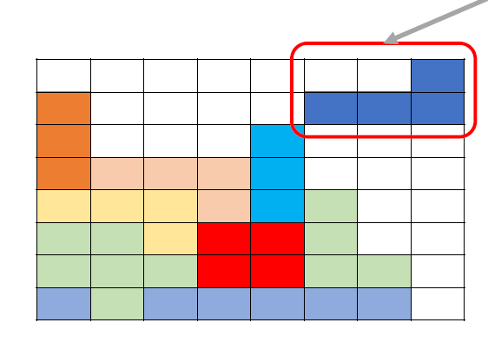
Reward of reinforcement(1/5)

Slide 12
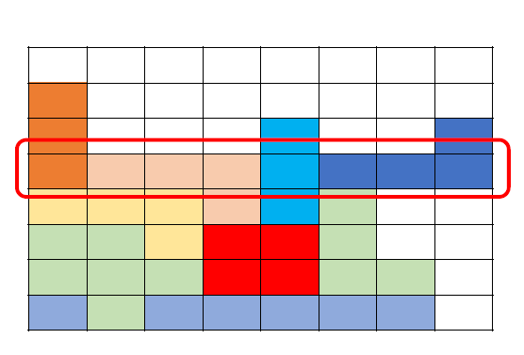
Reward of reinforcement(2/5)

Slide 13
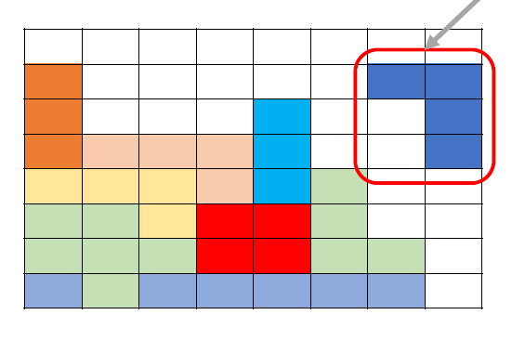
Reward of reinforcement(3/5)

Slide 14
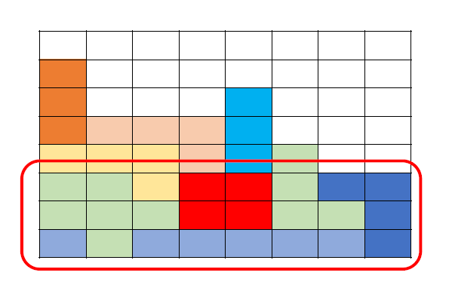
Reward of reinforcement(4/5)

Slide 15
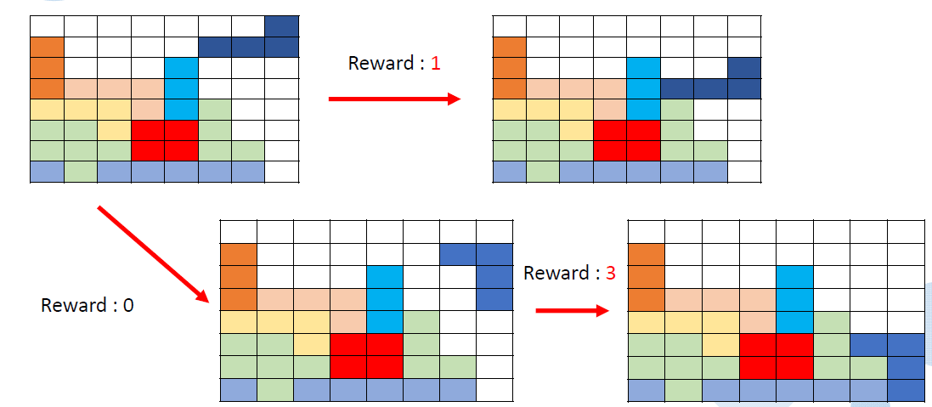
Reward of reinforcement(5/5)

Slide 16
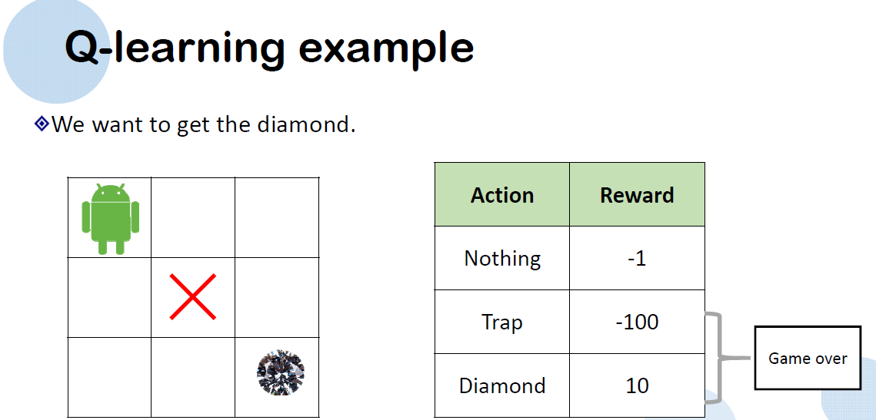

Slide 17
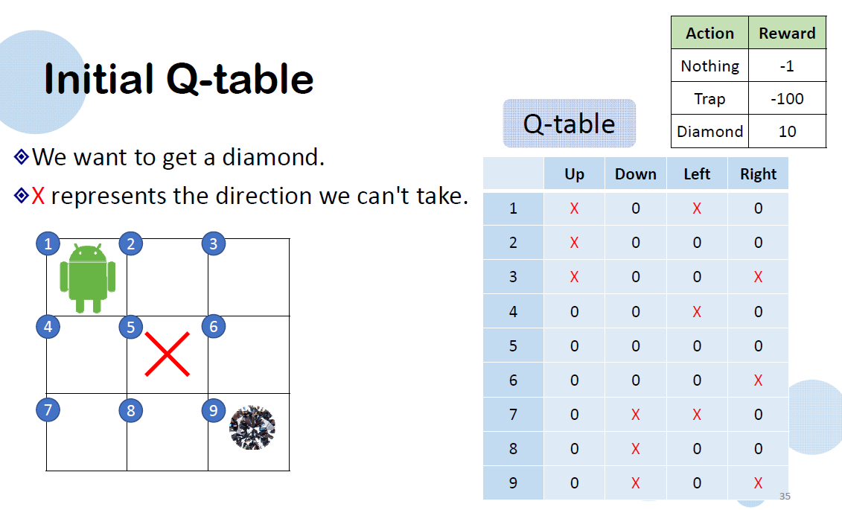

Slide 18
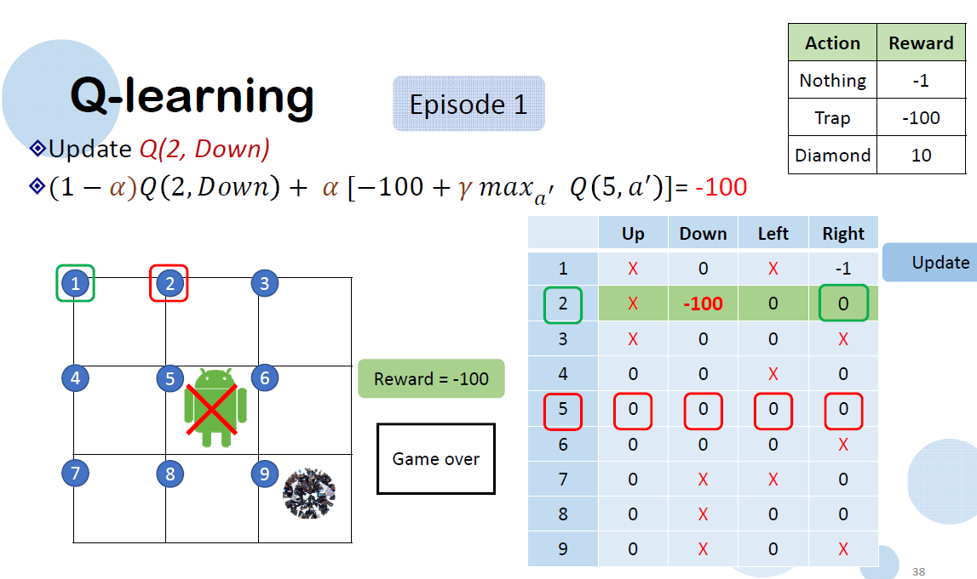

Slide 19
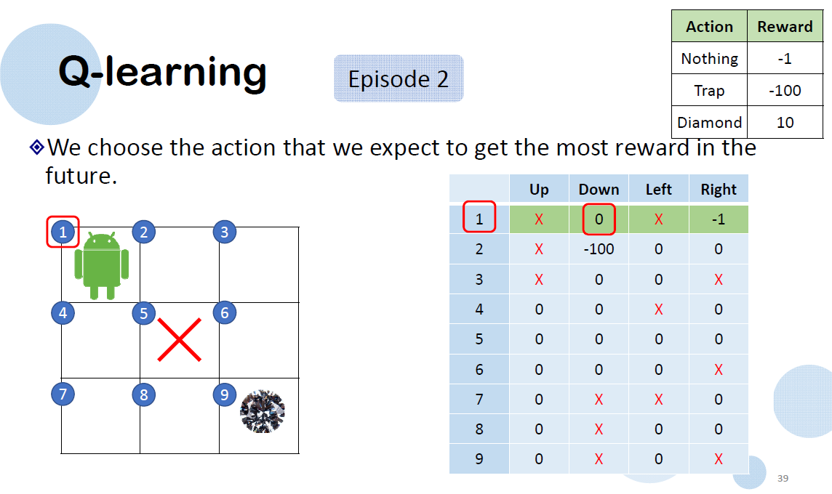

Slide 20
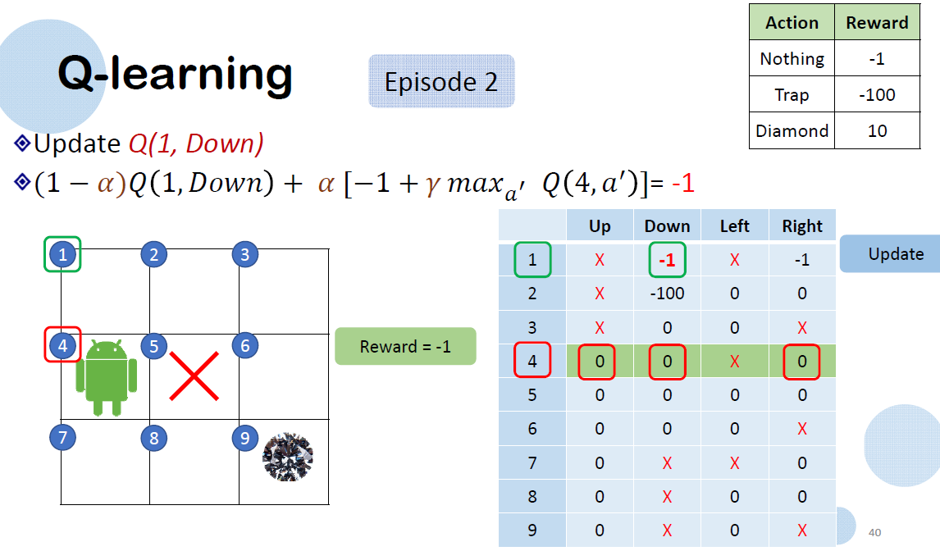

Slide 21
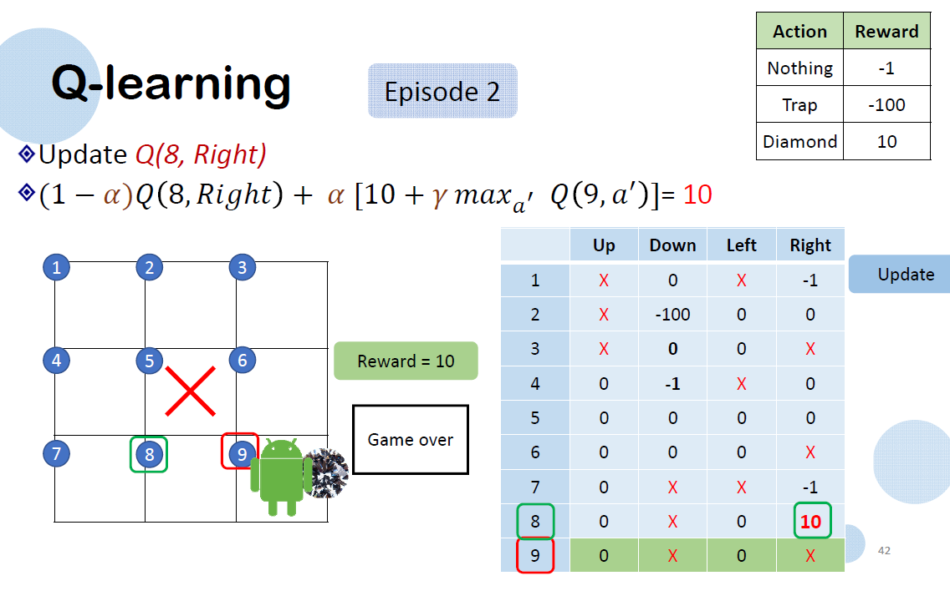

Slide 22
One player game
and
Two players games
Maximal Q-value
Minimax Q-value

Slide 23
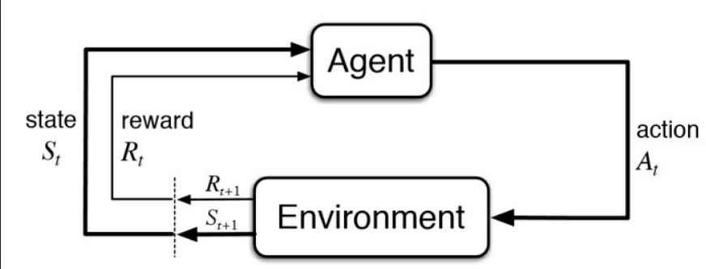
opponent

Slide 24
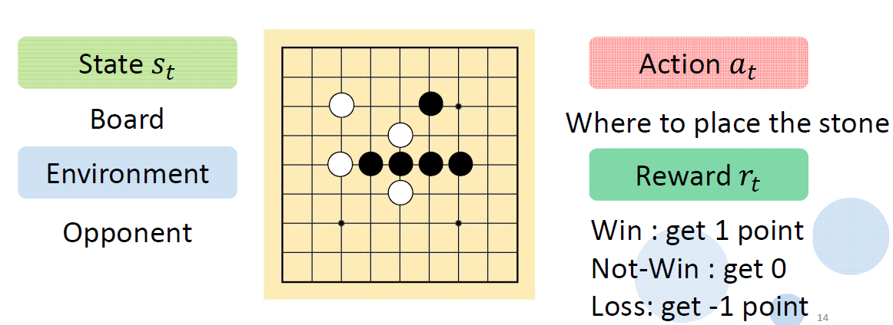

Slide 25
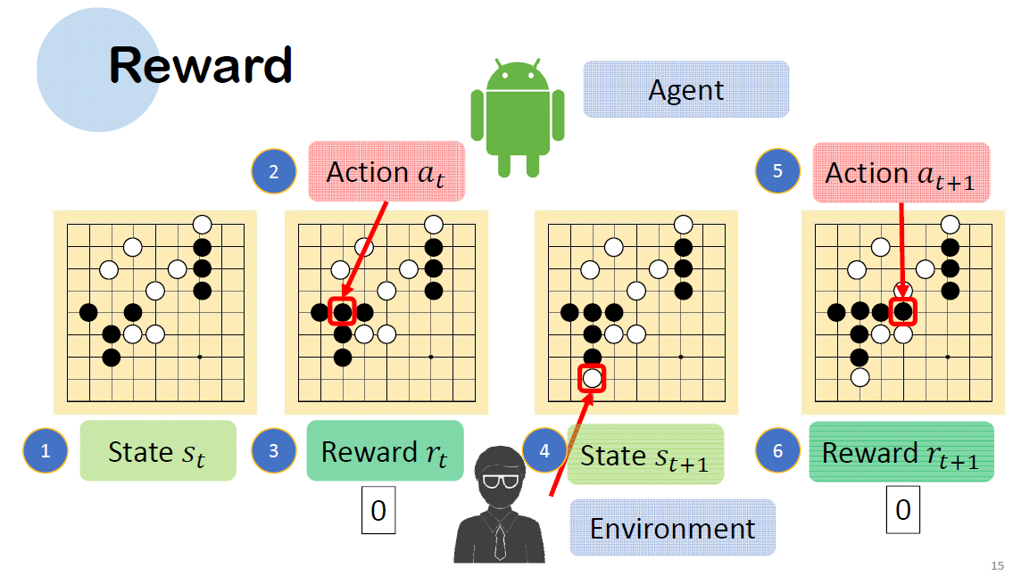

Slide 26
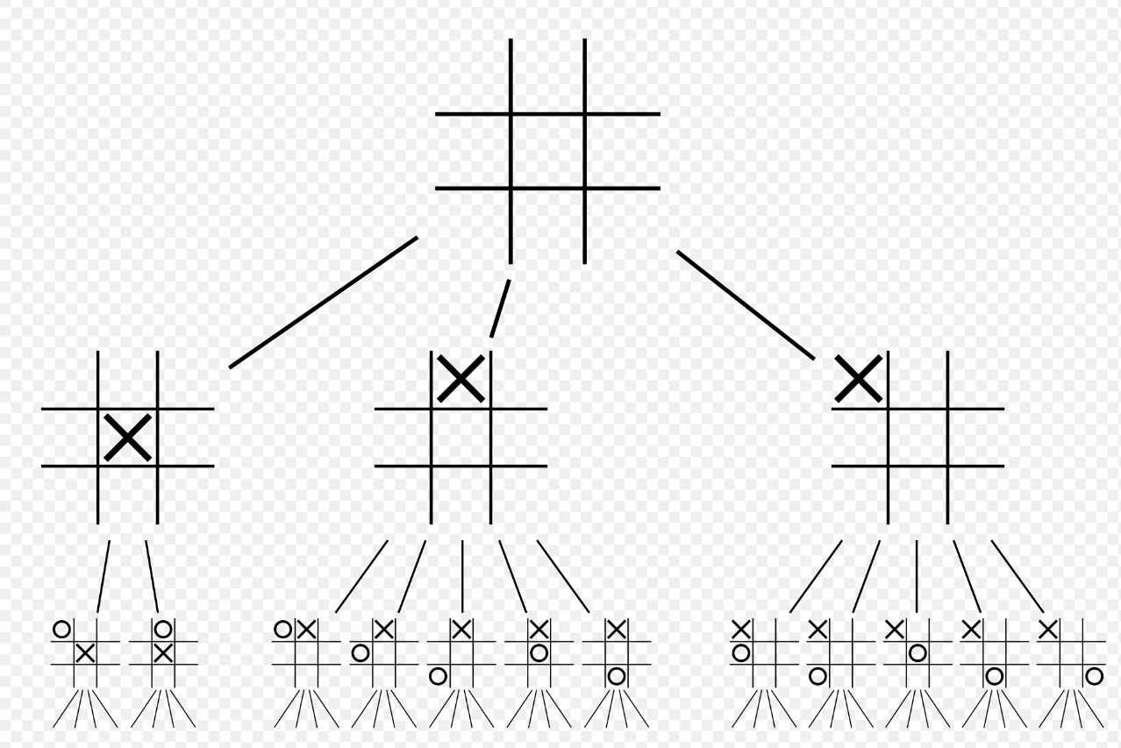
Tic-tac toe game
Notes:
井字遊戲中旋轉跟反射是等效的，所以可以將原本第一層的九種選擇，簡單化簡、歸類為三種選擇:中心、周邊、角落。
同理第二層可化簡如上圖。

Slide 27
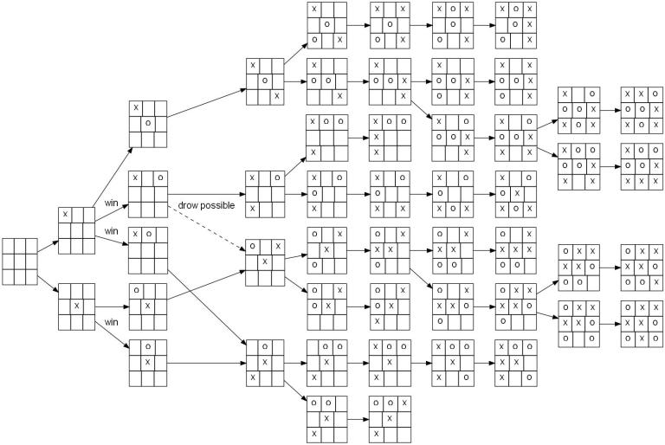

Slide 28
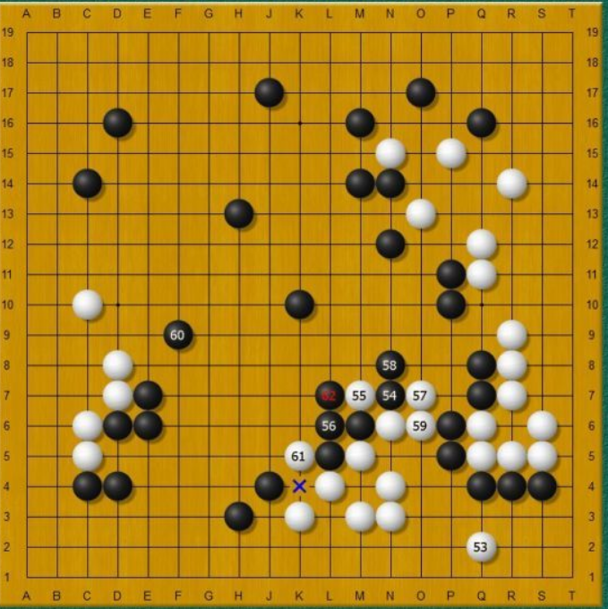

Slide 29
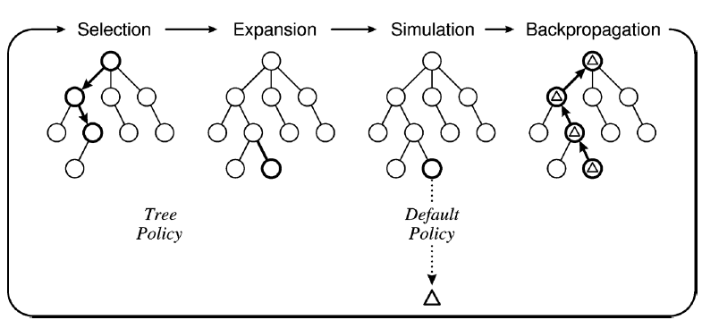
(Or Called Rollout Policy)

Slide 30
Monte Carlo Tree Search(MCTS) steps:
1.Selection(tree traversal: root(r)->leaf(l), based on UCB1.)
2.Expansion(keep doing until one wins)
3.Simulation(or called Rollout, based on random strategy)
4.Backpropagation(update from leaf to root)

Slide 31
Flow Chart of MCTS:
Start
state(S0)
Current State
state(S1)
state(S2)
state(S3)
Is current
state a
leaf node?
Current = max[UCB1(Si)]
state(S5)
state(S4)
state(S6)
Node Expansion
Simulation
(Rollout)
Backpropagation

Slide 32


Step1. Selection
Start
state(S0)
Current State
state(S1)
state(S2)
state(S3)
Is current
state a
leaf node?
Current = max[UCB1(Si)]
state(S5)
state(S4)
state(S6)
Node Expansion
Simulation
(Rollout)
Backpropagation

Slide 33
Step2. Expansion
Start
state(S0)
Current State
state(S1)
state(S2)
state(S3)
Is current
state a
leaf node?
Current = max[UCB1(Si)]
state(S5)
state(S4)
state(S6)
Node Expansion
Node Expansion
state(S7)
Simulation
(Rollout)
Backpropagation

Slide 34
Step3. Simulation
Start
state(S0)
Current State
state(S1)
state(S2)
state(S3)
Is current
state a
leaf node?
Current = max[UCB1(Si)]
state(S5)
state(S4)
state(S6)
Node Expansion
state(S7)
Rollout: use random strategy
Q(a,s) =
Simulation
(Rollout)
Backpropagation

Slide 35
Step4:Backpropagation
Start
state(S0)
Current State
state(S1)
state(S2)
state(S3)
Is current
state a
leaf node?
Current = max[UCB1(Si)]
state(S5)
state(S4)
state(S6)
Node Expansion
Simulation
(Rollout)
Backpropagation

Slide 36
0/3
0/2
0/5
0/5
state(S5)
state(S4)
Node Expansion
state(S7)

Slide 37
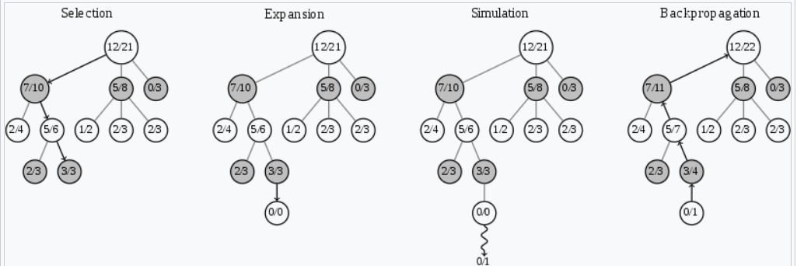

Slide 38
Thank you!

