Slide 1
Prediction and interpretation of miRNA-disease associations based on miRNA target genes using canonical correlation analysis
Hailin Chen1, Zuping Zhang, Dayi Feng
BioMed Central(BMC) Bioinformatics, Volume 20, July 25, 2019
Speaker: Jheng-Yan Lyu
Date: July 30, 2019

Slide 2
Abstract (1/2)
Background: It has been shown that the deregulation of miRNAs is associated with the development and progression of many human diseases. To reduce time and cost of biological experiments, a number of algorithms have been proposed for predicting miRNA-disease associations. However, the existing methods rarely investigated the cause-and-effect mechanism behind these associations, which hindered further biomedical follow-ups.
Results: In this study, we presented a CCA-based model in which the possible molecular causes of miRNA -disease associations were comprehensively revealed by extracting correlated sets of genes and diseases based on the co-occurrence of miRNAs in target gene profiles and disease profiles. Our method directly suggested the underlying genes involved, which could be used for experimental tests and confirmation. The inference of associated diseases of a new miRNA was made by taking into account the weight vectors of the extracted sets.

Slide 3
Abstract (2/2)
We extracted 60 pairs of correlated sets from 404 miRNAs with two profiles for 2796 target genes and 362 diseases. The extracted diseases could be considered as possible outcomes of miRNAs regulating the target genes which appeared in the same set, some of which were supported by independent source of information. Furthermore, we tested our method on the 404 miRNAs under the condition of 5-fold cross validations and received an AUC value of 0.84606. Finally, we extensively inferred miRNA-disease associations for 100 new miRNAs and some interesting prediction results were validated by established databases.
Conclusions: The encouraging results demonstrated that our method could provide a biologically relevant prediction and interpretation of associations between miRNAs and diseases, which were of great usefulness when guiding biological experiments for scientific research.

Slide 4
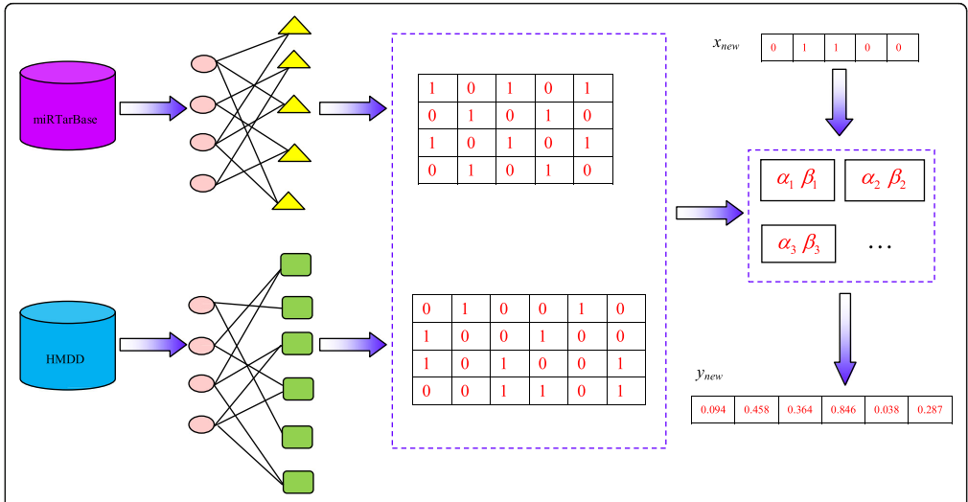
Construction of gene profiles and disease profiles for miRNAs

Slide 5



Canonical correlation coefficient
u_{i} = α^{T} t_{i} , v_{i} = β^{T} d_{i} (i = 1,2,3,…,n)
α = (α₁, α₂, α₃, …, α_{p})^{T}, β = (β₁, β₂, β₃, …, β_{q})^{T}
Let X denote the n × p matrix and Y denote the n × q matrix.
the maximization problem can be formally rewritten as follows:

Slide 6
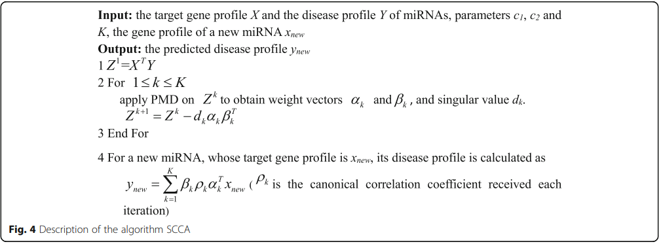
Canonical correlation analysis (CCA)

Slide 7
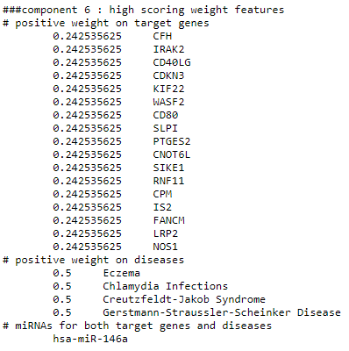
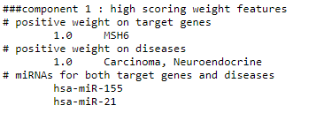
Results
They are well tuned and we obtain the best AUC value of 0.84606 with c1 = 0.01, c2 = 0.01 and K = 60.

Slide 8
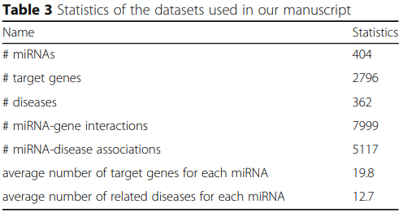
Statistics of the datasets

Slide 9
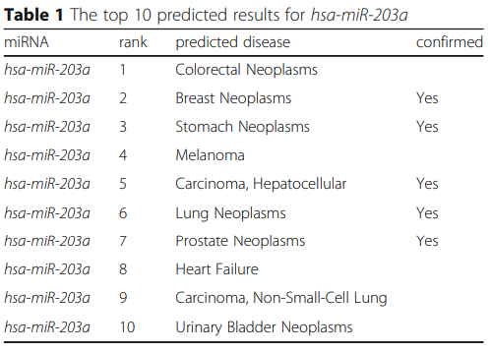
Results
The top 10 predicted results for hsa-miR-203a

Slide 10
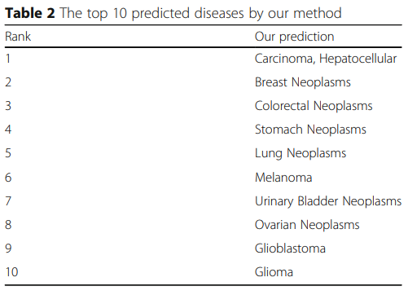
Results
The top 10 predicted diseases by our method

