Slide 1
Maximal common subsequence algorithm
Yoshifumi Sakai
Theoretical Computer Science, Available online 2 July 2019.
In press, Corrected Proof
Presenter: Du-Cheng Wu
Date: Jul. 30, 2019

Slide 2
Abstract
A common subsequence of two strings is maximal if inserting any character into it no longer yields a common subsequence. The present article proposes a (sub)linearithmic-time, linear-space algorithm for finding a maximal common subsequence of two strings and a linear-time algorithm for determining if a common subsequence of two strings is maximal.

Slide 3
Maximal common subsequence(MCS)
X = ACEDF
Y = AEDCF
LCS = AEDF
MCS = AEDF, ACF

Slide 4
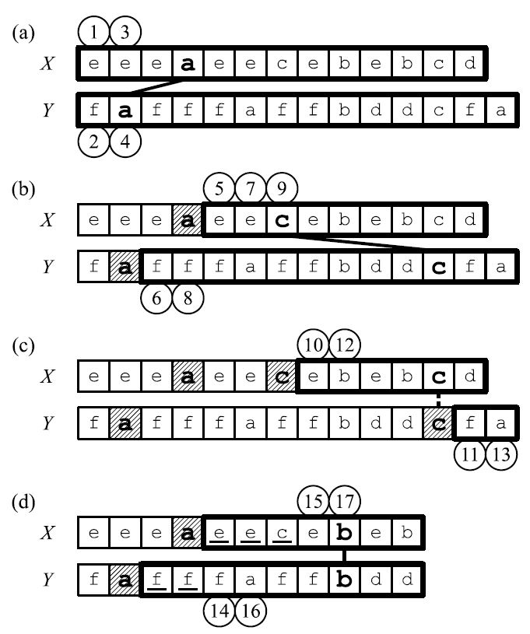
Maximal common subsequence(MCS)
(0, 0, 0)
(0, 0, 4)。(4, 2, 0)
(0, 0, 4)。(4, 2, 5)。(7, 12, 0)
(0, 0, 4)。(4, 2, 5)

Slide 5
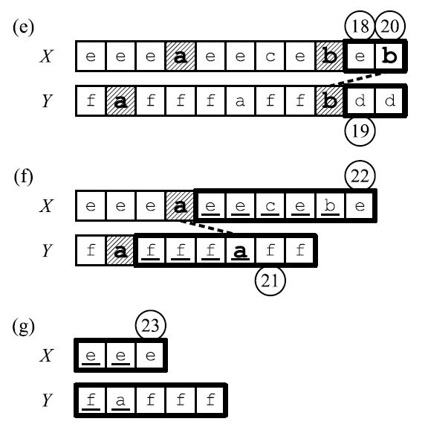
Maximal common subsequence(MCS)
(0, 0, 4)。(4, 2, 9)。(9, 9, 0)
(0, 0, 4)。(4, 2, 9)
(0, 0, 4)

Slide 6
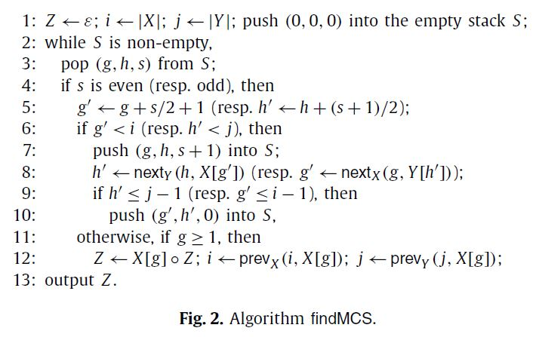
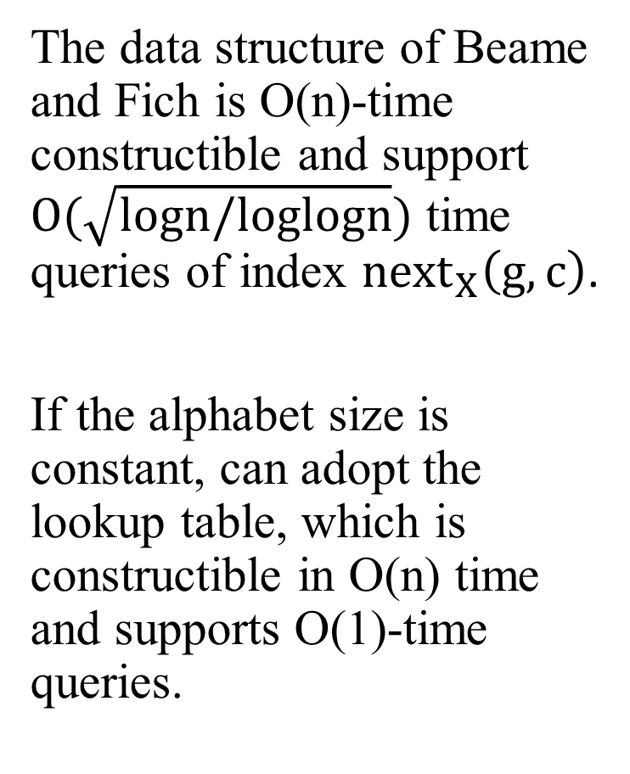
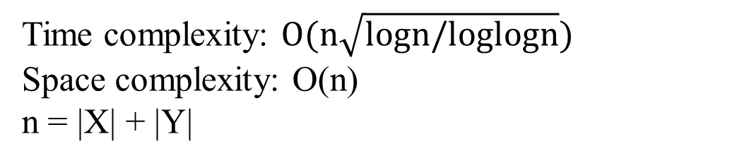
Maximal common subsequence(MCS)
The data structure of Beame and Fich is O(n)-time constructible and support $O(\sqrt{logn/loglogn})$ time queries of index ${next}_{X}\left(g,c\right)$.
If the alphabet size is constant, can adopt the lookup table, which is constructible in O(n) time and supports O(1)-time queries.
Time complexity: $O(n\sqrt{logn/loglogn})$
Space complexity: O(n)
n = |X| + |Y|

Slide 7
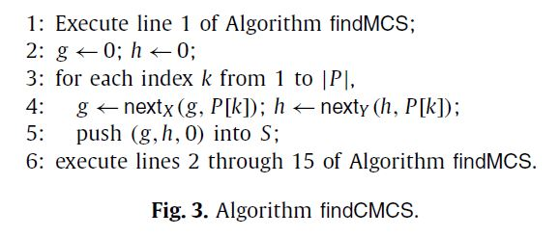
Constrained MCS(CMCS)
Output an MCS of X and Y that contains P.

Slide 8
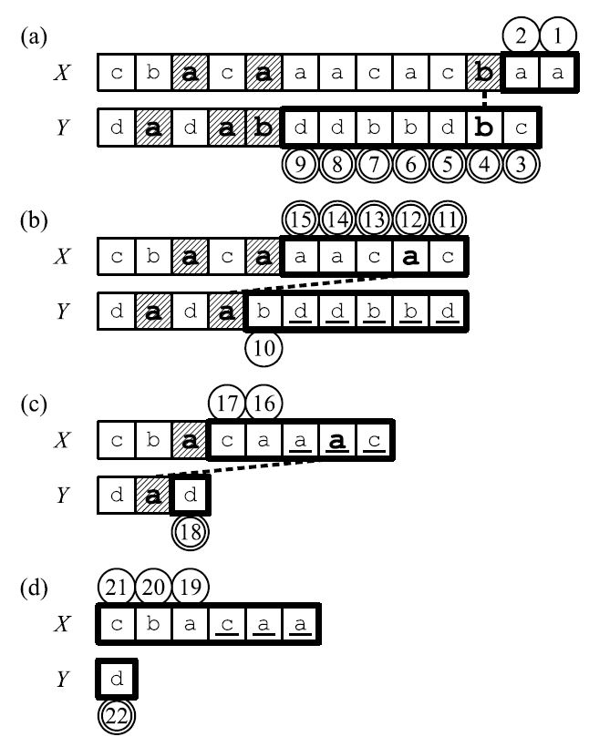
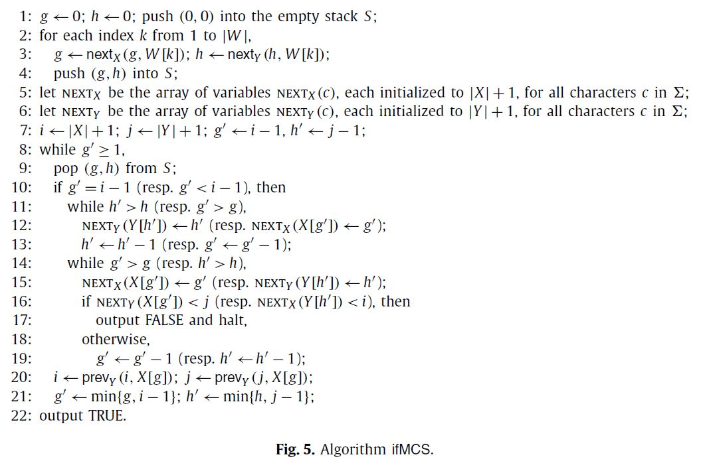
Check MCS
Time complexity: O(n)

