Slide 1
A fast algorithm for the all-pairs suffix–prefix problem
Jihyuk Lim, Kunsoo Park Theoretical Computer Science 698 (2017) pp.14-24
Speaker: Kuan-Lin Lai
Date: Aug. 15, 2019

Slide 2
Abstract
The all-pairs suffix–prefix problem occurs as a subproblem of DNA sequence assembly where it is the most time-consuming part of the whole assembly. Although there are algorithms for the all-pairs suffix–prefix problem which are optimal in the asymptotic time complexity, they are slower than SOF and Readjoiner which are state-of-the-art algorithms used in practice. In this paper we present an algorithm for the all-pairs suffix– prefix problem that uses a simple data structure for storing input strings and advanced algorithmic techniques for matching, which together lead to fast running time in practice. Our algorithm is 14 times faster than SOF and 18 times faster than Readjoiner on average in real datasets and random datasets.

Slide 3
all-pairs suffix–prefix problem (APSP)
Ex:
S1 = GGACTAAACGAC S2 = ACGACGACA S3 = ACAAATCTGGTA
[S1, S2] = ACGAC [S2, S3] = ACA [S1, S3] = NULL
Other algorithms time complexity: $O(N+k^{2})$

Slide 4
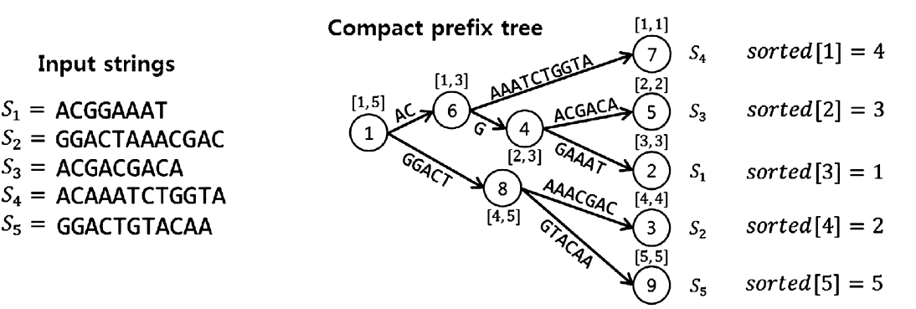
Compact prefix tree

Slide 5
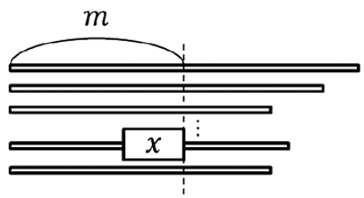
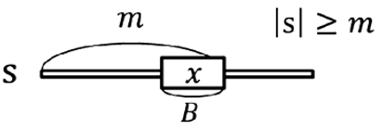
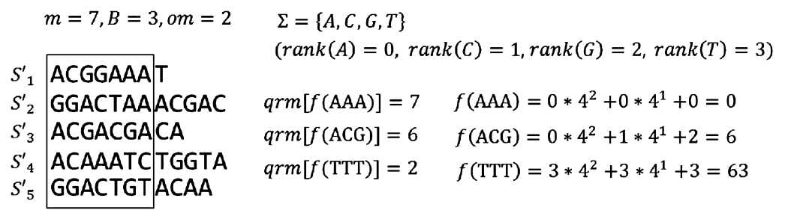
Preprocessing and matching

Slide 6
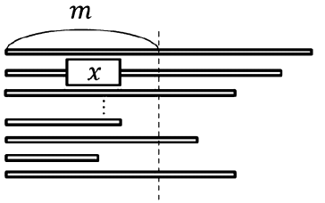
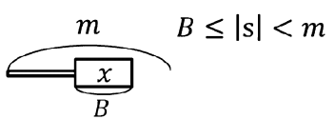


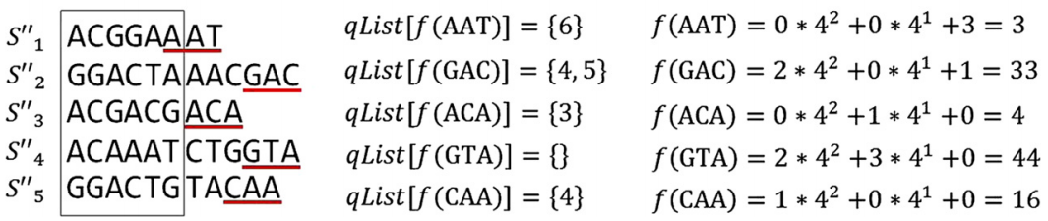
Preprocessing and matching

Slide 7
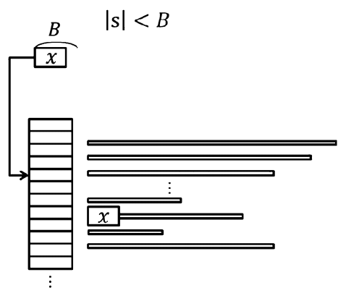
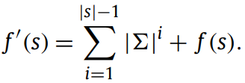
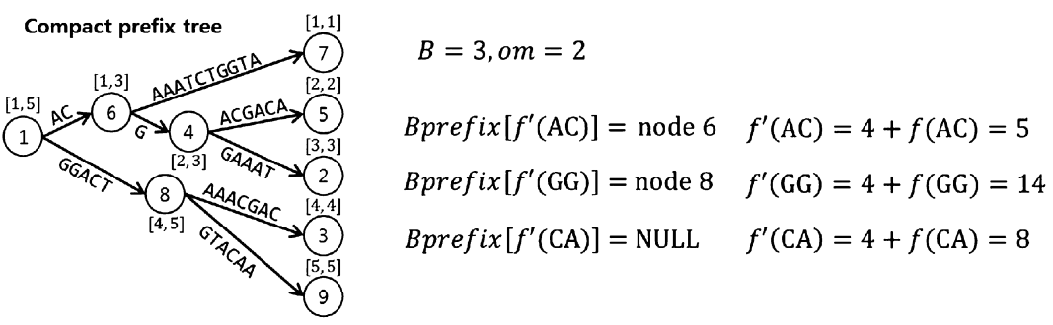
Preprocessing and matching

Slide 8
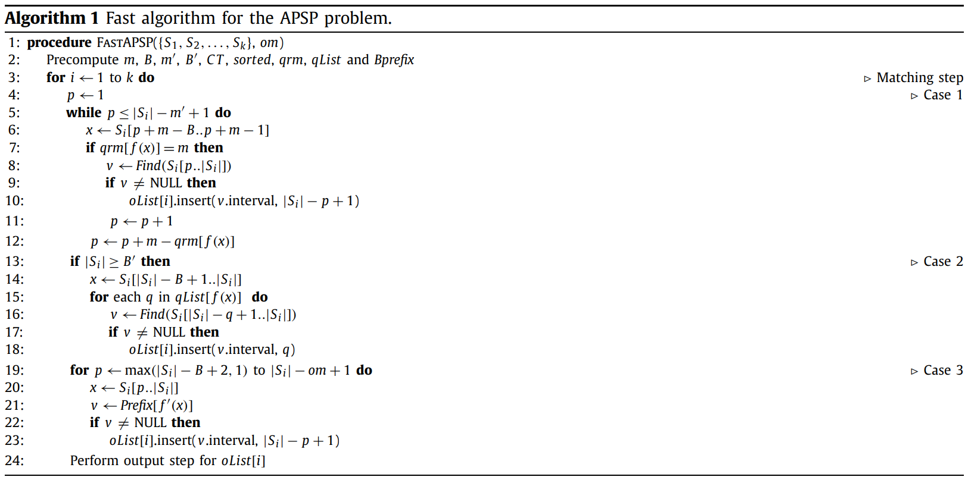
Pseudocode

Slide 9
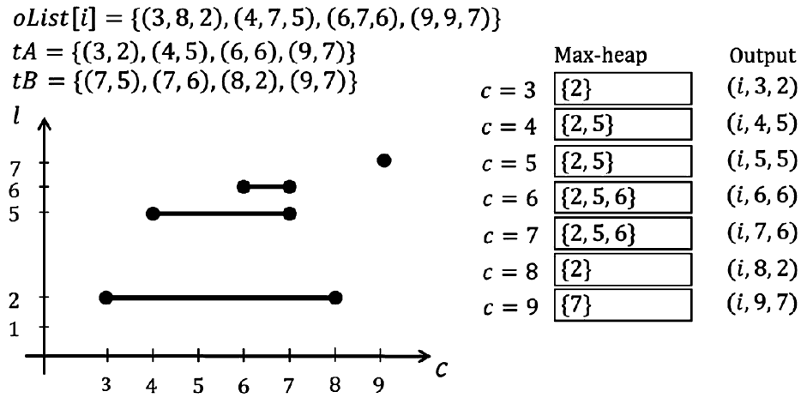
Output step

Slide 10
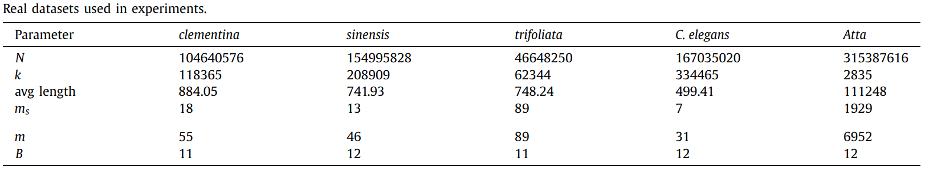
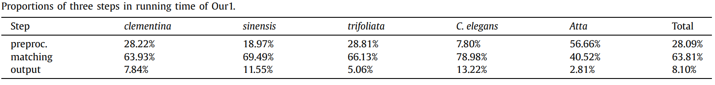
Experiments

Slide 11
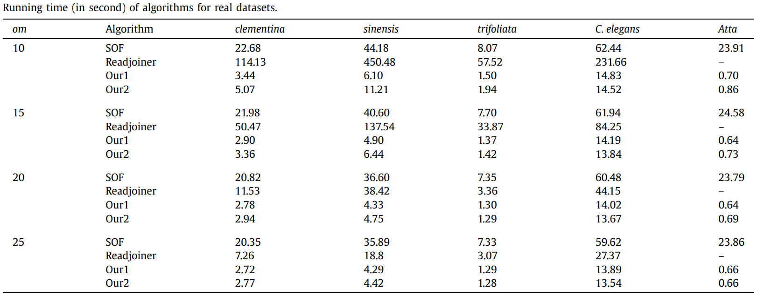
Experiments

Slide 12
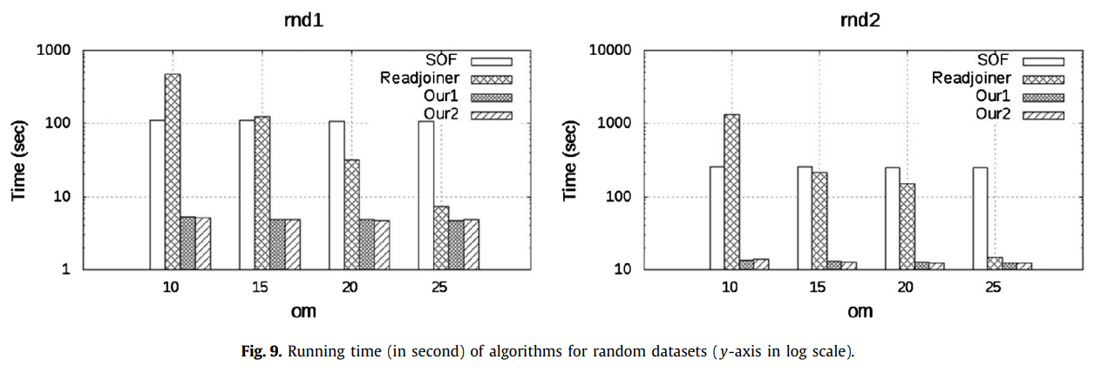
Experiments

Slide 13
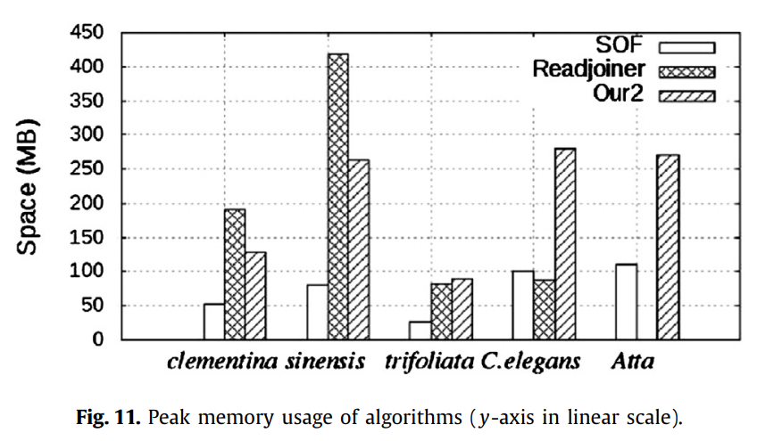
Experiments

