Slide 1
MatAlign: Precise Protein Structure Comparison by Matrix Alignment
Zeyar Aung,and Kian-lee Tan
Journal of Bioinformatics and Computational Biology
Vol. 4, No. 6 (2006) 1197–1216
Presenter : Feng-Yang Tsai
Date:Aug. 15, 2019.

Slide 2
Abstract(1/2)
We propose a detailed protein structure alignment method named “MatAlign”. It is a two-step algorithm. Firstly, we represent 3D protein structures as 2D distance matrices, and align these matrices by means of dynamic programming in order to ﬁnd the initially aligned residue pairs. Secondly, we reﬁne the initial alignment iteratively into the optimal one according to an objective scoring function. We compare our method against DALI and CE, which are among the most accurate and the most widely used of the existing structural comparison tools. On the benchmark set of 68 protein structure pairs by Fischer et al., MatAlign provides better alignment results, according to four diﬀerent criteria, than both DALI and CE in a majority of cases.

Slide 3
Abstract(2/2)
MatAlign also performs as well in structural database search as DALI does, and much better than CE does. MatAlign is about two to three times faster than DALI, and has about the same speed as CE. The software and the supplementary information for this paper are available at http://xena1.ddns.comp.nus.edu.sg/ ∼ genesis/MatAlign/.

Slide 4
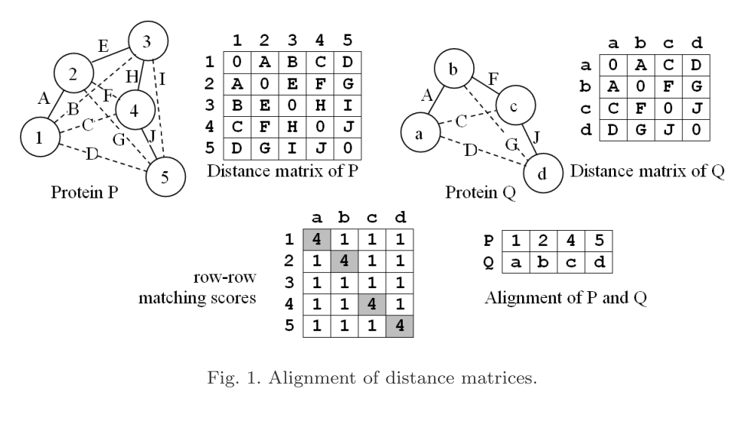


Distance matrix representation:
Notes:
Aligning distance matrices for structural alignment

Slide 5
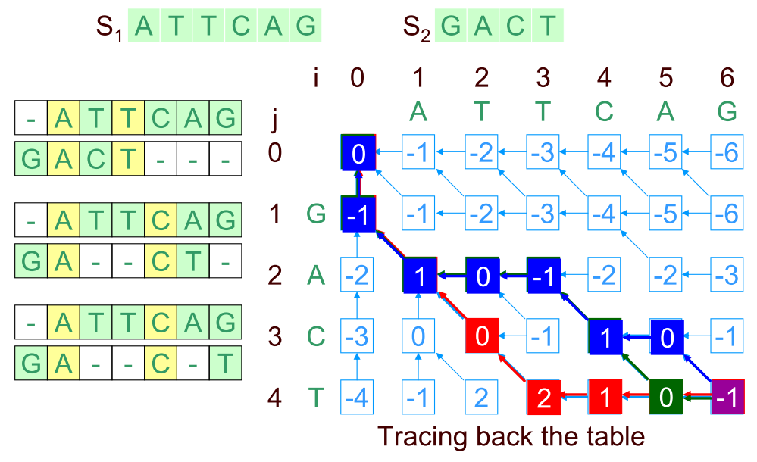

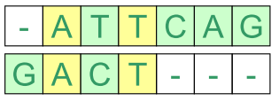


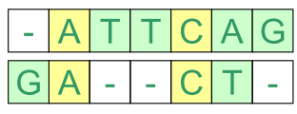
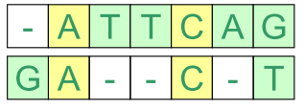
Needleman–Wunsch algorithm:

Slide 6
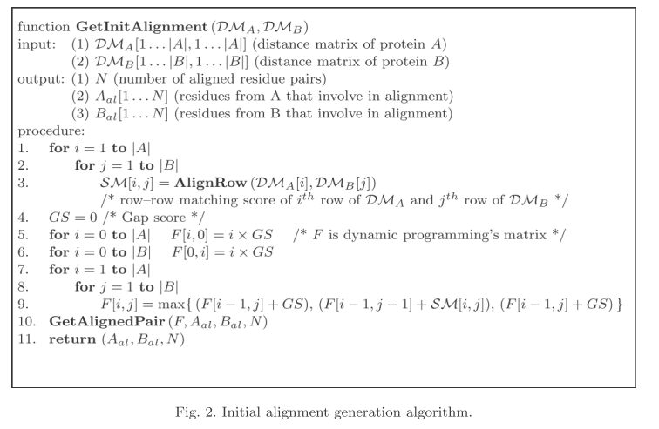
The MatAlign Method:

Slide 7
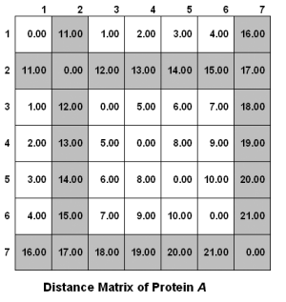
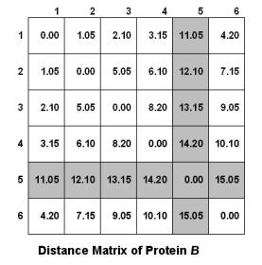

Slide 8
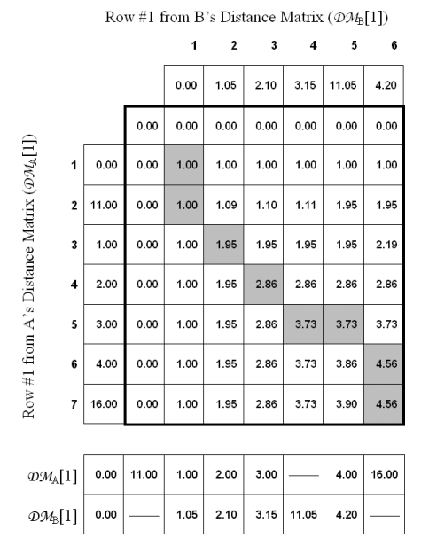
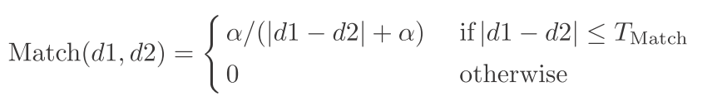
We use the empirically chosen values
α = 0.75 and TMatch = 1.6
The function Match( • , • ) is used
in the dynamic programming’s
selection step.

Slide 9
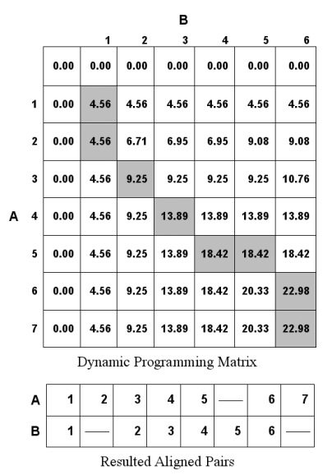
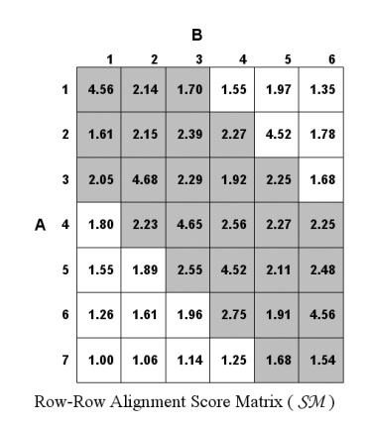

Slide 10
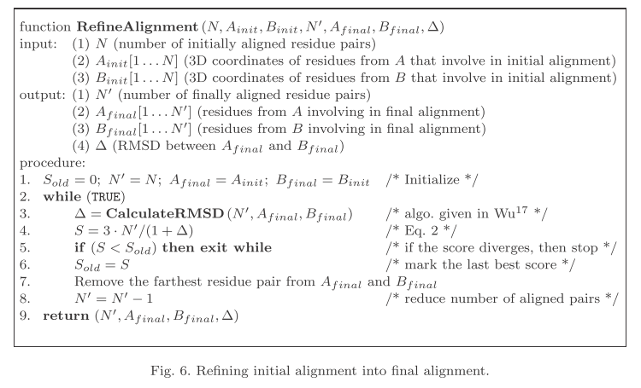
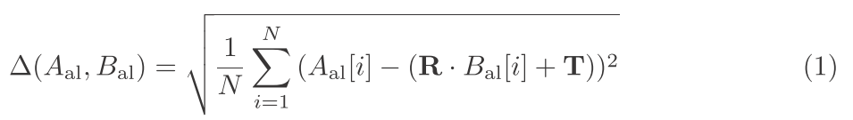
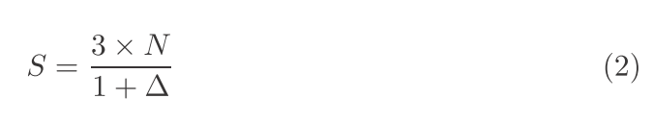

Slide 11
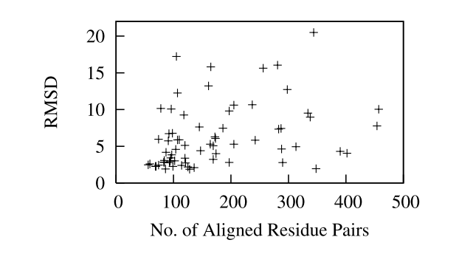
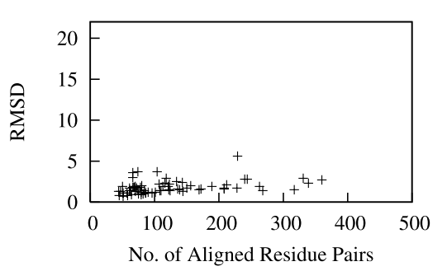
Results:

Slide 12
