Slide 1
Research on Longest Common Subsequence Fast Algorithm
Jiamei Liu, Suping Wu
School of Mathematics and Computer Science,
Ningxia University
International Conference on Consumer Electronics, Communications and Networks(CECNet), IEEE,
Xianning, China, March, 2011
Speaker: Kuan-Chih Chen
Date: 2018.05.30

Slide 2
Abstract
In order to improve the efficiency of searching the longest common subsequence(LCS), a method of finding LCS (here, the length of the LCS p is much smaller than the length of smaller string of two strings m) is realized in this paper, which transform this problem into solving the problem of matrix L (p, m), by theorem the process of computing each element in the matrix is optimized.
Algorithm analysis and experimental results show this algorithm is better than dynamic programming method. And a parallel algorithm based on OpenMP is provided in this paper, which speed of solving large-scale data is greatly improved.

Slide 3
The Longest Common Subsequence(LCS) problem
A: acdabbc
A: acdabbc
B: cddbacaba
B: cddbacaba
LCS: cdbc

Slide 4
The matrix L(p, m) problem
A: acdabbc
(m)
LCS
(p)
B: cddbacaba
(n)
L(k, i) means the minimum value of j such that sequences A [1: i] and B [l: j] have the LCS of length k
k i | 1 | 2 | … | m
1 | L(1, 1) | L(1, 2) | …
2 | L(2, 1)
… | …
p |  |  |  | L(p, m)
A : [1:1] ( a ) and B [l: j] have the LCS of length 1 => $L(1, 1)$= j = 5
A : [1:2] ( ac ) and B [l: j] have the LCS of length 1 => $L(1, 2)$= j = 1

Slide 5
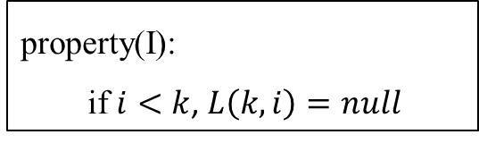
The matrix L(p, m) problem
A: acdabbc
property(I):
if $i<k$, $L\left(k, i\right)=null$
B: cddbacaba
k i | 1 | 2 | 3 | 4 | 5 | 6 | 7
1
2
3
4
5
6
7
5

Slide 6

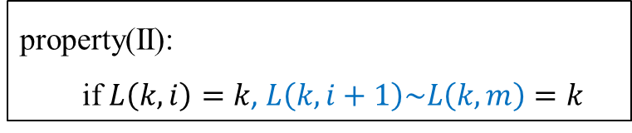
The matrix L(p, m) problem
A: acdabbc
$$L_{i+1}\left(k\right)=\min\left(j, L_{i}\left(k\right)\right),$$
$$j is the least number that$$
$$A\left[i+1\right]=B\left[j\right] \&\& j>L_{i}(k−1)$$
property(II):
if $L\left(k, i\right)=k$, $L\left(k, i+1\right)\sim L\left(k,m\right)=k$
B: cddbacaba
k i | 1 | 2 | 3 | 4 | 5 | 6 | 7
1 | 5
2
3
4
5
6
7
1
1
1
1
1
1

Slide 7
The matrix L(p, m) problem
A: acdabbc
$$L_{i+1}\left(k\right)=\min\left(j, L_{i}\left(k\right)\right),$$
$$j is the least number that$$
$$A\left[i+1\right]=B\left[j\right] \&\& j>L_{i}(k−1)$$
B: cddbacaba
k i | 1 | 2 | 3 | 4 | 5 | 6 | 7
1 | 5 | 1 | 1 | 1 | 1 | 1 | 1
2
3
4
5
6
7
6

Slide 8
The matrix L(p, m) problem
A: acdabbc
$$L_{i+1}\left(k\right)=\min\left(j, L_{i}\left(k\right)\right),$$
$$j is the least number that$$
$$A\left[i+1\right]=B\left[j\right] \&\& j>L_{i}(k−1)$$
property(II):
if $L\left(k, i\right)=k$, $L\left(k, i+1\right)\sim L\left(k,m\right)=k$
B: cddbacaba
k i | 1 | 2 | 3 | 4 | 5 | 6 | 7
1 | 5 | 1 | 1 | 1 | 1 | 1 | 1
2 |  | 6
3
4
5
6
7
2
2
2
2
2

Slide 9
The matrix L(p, m) problem
A: acdabbc
$$L_{i+1}\left(k\right)=\min\left(j, L_{i}\left(k\right)\right),$$
$$j is the least number that$$
$$A\left[i+1\right]=B\left[j\right] \&\& j>L_{i}(k−1)$$
B: cddbacaba
k i | 1 | 2 | 3 | 4 | 5 | 6 | 7
1 | 5 | 1 | 1 | 1 | 1 | 1 | 1
2 |  | 6 | 2 | 2 | 2 | 2 | 2
3
4
5
6
7

Slide 10
The matrix L(p, m) problem
A: acdabbc
$$L_{i+1}\left(k\right)=\min\left(j, L_{i}\left(k\right)\right),$$
$$j is the least number that$$
$$A\left[i+1\right]=B\left[j\right] \&\& j>L_{i}(k−1)$$
B: cddbacaba
k i | 1 | 2 | 3 | 4 | 5 | 6 | 7
1 | 5 | 1 | 1 | 1 | 1 | 1 | 1
2 |  | 6 | 2 | 2 | 2 | 2 | 2
3
4
5
6
7
5
4
4
6

Slide 11
The matrix L(p, m) problem
A: acdabbc
$$L_{i+1}\left(k\right)=\min\left(j, L_{i}\left(k\right)\right),$$
$$j is the least number that$$
$$A\left[i+1\right]=B\left[j\right] \&\& j>L_{i}(k−1)$$
B: cddbacaba
k i | 1 | 2 | 3 | 4 | 5 | 6 | 7
1 | 5 | 1 | 1 | 1 | 1 | 1 | 1
2 |  | 6 | 2 | 2 | 2 | 2 | 2
3 |  |  |  | 5 | 4 | 4 | 6
4 |  |  |  |  | 8 | 8
5
6
7
6

Slide 12

The matrix L(p, m) problem
A: acdabbc
B: cddbacaba
$$LCS=cdbc$$
k i | 1 | 2 | 3 | 4 | 5 | 6 | 7
1 | 5 | 1 | 1 | 1 | 1 | 1 | 1
2 |  | 6 | 2 | 2 | 2 | 2 | 2
3 |  |  |  | 5 | 4 | 4 | 6
4 |  |  |  |  | 8 | 8 | 6
5
6
7

Slide 13
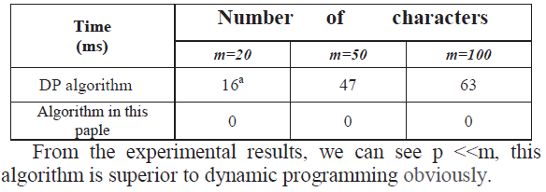
Experimental Results
(ms)

Slide 14
OpenMP
An API, formed in 1997
Used for writing transplantable multi-threaded application
k i | 1 | 2 | 3 | 4 | 5 | 6 | 7
1 | 5 | 1 | 1 | 1 | 1 | 1 | 1
2 |  | 6 | 2 | 2 | 2 | 2 | 2
3 |  |  |  | 5 | 4 | 4 | 6
4 |  |  |  |  | 8 | 8
5
6
7
6

Slide 15
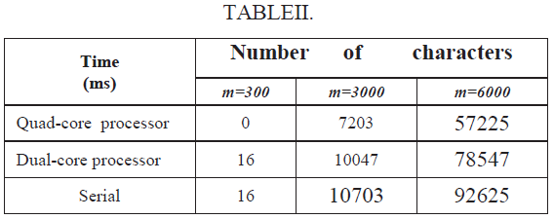
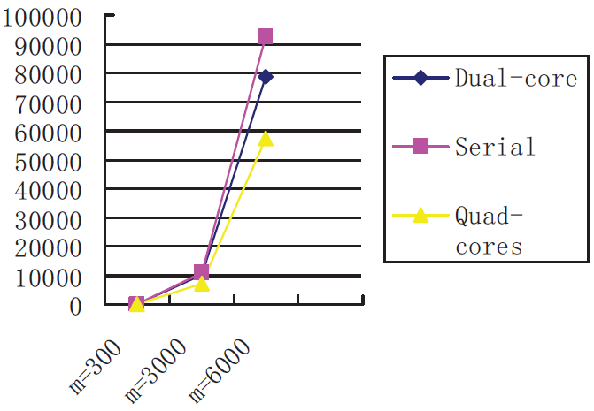
Experimental Results(II)
Intel(R) Core(TM)2 Dualcore
processor + 1G memory
Intel(R) Core(TM)2 Quadcores
processors + 4G memory
(ms)

Slide 16
A: acdabbc
A: acdabbc
B: cddbacaba
B: cddbacaba
LCS: cdbc
k i | 1 | 2 | 3 | 4 | 5 | 6 | 7
1 | 5 | 1 | 1 | 1 | 1 | 1 | 1
2 | $ | 6 | 2 | 2 | 2 | 2 | 2
3 | $ | $ | $ | 5 | 4 | 4 | 4
4 | $ | $ | $ | $ | 8 | 8 | 6
5 | $ | $ | $ | $ | $ | $ | $
6 | $ | $ | $ | $ | $ | $ | $
7 | $ | $ | $ | $ | $ | $ | $

