Slide 1
A Similarity Measure of Jumping Dynamic Time Warping
Lin Feng, Xiaoyan Zhao, Yiwei Liu, Yuan Yao, Bo Jin
2010 Seventh International Conference on Fuzzy Systems and Knowledge Discovery (FSKD 2010), Yantai, China
Presenter: Shan-Ru Liu
Date: 2018/05/30

Slide 2
Abstract
The problem of similarity measure for time series has attracted considerable research interest. Most of the recently used algorithms utilize the Dynamic Time Warping (DTW) distance for measuring the similarity of time series, in various areas such as science, medicine, industry, and finance. DTW is a considerably more robust distance measure for time series, which allows similar shapes to match even if they are of different lengths. Unfortunately however, several serious problems are associated with the use of DTW, such as high complexity and “one to many” problems. The present study is aimed at introducing a novel technique for improving the DTW algorithm, known as Jumping Dynamic Time Warping (JDTW). It is proven that this approach improves the efficiency with lower omission factor and reduces the noise impact of query sequence.

Slide 3
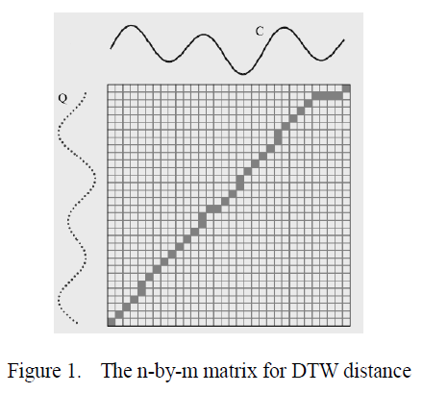
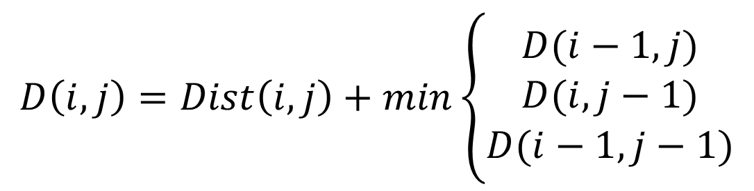
DTW
$$D\left(i,j\right)=Dist\left(i,j\right)+min\left\{\begin{aligned}D(i−1,j) \\ D(i,j−1) \\ D(i−1,j−1)\end{aligned}\right.$$
Time Complexity : O(N²)

Slide 4
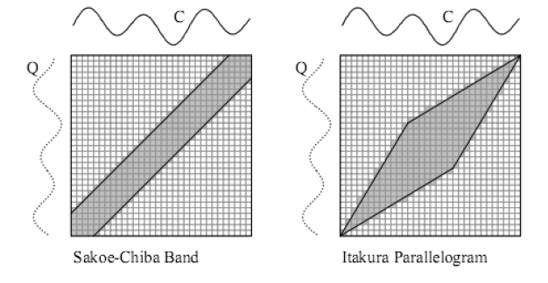
Lower Bounding of DTW
Time Complexity : O(N)

Slide 5
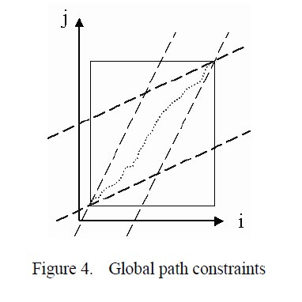
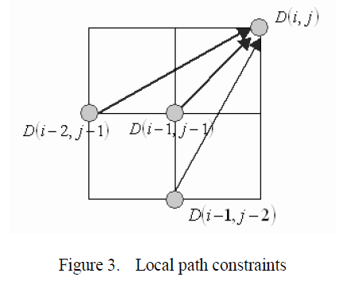
Path Constraints of DTW
27°
45°
63°

Slide 6
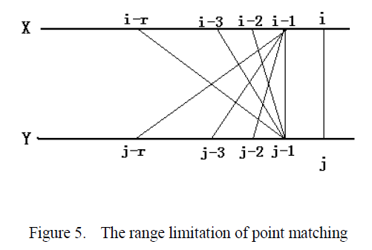
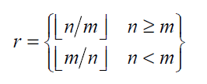
Local Path Constraints of JDTW
Two time series X(x₁,x₂,…,x_{n}), Y(y₁,y₂,…,y_{m})

Slide 7
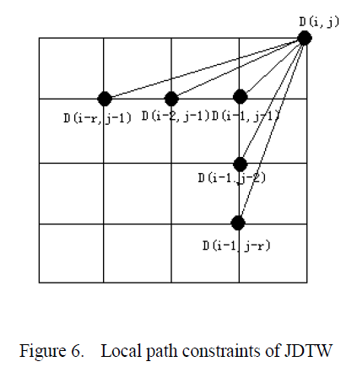
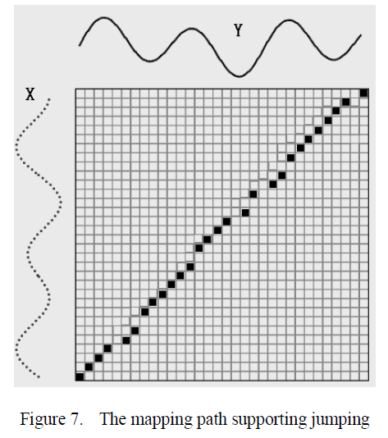
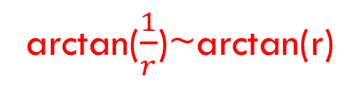
Local Path Constraints of JDTW
arctan($\frac{1}{r}$)~arctan(r)

Slide 8
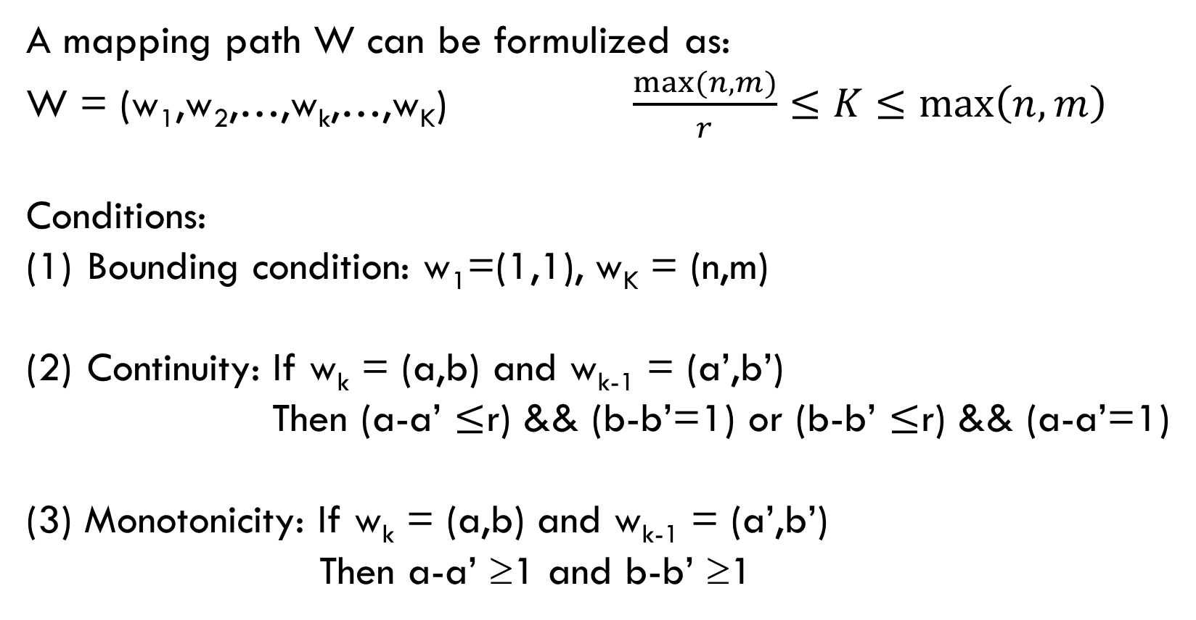
Local Path Constraints of JDTW
A mapping path W can be formulized as:
W = (w₁,w₂,…,w_{k},…,w_{K}) $\frac{max⁡(n,m)}{r}≤K≤\max\left(n,m\right)$
Conditions:
Bounding condition: w₁=(1,1), w_{K} = (n,m)
Continuity: If w_{k} = (a,b) and w_{k-1} = (a’,b’)
Then (a-a’ $≤$r) && (b-b’=1) or (b-b’ $≤$r) && (a-a’=1)
(3) Monotonicity: If w_{k} = (a,b) and w_{k-1} = (a’,b’)
Then a-a’ ≥1 and b-b’ ≥1

Slide 9
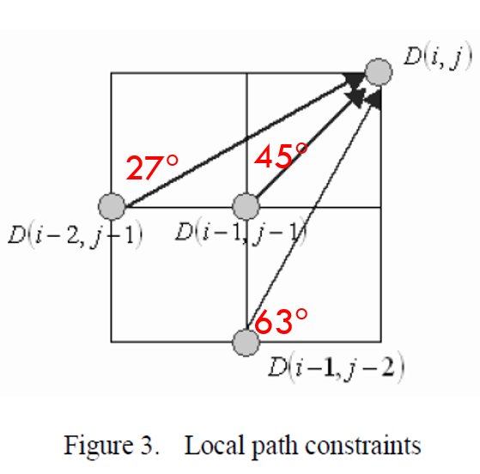


Local Path Constraints of JDTW
The 27-45-63 local paths can be taken as a special case of JDTW
when r = 2

Slide 10
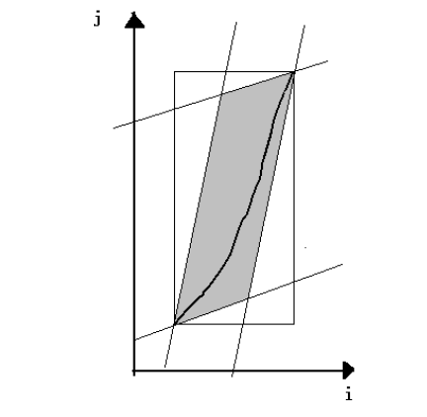
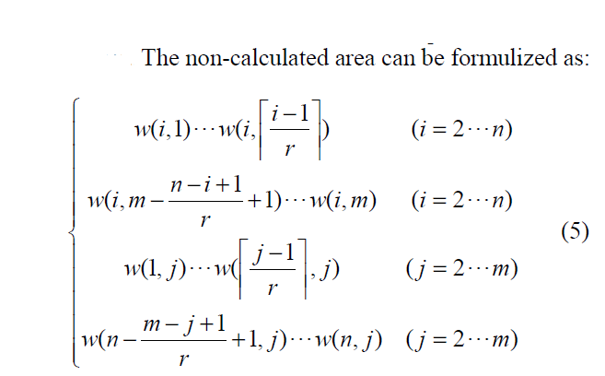
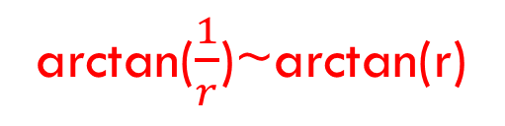
Global Path Constraints of JDTW
arctan($\frac{1}{r}$)~arctan(r)

Slide 11
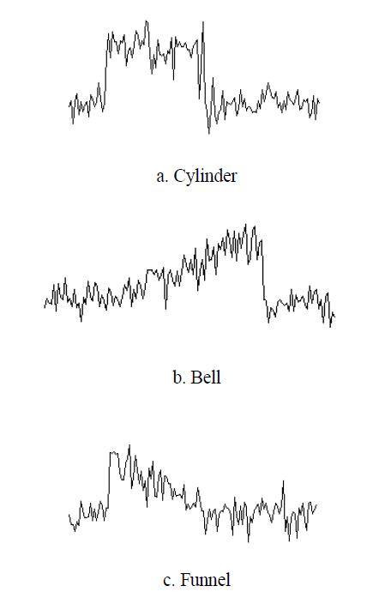
Experiment with Original CBF Data (1/2)

Slide 12
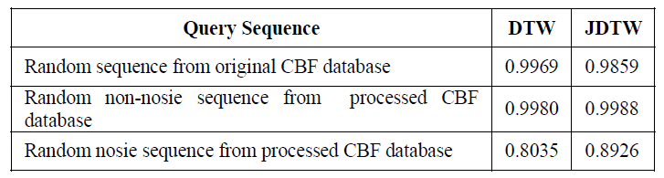
Experiment with Original CBF Data (2/2)

Slide 13
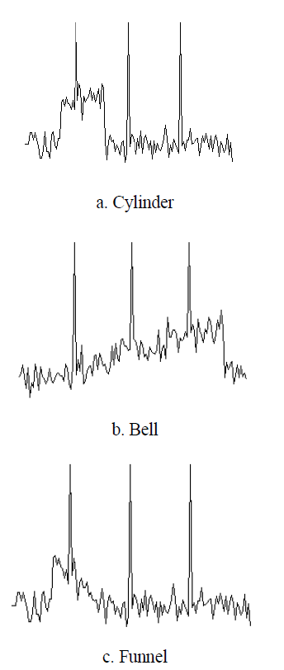
Experiment with Processed CBF Data (1/3)

Slide 14
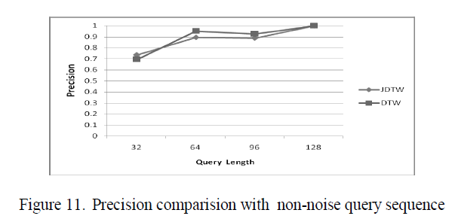
Experiment with Processed CBF Data (2/3)

Slide 15
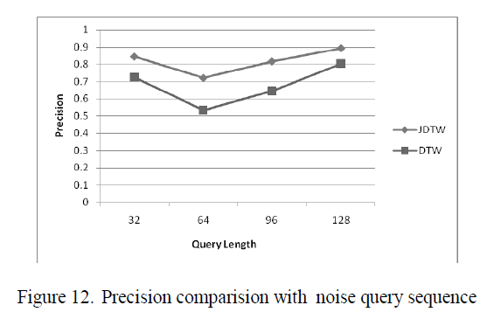
Experiment with Processed CBF Data (3/3)

