Slide 1
Maximal Palindromic Factorization
Ali Alatabbi, Costas S. Iliopoulos, and M. Sohel Rahman
Department of Informatics, King’s College London, London WC2R 2LS, United Kingdom
AℓEDA Group, Department of CSE, BUET, Dhaka-1000, Bangladesh
Proceedings of the Prague Stringology Conference (2012), August 27–28
Presenter: Ting-Wei Liang
Date: 2018/06/19

Slide 2
Abstract(1/2)
A palindrome is a symmetric string, phrase, number, or other sequence of units sequence that reads the same forward and backward. We present an algorithm for maximal palindromic factorization of a finite string by adapting an Gusfield algorithm for detecting all occurrences of maximal palindromes in a string in linear time to the length of the given string then using the breadth first search (BFS) to find the maximal palindromic factorization set.

Slide 3
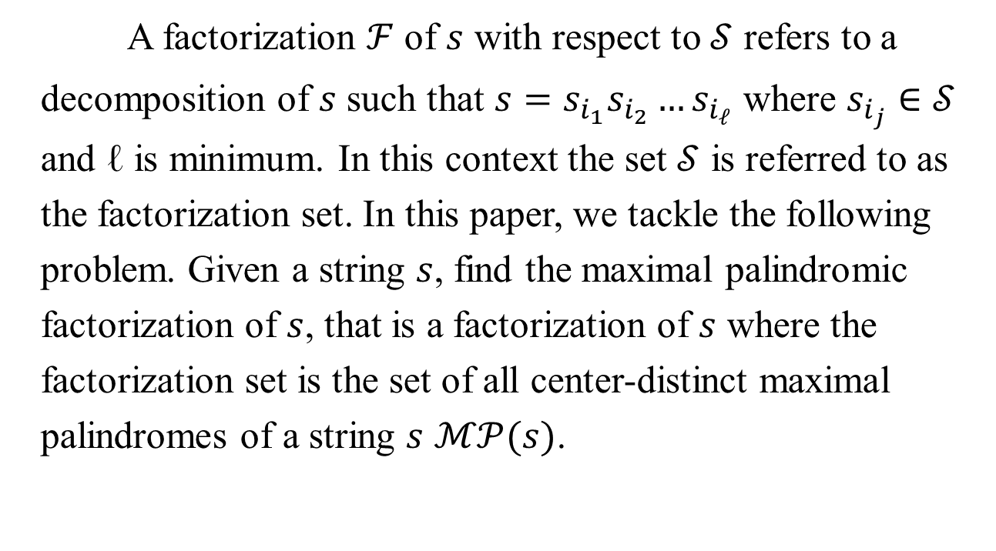
Abstract(2/2)
A factorization $ℱ$ of $s$ with respect to $𝒮$ refers to a decomposition of $s$ such that $s=s_{i_{1}}s_{i_{2}}…s_{i_{ℓ}}$ where $s_{i_{j}}∈𝒮$ and ℓ is minimum. In this context the set $𝒮$ is referred to as the factorization set. In this paper, we tackle the following problem. Given a string $s$, find the maximal palindromic factorization of $s$, that is a factorization of $s$ where the factorization set is the set of all center-distinct maximal palindromes of a string $s$ $ℳ𝒫(s)$.

Slide 4
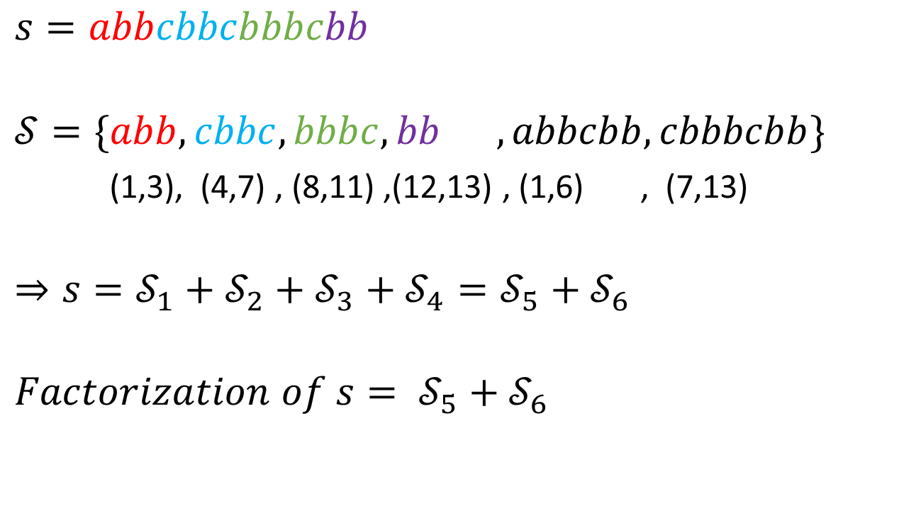
Factorization
$$s=abbcbbcbbbcbb$$
$$𝒮=\{abb, cbbc,bbbc, bb ,abbcbb,cbbbcbb\}$$
(1,3), (4,7) , (8,11) ,(12,13) , (1,6) , (7,13)
$$⇒s=𝒮_{1}+𝒮_{2}+𝒮_{3}+𝒮_{4}=𝒮_{5}+𝒮_{6}$$
$$Factorization of s= 𝒮_{5}+𝒮_{6}$$

Slide 5


Center-distinct maximal palindromes ($ℳ𝒫$)
$center of s\left[i…j\right]=\left\lfloor \frac{i+j}{2}\right\rfloor$
$$ℳ𝒫\left[9\right]=\{2,9\}$$
a | b | b | c | b | b | c | b | b | b | c | b | b
a | b | b | c | b | b | c | b | b | b | c | b | b

Slide 6









Maximal Palindromic Factorization
$$ℳ𝒫[3]$$
$$ℳ𝒫′[9]$$
$$s=abbcbbcbbbcbb$$
$$Factorization of s=a bb c bbcbbbcbb$$
$$ℳ𝒫[1]$$
$$ℳ𝒫[9]$$
$$ℳ𝒫[2]$$
$$ℳ𝒫[4]$$
$$ℳ𝒫\left[i_{1}\right]+ ℳ𝒫\left[i_{2}\right]+ …=$$
$$=s$$

Slide 7
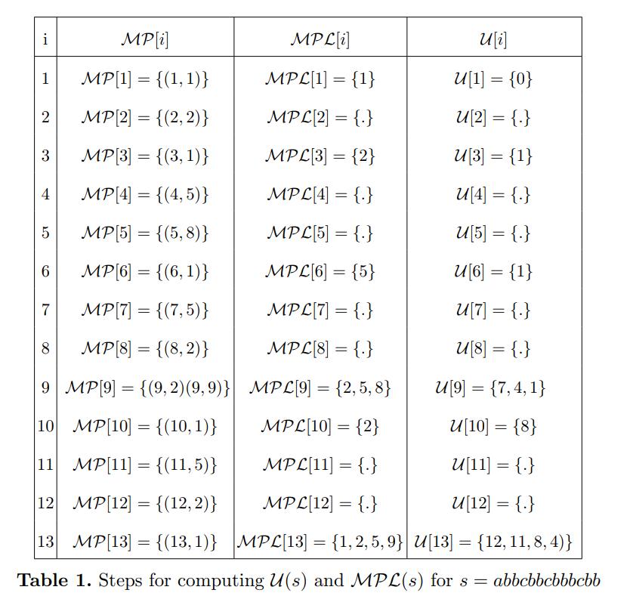


$$ℳ𝒫ℒ\left(s\right) \& 𝒰(s)$$
1 | 2 | 3 | 4 | 5 | 6 | 7 | 8 | 9 | 10 | 11 | 12 | 13
a | b | b | c | b | b | c | b | b | b | c | b | b
$$𝒰\left[9\right]=\{7\}$$

Slide 8

$$ℳ𝒫ℒ\left(s\right) \& 𝒰(s)$$
1 | 2 | 3 | 4 | 5 | 6 | 7 | 8 | 9 | 10 | 11 | 12 | 13
a | b | b | c | b | b | c | b | b | b | c | b | b
$$𝒰\left[9\right]=\{7,4\}$$

Slide 9

$$ℳ𝒫ℒ\left(s\right) \& 𝒰(s)$$
1 | 2 | 3 | 4 | 5 | 6 | 7 | 8 | 9 | 10 | 11 | 12 | 13
a | b | b | c | b | b | c | b | b | b | c | b | b
$$𝒰\left[9\right]=\{7,4,1\}$$

Slide 10
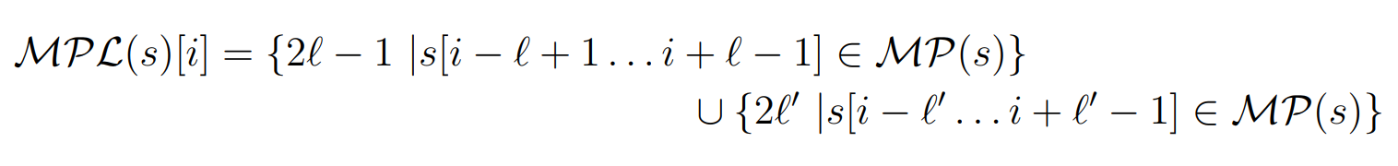
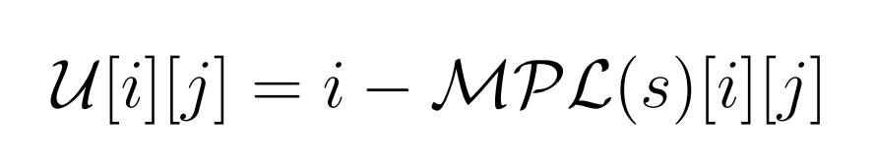
$$ℳ𝒫ℒ\left(s\right) \& 𝒰(s)$$
1.
2.

Slide 11
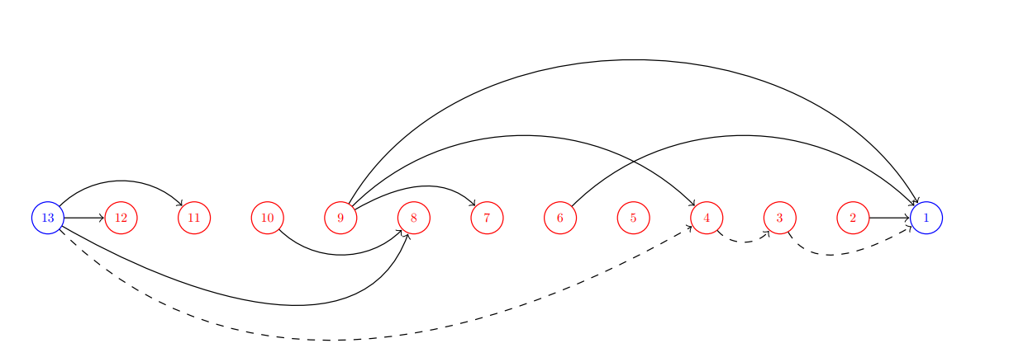


$$𝒢(V,E)$$
$$s=abbcbbcbbbcbb$$
$$V=\left\{ i | 1≤i≤n\right\}$$
$$E=\left\{\left(i,j\right) \right| j∈𝒰(s)[i]\}=O(2n)$$
$$Factorization of s=a bb c bbcbbbcbb$$
0

Slide 12
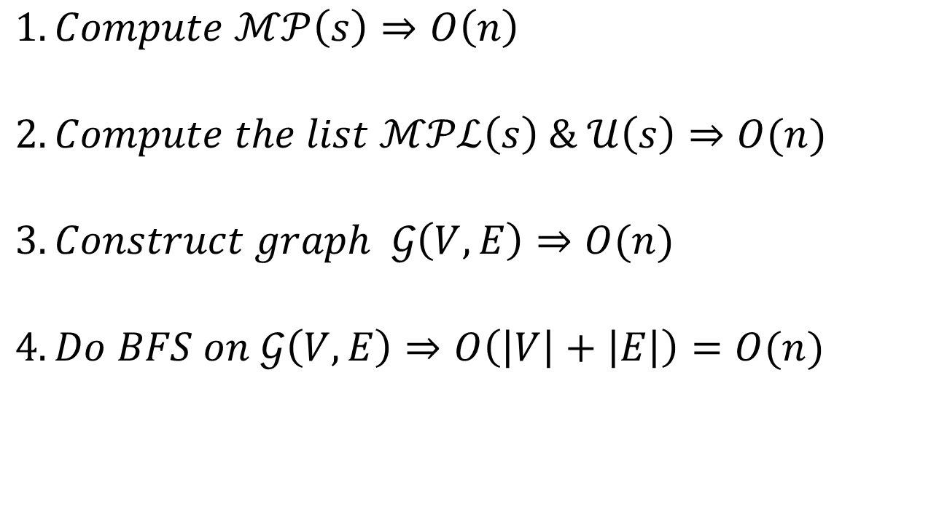
Time Complexity
$$1.Compute ℳ𝒫\left(s\right)⇒O\left(n\right)$$
$$2.Compute the list ℳ𝒫ℒ\left(s\right) \& 𝒰\left(s\right)⇒O(n)$$
$$3.Construct graph 𝒢\left(V,E\right)⇒O(n)$$
$$4.Do BFS on 𝒢\left(V,E\right)⇒O\left(\left|V\right|+\left|E\right|\right)=O(n)$$

