Slide 1
liteDTW: A lightweight dynamic time warping for tiny wireless sensing devices
Mohamed Abdelaal, Peter Nazier Mosaad, Oliver Theel
2015 IEEE Conference on Wireless Sensors (ICWiSe)
24-26 Aug. 2015, Melaka, Malaysia
Presenter: Shan-Ru Liu
Date: 2018/06/19

Slide 2
Abstract (1/2)
Wireless sensor networks have been recognized as promising tools to collect relevant, in-situ data for a wide range of application domains. However, such networks suffer from hard constraints including the allocated resources. Hence, current research endeavors strive to minimize the amount of data that has to be transmitted. This is typically achieved via data fusing or sending some nodes to sleep mode whenever their readings exhibit a high degree of spatio/temporal correlation. Accordingly, the degree of correlation can be considered as a metrics for data filtering. The Dynamic time warping (DTW) algorithm is a "natural" candidate for data fusion and correlation estimation at intermediate sensor nodes via matching the various measured readings.

Slide 3
Abstract (2/2)
However, the DTW algorithm suffers from the excessive computational overhead which is ill-suited for the "resources-taxed" sensor nodes. This work aims at reducing this burden via refining the implementation procedure of the DTW algorithm. The liteDTW is a novel version of the DTW algorithm with linear operations and fuzzy abstraction. The core idea is to reduce the DTW matrix dimensions via shrinking the input patterns. Several simulations and real experiments have been conducted to validate that the liteDTW algorithm excels over the naive one in terms of accuracy, time and space overhead. Moreover, the Cooja simulator of the Contiki OS has been utilized to assess the energy profit of adopting the liteDTW algorithm for data fusion.

Slide 4
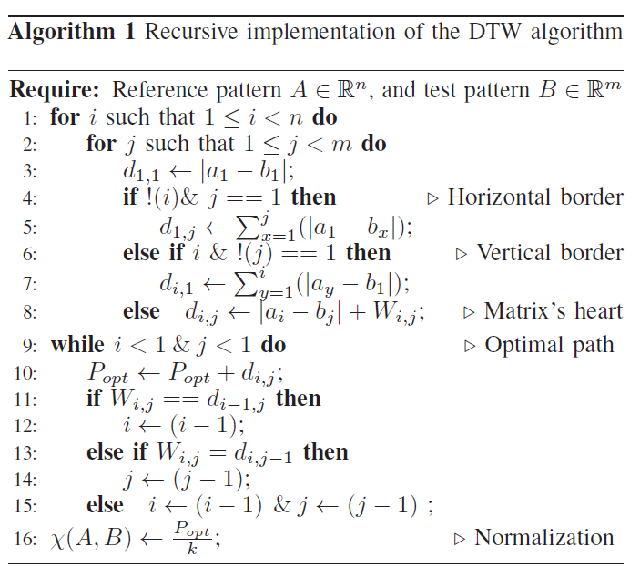
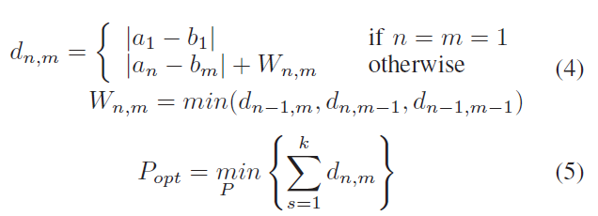
DTW

Slide 5
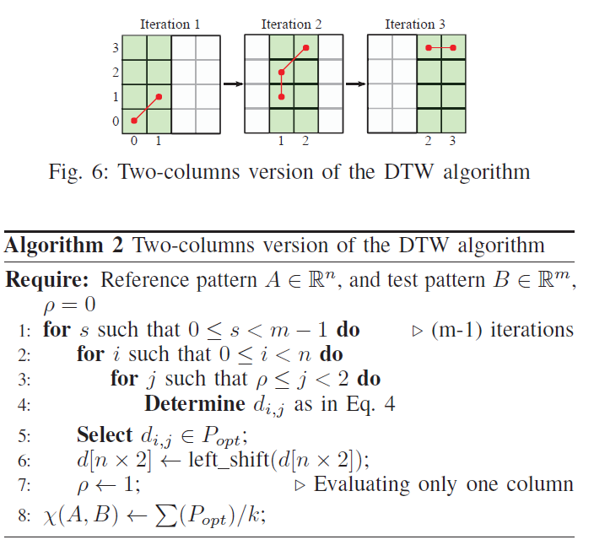
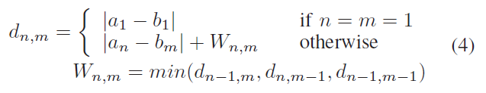
liteDTW
O(n*m) -> O(n*2)

Slide 6
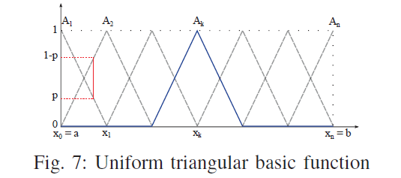
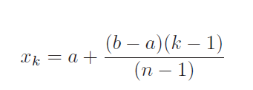
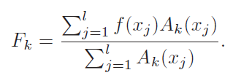

Fuzzy Abstraction

Slide 7
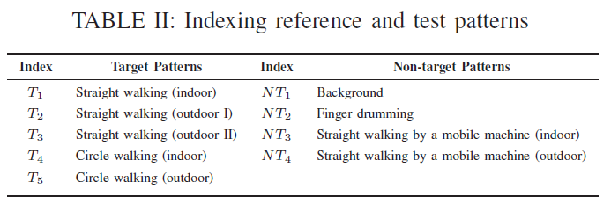
Test Data (1/3)

Slide 8
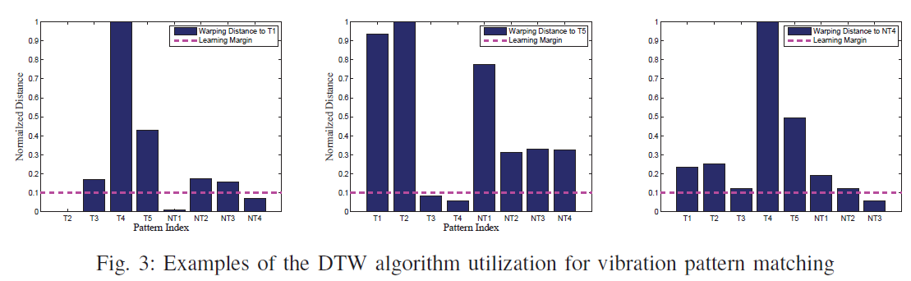
Test Data (2/3)

Slide 9
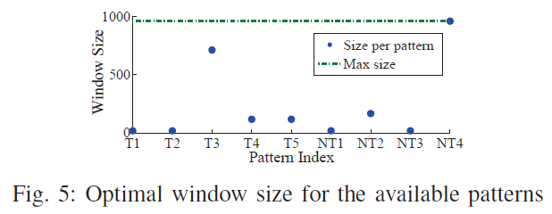
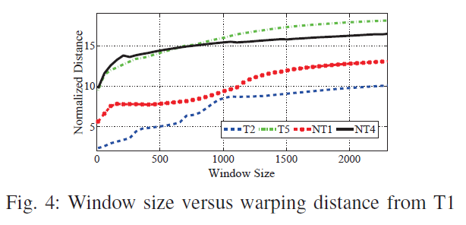
Test Data (3/3)

Slide 10
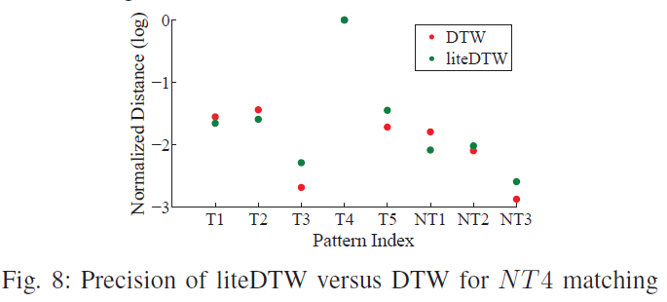
Result (1/4)

Slide 11
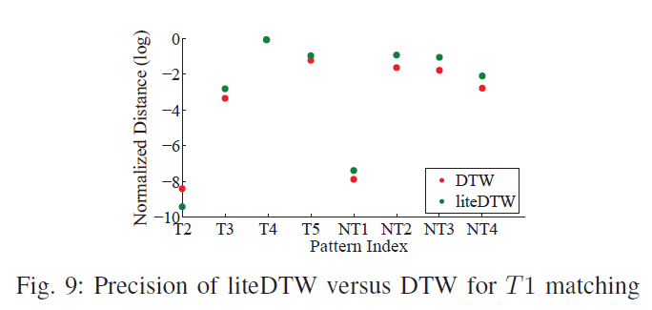
Result (2/4)

Slide 12
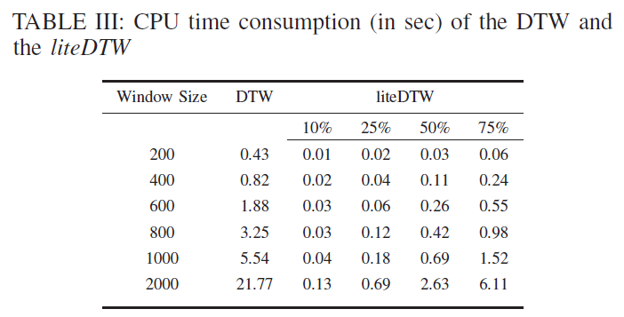
Result (3/4)

Slide 13

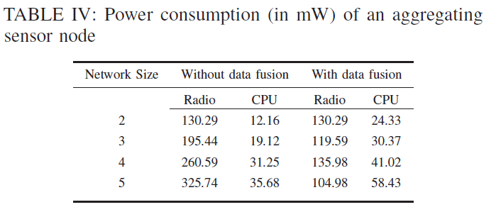
Result (4/4)

