Slide 1
Efficient Multi-word Parameterized Matching on Compressed Text
Rajesh Prasad, Rama Garg
IEEE 6th International Conference on Adaptive Science & Technology (ICAST), Lagos, Nigeria, Oct 29~ Oct 31, 2014
Speaker: Kuan-Chih Chen
Date: 2018.06.26
Notes:
Rajesh Prasad - Department of Computer Science, Yobe State University, Damaturu, Nigeria
Rama Garg - Department of Computer Science & Engineering, Ajay Kumar Garg Engineering College, Ghaziabad, India

Slide 2
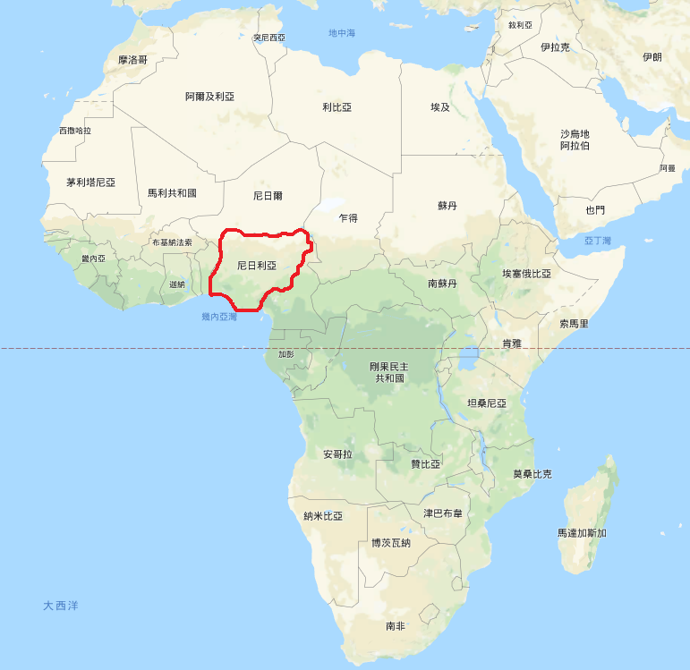
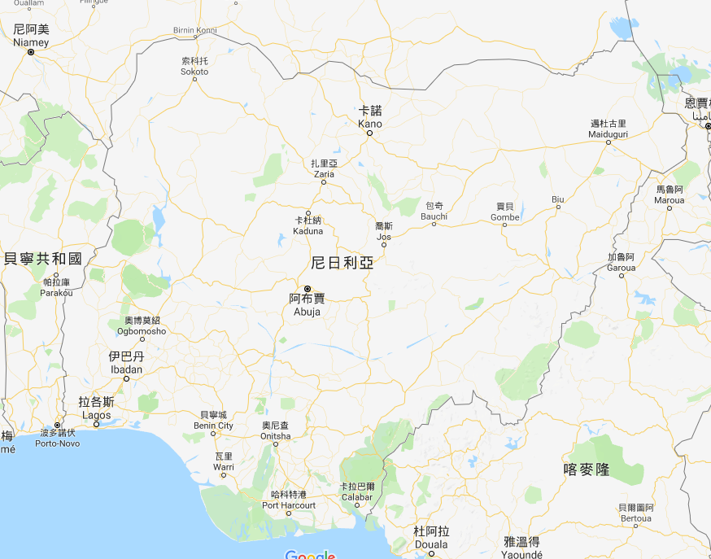

Slide 3
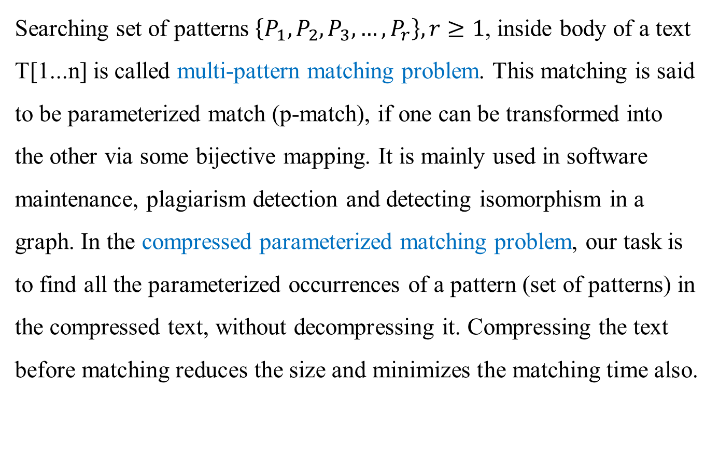
Abstract (1/2)
Searching set of patterns $\left\{P_{1}, P_{2}, P_{3}, …, P_{r}\right\}, r≥1$, inside body of a text T[1...n] is called multi-pattern matching problem. This matching is said to be parameterized match (p-match), if one can be transformed into the other via some bijective mapping. It is mainly used in software maintenance, plagiarism detection and detecting isomorphism in a graph. In the compressed parameterized matching problem, our task is to find all the parameterized occurrences of a pattern (set of patterns) in the compressed text, without decompressing it. Compressing the text before matching reduces the size and minimizes the matching time also.

Slide 4
Abstract (2/2)
In this paper, we develop an efficient algorithm for parameterized multi-word matching problem on the compressed text, where both patterns and text are compressed before actual matching is performed and pattern is treated as word. For compressing the pattern and text, we use efficient compression code: Word Based Tagged Code (WBTC) and bit-parallel algorithm is used for searching purpose. Experimental results show that our algorithm is up to three times faster than the search on the uncompressed text.

Slide 5
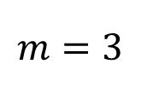
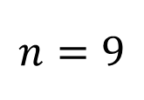
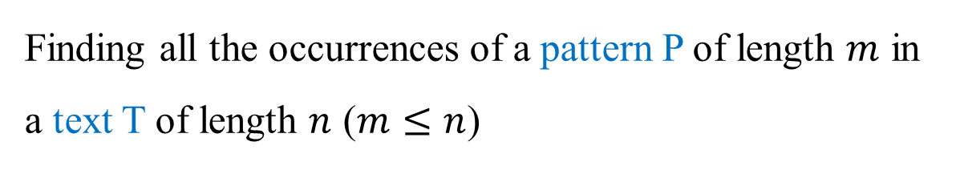
Definition – String Matching Problem
Finding all the occurrences of a pattern P of length $m$ in a text T of length $n$ ($m≤n$)
T: ABACBBABA
$$n=9$$
P: ABA
$$m=3$$
Ans: True, at position 0 and 6

Slide 6
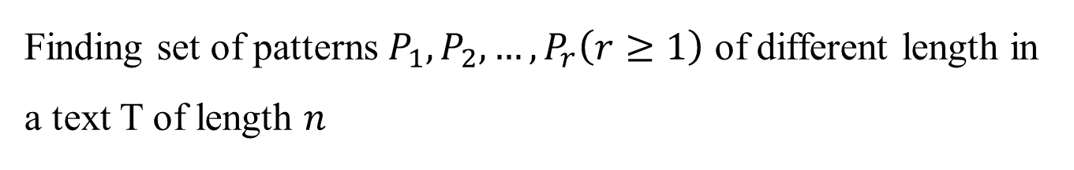
Definition – Multi-pattern Matching Problem
Finding set of patterns $P_{1}, P_{2}, …,P_{r}\left(r≥1\right)$ of different length in a text T of length $n$
T: ABACBBABA
P: ABAC, CBB
Ans: True, at position 0(ABAC), 3(CBB)

Slide 7
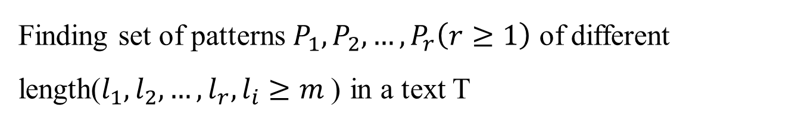
Definition – Multi-word Parameterized Matching Problem
Finding set of patterns $P_{1}, P_{2}, …,P_{r}\left(r≥1\right)$ of different length($l_{1}, l_{2}, …,l_{r}, l_{i}≥m$) in a text T
T is the set of words, patterns are also treated as words
Parameterized Matching(p-match):
ABAC
DEDF
Bijection mapping
A→D
B→E
C→F

Slide 8
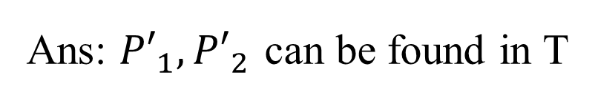
Definition – Multi-word Parameterized Matching Problem
Finding set of patterns $P_{1}, P_{2}, …,P_{r}\left(r≥1\right)$ of different length($l_{1}, l_{2}, …,l_{r}, l_{i}≥m$) in a text T
T: ABA CBB ABA
P: ABAC, CBB
P’: ABA, CBB
Ans: ${P′}_{1}, {P′}_{2}$ can be found in T

Slide 9
Compression - Word Based Tagged Code(WBTC)
The code always ends with either 01 or 10
Add 00 and 11 as prefix repeatedly
01 → 10 → 0001 → 0010 → 1101 → 1110 → 000001 → 000010 …
T = AATT CCGG GATA CGAC AATT GATA GATA ACAC
Sort by frequency:
Encode:
Index | Word | Frequency
0 | AATT | 2
1 | CCGG | 1
2 | GATA | 3
3 | CGAC | 1
4 | ACAC | 1
Index | Word | Frequency
0 | GATA | 3
1 | AATT | 2
2 | CCGG | 1
3 | CGAC | 1
4 | ACAC | 1
Index | Word | Code
0 | GATA | 01
1 | AATT | 10
2 | CCGG | 0001
3 | CGAC | 0010
4 | ACAC | 1101

Slide 10
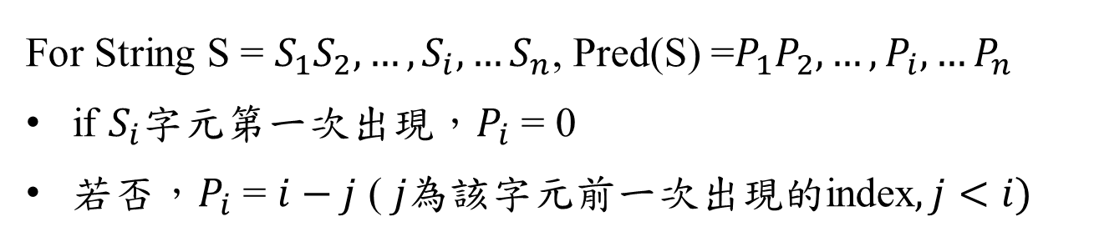
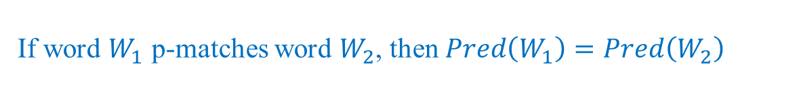
Predecessor String
For String S = $S_{1}S_{2}, …,S_{i}, …S_{n}$, Pred(S) =$P_{1}P_{2},…,P_{i},…P_{n}$
if $S_{i}$字元第一次出現，$P_{i}$ = 0
若否，$P_{i}$ = $i−j$ ( $j為$該字元前一次出現的index$, j<i)$
S = A C C A T G A G
S | A | C | C | A | T | G | A | G
Pred(S) | 0 | 0 | 1 | 3 | 0 | 0 | 3 | 2
If word $W_{1}$ p-matches word $W_{2}$, then $Pred\left(W_{1}\right)=Pred\left(W_{2}\right)$
Pred(ACCATGAG) = Pred(CAACTGCG) = 00130032 ,
ACCATGAG p-matches CAACTGCG

Slide 11
Their algorithm – Multi-word Parameterized Matching (MPM) algorithm
Preprocessing
Searching
Text
Pred
Compress
Patterns
Compress
Bit-parallel algorithm

Slide 12
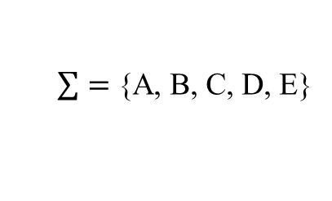
Preprocessing of Text
T:
ABAA BABAA BCBB ACBB DEDEB
$\sum{=}$ {A, B, C, D, E}
Modified:
ABAA {BABA ABAA} BCBB ACBB {DEDE EDEB}
Pred:
0021 0022 0021 0021 0021 0022 0020
Vocabulary Table:
Word | Index | Frequency
0021 | 9 | 5
0022 | 10 | 2
0020 | 8 | 1
Word | Index | Codes
0021 | 9 | 01
0022 | 10 | 10
0020 | 8 | 0001
5?
18?
T’:
01 10 01 01 01 10 0001 01
(Compressed Text)

Slide 13
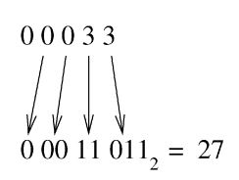
Index
T: ACGAC
T: ABAA
Pred:
Pred : 0 0 2 1
0 10 1 = 5
T: BABA
Pred : 0 0 2 2
0 10 010 = 18

Slide 14
Preprocessing of Text
T:
ABAA BABAA BCBB ACBB DEDEB
$\sum{=}$ {A, B, C, D, E}
Modified:
ABAA {BABA ABAA} BCBB ACBB {DEDE EDEB}
Pred:
0021 0022 0021 0021 0021 0022 0020
Sort by frequency:
Encode:
Vocabulary Table:
Word | Index | Frequency
0021 | 9 | 5
0022 | 10 | 2
0020 | 8 | 1
Word | Index | Codes
0021 | 9 | 01
0022 | 10 | 10
0020 | 8 | 0001
5?
18?
T’:
01 10 01 01 01 10 0001 01
(Compressed Text)

Slide 15
Preprocessing of Patterns
P:
ABAA, BABAA, BBAAB
Modified:
ABAA, BABA, BBAA
Pred(index):
0021(9) 0022(10) 0101(17)
搜尋index，如果不在table，該word可以刪除 [?]
Word | Index | Codes
0021 | 9 | 01
0022 | 10 | 10
0020 | 8 | 0001

Slide 16
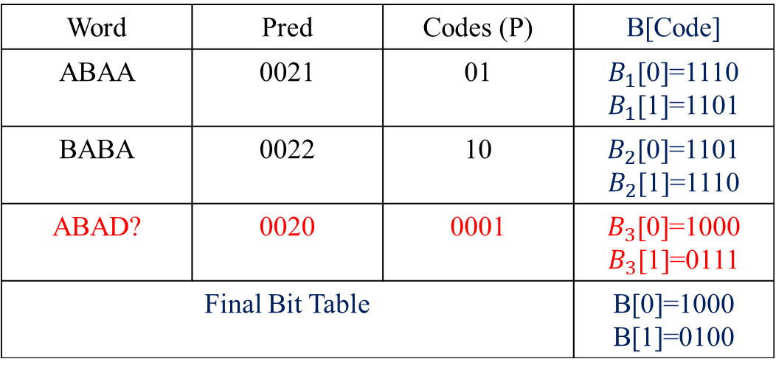




Build bit-table:
The length of B is $m$ (max length of codes)
Word | Index | Frequency
0021 | 9 | 5
0022 | 10 | 2
0020 | 8 | 1
Word | Pred | Codes (P) | B[Code]
ABAA | 0021 | 01 | $B_{1}$[0]=1110 $B_{1}$[1]=1101
BABA | 0022 | 10 | $B_{2}$[0]=1101 $B_{2}$[1]=1110
ABAD? | 0020 | 0001 | $B_{3}$[0]=1000 $B_{3}$[1]=0111
Final Bit Table |  |  | B[0]=1000 B[1]=0100
if P[i] = c, $i^{th}$ bit of $B$[c] = 0 (from right to left)
$P_{1}=01$ → $B_{1}\left[0\right]=1110$
$P_{3}=0001$ → $B_{3}\left[0\right]=1000$
each bit uses AND operation to get final bits
B[0] = 1110 & 1101 & 1000 = 1000
B[1] = 1101 & 1110 & 0111 = 0100

Slide 17
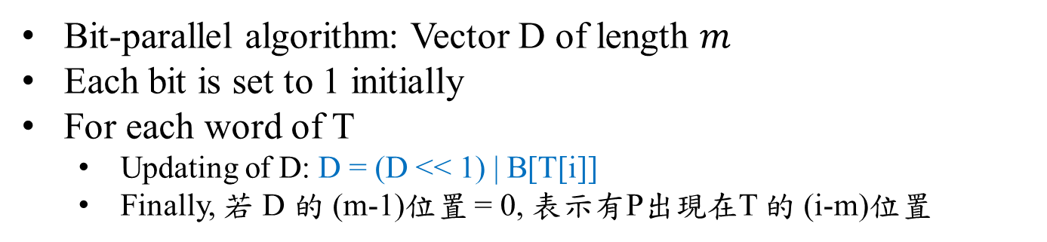
Searching
Bit-parallel algorithm: Vector D of length $m$
Each bit is set to 1 initially
For each word of T
Updating of D: D = (D << 1) | B[T[i]]
Finally, 若 D 的 (m-1)位置 = 0, 表示有P出現在T 的 (i-m)位置
T:
0
1
10 01 01 01 10 0001 01
B[0]=1000
B[1]=0100
1st:
D = 1110 | B[0]
= 1110 | 1000 = 1110
2nd:
D = 1100 | B[1]
= 1100 | 0100 = 1100
有P(code:01, ABAA)出現在T當中

Slide 18
Searching
Bit-parallel algorithm: Vector D of length $m$
Each bit is set to 1 initially
For each word of T
Updating of D: D = (D << 1) | B[T[i]]
Finally, 若 D 的 (m-1)位置 = 0, 表示有P出現在T 的 (i-m)位置
T:
0
1
10 01 01 01 10 0001 01
B[0]=1000
B[1]=0100
1st:
D = 1110 | B[1]
= 1110 | 0100 = 1110
2nd:
D = 1100 | B[0]
= 1100 | 1000 = 1100
有P(code:10, BABA)出現在T當中

Slide 19
Searching
Bit-parallel algorithm: Vector D of length $m$
Each bit is set to 1 initially
For each word of T
Updating of D: D = (D << 1) | B[T[i]]
Finally, 若 D 的 (m-1)位置 = 0, 表示有P出現在T 的 (i-m)位置
T:
0
1
10 01 01 01 10 0001 01
B[0]=1000
B[1]=0100
1st:
D = 1110 | B[0]
3rd:
D = 1000 | B[0]
= 1110 | 1000 = 1110
= 1000 | 1000 = 1000
2nd:
D = 1100 | B[0]
4th:
D = 0000 | B[1]
= 1100 | 1000 = 1100
= 0000 | 0100 = 0100

Slide 20
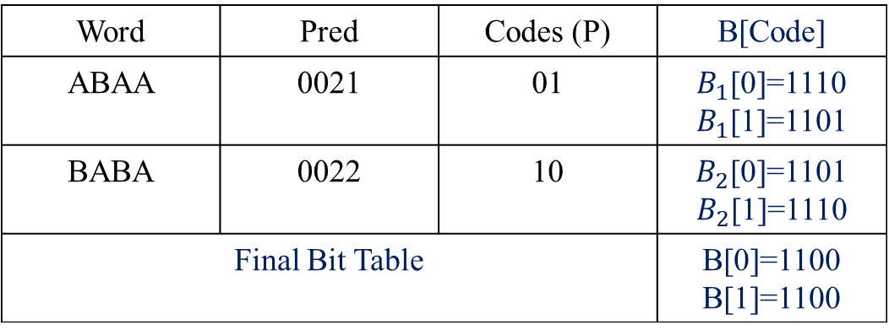
Build bit-table:
The length of B is $m$ (max length of codes)
Word | Index | Frequency
0021 | 9 | 5
0022 | 10 | 2
0020 | 8 | 1
Word | Pred | Codes (P) | B[Code]
ABAA | 0021 | 01 | $B_{1}$[0]=1110 $B_{1}$[1]=1101
BABA | 0022 | 10 | $B_{2}$[0]=1101 $B_{2}$[1]=1110
Final Bit Table |  |  | B[0]=1100 B[1]=1100
each bit uses AND operation to get final bits
B[0] = 1110 & 1101 = 1100
B[1] = 1101 & 1110 = 1100
T:
0
1
10 01 01 01 10 0001 01
1st:
D = 1110 | B[0]
3rd:
D = 1000 | B[0]
= 1110 | 1100 = 1110
= 1000 | 1100 = 1100
2nd:
D = 1100 | B[0]
4th:
D = 0000 | B[1]
= 1100 | 1100 = 1100
= 0000 | 1100 = 1100

Slide 21
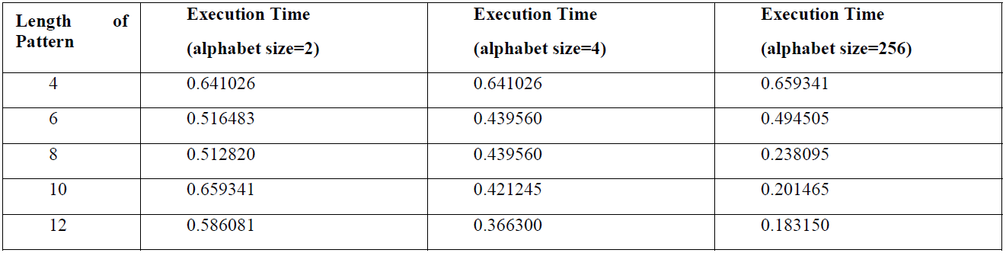
Experimental results:
Alphabet size | Text composition | size of file
4 | A, C, G, T | 16KB
2 | 0, 1 | 12KB
256 |  | 4KB

Slide 22
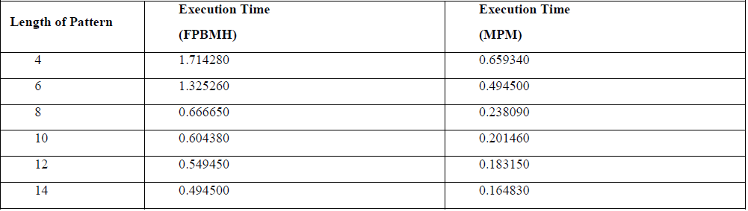
Experimental results:

Slide 23
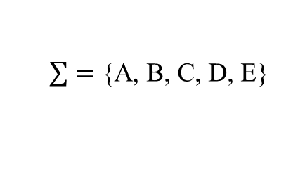
Text:
ABAA BABAA BCDD ACBB DEDEBB
$\sum{=}$ {A, B, C, D, E}
Modified:
ABAA {BABA ABAA} BCDD ACBB {DEDE EDEB DEBB}
Pred:
0021 0022 0021 0021 0021 0022 0020 0021

Slide 24
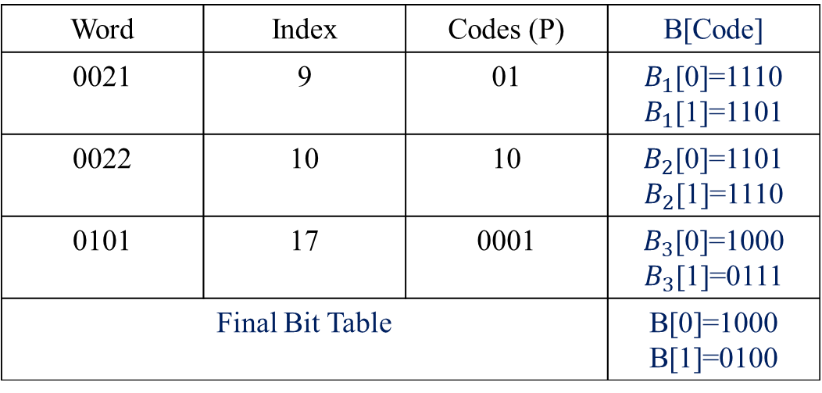

如果BBAA(0101)加入:
The length of B is $m$ (max length of codes)
Word | Index | Frequency
0021 | 9 | 5
0022 | 10 | 2
0020 | 8 | 1
Word | Index | Codes (P) | B[Code]
0021 | 9 | 01 | $B_{1}$[0]=1110 $B_{1}$[1]=1101
0022 | 10 | 10 | $B_{2}$[0]=1101 $B_{2}$[1]=1110
0101 | 17 | 0001 | $B_{3}$[0]=1000 $B_{3}$[1]=0111
Final Bit Table |  |  | B[0]=1000 B[1]=0100
if P[i] = c, $i^{th}$ bit of $B$[c] = 0 (from right to left)
$P_{1}=01$ → $B_{1}\left[0\right]=1110$
$P_{3}=0001$ → $B_{3}\left[0\right]=1110$
each bit uses AND operation to get final bits
B[0] = 1110 & 1101 & 1000 = 1000
B[1] = 1101 & 1110 & 0111 = 0100

