Slide 1
Algorithmic financial trading with deep convolutional neural networks: Time series to image conversion approach
Omer Berat Sezer, Ahmet Murat Ozbayoglu
Applied Soft Computing, Volume 70, September 2018,
Pages 525-538
Presenter: Cheng-Han Wu
Date:2018/6/26

Slide 2
Abstract(1/2)
Computational intelligence techniques for financial trading systems have always been quite popular. In the last decade, deep learning models start getting more attention, especially within the image processing community. In this study, we propose a novel algorithmic trading model CNN-TA using a 2-D convolutional neural network based on image processing properties. In order to convert financial time series into 2-D images, 15 different technical indicators each with different parameter selections are utilized. Each indicator instance generates data for a 15 day period.

Slide 3
Abstract(2/2)
As a result, 15 × 15 sized 2-D images are constructed. Each image is then labeled as Buy, Sell or Hold depending on the hills and valleys of the original time series. The results indicate that when compared with the Buy & Hold Strategy and other common trading systems over a long out-of-sample period, the trained model provides better results for stocks and ETFs.

Slide 4
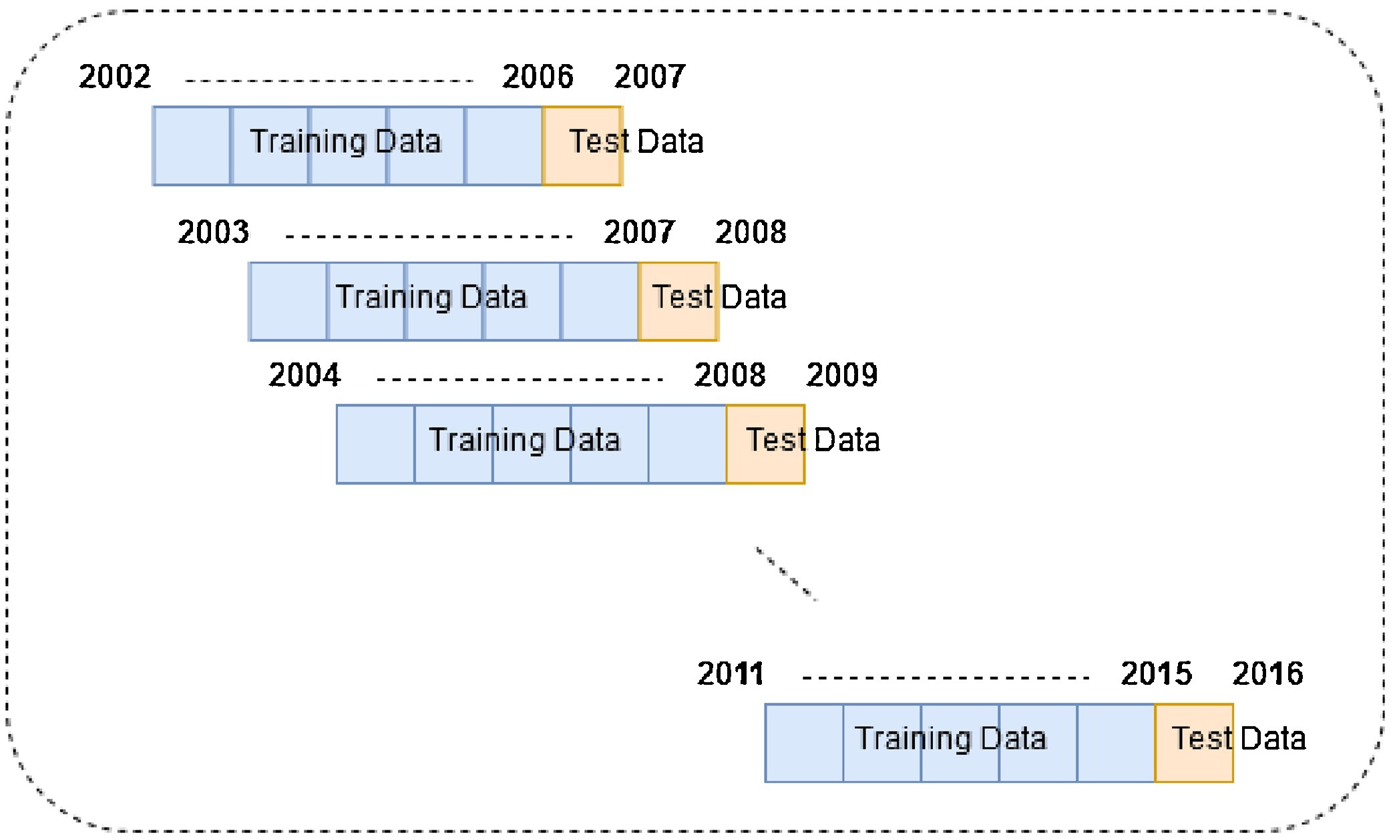
Testing and training

Slide 5
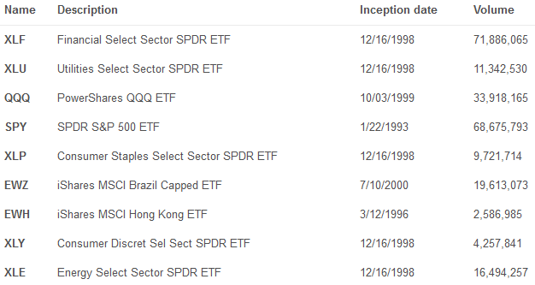
Data
Dow 30 index

Slide 6
Feature select (1/2)
Relative Strength Index (RSI)
Williams %R
Simple moving average (SMA)
Exponential moving average (EMA)
Weighted moving average (WMA)
Hull moving average (HMA)
Triple exponential moving average
Commodity Channel Index (CCI)
Chande momentum oscilator indicator (CMO)

Slide 7
Feature select (2/2)
Moving average convergence and divergence (MACD)
Percentage price oscillator (PPO)
Rate of change (ROC)
Chaikin money flow indicator (CMFI)
Directional movement indicator (DMI)
Parabolic SAR
2002/1/1/ to 2017/1/1 (testing : 2007/1/1 to 2017/1/1)
2002/1/1/ to 2012/1/1 (testing : 2007/1/1 to 2012/1/1)

Slide 8
Feature Image
6-20 days of each indicators
15x15

Slide 9
Labeling
11
11
If min
SELL
Elif max
BUY
Else
HOLD
11
11

Slide 10
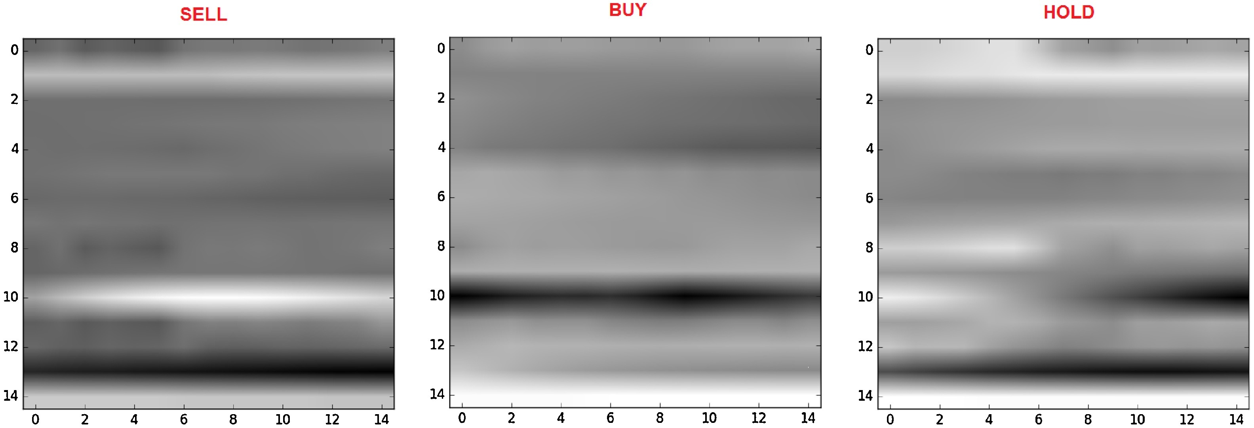
Label image

Slide 11
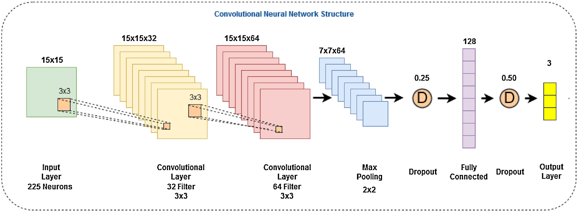
CNN

Slide 12

CNN
$s\left(t\right)=\left(x∗w\right)\left(t\right)=\sum_{a=−∞}^{∞}{x\left(a\right)w(t−a)}$
$S\left(i,j\right)=\left(I∗K\right)\left(i,j\right)=\sum_{m}{\sum_{n}{I\left(m,n\right)K(i−m,j−n)}}$
$e_{i}=\sum_{j}{W_{i,j}x_{j}+b_{i}}$
$y=softmax(e)$

Slide 13
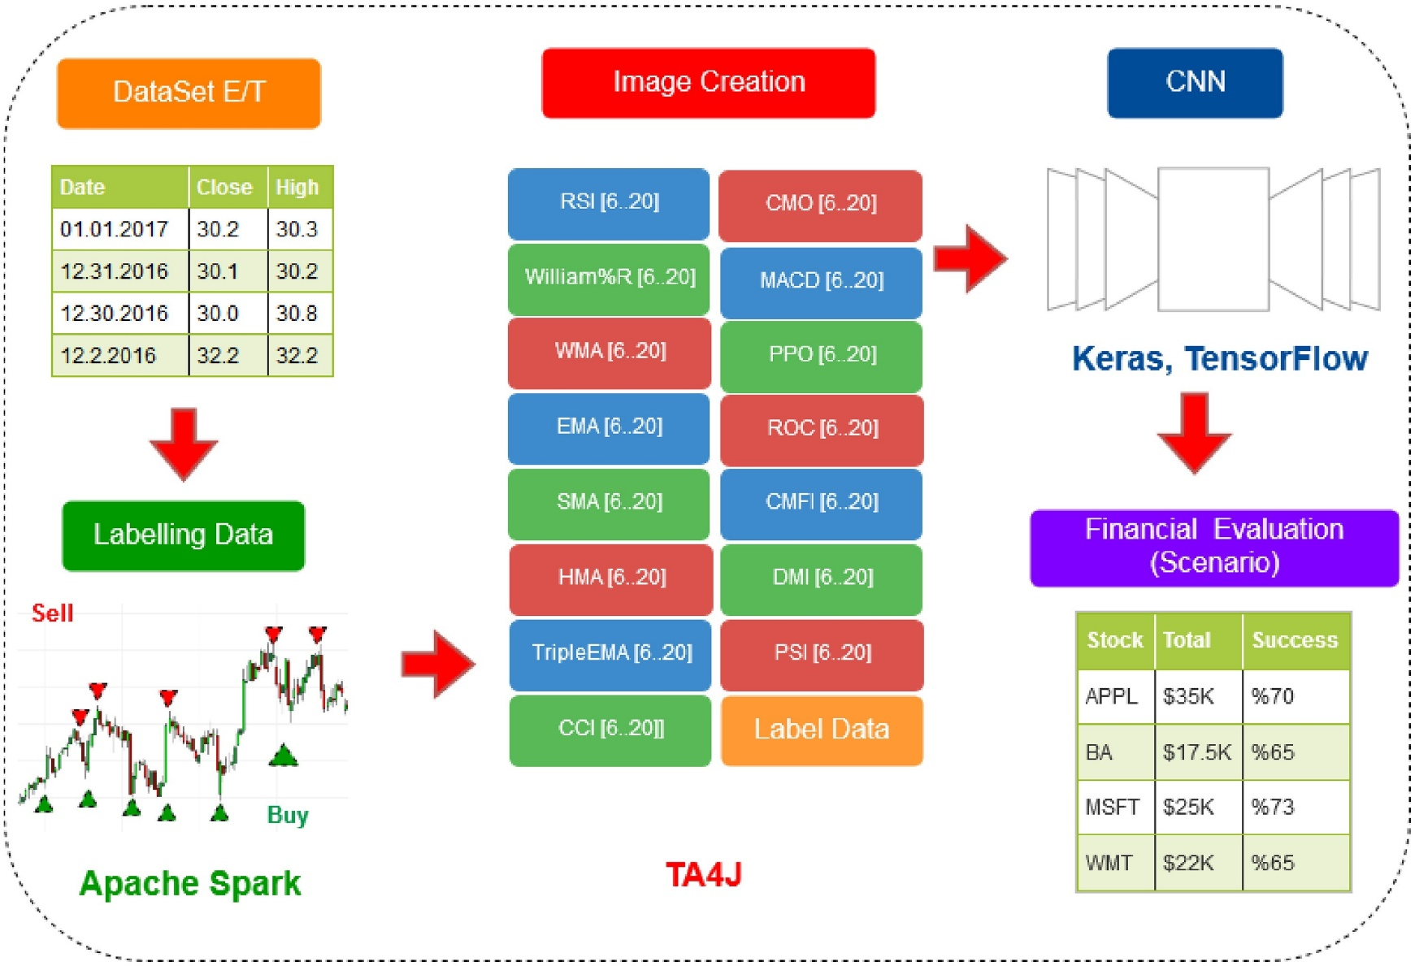
Overall
Notes:
目標是確定最適合買入，賣出和持有相關股票價格時間序列的點數。

Slide 14
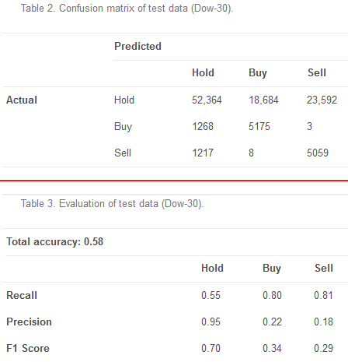
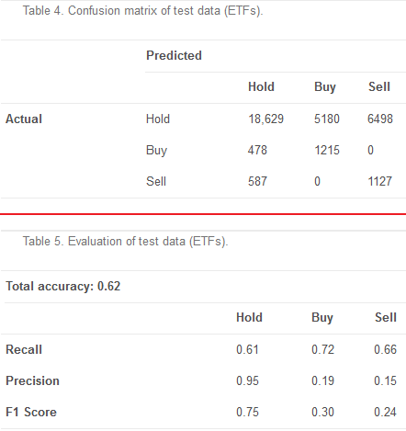
Computational model performance
Notes:
2/(1/R+1/P)

Slide 15
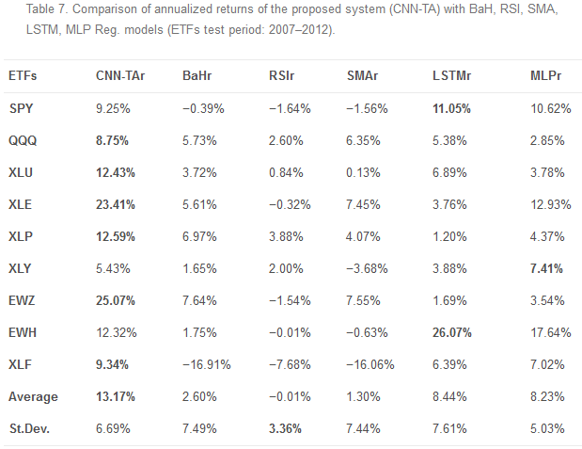
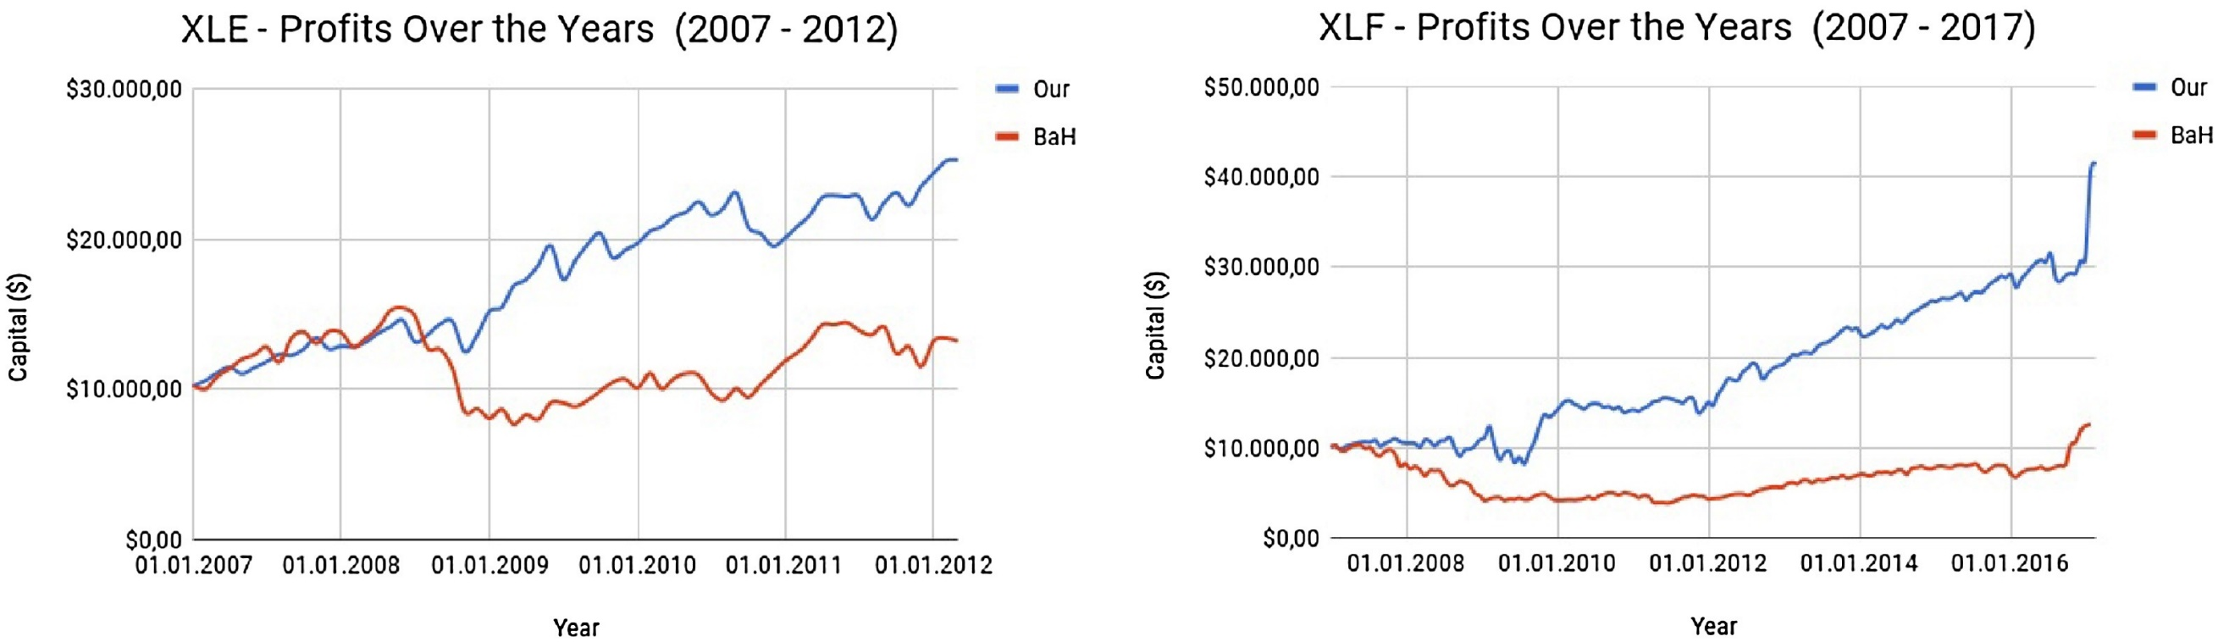
ETF analysis
Transaction cost 0.01%
Notes:
2/(1/R+1/P)

Slide 16
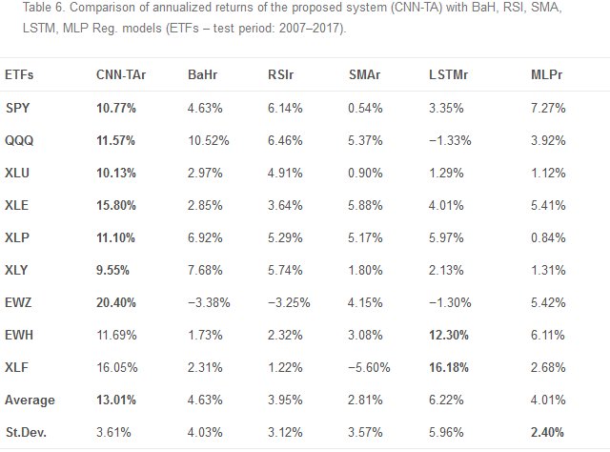
ETF analysis
Notes:
2/(1/R+1/P)

Slide 17
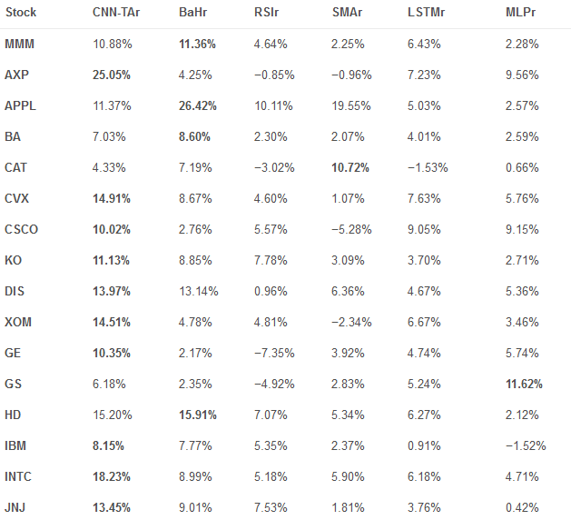
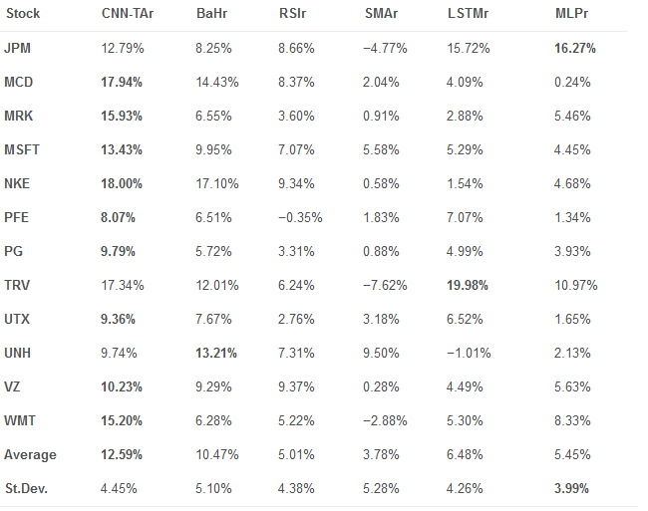
Dow 30 analysis 2007-2017
Notes:
2/(1/R+1/P)

Slide 18
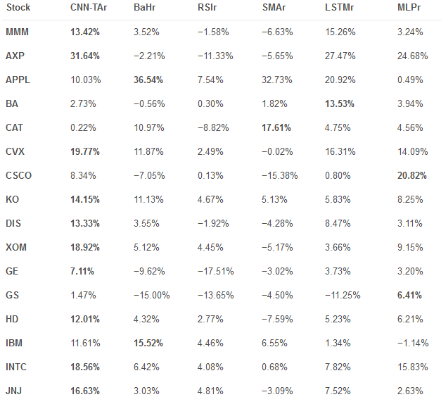
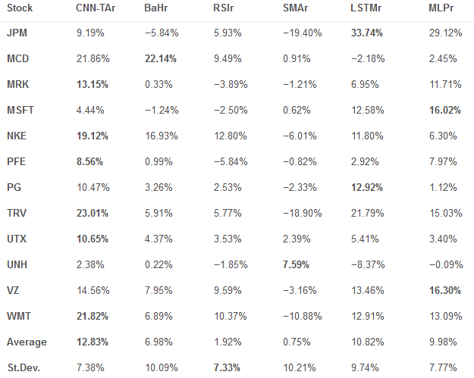
Dow 30 analysis 2007-2012
Notes:
2/(1/R+1/P)

Slide 19
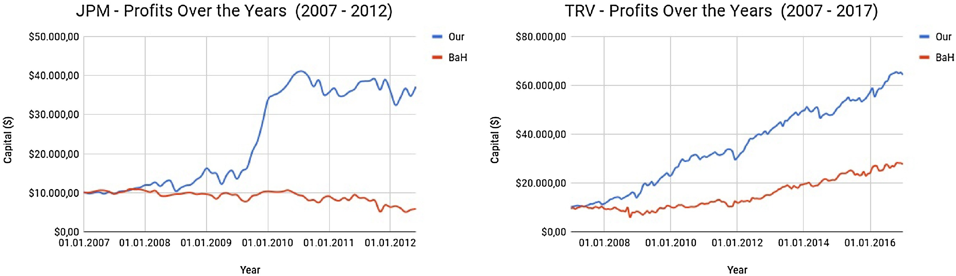
Dow 30 analysis
Notes:
2/(1/R+1/P)

