Slide 1
Prefix transpositions on binary and ternary strings
Amit Kumar Dutta, Masud Hasan, M. Sohel Rahman
Information Processing Letters, 113 (2013) p.265–270
Speaker: Kuan-Chih Chen
Date: 2018.07.10
Notes:
孟加拉工程技術大學,達卡,孟加拉

Slide 2


Notes:
孟加拉工程技術大學,達卡,孟加拉

Slide 3
Abstract
The problem of sorting by prefix transpositions asks for the minimum number of prefix transpositions required to sort the elements of a given permutation. In this paper, we study a variant of this problem where the prefix transpositions act not on permutations but on strings over an alphabet of fixed size. Here, we determine the minimum number of prefix transpositions required to sort the binary and ternary strings, with polynomial time algorithms for these sorting problems.

Slide 4


Definition
String S = 1234567
Permutation of S
1234567, 2134567, 4316572, 7654321, ...
Transposition
$$f(2, 4, 7)$$
[2:3]&[4:6]
1234567
1456237
Prefix transposition
$$f(1, 3, 3)$$
[1:2]&[3:3]
1234567
3124567
(prefix)

Slide 5
Definition
Sorting by prefix transposition problem:
find minimum number of prefix transpositions required to
transform given permutation(S) to the identity permutation(T)
S:7341256
T:1234567
1
7341256
7123456
2
1234567

Slide 6
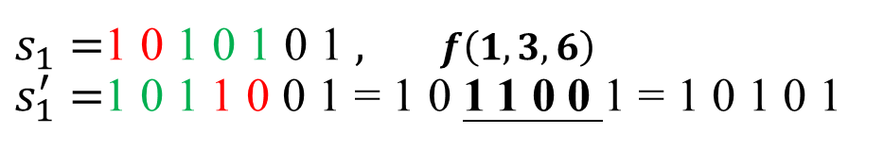
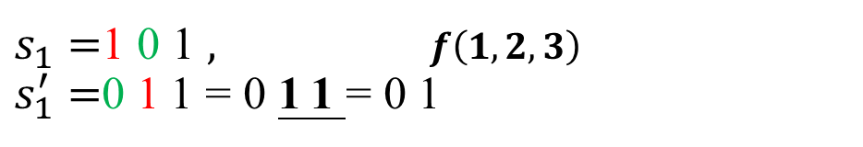


Definition (this paper)
Fully binary string / Fully ternary string
$$s_{1}=1010101$$
$$s_{2}=1021021$$
After prefix transposition, string needs to be reduced as normalized string.
$s_{1}=$101$,$ $f\left(1, 2, 3\right)$
$s_{1}^{′}=$011=011=01
1-transposition: reduce a symbol
$s_{1}=$1010101$,$ $f\left(1, 3, 6\right)$
$s_{1}^{′}=$1011001=1011001=10101
2-transposition: reduce two symbols
Notes:
這種轉變的靈感來自於生物學觀察，即同一基因的多個“拷貝”可以出現在基因組的不同位置

Slide 7
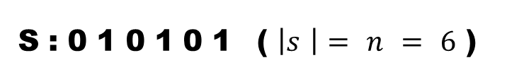
Definition (this paper)
Sorting by prefix transposition problem:
find minimum number of prefix transpositions required to
reduce the fully binary/ternary string to one of length k
(by grouping and sorting)
S:010101 ($\left|s\right|=n=6$)
010101→ 001101 → 0101 → 0011 → 01
2-transposition
2-transposition
Grouping distance: $d_{g}\left(s\right)=2$ (two 2-transpositions)
Obsev: The more 2-transpositions we can give, the smaller $d_{g}\left(s\right)$ we may get

Slide 8
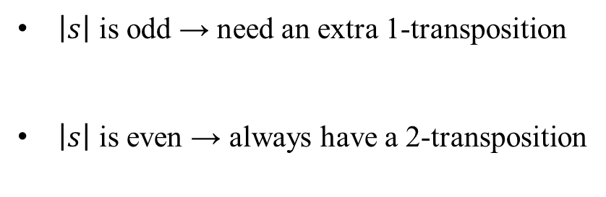
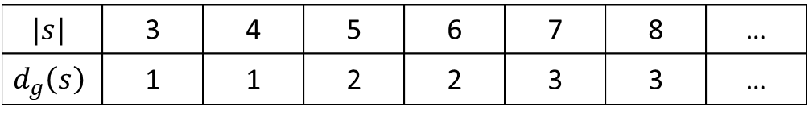
Grouping - binary
Possible kinds of generalized string:
0101…01
1010…10
For fully binary normalized string $s$ ($\left|s\right|>2),d_{g}\left(s\right)=\left\lceil \frac{|s|−2}{2}\right\rceil$
$\left|s\right|$ is odd → need an extra 1-transposition
$\left|s\right|$ is even → always have a 2-transposition
101→ 011 → 01
1010→ 1100 → 10
$$|s|$$ | 3 | 4 | 5 | 6 | 7 | 8 | …
$$d_{g}\left(s\right)$$ | 1 | 1 | 2 | 2 | 3 | 3 | …

Slide 9
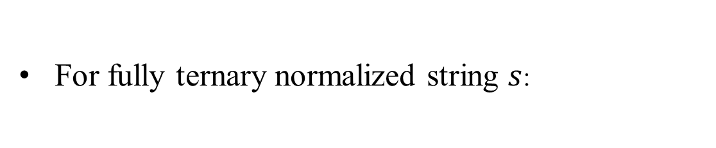
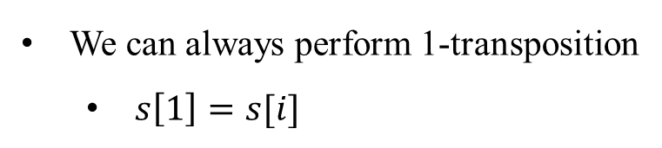

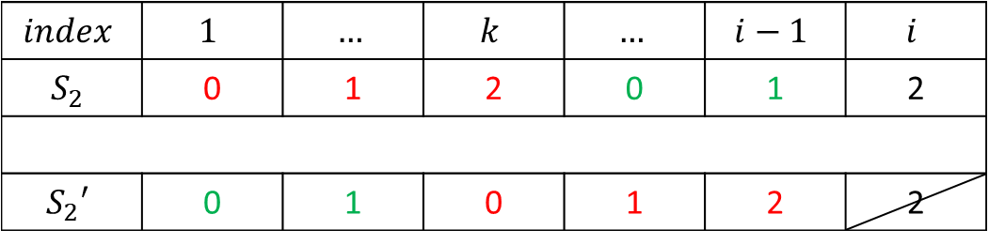
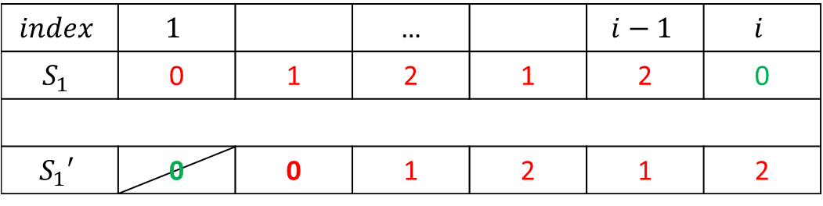
Grouping - ternary
For fully ternary normalized string $s$:
We can always perform 1-transposition
$s\left[1\right]=s[i]$
Lemma 1
$$index$$ | $$1$$ |  | … |  | $$i−1$$ | $$i$$
$$S_{1}$$ | 0 | 1 | 2 | 1 | 2 | 0
$$S_{1}′$$ | 0 | 0 | 1 | 2 | 1 | 2
$s\left[k\right]=s[i]$
$$index$$ | $$1$$ | $$…$$ | $$k$$ | $$…$$ | $$i−1$$ | $$i$$
$$S_{2}$$ | 0 | 1 | 2 | 0 | 1 | 2
$$S_{2}′$$ | 0 | 1 | 0 | 1 | 2 | 2

Slide 10
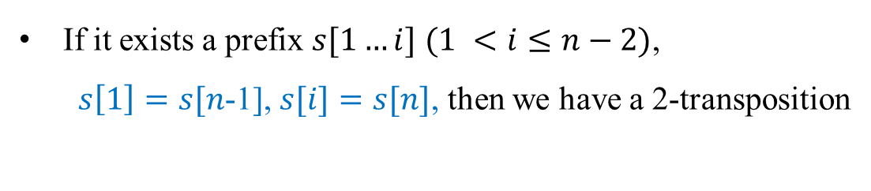
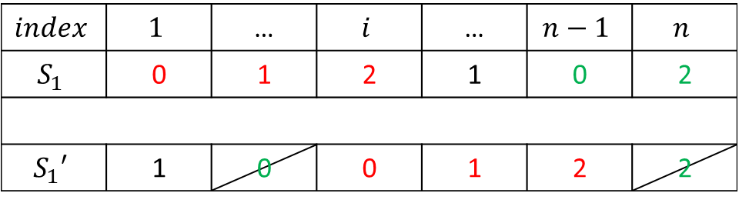
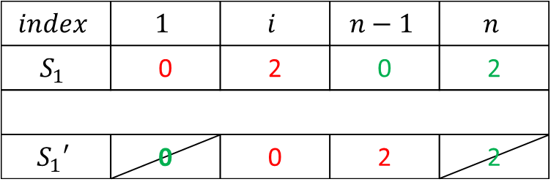
Grouping - ternary
For fully ternary normalized string $s$:
If it exists a prefix $s[1…i]$ $(1 <i≤n−2)$,
$s\left[1\right]=s[n$-1], $s[i]=s[n]$, then we have a 2-transposition
Lemma 2
$$index$$ | $$1$$ | … | $$i$$ | … | $$n−1$$ | $$n$$
$$S_{1}$$ | 0 | 1 | 2 | 1 | 0 | 2
$$S_{1}′$$ | 1 | 0 | 0 | 1 | 2 | 2
$$index$$ | $$1$$ | $$i$$ | $$n−1$$ | $$n$$
$$S_{1}$$ | 0 | 2 | 0 | 2
$$S_{1}′$$ | 0 | 0 | 2 | 2

Slide 11

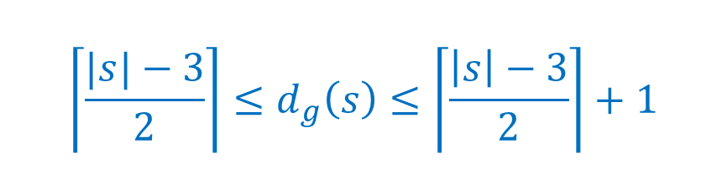

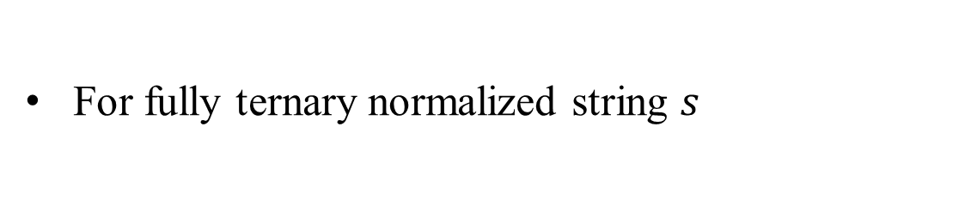
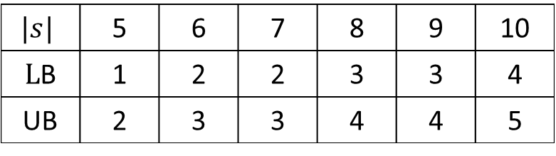



Grouping - ternary
For fully ternary normalized string $s$
{
$${\left\lceil \frac{|s|−3}{2}\right\rceil ≤d}_{g}\left(s\right)≤\left\lceil \frac{\left|s\right|−3}{2}\right\rceil +1$$
$$\left|s\right|>4$$
$$(Lower)$$
$$(Upper)$$
$$d_{g}\left(s\right)=1$$
$$\left|s\right|=4$$
$$|s|$$ | 5 | 6 | 7 | 8 | 9 | 10
$L$B | 1 | 2 | 2 | 3 | 3 | 4
UB | 2 | 3 | 3 | 4 | 4 | 5

Slide 12

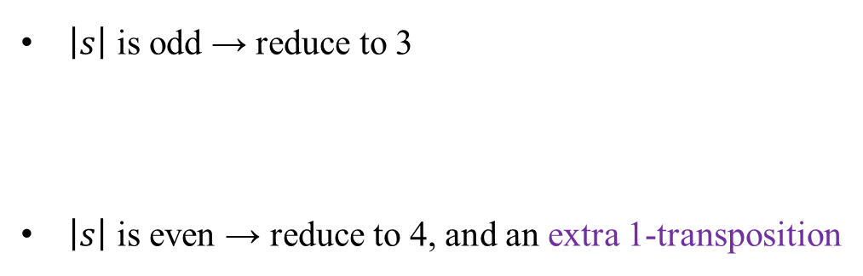
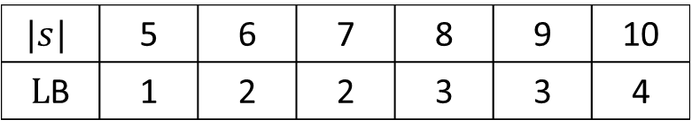

Grouping - ternary
Lower bound:
We assume that in best case, we can use 2-transposition in every step
$\left|s\right|$ is odd → reduce to 3
$\left|s\right|$ is even → reduce to 4, and an extra 1-transposition
$\left|s\right|$=7→ 5 → 3 $d_{g}\left(s\right)=2$
1010102→1100102→10102→11002 →102
$\left|s\right|$=8→ 6 → 4 $d_{g}\left(s\right)=2+1=3$
10101012→11001012→101012→110012→1012→0112→012
$$|s|$$ | 5 | 6 | 7 | 8 | 9 | 10
$L$B | 1 | 2 | 2 | 3 | 3 | 4

Slide 13


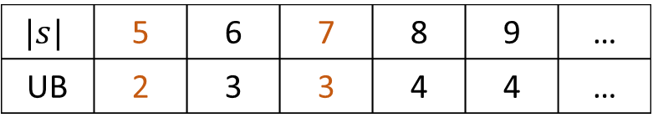
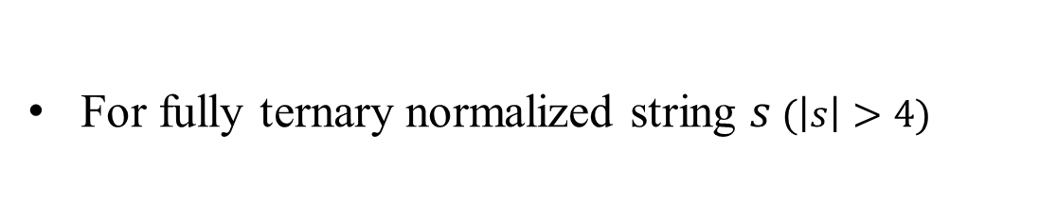


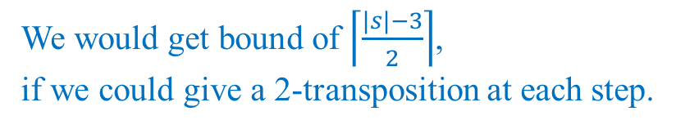
Grouping - ternary
For fully ternary normalized string $s$ $(\left|s\right|>4)$
$${\left\lceil \frac{|s|−3}{2}\right\rceil ≤d}_{g}\left(s\right)≤\left\lceil \frac{\left|s\right|−3}{2}\right\rceil +1$$
$$(Lower)$$
$$(Upper)$$
In upper bound:
e can give
$∵$Lemma 1:
We can always perform 1-transposition
When $n=5$ and $n=6,d_{g}\left(s\right)=$ 2 and 3 respectively
$$|s|$$ | 5 | 6 | 7 | 8 | 9 | …
UB | 2 | 3 | 3 | 4 | 4 | …
We would get bound of $\left\lceil \frac{|s|−3}{2}\right\rceil$,
if we could give a 2-transposition at each step.

Slide 14
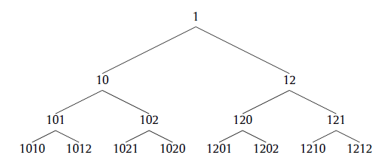
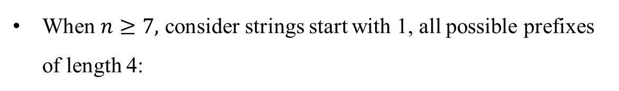
Grouping - ternary
Upper bound
When $n≥7,$ consider strings start with 1, all possible prefixes of length 4:
Lemma 2
Notes:
we can use relabeling for strings starting with 0 or 2, so it suffices to prove the bound considering those prefixes
開頭是0和2的情況可以用1去推得(relabel)，所以只需透過這8個prefix證明bound

Slide 15
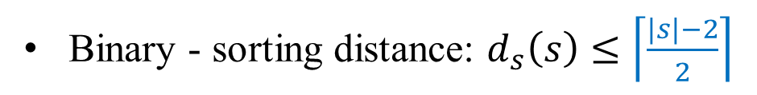

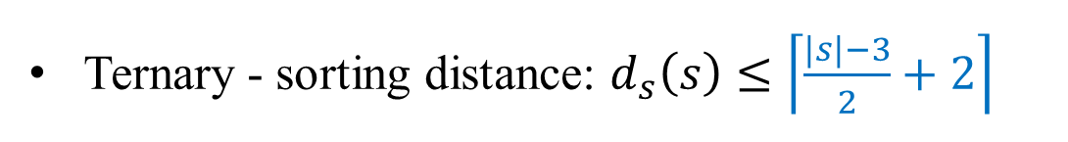

Sorting
(Sorting = grouping + sorting)
Binary - sorting distance: $d_{s}\left(s\right)≤\left\lceil \frac{|s|−2}{2}\right\rceil$
After grouping, they are already sorted
(ascending or descending order)
$$01$$
$$10$$
Ternary - sorting distance: $d_{s}\left(s\right)≤\left\lceil \frac{|s|−3}{2}+2\right\rceil$
After grouping, we have some types of grouped strings:
012, 021, 102, 120, 201, 210
these 4 types need to be sorted by a more 0-transposition

