Slide 1
A fast algorithm for solving a generalized longest common subsequence problem
Daxin Zhu and Xiaodong Wang
International Computer Sciences and Informatics Conference (ICSIC), Amman, January 12-13, 2016, pp 1-7
.
Presenter: Kuo-Feng Huang
Date: 2018/07/10

Slide 2
Abstract
The In this paper, a generalized longest common subsequence problem is considered. For this new problem, two constraining sequences of length s and t must be included as the subsequences of the two main sequences and the length of the result must be maximal. For the two input sequences X and Y of lengths n and m, and the given two constraining sequences of length s and t , we present an O(nmst) time dynamic programming algorithm for solving the new generalized longest common subsequence problem. The correctness of the new algorithm is proved.

Slide 3
New generalized LCS
X: fbaced
Y: bfaedc
P: ad
Q: ba
LCS: f a e d 或 b a e d
New generalized LCS: b a e d => include ad and ba

Slide 4
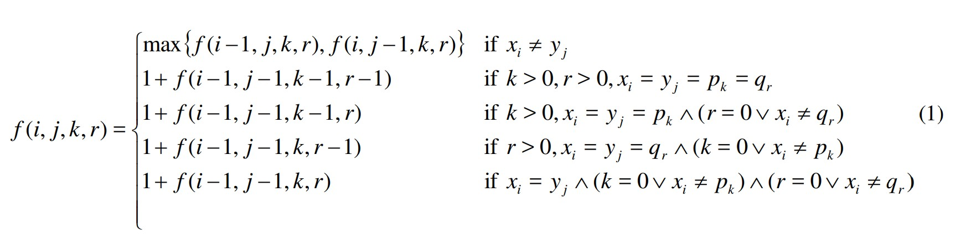
New generalized LCS
X: x₁x₂x₃…x_{i}…x_{n}
Y: y₁y₂y₃…y_{j}…y_{m}
P: p₁p₂p₃…p_{k}…p_{s}
Q: q₁q₂q₃…q_{r}…q_{t}

Slide 5
New generalized LCS
X:abcd Y:acdb P:a Q:d
f(i,j,0,0)
f(i,j,1,0)
0 | 0 | 0 | 0 | 0
0 | 1 | 1 | 1 | 1
0 | 1 | 1 | 1 | 2
0 | 1 | 2 | 2 | 2
0 | 1 | 2 | 3 | 3
-∞ | -∞ | -∞ | -∞ | -∞
-∞ | 1 | 1 | 1 | 1
-∞ | 1 | 1 | 1 | 2
-∞ | 1 | 2 | 2 | 2
-∞ | 1 | 2 | 3 | 3
f(i,j,0,1)
f(i,j,1,1)
-∞ | -∞ | -∞ | -∞ | -∞
-∞ | -∞ | -∞ | -∞ | -∞
-∞ | -∞ | -∞ | -∞ | -∞
-∞ | -∞ | -∞ | -∞ | -∞
-∞ | -∞ | -∞ | 3 | 3
-∞ | -∞ | -∞ | -∞ | -∞
-∞ | -∞ | -∞ | -∞ | -∞
-∞ | -∞ | -∞ | -∞ | -∞
-∞ | -∞ | -∞ | -∞ | -∞
-∞ | -∞ | -∞ | 3 | 3

Slide 6
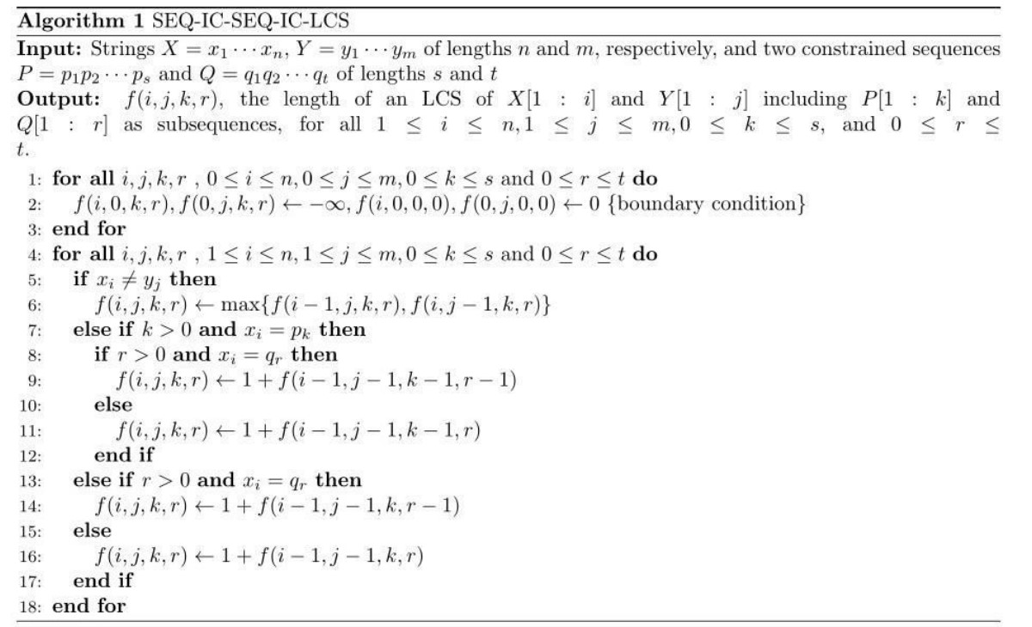
New generalized LCS

Slide 7
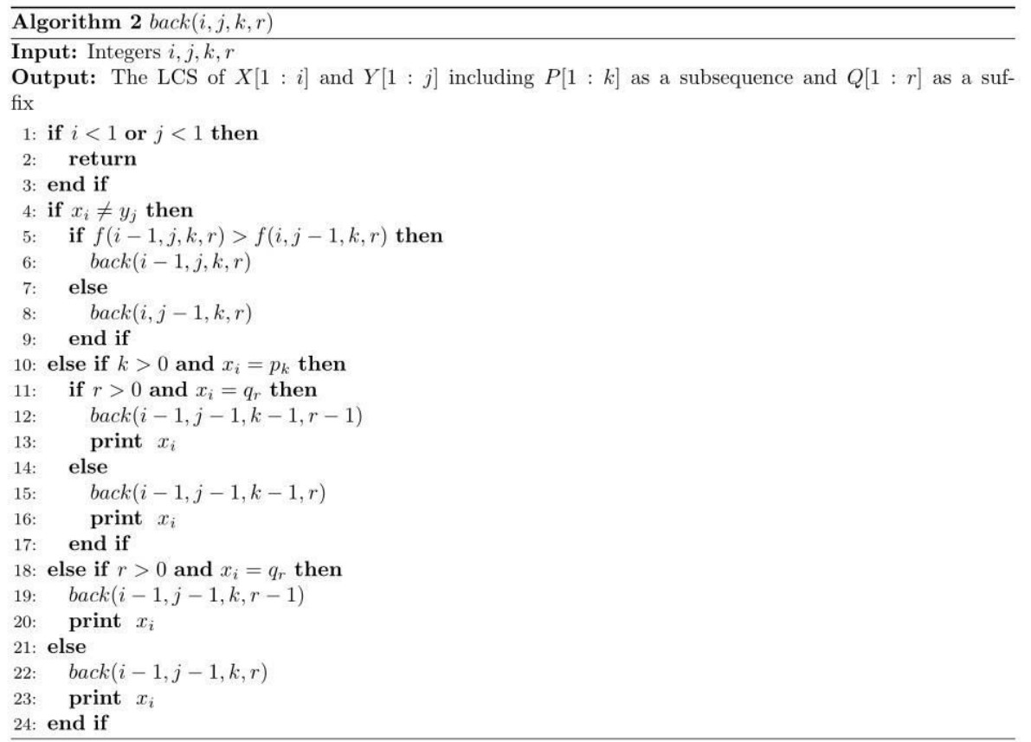
New generalized LCS

