Slide 1
Palindromic Subsequence Automata and Longest Common Palindromic Subsequence
Md. Mahbubul Hasan, A. S. M. Sohidull Islam,
M. Sohel Rahman and Ayon Sen
Mathematics in Computer Science (2017),
Volume 11, Issue 2, pp 219-232
Presenter: Ting-Wei Liang
Date: 2018/07/17

Slide 2
Abstract
In this paper, we present a novel weighted finite automaton called palindromic subsequence automaton
(PSA) that is a compact representation of all the palindromic subsequences of a string. Then we use PSA to solve the longest common palindromic subsequence problem. Our automata based algorithms are efficient both in theory and in practice.

Slide 3
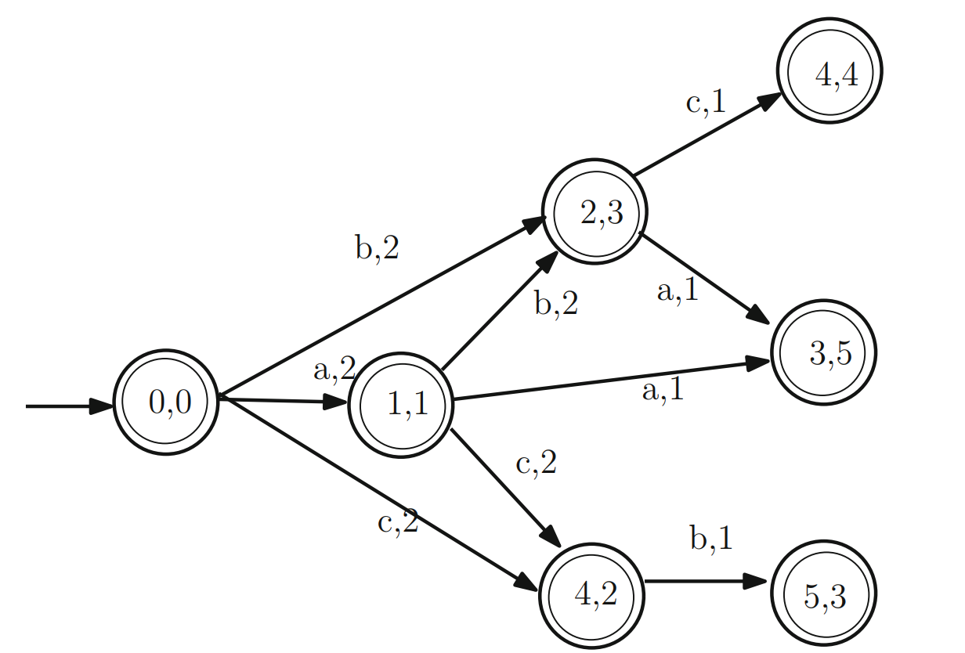


Palindromic Subsequence Automata (PSA)
$$S=abacbca$$
$$S^{R}=acbcaba$$

Slide 4

Next Match
$$S=abacbca$$
i | S[i] | NP[i] | SP[a] | SP[b] | SP[c]
7 | a | null | 7 | null | null
6 | c | null | 7 | null | 6
5 | b | null | 7 | 5 | 6
4 | c | 6 | 7 | 5 | 4
3 | a | 7 | 3 | 5 | 4
2 | b | 5 | 3 | 2 | 4
1 | a | 3 | 1 | 2 | 4

Slide 5



PSA Construction
1,1(a)
Dequeue (0,0)
Enqueue extends
Dequeue (1,1)
4,2
…
2,3(b)
2,3
Find all $Σ$ extends
Find all $Σ$ extends
0,0
1,1
4,2(c)
$$S=abacbca$$

Slide 6
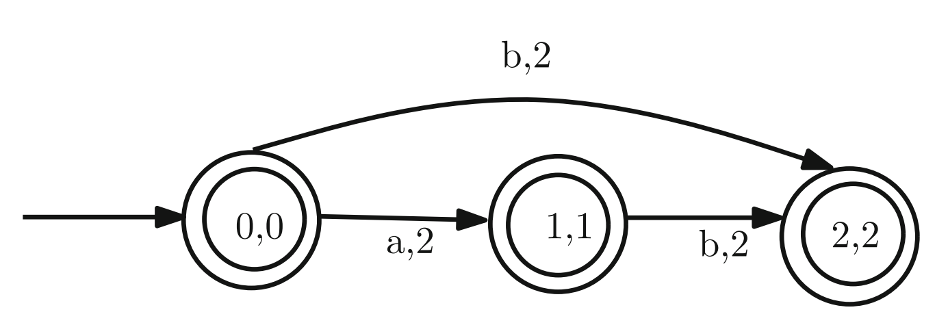

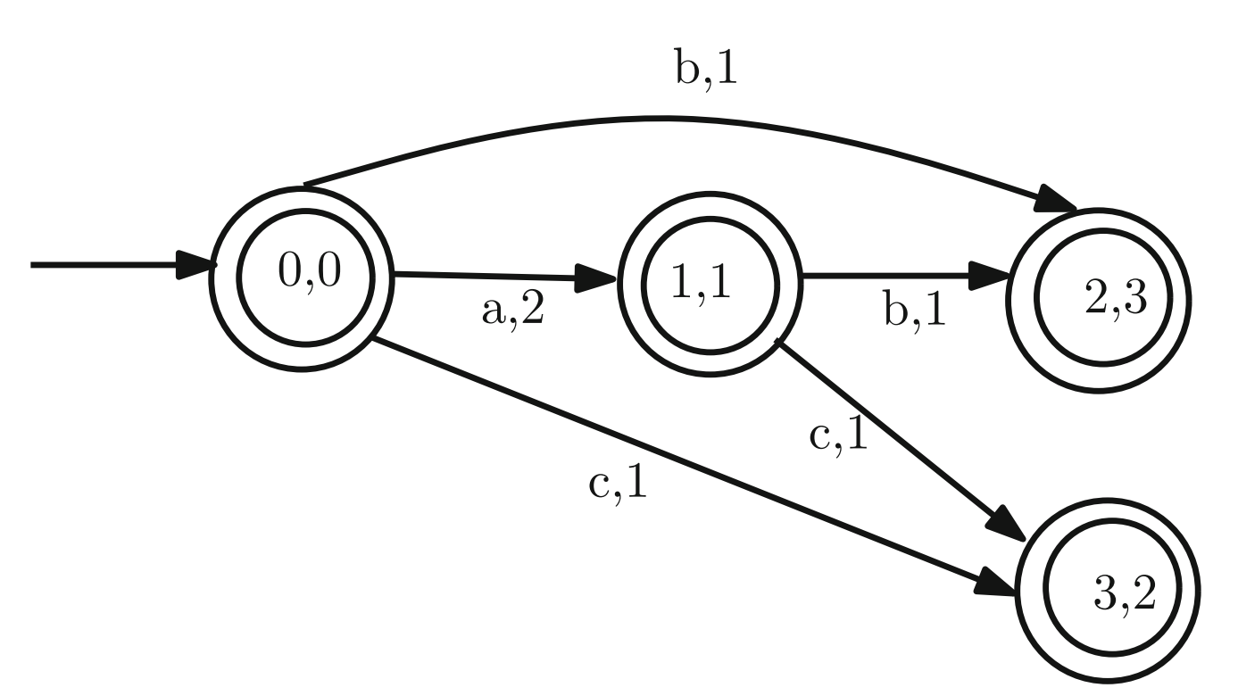

Common Palindromic Subsequence Automata (CPSA)

Slide 7
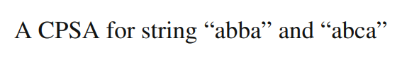
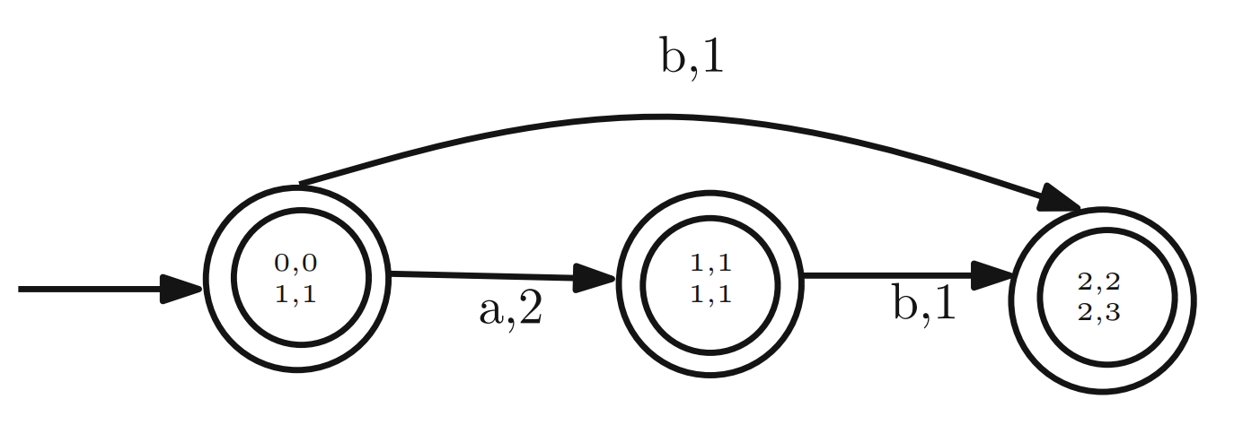

Common Palindromic Subsequence Automata (CPSA)

Slide 8
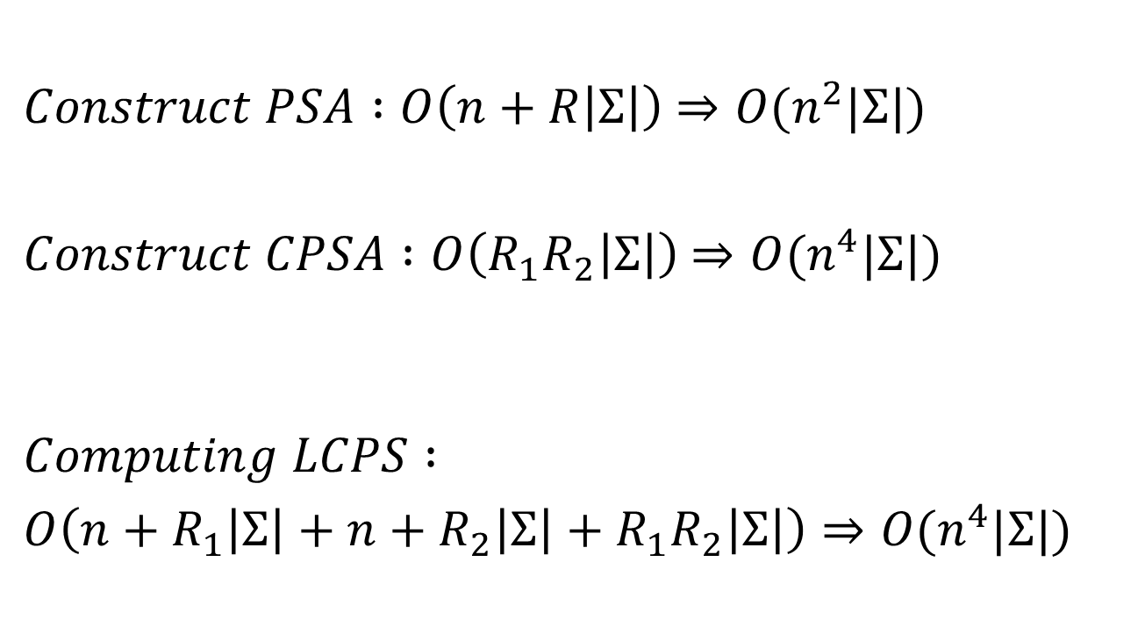
Time Complexity
$Construct PSA :O\left(n+R\left|Σ\right|\right)$ $⇒O(n^{2}|Σ|)$
$Construct CPSA :O\left(R_{1}R_{2}\left|Σ\right|\right)$ $⇒O(n^{4}|Σ|)$
$$Computing LCPS :$$
$O\left(n+R_{1}\left|Σ\right|+n+R_{2}\left|Σ\right|+R_{1}R_{2}\left|Σ\right|\right)⇒O(n^{4}|Σ|)$

Slide 9
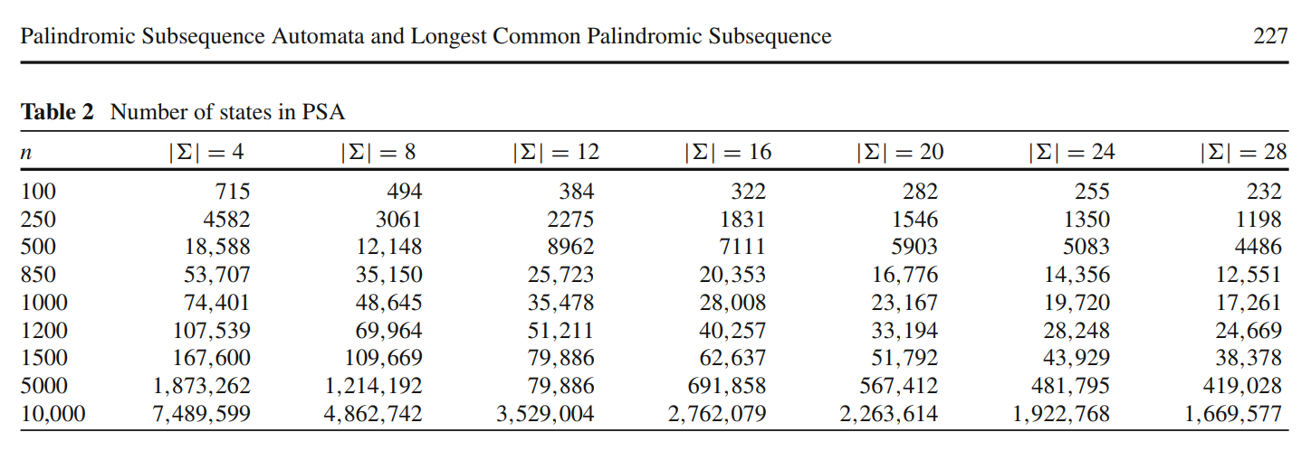
Experiments(PSA)

Slide 10
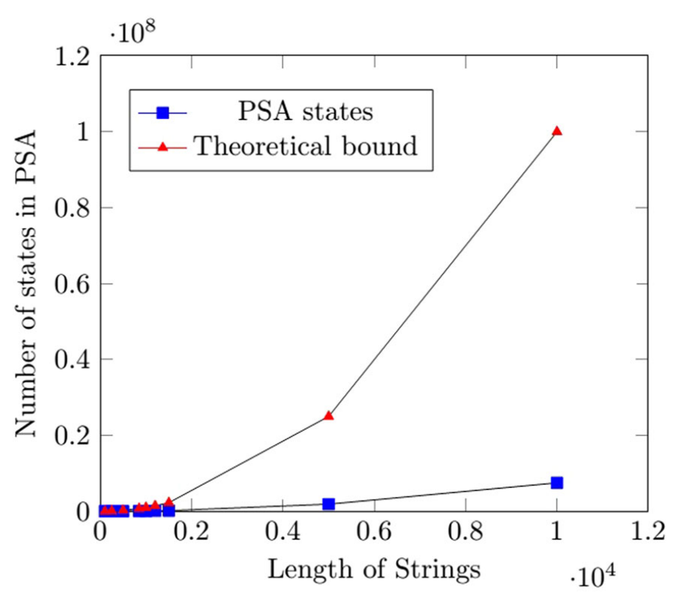
Experiments(PSA)

Slide 11
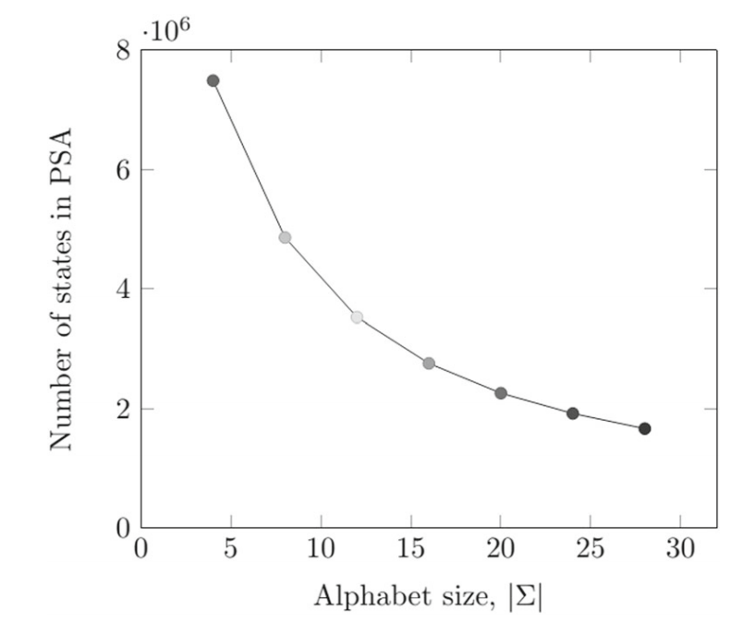
Experiments(PSA)

Slide 12
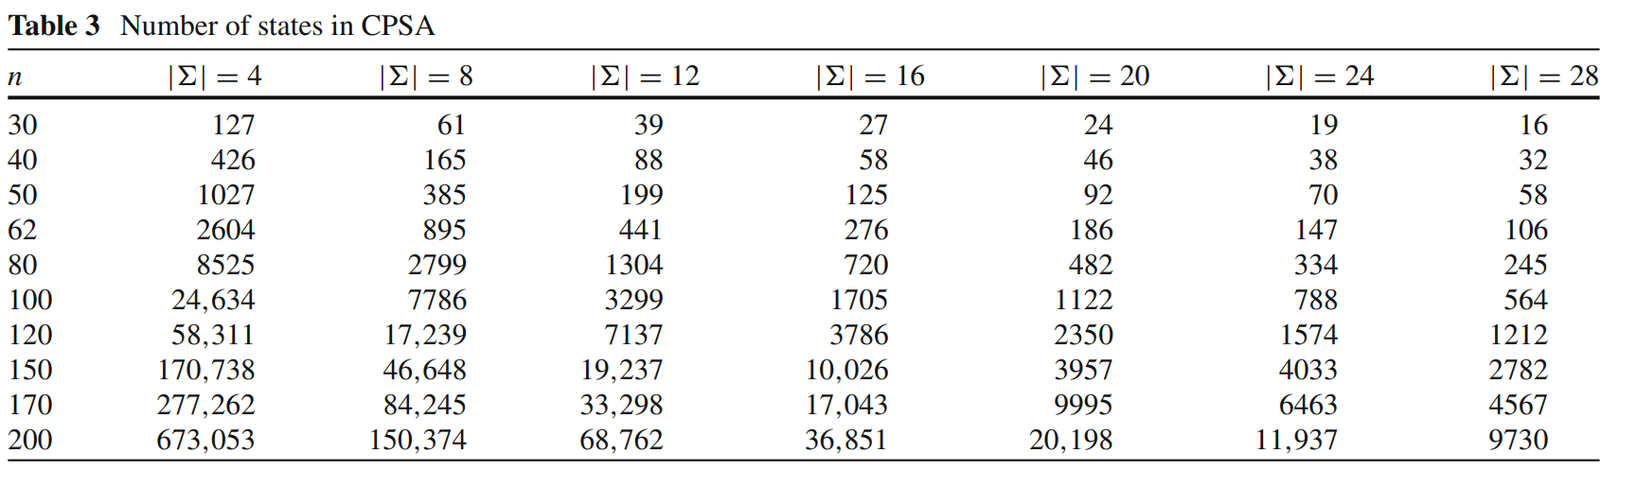
Experiments(CPSA)

Slide 13
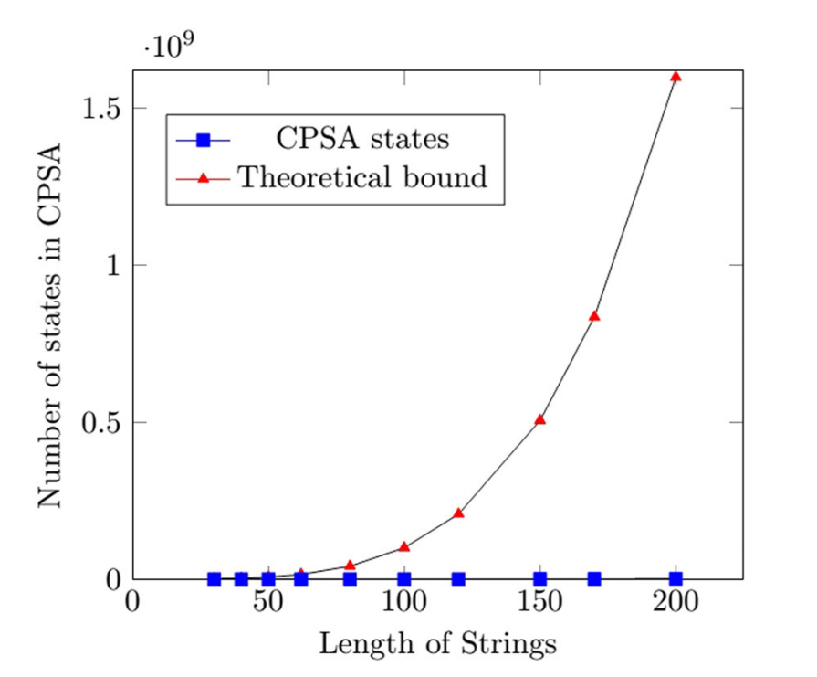
Experiments(CPSA)

Slide 14
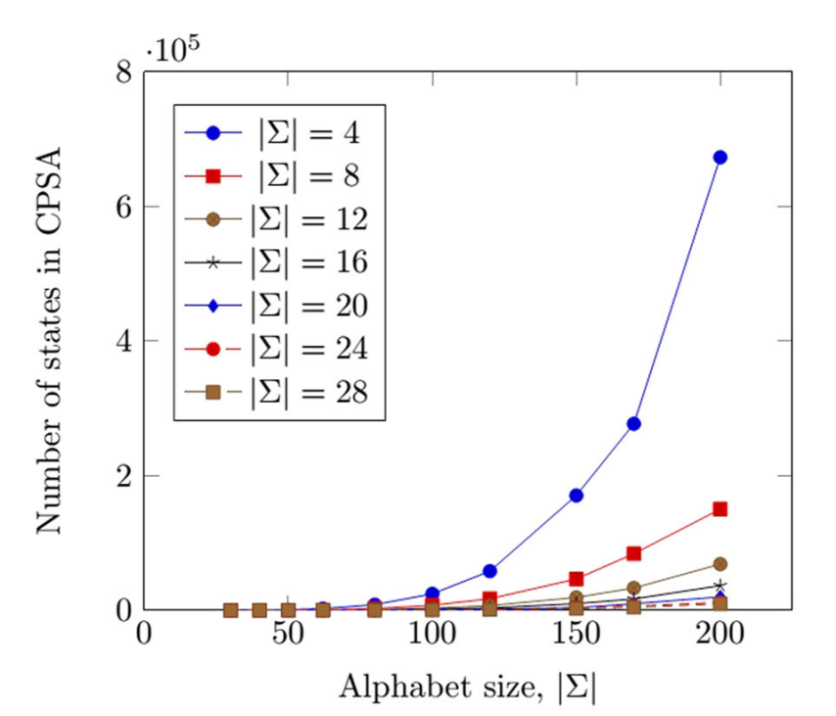
Experiments(CPSA)

Slide 15
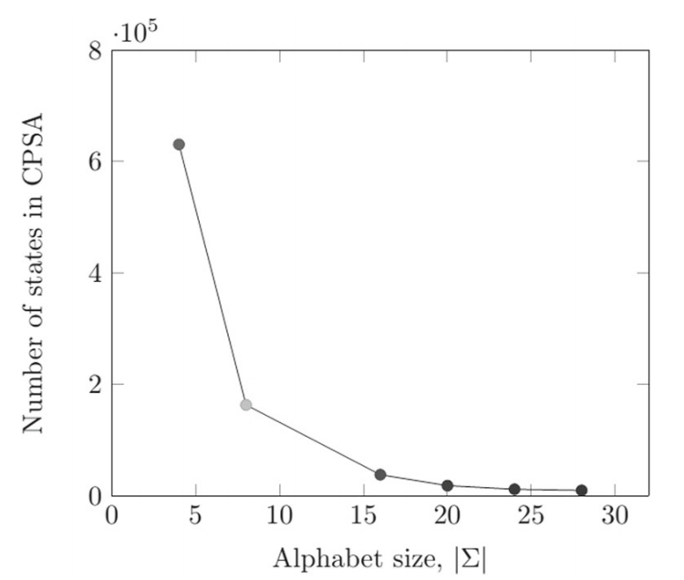
Experiments(CPSA)

