Slide 1
A neural network with a case based dynamic window for stock trading prediction
Pei-Chann Chang(張百棧), Chen-Hao Liu(劉鎮豪), Jun-Lin Lin(林志麟), Chin-Yuan Fan(樊晉源), Celeste S.P. Ng(吳思配)
Expert Systems with Applications, Volume 36, Issue 3, Part 2, April 2009, Pages 6889-6898
Presenter: Cheng-Han Wu
Date:2018/7/17

Slide 2
Abstract(1/2)
Stock forecasting involves complex interactions between market-influencing factors and unknown random processes. In this study, an integrated system, CBDWNN by combining dynamic time windows, case based reasoning (CBR), and neural network for stock trading prediction is developed and it includes three different stages: (1) screening out potential stocks and the important influential factors; (2) using back propagation network (BPN) to predict the buy/sell points (wave peak and wave trough) of stock price and (3) adopting case based dynamic window (CBDW) to further improve the forecasting results from BPN.

Slide 3
Abstract(2/2)
The system developed in this research is a first attempt in the literature to predict the sell/buy decision points instead of stock price itself. The empirical results show that the CBDW can assist the BPN to reduce the false alarm of buying or selling decisions. Nine different stocks with different trends, i.e., upward, downward and steady, are studied and one individual stock (AUO) will be studied as case example. The rates of return for upward, steady, and downward trend stocks are higher than 93.57%, 37.75%, and 46.62%, respectively. These results are all very promising and better than using CBR or BPN alone.

Slide 4
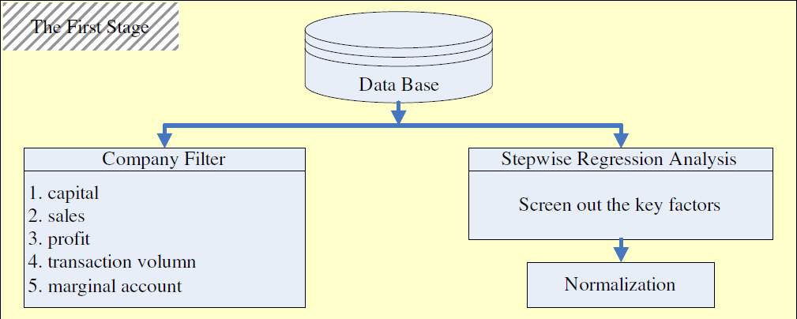
The First Stage

Slide 5
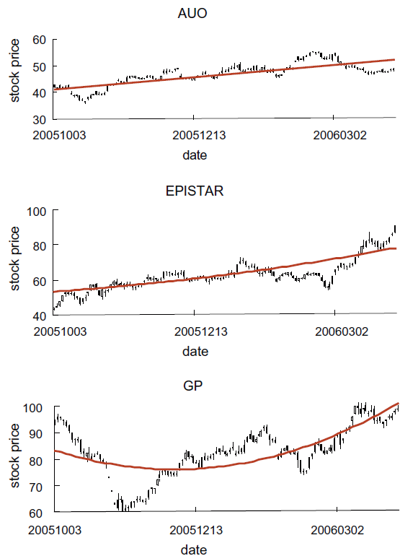
Selected Company (1/2)
AU Optronics Corp (AUO): 友達光電
Epistar Corp (EPISTAR): 晶元光電
Green Point Corp (GP) : 捷普綠點

Slide 6
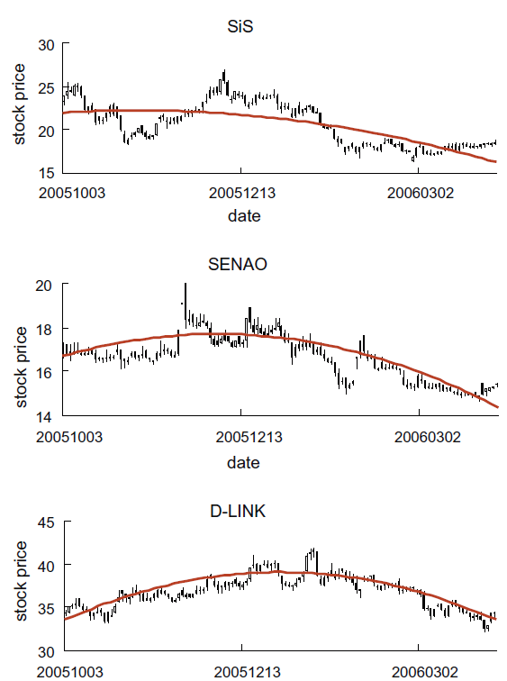
Selected Company (2/2)
Silicon Integrated System Corp (SiS) : 矽統科技
SENAO International Corp (SENAO) : 神準科技
D-Link Corp (D-LINK) : 友訊科技
Foxlink Corp (FOXLINK) : 正崴精密工業
Compal Corp (COMPAL) : 仁寶電腦工業
UMC Corp (UMC) : 聯華電子
2004/9/1~2005/8/31
2005/9/1~2005/12/31

Slide 7
Key Factors
Moving average (MA)
Moving average convergence and divergence (MACD)
BIAS
Stochastic oscillator (KD)
Relative strength indicator (RSI)
William (WMS%R)
Volume of transaction
The variation rate of technical indicators

Slide 8
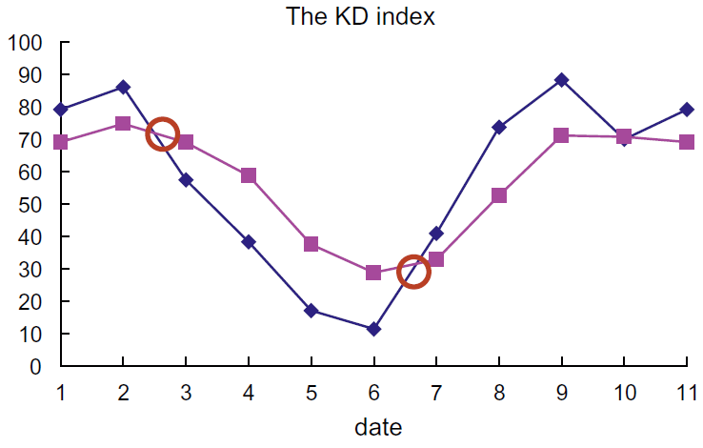

Buy/Sell Signal (1/3)
$RSV_{t}=\frac{C_{t}−L_{n}}{H_{n}−L_{n}}×100\%$
$K_{t}=RSV_{t}×\frac{1}{3}+K_{t−1}×\frac{2}{3}$
$D_{t}=K_{t}×\frac{1}{3}+D_{t−1}×\frac{2}{3}$

Slide 9
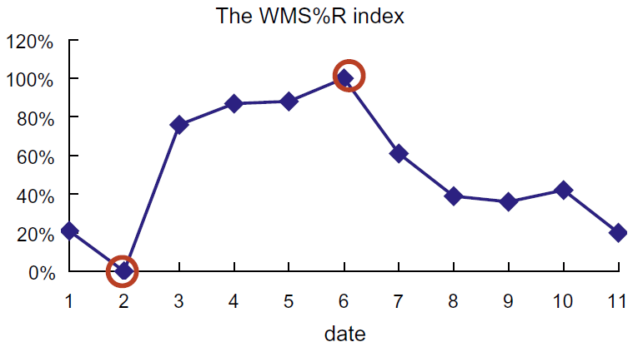

Buy/Sell Signal (2/2)
$WMS\%R_{t}=\frac{H_{n}−C_{t}}{H_{n}−L_{n}}×100\%$

Slide 10
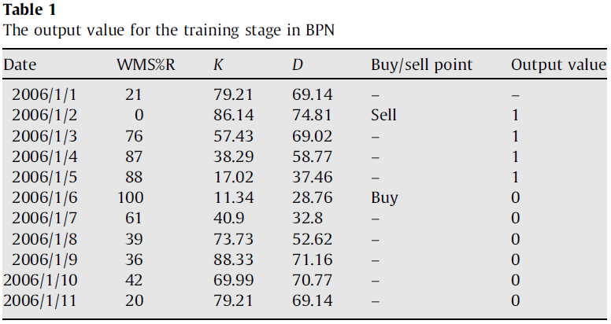
Buy/Sell Signal (3/3)

Slide 11
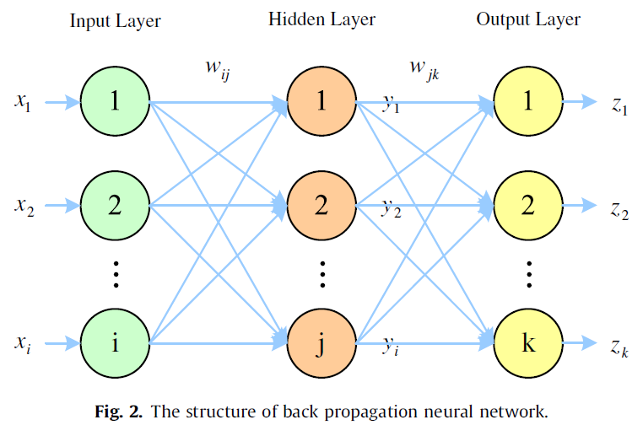

Back propagation network
$y_{j}=f\left(X_{j}\right)=f\left(\sum_{i=1}^{I}{w_{ij}x_{i}+w_{oj}}\right)$
$z_{k}=f\left(Y_{k}\right)=f\left(\sum_{j=1}^{J}{w_{jk}y_{j}+w_{ok}}\right)$
$E=\frac{1}{2}\sum_{k=1}^{K}{e_{k}^{2}=}$ $\frac{1}{2}\sum_{k=1}^{K}{{\left(t_{k}−z_{k}\right)}^{2}}$

Slide 12
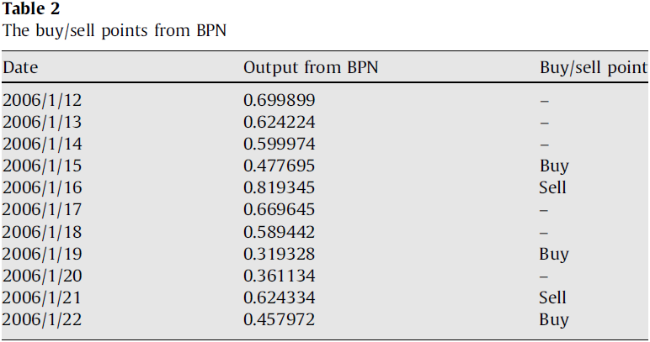
BPN output

Slide 13
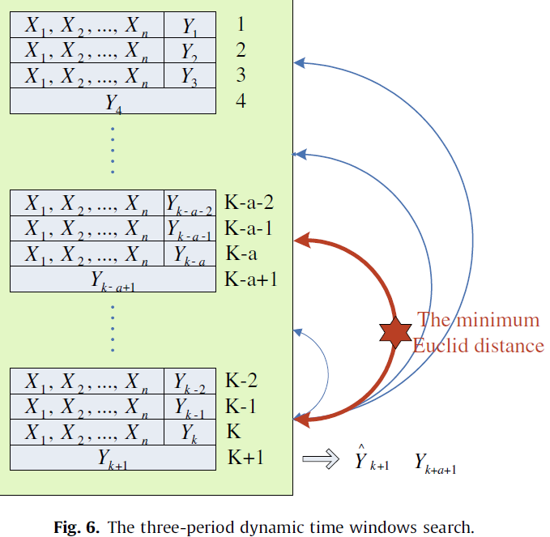

Case based dynamic windows
$$\hat{Y_{k}}=\sum_{i=1}^{m}{W_{i}Y_{i}}$$
$$W_{i}=\frac{d_{i}}{\sum_{i=1}^{m}{d_{i}}}$$

Slide 14
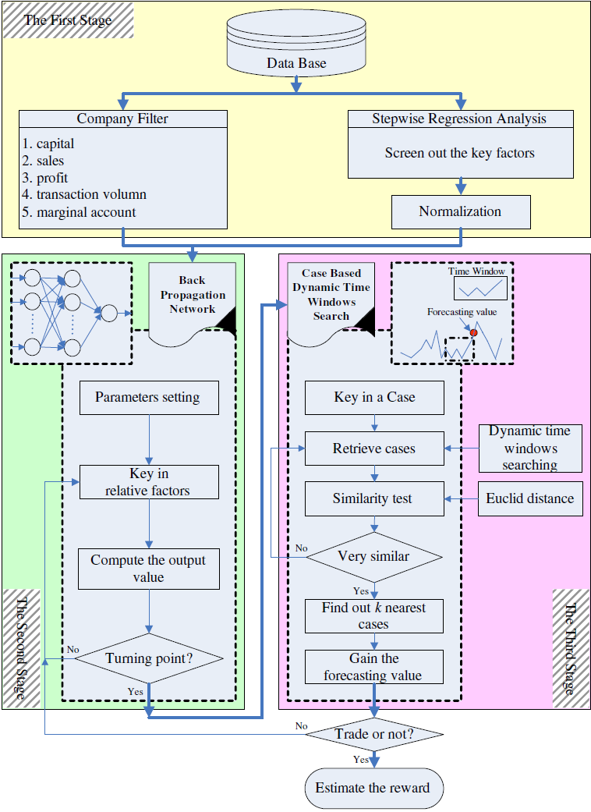

Slide 15
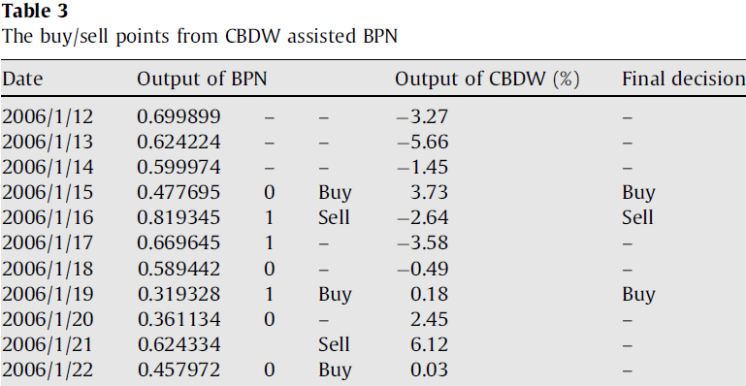
CBDW assisted BPN
0

Slide 16
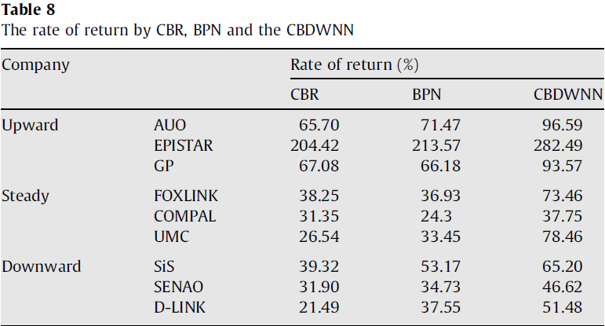
Result

