Slide 1
Computing a longest common subsequence that is almost increasing on sequences having no repeated elements
Johra Muhammad Moosa, M. Sohel Rahman, Fatema Tuz Zohora
Journal of Discrete Algorithms 20 (2013) 12–20
Speaker: Kuan-Chih Chen
Date: 2018.01.02
Notes:
作者:
Johra Muhammad Moosa 孟加拉

Slide 2
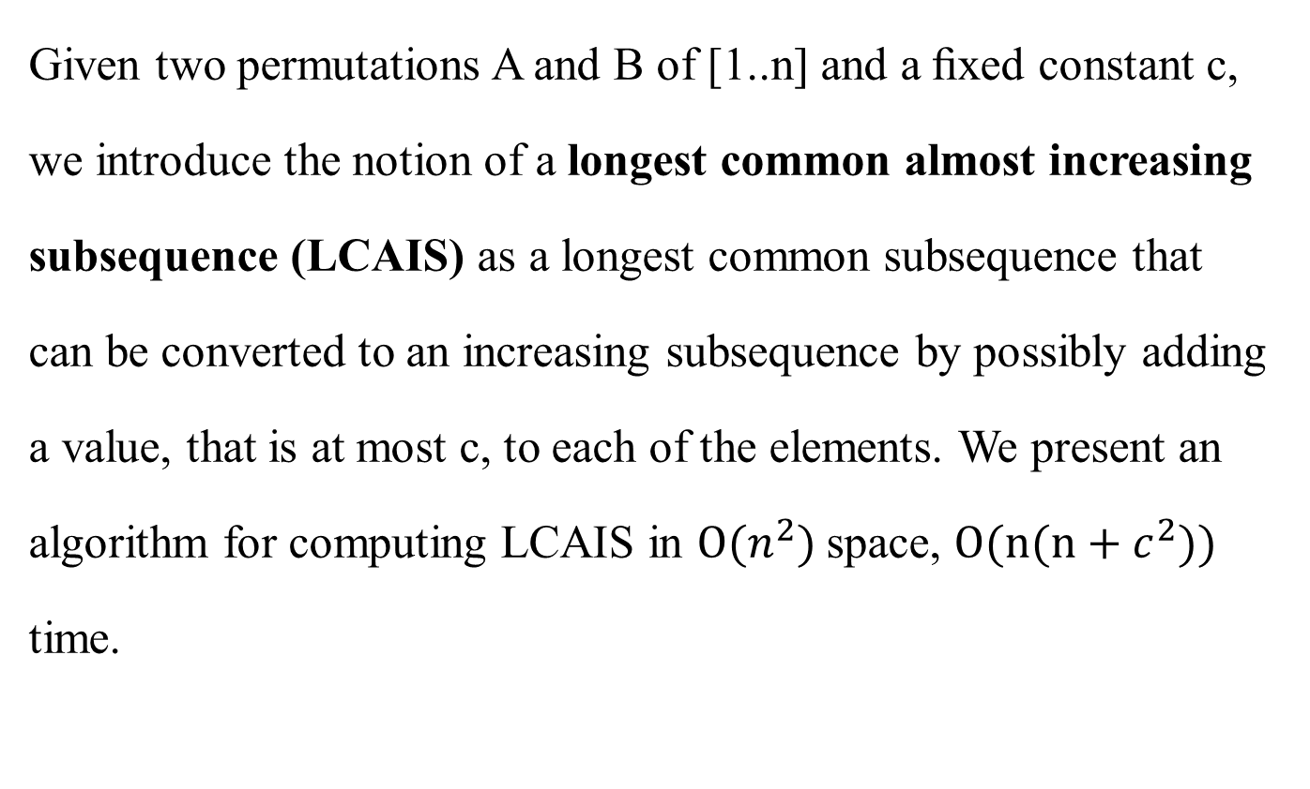
Abstract
Given two permutations A and B of [1..n] and a ﬁxed constant c, we introduce the notion of a longest common almost increasing subsequence (LCAIS) as a longest common subsequence that can be converted to an increasing subsequence by possibly adding a value, that is at most c, to each of the elements. We present an algorithm for computing LCAIS in $O(n^{2})$space, $O(n(n+c^{2}))$ time.

Slide 3

Sequence/permutation
A (1, 2, 3, 5, 13, 11, 9)
Longest increasing subequence
B (1, 2, 3, 5, 13)
Longest almost increasing subequence (c = 3)
$$∀y_{i}>\max_{j=1}^{i−1}{ y}_{j}−c$$
C (1, 2, 3, 5, 13, 11)

Slide 4
Solving a longest common almost increasing subsequence(LCAIS) problem
Given two permutations
A (20, 7, 15, 1, 14, 3, 6, 13, 11, 18, 10, 9), m = 12
B (7, 12, 15, 14, 21, 13, 6, 11, 10, 9), n = 10
and a constant c = 3, find the LCAIS of A & B

Slide 5
_{A(i)} ^{B(j)} |  | 1 | 2 | 3 | 4 | 5 | 6 | 7 | 8 | 9 | 10
 |  | 7 | 12 | 15 | 14 | 21 | 13 | 6 | 11 | 10 | 9
1 | 20
2 | 7
3 | 15
4 | 1
5 | 14
6 | 3
7 | 6
8 | 13
9 | 11
10 | 18
11 | 10
12 | 9

Slide 6

_{A(i)} ^{B(j)} |  | 1 | 2 | 3 | 4 | 5 | 6 | 7 | 8 | 9 | 10
 |  | 7 | 12 | 15 | 14 | 21 | 13 | 6 | 11 | 10 | 9
1 | 20
2 | 7 | *
3 | 15
4 | 1
5 | 14
6 | 3
7 | 6
8 | 13
9 | 11
10 | 18
11 | 10
12 | 9
$$L_{j}[k]$$
_{k} ^{j} | 1 | 2 | 3 | 4 | 5 | 6 | 7 | 8 | 9 | 10
1 | 7 | 7 | 7 | 7 | 7 | 7 | 7 | 7 | 7 | 7
2
3
4
5
6
7
8
9
10
CAIS: 7

Slide 7

$$pre(15)=(7)$$
_{A(i)} ^{B(j)} |  | 1 | 2 | 3 | 4 | 5 | 6 | 7 | 8 | 9 | 10
 |  | 7 | 12 | 15 | 14 | 21 | 13 | 6 | 11 | 10 | 9
1 | 20
2 | 7 | *
3 | 15 |  |  | *
4 | 1
5 | 14
6 | 3
7 | 6
8 | 13
9 | 11
10 | 18
11 | 10
12 | 9
$$L_{j}[k]$$
$$L_{j}[k]$$
_{k} ^{j} | 1 | 2 | 3 | 4 | 5 | 6 | 7 | 8 | 9 | 10
1 | 7 | 7 | 7 | 7 | 7 | 7 | 7 | 7 | 7 | 7
2
3
4
5
6
7
8
9
10
_{k} ^{j} | 1 | 2 | 3 | 4 | 5 | 6 | 7 | 8 | 9 | 10
1 | 7 | 7 | 7 | 7 | 7 | 7 | 7 | 7 | 7 | 7
2 |  |  | 15 | 15 | 15 | 15 | 15 | 15 | 15 | 15
3
4
5
6
7
8
9
10
CAIS: 7, 15

Slide 8


$$pre(15)=(7)$$
_{A(i)} ^{B(j)} |  | 1 | 2 | 3 | 4 | 5 | 6 | 7 | 8 | 9 | 10
 |  | 7 | 12 | 15 | 14 | 21 | 13 | 6 | 11 | 10 | 9
1 | 20
2 | 7 | *
3 | 15 |  |  | *
4 | 1
5 | 14 |  |  |  | *
6 | 3
7 | 6
8 | 13
9 | 11
10 | 18
11 | 10
12 | 9
$$L_{j}[k]$$
$$L_{j}[k]$$
$$pre(14)=(7, 15)$$
_{k} ^{j} | 1 | 2 | 3 | 4 | 5 | 6 | 7 | 8 | 9 | 10
1 | 7 | 7 | 7 | 7 | 7 | 7 | 7 | 7 | 7 | 7
2 |  |  | 15 | 15 | 15 | 15 | 15 | 15 | 15 | 15
3
4
5
6
7
8
9
10
_{k} ^{j} | 1 | 2 | 3 | 4 | 5 | 6 | 7 | 8 | 9 | 10
1 | 7 | 7 | 7 | 7 | 7 | 7 | 7 | 7 | 7 | 7
2 |  |  | 15 | 15 | 15 | 15 | 15 | 15 | 15 | 15
3 |  |  |  | 14 | 14 | 14 | 14 | 14 | 14 | 14
4
5
6
7
8
9
10
CAIS: 7, 15, 14

Slide 9




$$pre(15)=(7)$$
$$pre(6)=(7)$$
_{A(i)} ^{B(j)} |  | 1 | 2 | 3 | 4 | 5 | 6 | 7 | 8 | 9 | 10
 |  | 7 | 12 | 15 | 14 | 21 | 13 | 6 | 11 | 10 | 9
1 | 20
2 | 7 | *
3 | 15 |  |  | *
4 | 1
5 | 14 |  |  |  | *
6 | 3
7 | 6 |  |  |  |  |  |  | *
8 | 13
9 | 11
10 | 18
11 | 10
12 | 9
$$L_{j}[k]$$
$$L_{j}[k]$$
$$pre(14)=(7, 15)$$
_{k} ^{j} | 1 | 2 | 3 | 4 | 5 | 6 | 7 | 8 | 9 | 10
1 | 7 | 7 | 7 | 7 | 7 | 7 | 7 | 7 | 7 | 7
2 |  |  | 15 | 15 | 15 | 15 | 15 | 15 | 15 | 15
3 |  |  |  | 14 | 14 | 14 | 14 | 14 | 14 | 14
4
5
6
7
8
9
10
_{k} ^{j} | 1 | 2 | 3 | 4 | 5 | 6 | 7 | 8 | 9 | 10
1 | 7 | 7 | 7 | 7 | 7 | 7 | 7 | 7 | 7 | 7
2 |  |  | 15 | 15 | 15 | 15 | 6 | 6 | 6 | 6
3 |  |  |  | 14 | 14 | 14 | 14 | 14 | 14 | 14
4
5
6
7
8
9
10
CAIS: 7, 15, 14
CAIS: 7, 6

Slide 10
_{A(i)} ^{B(j)} |  | 1 | 2 | 3 | 4 | 5 | 6 | 7 | 8 | 9 | 10
 |  | 7 | 12 | 15 | 14 | 21 | 13 | 6 | 11 | 10 | 9
1 | 20
2 | 7 | *
3 | 15 |  |  | *
4 | 1
5 | 14 |  |  |  | *
6 | 3
7 | 6 |  |  |  |  |  |  | *
8 | 13
9 | 11
10 | 18
11 | 10
12 | 9
CAIS: 7, 15, 14
CAIS: 7, 6

Slide 11




$$pre(15)=(7)$$
$$pre(6)=(7)$$
_{A(i)} ^{B(j)} |  | 1 | 2 | 3 | 4 | 5 | 6 | 7 | 8 | 9 | 10
 |  | 7 | 12 | 15 | 14 | 21 | 13 | 6 | 11 | 10 | 9
1 | 20
2 | 7 | *
3 | 15 |  |  | *
4 | 1
5 | 14 |  |  |  | *
6 | 3
7 | 6 |  |  |  |  |  |  | *
8 | 13 |  |  |  |  |  | *
9 | 11
10 | 18
11 | 10
12 | 9
$$L_{j}[k]$$
$$pre(14)=(7, 15)$$
$$pre(13)=(7, 15, 14)$$
_{k} ^{j} | 1 | 2 | 3 | 4 | 5 | 6 | 7 | 8 | 9 | 10
1 | 7 | 7 | 7 | 7 | 7 | 7 | 7 | 7 | 7 | 7
2 |  |  | 15 | 15 | 15 | 15 | 6 | 6 | 6 | 6
3 |  |  |  | 14 | 14 | 14 | 14 | 14 | 14 | 14
4 |  |  |  |  |  | 13 | 13 | 13 | 13 | 13
5
6
7
8
9
10
CAIS: 7, 15, 14
CAIS: 7, 6
CAIS: 7, 15, 14, 13

Slide 12





$$pre(15)=(7)$$
$$pre(6)=(7)$$
$$pre(11)=(7, 6)$$
_{A(i)} ^{B(j)} |  | 1 | 2 | 3 | 4 | 5 | 6 | 7 | 8 | 9 | 10
 |  | 7 | 12 | 15 | 14 | 21 | 13 | 6 | 11 | 10 | 9
1 | 20
2 | 7 | *
3 | 15 |  |  | *
4 | 1
5 | 14 |  |  |  | *
6 | 3
7 | 6 |  |  |  |  |  |  | *
8 | 13 |  |  |  |  |  | *
9 | 11 |  |  |  |  |  |  |  | *
10 | 18
11 | 10
12 | 9
$$L_{j}[k]$$
$$pre(14)=(7, 15)$$
$$pre(13)=(7, 15, 14)$$
_{k} ^{j} | 1 | 2 | 3 | 4 | 5 | 6 | 7 | 8 | 9 | 10
1 | 7 | 7 | 7 | 7 | 7 | 7 | 7 | 7 | 7 | 7
2 |  |  | 15 | 15 | 15 | 15 | 6 | 6 | 6 | 6
3 |  |  |  | 14 | 14 | 14 | 14 | 11 | 11 | 11
4 |  |  |  |  |  | 13 | 13 | 13 | 13 | 13
5
6
7
8
9
10
CAIS: 7, 6
CAIS: 7, 6, 11
CAIS: 7, 15, 14, 13

Slide 13



$$pre(10)=(7, 6, 11)$$
$$pre(11)=(7, 6)$$
_{A(i)} ^{B(j)} |  | 1 | 2 | 3 | 4 | 5 | 6 | 7 | 8 | 9 | 10
 |  | 7 | 12 | 15 | 14 | 21 | 13 | 6 | 11 | 10 | 9
1 | 20
2 | 7 | *
3 | 15 |  |  | *
4 | 1
5 | 14 |  |  |  | *
6 | 3
7 | 6 |  |  |  |  |  |  | *
8 | 13 |  |  |  |  |  | *
9 | 11 |  |  |  |  |  |  |  | *
10 | 18
11 | 10 |  |  |  |  |  |  |  |  | *
12 | 9 |  |  |  |  |  |  |  |  |  | *
$$L_{j}[k]$$
$$pre(9)=(7, 6, 11, 10)$$
_{k} ^{j} | 1 | 2 | 3 | 4 | 5 | 6 | 7 | 8 | 9 | 10
1 | 7 | 7 | 7 | 7 | 7 | 7 | 7 | 7 | 7 | 7
2 |  |  | 15 | 15 | 15 | 15 | 6 | 6 | 6 | 6
3 |  |  |  | 14 | 14 | 14 | 14 | 11 | 11 | 11
4 |  |  |  |  |  | 13 | 13 | 13 | 10 | 10
5 |  |  |  |  |  |  |  |  |  | 9
6
7
8
9
10
CAIS: 7, 6, 11
CAIS: 7, 15, 14, 13
CAIS: 7, 6, 11, 10, 9

