Slide 1
Using mixture design and neural networks to build stock selection decision support systems
Yi-Cheng Liu(劉一成), I-Cheng Yeh(葉怡成)
Neural Computing and Applications, March 2017, Volume 28, Issue 3,
pp. 521–535
Presenter：Jia-Hong Liu

Slide 2
Abstract(1/2)
There are three disadvantages of weighted scoring stock selection models. First, they cannot identify the relations between weights of stock-picking concepts and performances of portfolios. Second, they cannot systematically discover the optimal combination for weights of concepts to optimize the performances. Third, they are unable to meet various investors’ preferences. This study aimed to more efficiently construct weighted scoring stock selection models to overcome these disadvantages. Since the weights of stock-picking concepts in a weighted scoring stock selection model can be regarded as components in a mixture, we used the simplex-centroid mixture design to obtain the experimental sets of weights.

Slide 3
Abstract(2/2)
These sets of weights are simulated with US stock market historical data to obtain their performances. Performance prediction models were built with the simulated performance data set and artificial neural networks. Furthermore, the optimization models to reflect investors’ preferences were built up, and the performance prediction models were employed as the kernel of the optimization models, so that the optimal solutions can now be solved with optimization techniques. The empirical values of the performances of the optimal weighting combinations generated by the optimization models showed that they can meet various investors’ preferences and outperform those of S&P’s 500 not only during the training period but also during the testing period.

Slide 4
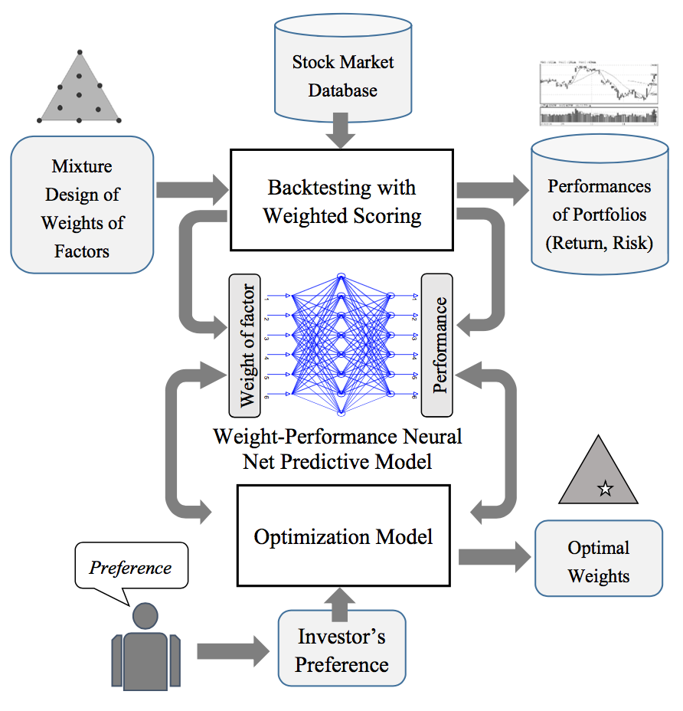

Notes:
The performances of the 63 weighting combinations of stock-picking concepts with a weighted scoring approach were obtained by simulating them with Standard and Poor’s Compustat US database. Sorted by a weighted scoring approach, the stocks with the top 10 % overall weighted scores are selected to form the investment port- folio. The holding and rebalancing period of the investment portfolio in this study is one-quarter. The backtest period includes 80 quarters, from 1990/Q4 to 2010/Q3. Through the backtesting, each weighting combination can get 80 quarterly return rates of the portfolio. Six performance indicators can be computed based on these quarterly return rates: the annualized return rate, the excess return rate, the absolute winning rate, the relative winning rate, total risk, and systematic risk. Except for the annualized return rate, the period units of the other five indicators are quarters.

Slide 5
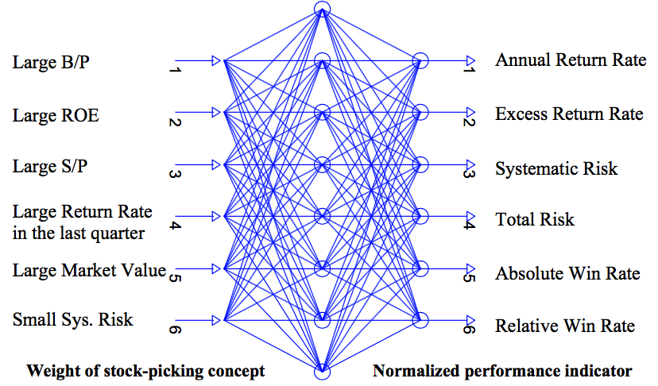
Neural Network
value-to-price ratios (B/P)
Return on equity (ROE)
sales-to-price ratios (S/P)

Slide 6








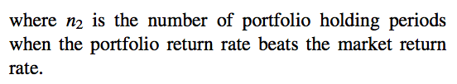

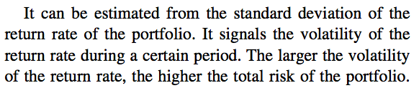
The return indicators and The risk indicators
Notes:
http://www.moneychimp.com/articles/risk/regression.htm

Slide 7

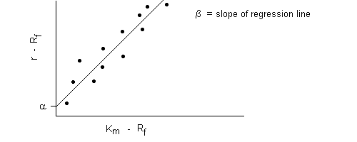

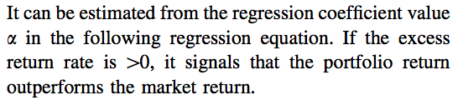

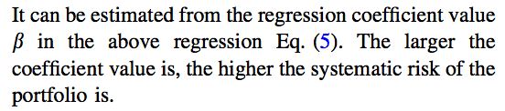


Excess return and Systematic risk
$$R_{i}−R_{f}$$
$$R_{m}−R_{f}$$

Slide 8



simplex-centroid design
1-component designs: It consists of different combinations of 1 and 0:
2-component designs: It consists of different combination of 1/2 and 0:
3-component designs: It consists of different combination of 1/3 and 0:

Slide 9
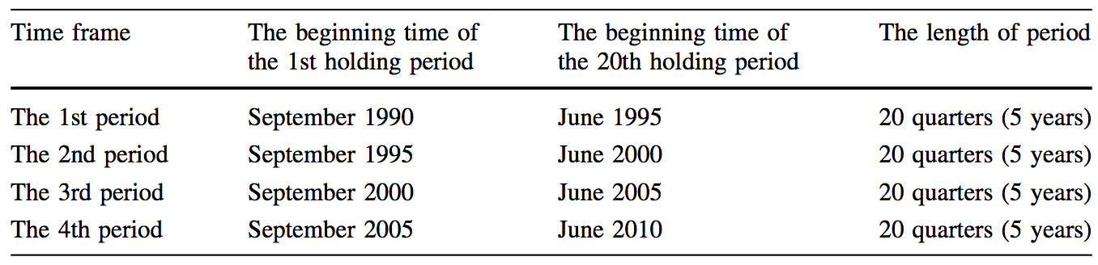
Experimental design
Building performance predictive model with neural networks and cross-validation
Effects of weights of stock-picking concepts on performance indicators
Standard and Poor’s Compustat US database

Slide 10
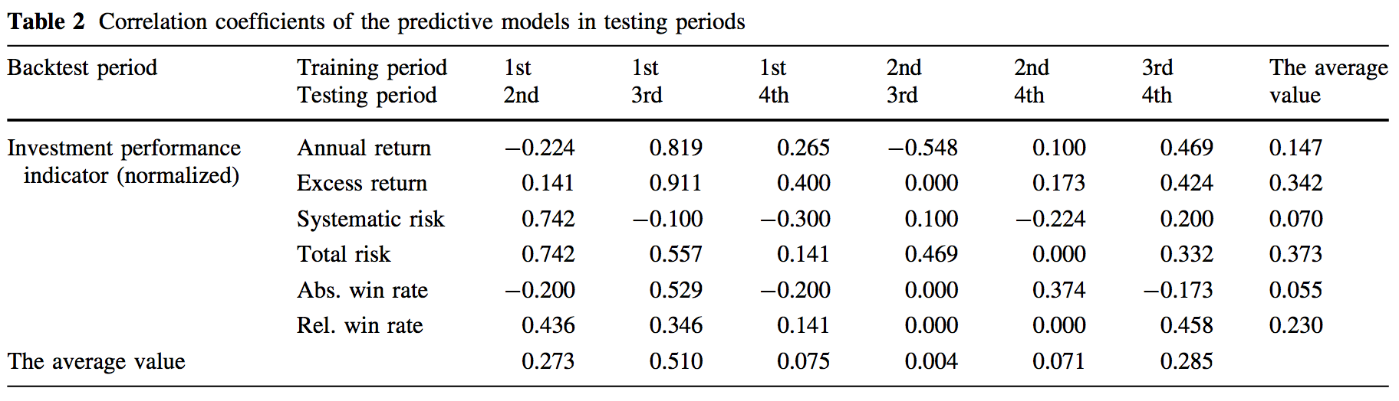
Building performance predictive model with neural networks and cross-validation

Slide 11
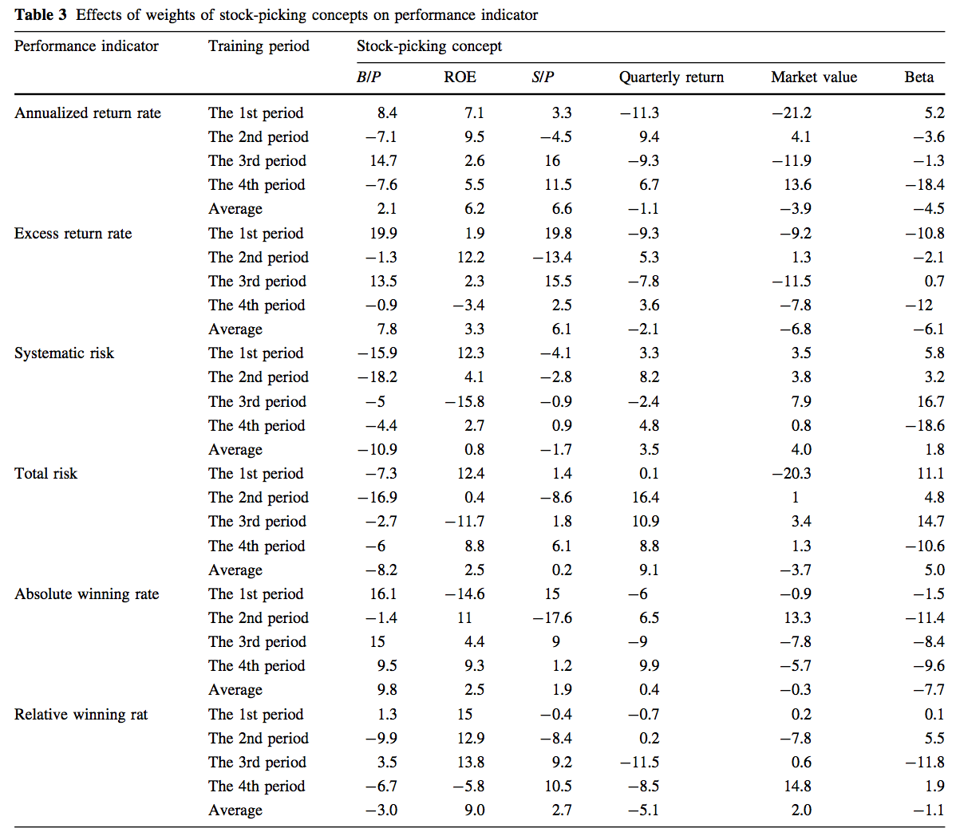
Effects of weights of stock-picking concepts on performance indicators

Slide 12
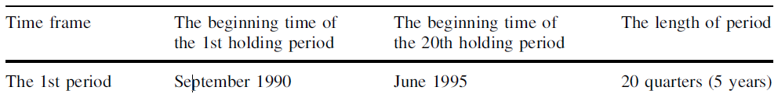
Experimental design
Sorted by a weighted scoring approach, the stocks with the top 10 % overall weighted scores are selected to form the investment portfolio.
Generating the optimal weighting combinations of stock-picking concepts
Model 1: maximizing objective without constrain
Model 2: maximizing return with risk constrain
Standard and Poor’s Compustat US database

Slide 13
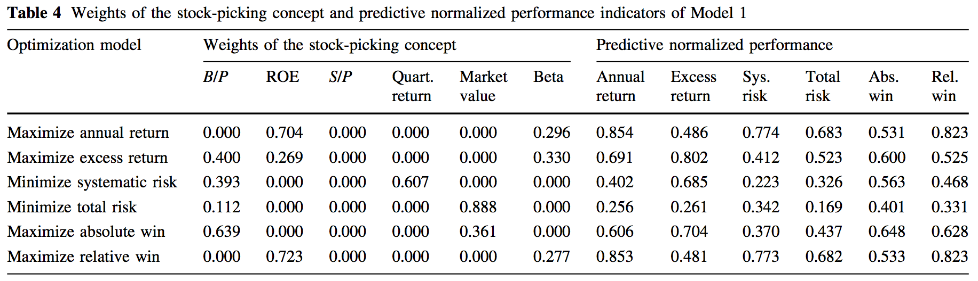
Model 1: maximizing objective without constrain(1/3)
Notes:
first time frame (1991–1995)

Slide 14
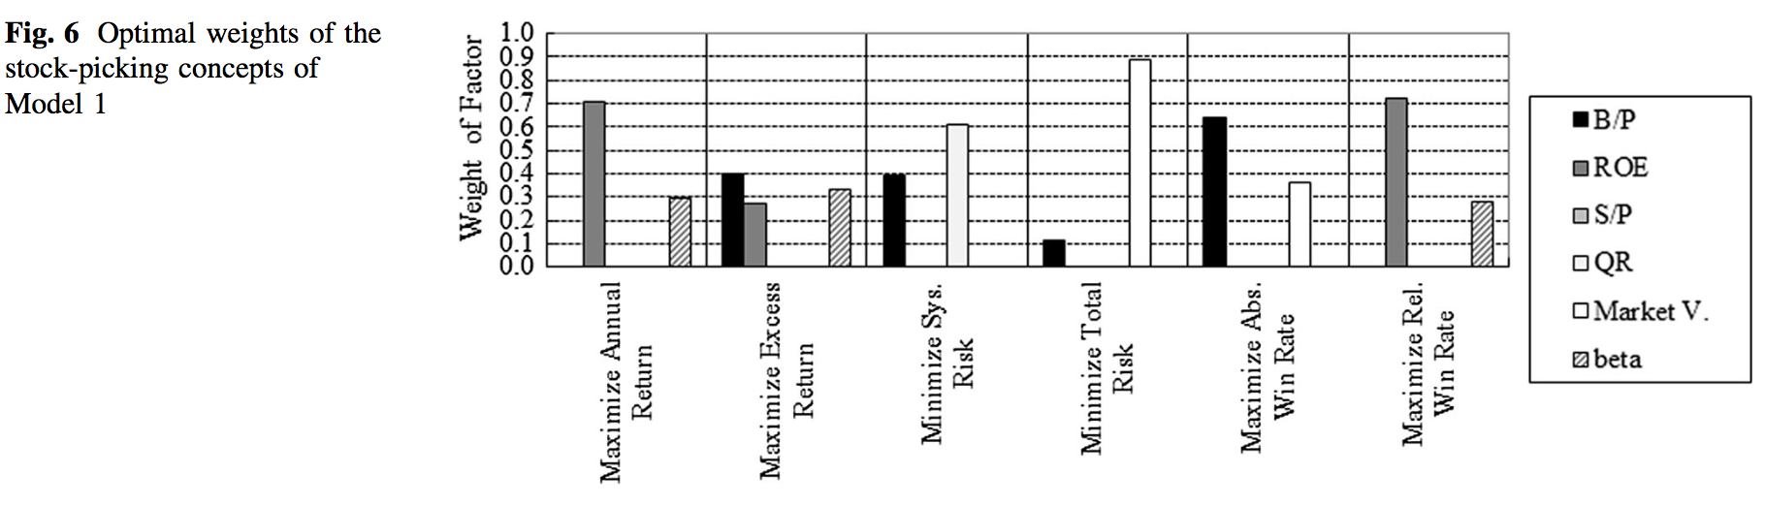
Model 1: maximizing objective without constrain (2/3)

Slide 15
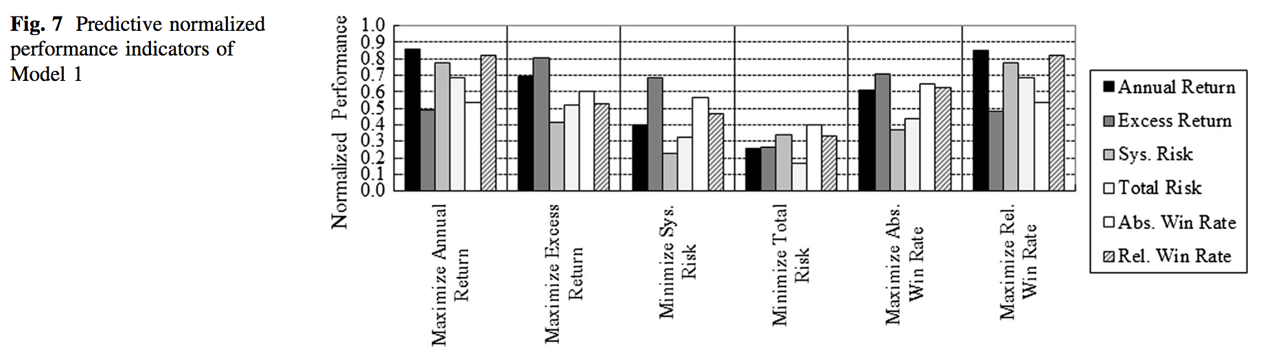
Model 1: maximizing objective without constrain (3/3)

Slide 16
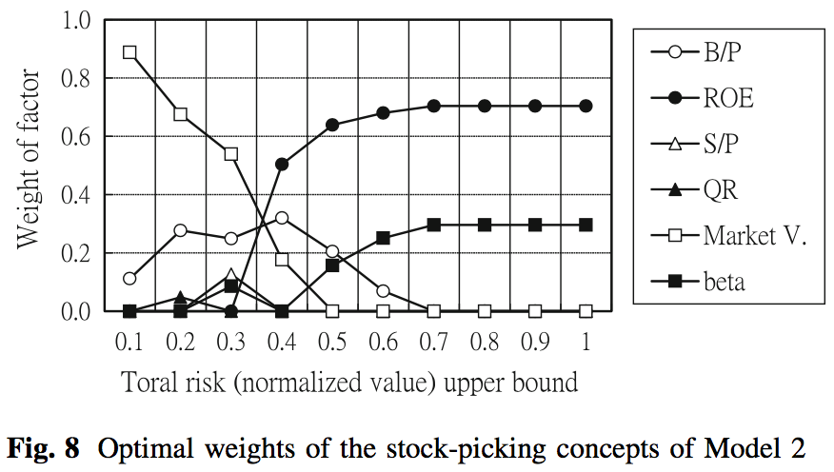
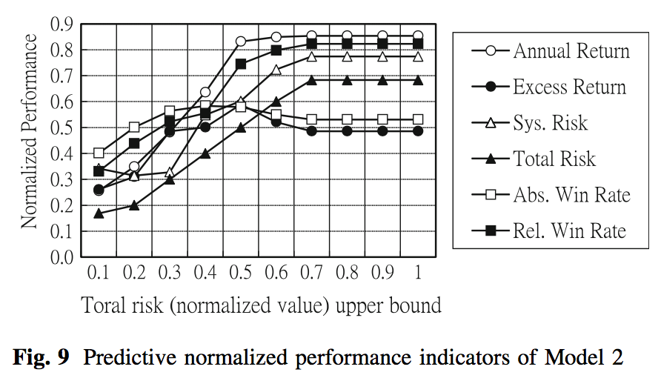
Model 2: maximizing return with risk constrain(1/1)

Slide 17
Experimental design
Sorted by a weighted scoring approach, the stocks with the top 10 % overall weighted scores are selected to form the investment portfolio.
Verifying the optimal weighting combinations of stock-picking concepts
Model 1: maximizing objective without constrain
Model 2: maximizing return with risk constrain
Standard and Poor’s Compustat US database
training period data(1991–1995, totally 5 years)
testing period data (1996–2010, total 15 years)
Notes:
these optimal solutions would be validated by conducting backtesting not only with the training period data (1991–1995, totally 5 years) but also with the testing per- iod data (1996–2010, total 15 years). The performances of Standard and Poor’s 500 were employed as the benchmark.

Slide 18
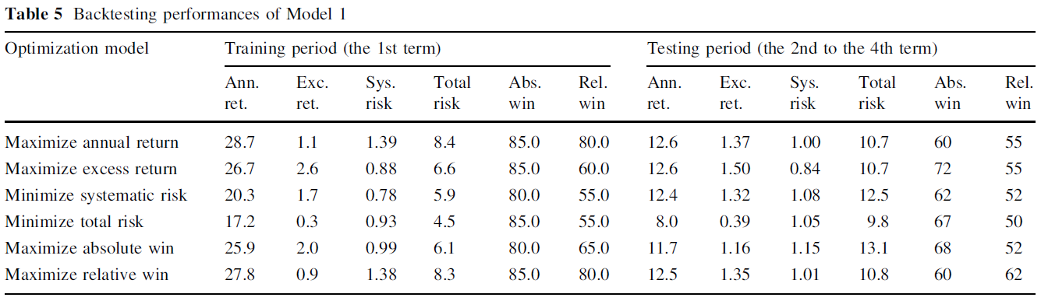
Model 1: maximizing objective without constrain

Slide 19
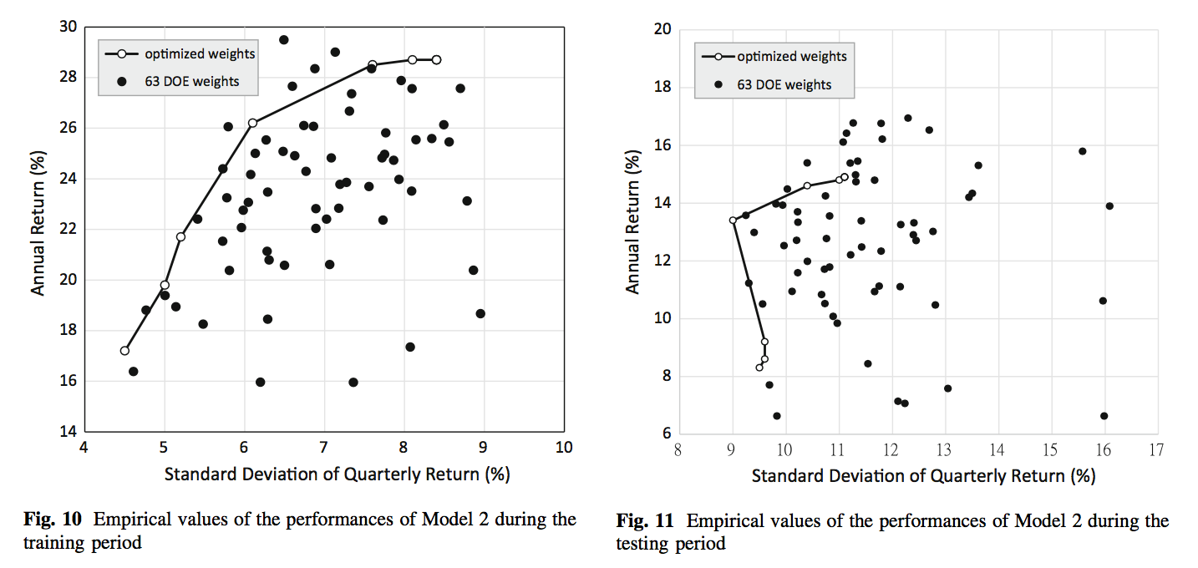
Model 2: maximizing return with risk constrain

Slide 20
Experimental design
Sorted by a weighted scoring approach, the stocks with the top 10 % overall weighted scores are selected to form the investment portfolio.
The accumulative return of the maximizing annualized return rates model
Standard and Poor’s Compustat US database
training period data (1991/Q1–1995/Q3)
testing period data (1995/Q4–2014/Q3)

Slide 21
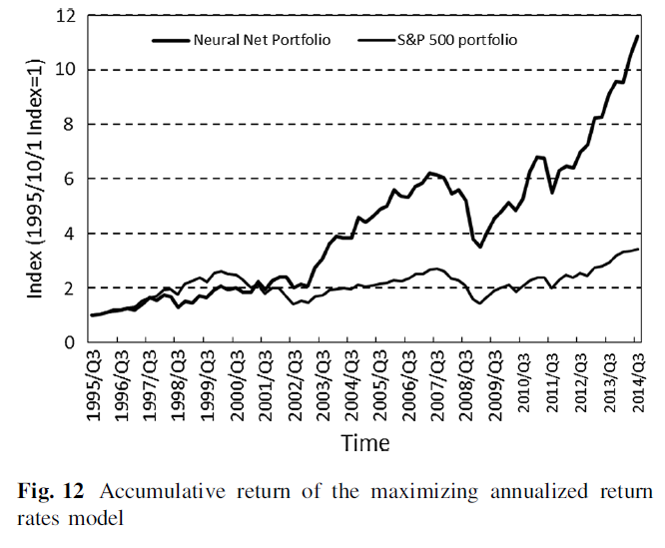
The accumulative return of the maximizing annualized return rates model

Slide 22
Regression, Alpha, R-Squared
http://www.moneychimp.com/articles/risk/regression.htm
Notes:
https://hellolynn.hpd.io/2017/05/29/十分鐘讀懂投資理財學-投資基金一天到晚聽到的/

